Slide 1
FCT Fitness Challenge Tracker App
Made by Viktoria Cholakova

Slide 2
Fitness Challenge Tracker
The Fitness Challenge Tracker (FCT) is a web application designed to facilitate fitness challenges among users. It encourages a healthy lifestyle by allowing users to create, join, and participate in fitness challenges.

Slide 3
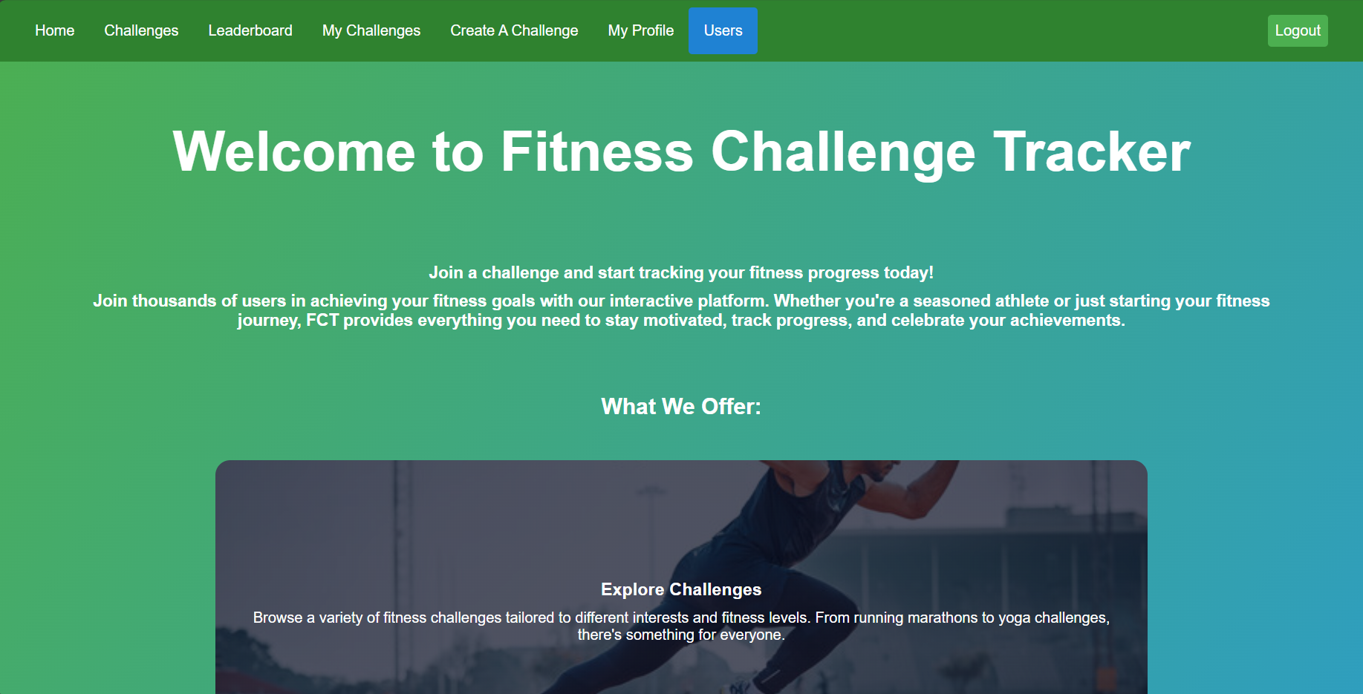
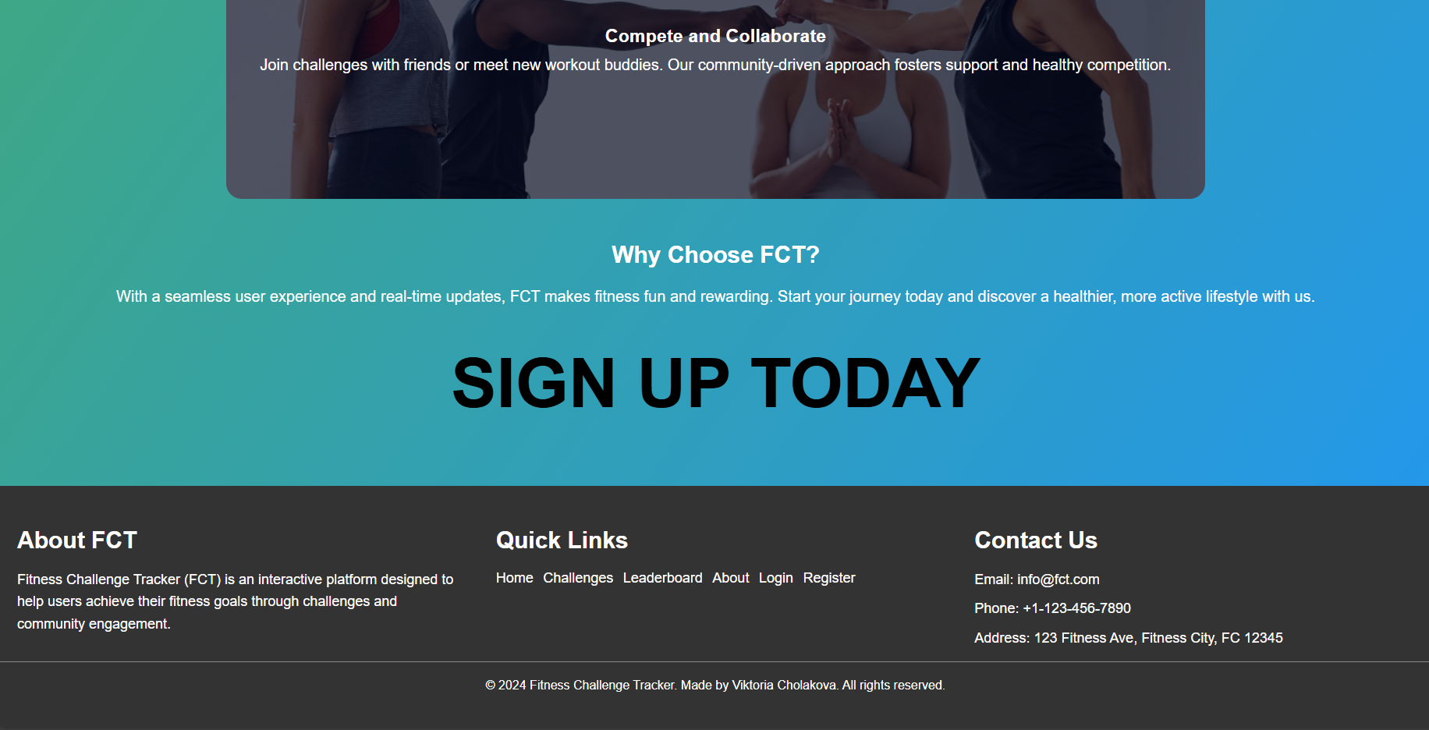
Main Page

Slide 4
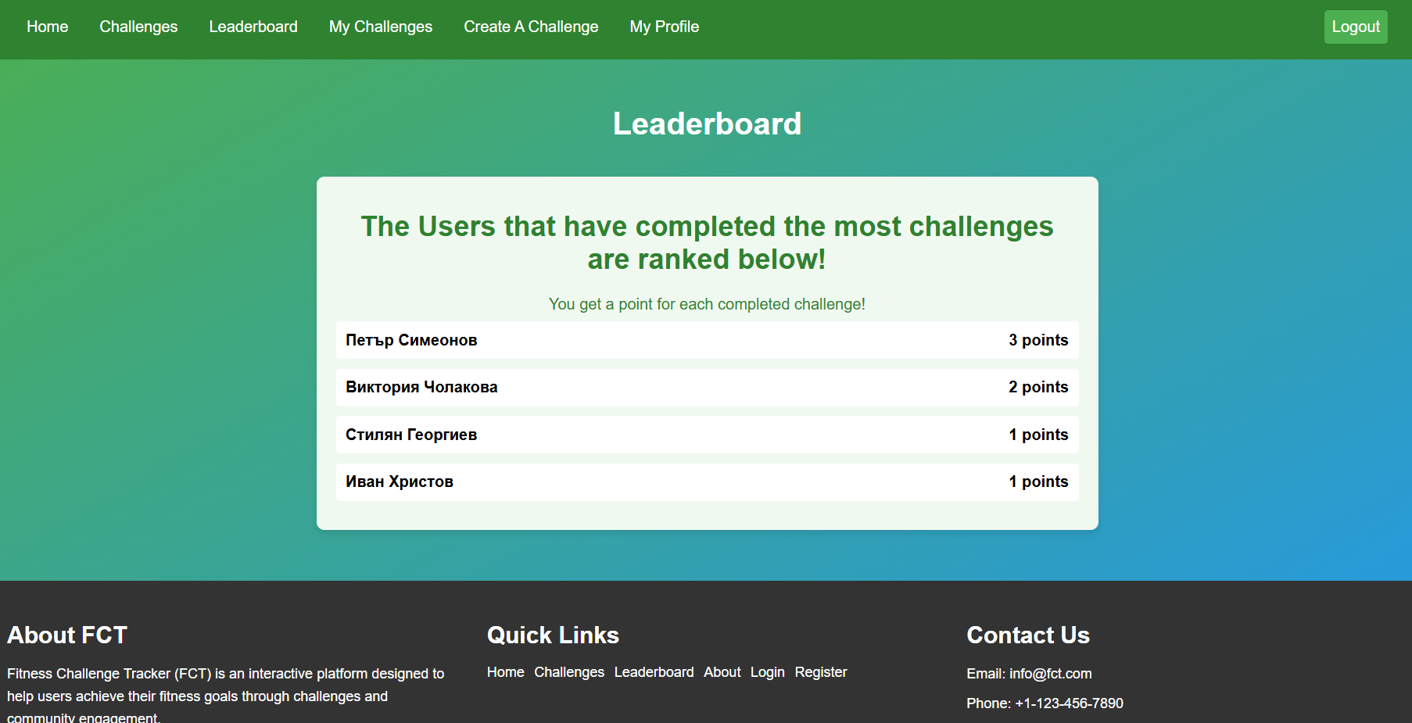
Leaderboard that ranks the users

Slide 5
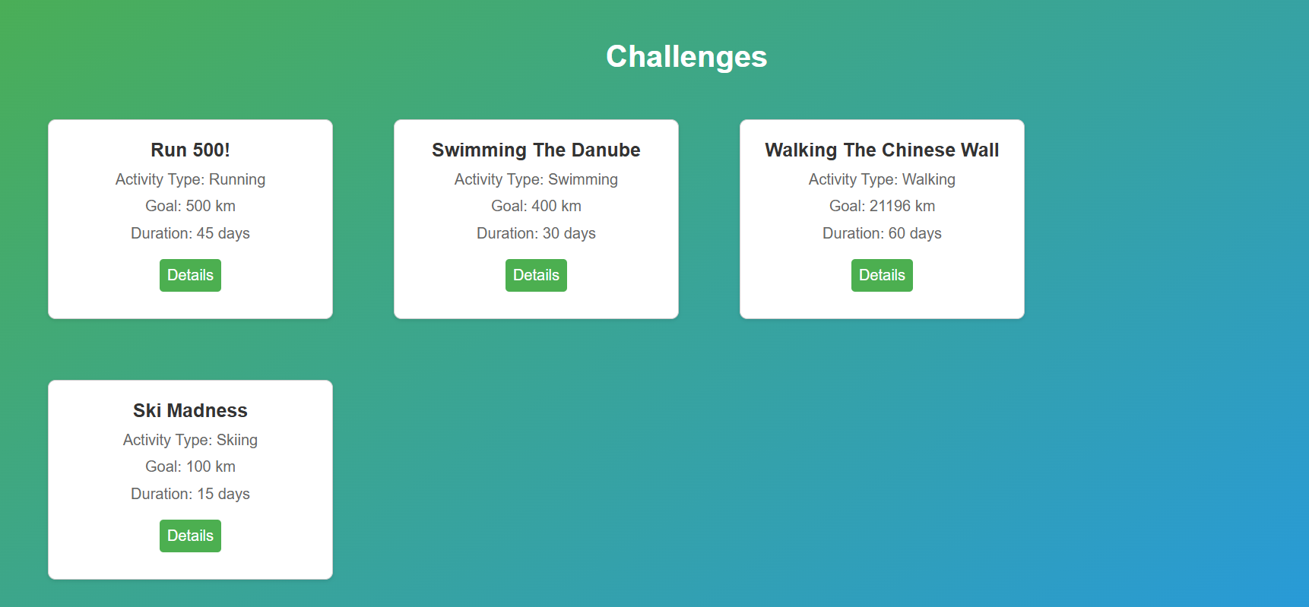
The challenges tab that displays them all

Slide 6
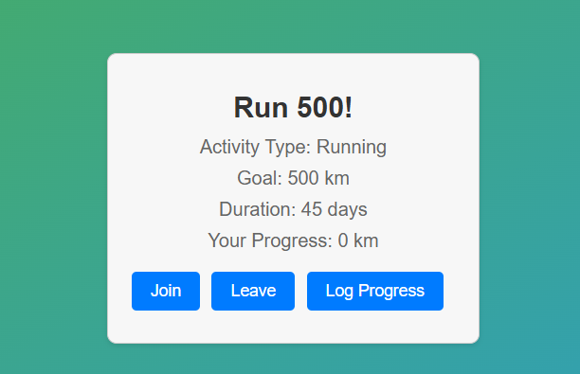
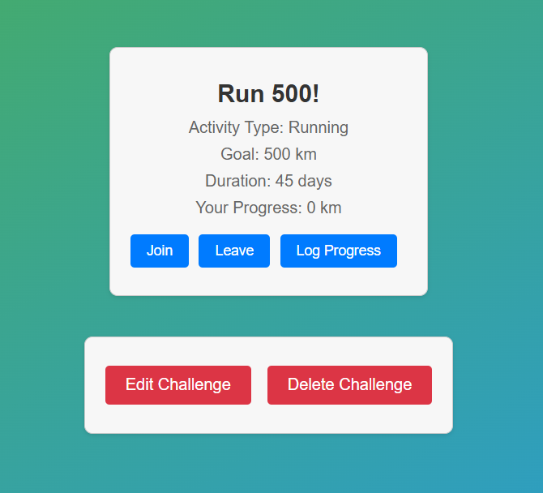
The actual Challenge Details
The admin version

Slide 7
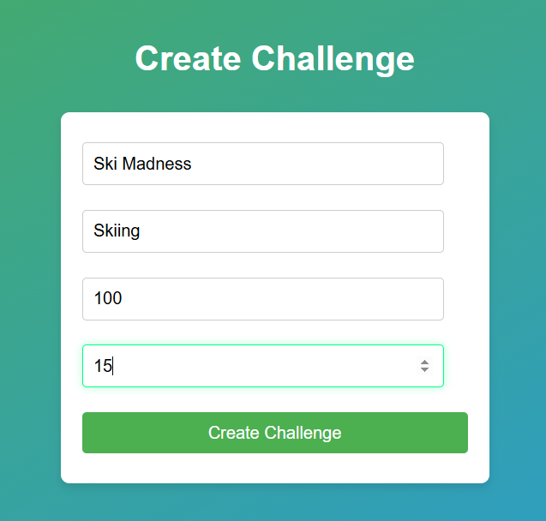
Creating a Challenge

Slide 8
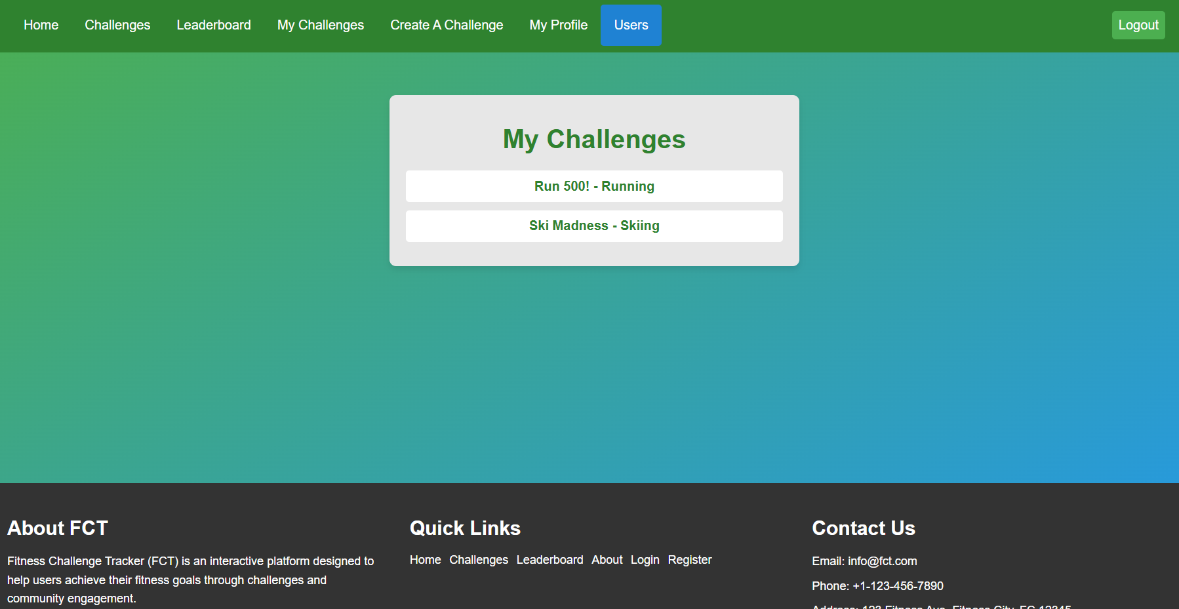
The Challenges a user is a participant of
admin only

Slide 9
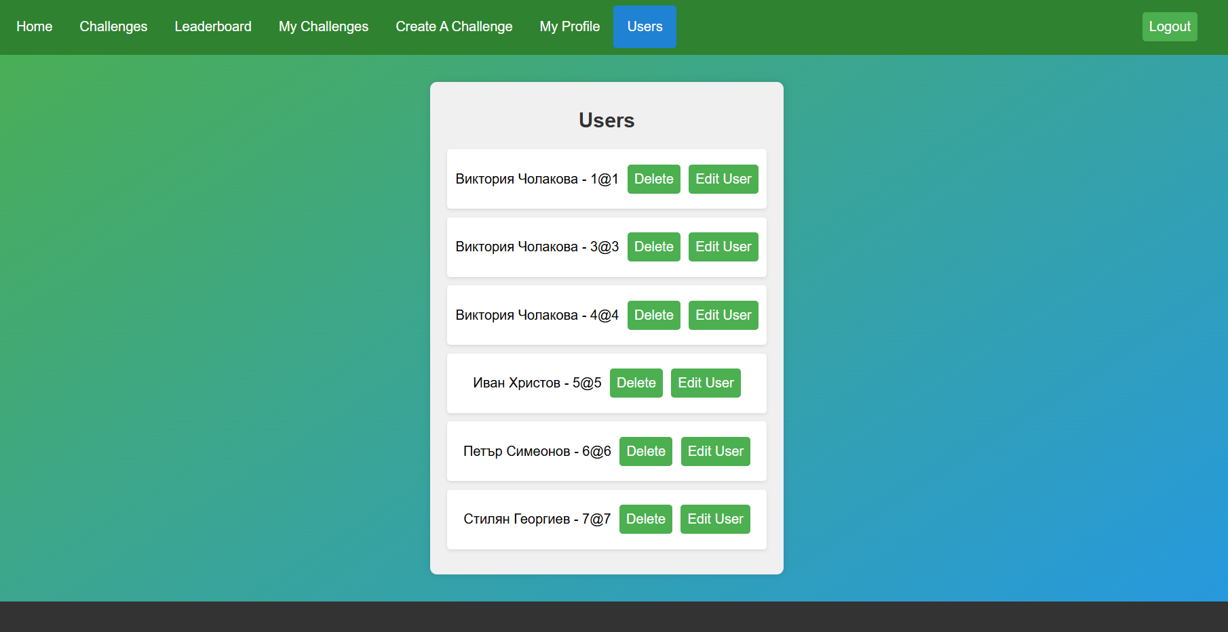
A page to manage all users accessible only by the admin

Slide 10
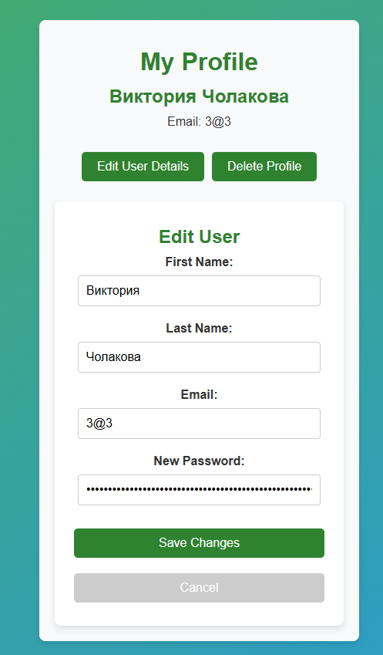
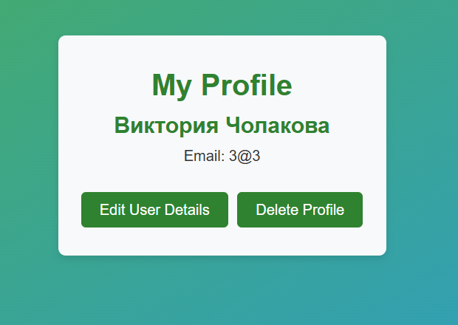
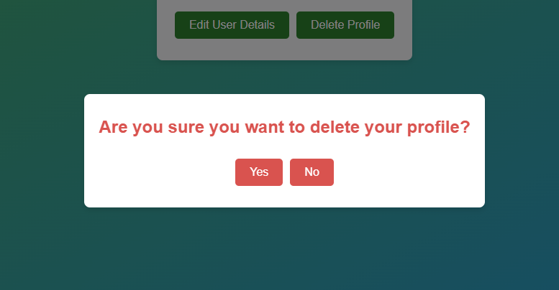
Personal Profile page

Slide 11
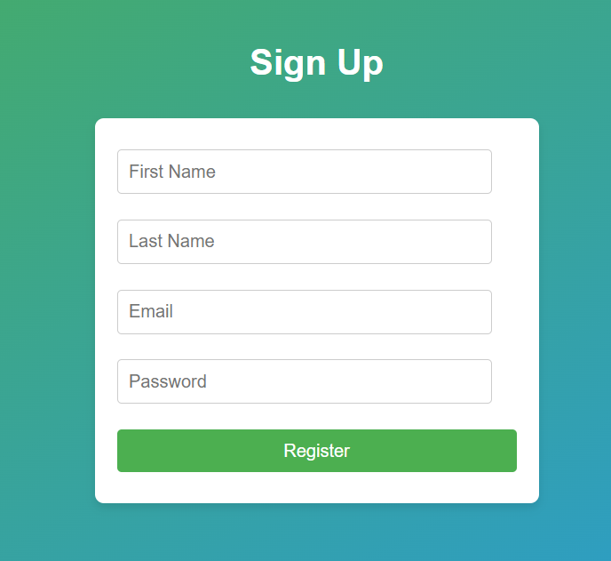
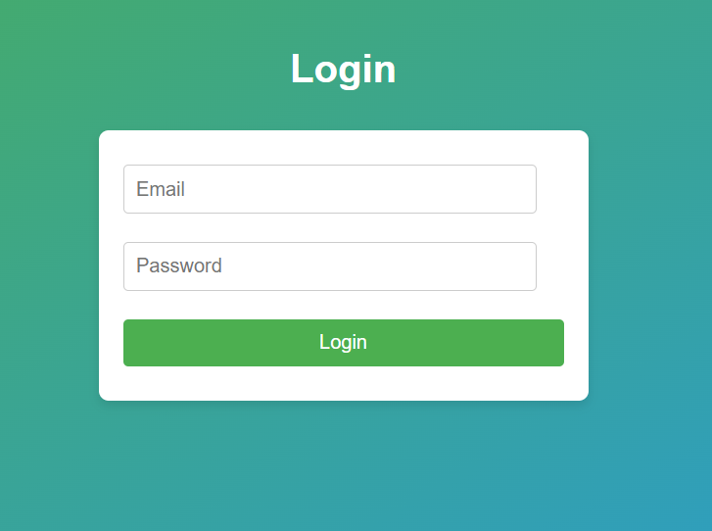
Login and Register Pages

Slide 12
Thank you for listening!
GitHub Link: https://github.com/Viktoria75/FCT

