Slide 1
Week 14 SpendSense
Viktoria Todorova

Slide 2
TABLE OF CONTENTS
01
02
03
04
ARCHITECTURE
PREVIOUS SPRINTS
THIS SPRINT
NEXT

Slide 3
DESCRIPTION
Financial management system designed to help businesses and individuals track, manage, and analyze their finances.
Expense Tracking
Budget Creation and Management
Reports and Dashboards
SpendSence helps make managing finances easier in today's complicated financial world.

Slide 4
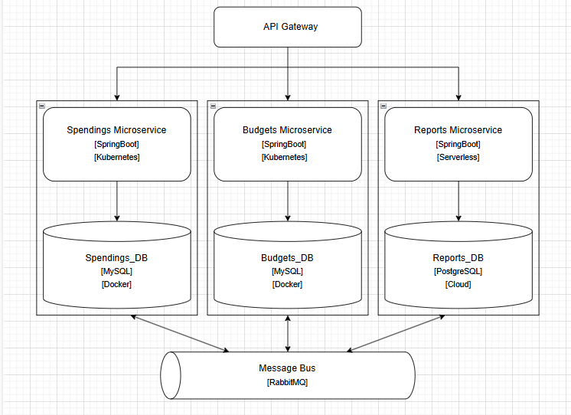
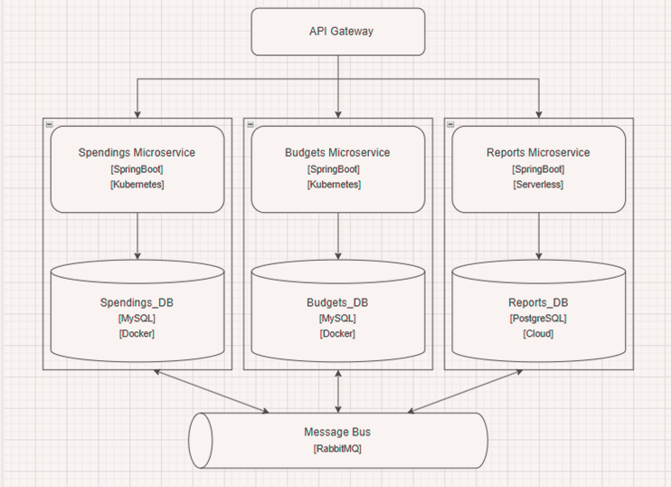
ARCHITECTURE
Traefik - Routes requests to the correct MS and provides a unified API layer, optimized for K8s
Runs only when needed, AWS Lambda works well with PostgreSQL
Always on, frequent API calls and need for stable DB connection
PostgreSQL for its advanced SQL features (complex queries, windows functions, etc.)
AWS RDS – handles scaling, backups and fault tolerance
Reliable transactions of messages, instead of broadcasting data – short-lived, simpler to set up,

Slide 5
Last week
This week
Graphana and Prometheus
Static quality checks with Snyk
HTTPS with TLS
Almost working login
Monitoring + Alerts
Working login (Finally 🎉🥂)
SAGA Orchestration for GDPR
2 MS + 2DBS in Minikube

Slide 6
MONITORING
Requests Traefik handled per service
Average number of successful GET requests per second
The slowest /api/expenses request
Total Deletion Attempts
Deletion Fails

Slide 7
NEXT SPRINT
Finish K8s Implementation
Move databases to the cloud
CD pipeline
Documentation – OWASP Report, Load test Report, Research Doc

Slide 8
QUESTIONS & ANSWERS

Slide 9
THANKS!
If you have any further questions, don’t hesitate to contact me at
v.todorova@fontysict.nl

