Slide 1
QUICKSTART
Clinical Data: Exploratory Data Analysis (EDA)
RSU, Bioinformatics group
Viktorija Dauksaite
Notes:
A quickstart for exploring clinical tabular data in Python and R. One synthetic cardiovascular risk clinic dataset is used on every slide, from loading to the final EDA report.

Slide 2




Why EDA comes first
Understand the data structure
Detect problems early
What one row means, which variables exist, their types, units and coding.
Entry errors, unit mismatches, duplicates and impossible values, before they reach an analysis.
Generate hypotheses
Inform the analysis plan
Patterns between groups and variables suggest questions; they are not yet findings.
Distributions, missingness and confounders guide the choice of statistical or machine learning methods.

Slide 3



Key concepts in EDA
Descriptive statistics
Data visualization
Data quality assessment
Central tendency (mean, median) and spread (SD, IQR, range) summarise each variable, chosen according to its type and shape.
Histograms, Q-Q plots, box plots and scatter plots show distributions, group differences and relationships that summary numbers hide.
Missing values, errors and inconsistencies are found and documented, because the accuracy of every later result depends on them.
In clinical data, each of these depends on context: how, when and why the data were collected.

Slide 4
The workflow in this quickstart
0
1
2
3
4
5
6
Question
Load
Clean
Explore
Outliers
Missing
Features
Study question,
data dictionary
Read, first look,
profile
Labels, types,
clinical checks
Distributions,
groups, relations
Plausibility,
context
Patterns, reasons,
handling
Derive, encode,
scale or transform
7A Statistical inference
7B Predictive modelling
Choose a test by outcome and design, report effect estimates with confidence intervals, address multiplicity and confounding.
Split by patient (and time or site), fit every learned preprocessing step inside training folds.
8 Report: cohort summary table, informative plots, problems found and documented decisions.
Question
Load
Clean
Explore
Outliers
Missing
Features
Infer / Predict
Report
Notes:
Missing-data assessment now comes before any formal group comparison, because how missingness is handled changes the comparison. After exploration the workflow splits: statistical inference and predictive modelling have different preprocessing and validation requirements. The tracker at the bottom of each slide follows this sequence.

Slide 5



Main resources and where to start
Data Science for Health Informatists
Python for Health Data Science
Data Analysis in Medicine and Health using R
Python, health data
Python, hands-on
R, clinical examples
Start with: Ch. 2 Data Processing and Cleaning, then Ch. 3 Exploratory Data Analysis.
Start with: the pandas chapter (Working with files), then the Stroke data wrangling exercise.
Start with: Ch. 4 Data Visualisation, Ch. 5 Data Wrangling, then Ch. 6 EDA (ggplot2, gtsummary).
Book home · Open Ch. 3 (EDA)
Book home · Open the stroke exercise
Book home · Open Ch. 6 (EDA)
New to coding? Python: Software Carpentry, Programming with Python (uses patient inflammation data). R: R for Data Science, 2nd edition (Whole game chapters).
Notes:
Task-specific links appear on the slide where each task is introduced, as 'Start here' chips. The full list is on the Resources by task slide near the end.

Slide 6
Start with a study question
Population
Adults attending a cardiovascular risk clinic at three sites (A, B, C), 2022 to 2025
550
420
3
rows (visits)
patients
sites
Comparison
Patients with diabetes versus without diabetes
Synthetic dataset
data/clinic_visits.csv was generated for this quickstart (regenerate with scripts/make_dataset.py). It contains no real patients. Realistic problems were planted on purpose: inconsistent labels, a unit mismatch, duplicate records, impossible values and structured missingness.
Outcome
Systolic blood pressure at the baseline visit, in mmHg
Unit of analysis
One row = one clinic visit. The study question uses one row per patient (visit 1).
A written question decides which rows, variables and comparisons matter, and keeps exploration from turning into a search for significant results.
Question
Load
Clean
Explore
Outliers
Missing
Features
Infer / Predict
Report

Slide 7
Data dictionary
Variable | Type | Unit | Coding and notes
patient_id | Identifier |  | P0001 to P0420. Never a model input
visit | Discrete |  | 1 = baseline, 2 = follow-up
visit_date | Date |  | YYYY-MM-DD
site | Nominal |  | A, B, C
age | Continuous | years | At the visit
sex | Binary (nominal) |  | female, male
height_cm, weight_kg | Continuous | cm, kg | Measured at the visit
systolic_bp, diastolic_bp | Continuous | mmHg | Seated, clinic measurement
cholesterol_total, hdl | Continuous | mg/dL | Fasting lipid panel
crp | Continuous | mg/L | "<0.3" = below the assay detection limit
smoking_status | Nominal |  | never, former, current
diabetes, statin | Binary |  | 0 = no, 1 = yes
ccs_class | Ordinal |  | Angina class: 0 = none, 1 to 4 = CCS class I to IV
Missing-value codes
Blank or -99 = not recorded.
Write down before analysis
Units for every measurement, the meaning of each category code, how missing values are coded, and whether a row is a patient, a visit or a specimen.
Question
Load
Clean
Explore
Outliers
Missing
Features
Infer / Predict
Report

Slide 8
What the raw data look like
patient_id | visit | visit_date | site | age | sex | height_cm | weight_kg | systolic_bp | diastolic_bp | cholesterol_total | hdl | crp | smoking_status | diabetes
P0001 | 1 | 2023-10-26 | A | 59 | female | 165.9 | 89 | 132 | 63 | 256 | 56 | 15.81 | former | 0
P0002 | 1 | 2022-08-13 | B | 64 | female | 171.0 | 96.9 | 135 | 82 |  |  | <0.3 | former | 1
P0003 | 1 | 2023-11-14 | B | 75 | male | 179.6 | 74.7 | 115 | 66 | 220 | 42 | 4.68 | current | 0
P0003 | 2 | 2024-08-06 | B | 75 | male | 179.6 | 76 | 132 | 62 | 198 | 38 | 6.75 | current | 0
P0004 | 1 | 2022-06-26 | A | 62 | female | 166.4 | 70.3 | 132 | 56 | 281 | 45 | 0.34 | current | 0
P0004 | 2 | 2023-04-10 | A | 62 | female | 166.4 | 66.7 | 134 | 58 | 262 | 42 | 0.47 | current | 0
P0005 | 1 | 2022-12-20 | A | 63 | female | 149.6 | 59.2 | 116 | 62 | 198 | 59 | 4.78 | former | 0
Numerical variables
Categorical, identifier and date variables
Rows 3 and 4 share a patient_id: a baseline and a follow-up visit. Repeated measurements are legitimate, not duplicates.
crp contains text ("<0.3") so it is read as a text column until it is cleaned.
Blank cells are missing values; their pattern is explored in step 5, not filled in here.
Question
Load
Clean
Explore
Outliers
Missing
Features
Infer / Predict
Report
Notes:
Columns statin and ccs_class are hidden here for space; they appear in the data dictionary.

Slide 9
Variable types, with examples from this dataset
Variable
Numerical
quantitative
Categorical
qualitative
Continuous
measured on a scale
age, systolic_bp, crp, hdl
Discrete
counted
visit (1, 2), number of visits
Ordinal
ordered categories
ccs_class (0 to IV)
Nominal
no natural order
sex, site, smoking_status; binary: diabetes, statin
Question
Load
Clean
Explore
Outliers
Missing
Features
Infer / Predict
Report
Notes:
Type determines the summary (slide on descriptive statistics), the plot, the encoding (feature engineering) and the test. Continuous variables can be further split into interval (no true zero, e.g. temperature in Celsius) and ratio (true zero, e.g. weight).

Slide 10
Set up and load the data
Python
R
# pip install pandas matplotlib seaborn scipy
import pandas as pd
df = pd.read_csv(
"data/clinic_visits.csv",
na_values=["", "NA", -99], # -99 = not recorded
parse_dates=["visit_date"],
)
# install.packages("tidyverse")
library(tidyverse)
df <- read_csv(
"data/clinic_visits.csv",
na = c("", "NA", "-99") # -99 = not recorded
) # dates parsed
Declare missing-value codes at load time, so -99 never enters a mean.
Parse dates on import to allow date checks and follow-up intervals.
pandas and matplotlib handle tables and plots; seaborn adds statistical plots; ggplot2, dplyr and tidyr (in tidyverse) do the same in R.
Start here: pandas intro tutorials
Start here: Software Carpentry Python
Start here: R for Data Science (2e)
Question
Load
Clean
Explore
Outliers
Missing
Features
Infer / Predict
Report

Slide 11
First look: structure before statistics
What the first look shows in this dataset
Python
550 rows, 420 patients
df.shape # rows = visits
df["patient_id"].nunique() # patients
df.info() # column types
df.describe() # numeric summaries
df["sex"].value_counts(dropna=False)
Some patients have two visits. Decide the unit of analysis before summarising.
crp has a text type
"<0.3" values block numeric conversion.
R
sex has 5 spellings
glimpse(df) # types and first values
summary(df)
n_distinct(df$patient_id)
count(df, sex)
female, male, F, Female and "Male " (trailing space).
describe() ranges
Minimum height of 17.2 cm and cholesterol values near 5 point to entry and unit problems.
Question
Load
Clean
Explore
Outliers
Missing
Features
Infer / Predict
Report

Slide 12
Optional: an automated profile report
Run on clinic_visits.csv
Python
Flagged by the report
# in a terminal (prefix with % in a notebook)
pip install fg-data-profiling
from data_profiling import ProfileReport
profile = ProfileReport(df, title="Clinic visits")
profile.to_file("outputs/eda_report.html")
  4 duplicate rows
  crp: 30% missing; hdl, cholesterol, weight 7 to 9%
  sex 'highly imbalanced' (really 5 spellings)
  SBP and DBP highly correlated (expected)
Formerly ydata-profiling: the old package name no longer receives updates. Older tutorials use from ydata_profiling import ProfileReport.
Not flagged: needs clinical checks
  Cholesterol in mmol/L at one site
  Diastolic ≥ systolic in 2 visits
  Follow-up dated before baseline
  Repeat visits versus true duplicates
Useful for: a fast overview of types, distributions, missingness and correlations.
The report flags; it does not decide. Clinical checks come next.
Start here: YData Profiling quickstart
Question
Load
Clean
Explore
Outliers
Missing
Features
Infer / Predict
Report

Slide 13
Data cleaning: make the table consistent
Step | In this dataset | Why it matters
Fix column names | snake_case, no spaces or units in symbols | Clean names are easier to code and to read in output
Recode missing-value codes | -99 in hdl and weight_kg → missing | A code treated as a number distorts every summary
Unify category labels | "F", "Female", "Male " → female, male | Inconsistent labels create false categories
Convert data types | crp text → numeric, plus a below-LOD flag | Numeric summaries and plots need numeric columns
Remove exact duplicate records | 4 rows that are copies of another row | Double entry inflates n and biases estimates
Python
R
df["sex"] = (df["sex"].str.strip().str.lower()
.replace({"f": "female", "m": "male"}))
df = df.drop_duplicates() # exact copies only
df["crp_below_lod"] = df["crp"].eq("<0.3")
df["crp"] = pd.to_numeric(df["crp"].replace("<0.3", 0.15))
df <- df |>
mutate(sex = str_to_lower(str_trim(sex)),
sex = case_match(sex, "f" ~ "female",
.default = sex),
crp_below_lod = crp == "<0.3",
crp = as.numeric(if_else(crp_below_lod,
"0.15", crp))) |>
distinct()
Question
Load
Clean
Explore
Outliers
Missing
Features
Infer / Predict
Report
Notes:
Replacing values below the detection limit with LOD/2 (0.15 mg/L) is one documented convention, not the only option. The flag column keeps the information so that a sensitivity analysis can treat those values differently.

Slide 14





Clinical data checks
Unit mismatches
Impossible values and combinations
46 cholesterol values from site C in 2023 are in mmol/L, not mg/dL.
2 visits with diastolic ≥ systolic BP; 1 height of 17.2 cm.
Check ranges by site and period; convert (× 38.67) only after confirming with the site.
Use clinical rules: DBP < SBP, plausible height, no pregnancy in males.
Repeat visits vs duplicates
Below detection limits
126 follow-up visits are legitimate repeat measurements. 4 rows are exact copies.
9 CRP results recorded as "<0.3".
A duplicate is the same patient and visit twice; a repeat is a new measurement.
Censored, not missing and not zero. Keep a flag and document the substituted value.
Inconsistent dates
Rule for every check
Query the source first. If a value cannot be resolved, set it to missing, and log the decision with the reason and the number of rows affected.
1 follow-up visit is dated before the baseline visit.
Check order of visits, dates in the future, and follow-up intervals.
Question
Load
Clean
Explore
Outliers
Missing
Features
Infer / Predict
Report

Slide 15
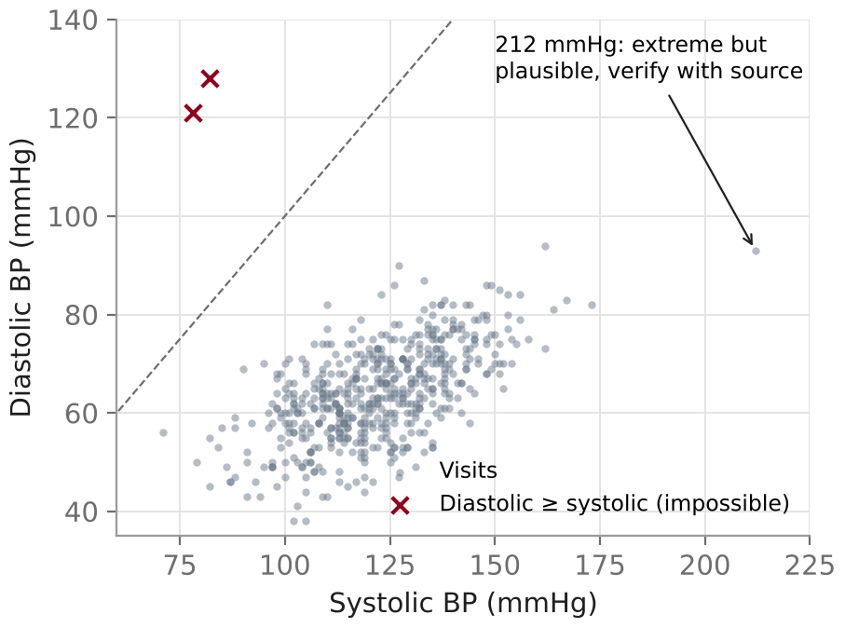
Clinical data checks in code
Python
df = df.sort_values(["patient_id", "visit"])
# (i) unit mismatch: cholesterol in mmol/L
mmol = df["cholesterol_total"] < 20
df.loc[mmol, "cholesterol_total"] *= 38.67
# (ii) same patient-visit twice?
df.duplicated(["patient_id", "visit"]).sum()
# (iii) follow-up dated before baseline
first = df.groupby("patient_id")["visit_date"].transform("first")
bad_date = df["visit_date"] < first
# (iv) impossible values and combinations
bad_bp = df["diastolic_bp"] >= df["systolic_bp"]
bad_height = (df["height_cm"].notna()
& ~df["height_cm"].between(120, 220))
df.loc[bad_bp, ["systolic_bp", "diastolic_bp"]] = np.nan
Two visits lie above the line of equality: diastolic ≥ systolic is impossible, most likely swapped at entry. The 212 mmHg reading is extreme but plausible, so it is verified rather than deleted.
Question
Load
Clean
Explore
Outliers
Missing
Features
Infer / Predict
Report

Slide 16
Descriptive statistics: choose by type and shape
Data type | Central tendency | Spread | Report as | Plots
Nominal / binary | Mode | Not applicable | n/N (%) per category | Bar chart
Ordinal | Median, mode | IQR, range | n/N (%) per level, or median (IQR) | Ordered bar chart
Discrete counts | Median or mean | IQR or SD | Depends on shape | Bar or dot plot, histogram
Continuous, roughly symmetric | Mean | SD | mean (SD) | Histogram, Q-Q plot, box plot
Continuous, skewed | Median | IQR, range | median (IQR) | Histogram, Q-Q plot, box or violin plot
Shape, not a test result, guides the summary. Look at the histogram and Q-Q plot, consider the sample size and the variable's clinical meaning. CRP is skewed, so it is reported as median (IQR) in mg/L; systolic BP is roughly symmetric, so mean (SD) in mmHg.
Question
Load
Clean
Explore
Outliers
Missing
Features
Infer / Predict
Report

Slide 17
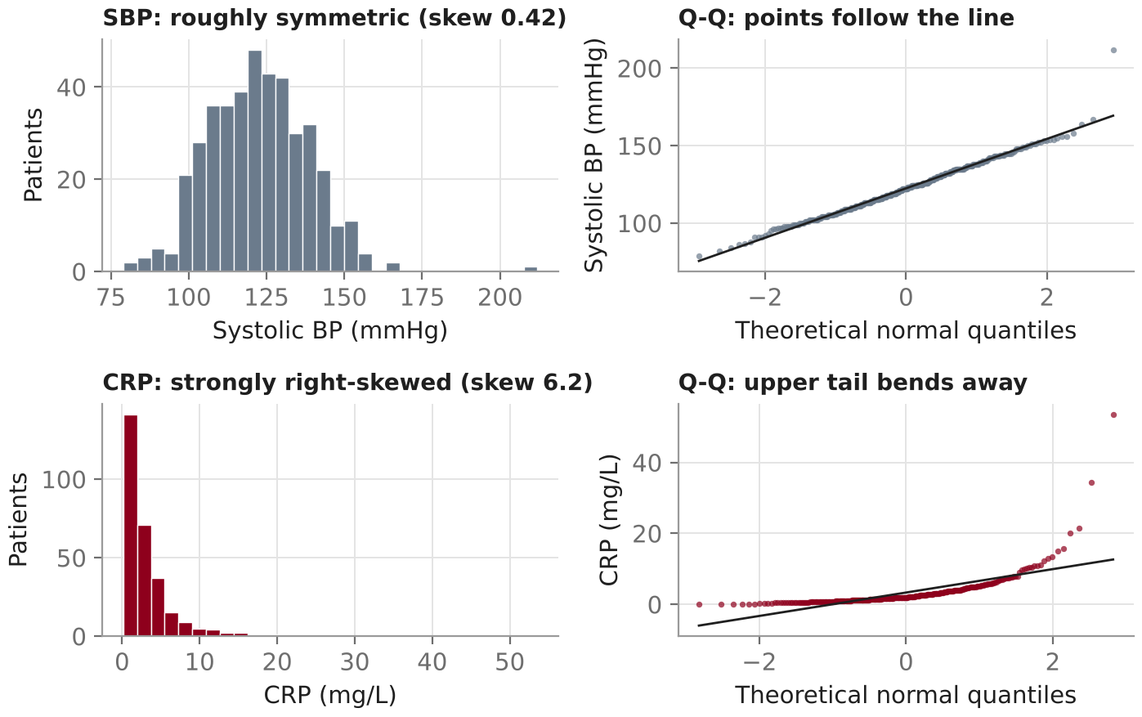
Look at each distribution: histogram and Q-Q plot
Python
import seaborn as sns
from scipy import stats
fig, ax = plt.subplots(1, 2, figsize=(9, 3.5))
sns.histplot(data=base, x="crp", ax=ax[0])
stats.probplot(base["crp"].dropna(),
dist="norm", plot=ax[1])
R
ggplot(base, aes(crp)) + geom_histogram(bins = 30)
ggplot(base, aes(sample = crp)) +
stat_qq() + stat_qq_line()
base = one row per patient (visit 1). Seaborn histplot() and displot() replace the deprecated distplot().
Start here: Seaborn: visualizing distributions
Question
Load
Clean
Explore
Outliers
Missing
Features
Infer / Predict
Report

Slide 18
Assessing normality: evidence, not a gate
What to consider
Python
from scipy.stats import shapiro
x = base["systolic_bp"].dropna() # all values,
print(len(x), x.skew()) # no .sample()
shapiro(x) # read with the Q-Q plot
# R: shapiro.test(base$systolic_bp)
Sample size per group: here 337 without and 83 with diabetes. Means of large groups are approximately normal even when data are skewed; small groups are not protected.
Skewness and extreme observations: one 212 mmHg reading gives the diabetes group a skew of 1.2.
Study design: independent groups, paired measurements or repeated visits change what has to be checked.
Check the quantity the method assumes is normal
Result in this dataset
n = 419, skew = 0.42, Shapiro-Wilk p < 0.001. Yet the Q-Q plot is close to a straight line and a t-test is reliable here.
Large samples reject trivial departures; small samples miss important ones. A p-value alone should not choose the test.
Method | Check
Two-sample t-test | Each group (or the residuals)
Paired t-test | Within-patient differences
Linear regression | Residuals: shape, constant variance, linearity
Question
Load
Clean
Explore
Outliers
Missing
Features
Infer / Predict
Report
Notes:
This replaces the fixed sample-size cut-offs (more than 100, fewer than 15) from the earlier version. Those rules oversimplify: robustness depends on the size of each group, the degree of skew, outliers and the design. The .sample(200) call was removed because it fails when fewer than 200 values exist and throws away data.

Slide 19
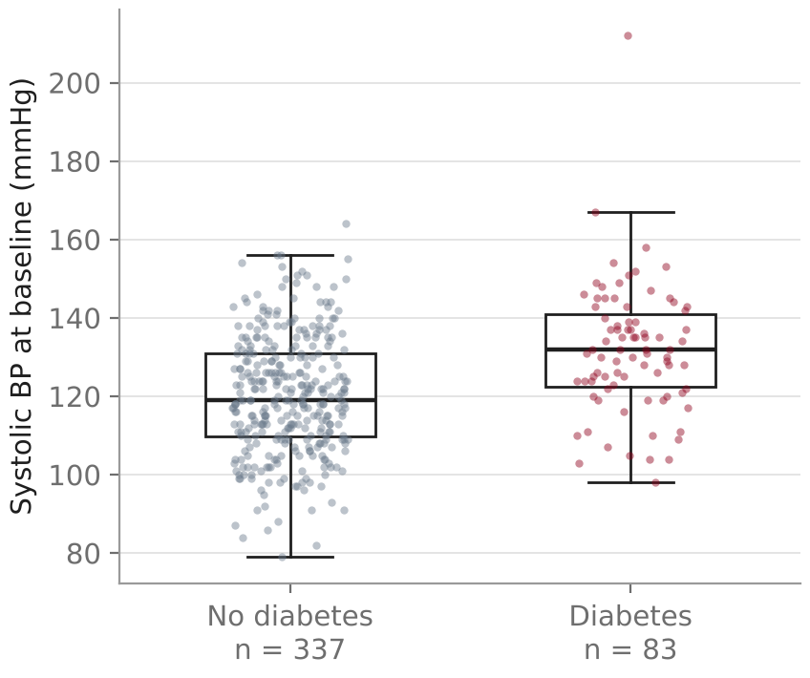
Compare groups visually before testing
Show the individual points, not only boxes or bars: group sizes differ four-fold here.
Label n per group and the units on the axis.
Patients with diabetes have higher SBP, but the plot cannot say why. Age differs too (next slide).
Python
sns.boxplot(data=base, x="diabetes", y="systolic_bp",
showfliers=False)
sns.stripplot(data=base, x="diabetes", y="systolic_bp",
alpha=0.4)
R
ggplot(base, aes(factor(diabetes), systolic_bp)) +
geom_boxplot(outlier.shape = NA) +
geom_jitter(width = 0.15, alpha = 0.4)
Question
Load
Clean
Explore
Outliers
Missing
Features
Infer / Predict
Report

Slide 20
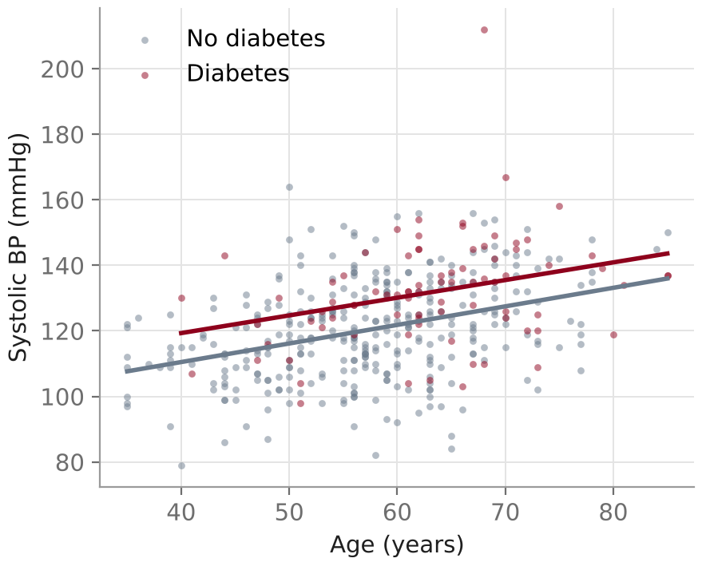
Explore relationships between variables
A first hint of confounding
SBP rises with age, and patients with diabetes are older (mean 63.1 vs 57.1 years). Part of the group difference may be an age difference.
Python
sns.scatterplot(data=base, x="age", y="systolic_bp",
hue="diabetes")
sns.pairplot(base[["age", "systolic_bp", "hdl",
"crp", "diabetes"]], hue="diabetes")
R
ggplot(base, aes(age, systolic_bp, colour = factor(diabetes))) +
geom_point() + geom_smooth(method = "lm")
Start here: Kaggle Data Visualization course
Question
Load
Clean
Explore
Outliers
Missing
Features
Infer / Predict
Report

Slide 21
Outliers: flag statistically, judge clinically
1
Clinical plausibility
Python
Is the value physically possible? Use clinical ranges (e.g. SBP 60 to 260 mmHg) and rules between variables.
q1, q3 = base["systolic_bp"].quantile([0.25, 0.75])
iqr = q3 - q1
flag = (~base["systolic_bp"].between(q1 - 1.5 * iqr,
q3 + 1.5 * iqr)
& base["systolic_bp"].notna())
base.loc[flag, ["patient_id", "age",
"systolic_bp", "diastolic_bp"]]
2
Statistical flags
IQR rule (beyond Q1 − 1.5 × IQR or Q3 + 1.5 × IQR) or z-scores. These flag; they do not prove an error.
3
Context
An extreme value may be the clinical finding: a hypertensive crisis, a very high CRP in infection. Check source records.
R
q <- quantile(base$systolic_bp, c(.25, .75), na.rm = TRUE)
lim <- q + c(-1.5, 1.5) * diff(q)
filter(base, systolic_bp < lim[1] | systolic_bp > lim[2])
Outliers are not removed by default. Correct verified errors, keep genuine values, and check whether conclusions change with and without them.
Question
Load
Clean
Explore
Outliers
Missing
Features
Infer / Predict
Report
Notes:
In this dataset the IQR rule flags one value, 212 mmHg in a 68-year-old with diastolic 93 mmHg. It is plausible, so it stays in the data. Sensitivity analysis in the tutorial notebook: the diabetes difference is 11.6 mmHg (7.7 to 15.6) with it and 10.6 mmHg (7.2 to 14.1) without it.

Slide 22
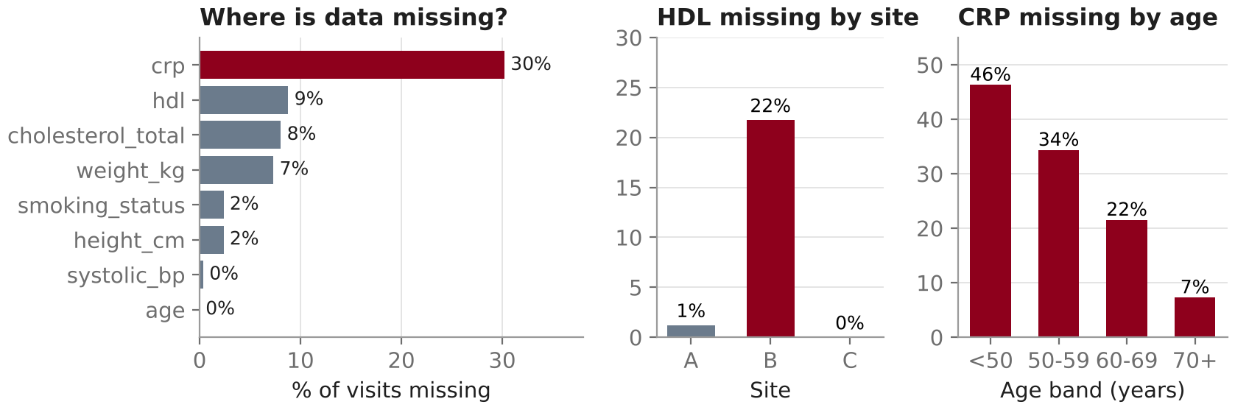
Explore missingness before any comparison
Python
import missingno as msno
df.isna().mean().round(2)
msno.matrix(df)
df.groupby("site")["hdl"].apply(
lambda s: s.isna().mean())
Explore missingness patterns and plausible reasons for missingness.
R
Mechanism | Meaning | Clinical example
MCAR | Unrelated to any data | Sample lost in transit
MAR | Explained by observed data | CRP ordered less often in younger patients; HDL not run at site B in 2022
MNAR | Depends on the unobserved value | Very unwell patients miss the follow-up visit
library(naniar)
miss_var_summary(df)
vis_miss(df)
gg_miss_var(df, facet = site)
Patterns are consistent with a mechanism but cannot prove it. Collection procedures and assumptions decide.
Question
Load
Clean
Explore
Outliers
Missing
Features
Infer / Predict
Report

Slide 23
Handling missing data depends on the goal
Statistical inference
Predictive modelling
Aim: unbiased estimates with honest uncertainty
Aim: good predictions for new patients
Complete-case analysis can be valid when missingness does not depend on the outcome given the covariates. State the assumption.
Multiple imputation under MAR: impute several datasets, fit the analysis in each, pool the results.
MNAR suspected: sensitivity analyses (e.g. delta adjustment) and clinical reasoning.
Imputation is part of the model: fit it on training folds only, inside a pipeline.
Missingness indicators can carry signal (a test was not ordered). They do not remove bias in effect estimates.
Use the same handling at deployment as in training.
Avoid mean imputation for inference, even under MCAR. Filling every gap with one value shrinks the variance, weakens correlations and makes confidence intervals too narrow. Missingness that carries meaning (e.g. a test not ordered) is information to model, not a reason to skip thinking about bias.
Start here: Flexible Imputation of Missing Data
Question
Load
Clean
Explore
Outliers
Missing
Features
Infer / Predict
Report
Notes:
The earlier 'MCAR: drop, mean/median impute' line implied these were interchangeable. Dropping cases under MCAR loses power but stays unbiased; mean imputation distorts variances and relationships regardless of the mechanism.

Slide 24
Multiple imputation: impute, analyse, pool
Impute
m = 20 completed datasets
Analyse
Fit the same model in each
Pool
Combine with Rubin's rules
Python (statsmodels)
import statsmodels.api as sm
from statsmodels.imputation.mice import MICEData, MICE
num = base[["systolic_bp", "diabetes", "age",
"bmi", "hdl", "crp"]]
mi = MICE("systolic_bp ~ diabetes + age + bmi",
sm.OLS, MICEData(num)).fit(10, 20)
R (mice)
library(mice)
dat <- base |>
select(systolic_bp, diabetes, age, sex, bmi,
hdl, crp, smoking_status) |> # no patient_id
mutate(across(c(sex, smoking_status), as.factor))
imp <- mice(dat, m = 20, seed = 123) # pmm, logreg,
# polyreg by type
fit <- with(imp, lm(systolic_bp ~ diabetes + age + bmi))
summary(pool(fit), conf.int = TRUE)
Exclude identifiers such as patient_id from the imputation model.
Match the method to the variable type: pmm for numeric, logreg for binary, polyreg for nominal, polr for ordinal.
Include the outcome and all analysis variables in the imputation model.
scikit-learn IterativeImputer() = iterative single imputation. One completed dataset: use it inside a prediction pipeline, not for pooled inference. complete(imp, 1) in R also extracts only one dataset.
Start here: mice: official workflow
Question
Load
Clean
Explore
Outliers
Missing
Features
Infer / Predict
Report
Notes:
Pooled result in this dataset (Python version, adjusted for age and BMI): diabetes coefficient about 5.2 mmHg (95% CI 1.6 to 8.8). Mixed data types (IDs, text categories, numbers) cannot be passed directly to IterativeImputer().fit_transform(df); they need encoding first, and identifiers must be dropped.

Slide 25
Feature engineering and encoding
Derive informative variables, with domain knowledge
Python
# regression: dummy coding, one reference level
X = pd.get_dummies(base[["sex", "smoking_status"]],
drop_first=True)
# machine learning pipelines
from sklearn.preprocessing import OneHotEncoder, OrdinalEncoder
nominal = OneHotEncoder(handle_unknown="ignore")
ordinal = OrdinalEncoder(categories=[[0, 1, 2, 3, 4]])
Python / R
df["bmi"] = df["weight_kg"] / (df["height_cm"] / 100) ** 2
df$bmi <- df$weight_kg / (df$height_cm / 100)^2
Variable type | Encoding | Example
Nominal | Dummy (one-hot) coding; factor in R | sex, site, smoking_status
Ordinal | Ordered integer codes, only when the order is meaningful | ccs_class 0 to 4
Binary | 0/1 | diabetes, statin
Target y (classification) | LabelEncoder is designed for y, not for predictors | diabetes as outcome
R
df <- df |> mutate(
sex = factor(sex),
smoking_status = factor(smoking_status,
levels = c("never", "former", "current")),
ccs_class = factor(ccs_class, levels = 0:4, ordered = TRUE))
lm(systolic_bp ~ age + sex + smoking_status, data = df)
Integer labels for nominal categories (site A = 0, B = 1, C = 2) invent an order and equal spacing that do not exist.
Question
Load
Clean
Explore
Outliers
Missing
Features
Infer / Predict
Report

Slide 26
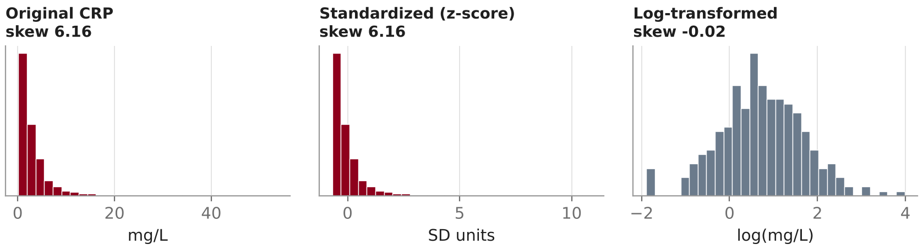
Scaling is not transformation
Scaling (z-score, min-max)
Transformation (log)
Changes units, keeps the shape. Standardized CRP is as skewed as raw CRP.
Needed for distance-based methods, PCA, clustering and penalised regression. In ML, fit the scaler on training data only.
Changes the shape. Justify it by the analysis: multiplicative effects, a model assumption, or ratios as the quantity of interest.
Interpretation changes: on the log scale, differences become ratios on the original scale.
Python
Keep descriptive summaries in interpretable units (mg/L, mmHg).
z = StandardScaler().fit_transform(base[["crp"]]); log_crp = np.log(base["crp"])
Question
Load
Clean
Explore
Outliers
Missing
Features
Infer / Predict
Report
Notes:
The earlier blanket rule 'do not normalize for hypothesis testing' was removed. A log transformation can be the right choice for a test or model, provided it is justified and the results are back-transformed for reporting. The spike at the left of the log histogram is the 9 values below the detection limit, all set to 0.15 mg/L.

Slide 27
After exploration: two paths
 | 7A Statistical inference | 7B Predictive modelling
Goal | Estimate an association or effect, with uncertainty | Predict the outcome for new patients
Example | How much higher is SBP with diabetes, adjusted for age? | Which clinic patients are likely to have diabetes?
Unit and split | One row per patient, or a model for repeated visits | Split by patient (and by time or site) before any learned step
Missing data | Complete case if justified; multiple imputation with pooling | Imputation fitted within training folds; indicators allowed
Preprocessing | Interpretable units; pre-specified covariates; justified transformations | Encoding, scaling and selection inside a pipeline
Checks | Assumptions (residuals), sensitivity analyses | Grouped cross-validation; temporal or external validation
Output | Effect estimate, 95% CI, p-value | Discrimination (AUC) and calibration
EDA informs both: which variables matter, likely confounders, needed transformations and how missingness should be handled.
Question
Load
Clean
Explore
Outliers
Missing
Features
Infer / Predict
Report

Slide 28
7A Choosing a test: outcome type and design
Continuous outcome | Design | Approximately normal* | Skewed or ordinal
1 group vs a reference value | Single sample | One-sample t-test | Wilcoxon signed-rank (assumes symmetry); sign test (median, no symmetry)
2 groups | Paired | Paired t-test on differences | Wilcoxon signed-rank on differences
 | Independent | Welch t-test (Student's if equal variances) | Mann-Whitney U †
3 or more groups | Repeated | Repeated-measures ANOVA or mixed model | Friedman test
 | Independent | One-way ANOVA (Welch ANOVA) | Kruskal-Wallis test
Categorical counts | Test
1 variable vs expected proportions | Chi-square goodness-of-fit (exact test if counts are small)
2 or more independent groups | Chi-square test of independence; Fisher's exact for small expected counts
Paired binary (before / after) | McNemar test
* Assessed in the quantity the test models (each group, the differences, or residuals); large groups are robust to moderate skew.
† Mann-Whitney tests whether values in one group tend to be larger than in the other. It compares medians only if the two distributions have the same shape.
Tests answer different questions: means, distributions or proportions. Each p-value is reported with an effect estimate.
Question
Load
Clean
Explore
Outliers
Missing
Features
Infer / Predict
Report
Notes:
Corrections from the earlier version: the one-sample non-normal row listed the Wilcoxon rank-sum test, which compares two independent groups; the one-sample analogue is the signed-rank test (symmetry assumed) or the sign test. Chi-square goodness-of-fit belongs to categorical counts. The heading no longer implies that every test compares means or medians.

Slide 29
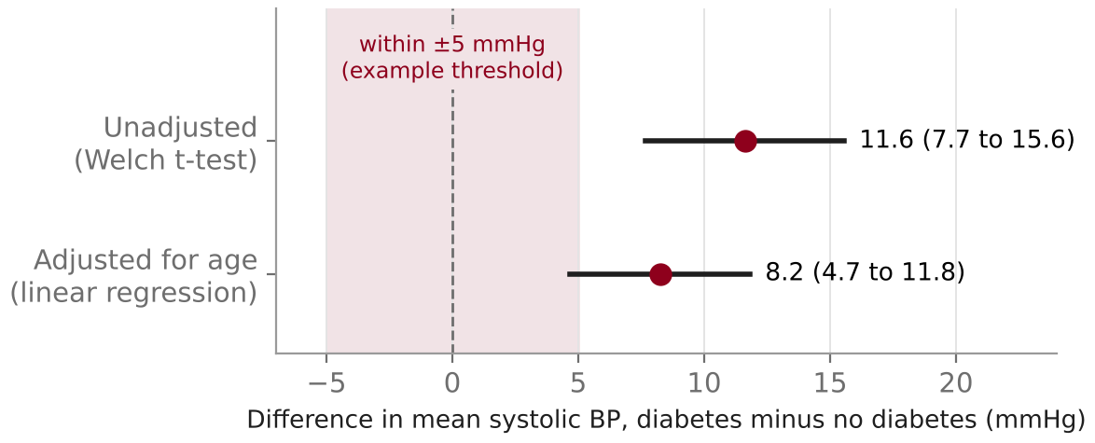
7A Report the effect and its uncertainty
Python
yes = base.loc[base.diabetes == 1, "systolic_bp"].dropna()
no = base.loc[base.diabetes == 0, "systolic_bp"].dropna()
res = stats.ttest_ind(yes, no, equal_var=False) # Welch
diff = yes.mean() - no.mean()
ci = res.confidence_interval(0.95)
print(f"{diff:.1f} ({ci.low:.1f} to {ci.high:.1f})")
R
Report: Mean systolic BP was 11.6 mmHg higher in patients with diabetes (95% CI 7.7 to 15.6; p < 0.001).
t.test(systolic_bp ~ diabetes, data = base)
# Welch by default; difference is group 0 minus 1
ASA statement on p-values
A p-value does not measure the size or the clinical importance of an effect. Compare the confidence interval with a difference that matters clinically.
Question
Load
Clean
Explore
Outliers
Missing
Features
Infer / Predict
Report

Slide 30
7A Multiple comparisons and confounding
Testing many biomarkers
Confounding by age
40%
chance of at least one false positive when 10 independent tests of true null hypotheses are run at α = 0.05
Age
Pre-specify one primary outcome and comparison.
Adjust for the number of tests: Holm (family-wise error) or Benjamini-Hochberg (false discovery rate).
Report every test performed, not only the significant ones.
Diabetes
SBP
Unadjusted: 11.6 mmHg (7.7 to 15.6)
Adjusted for age: 8.2 mmHg (4.7 to 11.8)
Older patients have more diabetes and higher SBP, so part of the crude difference is age. Treatment, BMI or site can confound in the same way.
Python / R
from statsmodels.stats.multitest import multipletests
reject, p_adj, _, _ = multipletests(p, method="fdr_bh")
p.adjust(p, method = "BH") # R
Python / R
smf.ols("systolic_bp ~ diabetes + age", data=base).fit()
lm(systolic_bp ~ diabetes + age, data = base) |> confint()
Question
Load
Clean
Explore
Outliers
Missing
Features
Infer / Predict
Report

Slide 31
7B Prediction: avoid leakage
Split by patient
and by time or site where the model will be used on new periods or centres
Python (scikit-learn)
num_cols = ["age", "bmi", "systolic_bp", "hdl", "crp"]
cat_cols = ["sex", "smoking_status"]
prep = make_column_transformer(
(make_pipeline(SimpleImputer(strategy="median",
add_indicator=True),
StandardScaler()), num_cols),
(make_pipeline(SimpleImputer(strategy="most_frequent"),
OneHotEncoder(handle_unknown="ignore")),
cat_cols))
model = make_pipeline(prep, LogisticRegression(max_iter=1000))
auc = cross_val_score(model, df[num_cols + cat_cols],
df["diabetes"],
groups=df["patient_id"], # all visits of a
cv=GroupKFold(n_splits=5), # patient stay in
scoring="roc_auc") # one fold
Fit on training folds
imputation, encoding, scaling and feature selection learn only from training data
Evaluate on held-out patients
grouped cross-validation, then temporal or external validation
Visits of one patient in both training and test folds inflate performance: a random forest scores AUC 0.79 with leaky folds but 0.74 on new patients.
Start here: scikit-learn: common pitfalls and data leakage
Question
Load
Clean
Explore
Outliers
Missing
Features
Infer / Predict
Report
Notes:
This example predicts diabetes from routine measurements only to show the mechanics. The grouped cross-validated AUC in the synthetic data is about 0.79 for logistic regression, which barely changes with leaky folds; a random forest drops from 0.79 (leaky KFold) to 0.74 (GroupKFold), shown in section 7B of the notebook. A clinical prediction model would also need calibration, a pre-specified set of predictors and external validation.

Slide 32
Cohort summary table (Table 1)
Characteristic | Overall N = 420 | No diabetes N = 337 | Diabetes N = 83 | Missing
Age, years, mean (SD) | 58.3 (9.9) | 57.1 (9.7) | 63.1 (9.3) | 0
Female, n/N (%) | 196/420 (47%) | 147/337 (44%) | 49/83 (59%) | 0
BMI, kg/m², mean (SD) | 27.4 (4.2) | 26.8 (4.1) | 29.9 (3.6) | 41
Systolic BP, mmHg, mean (SD) | 122.5 (16.0) | 120.2 (15.1) | 131.8 (16.5) | 1
CRP, mg/L, median (IQR) | 2.0 (1.1 to 3.9) | 1.9 (1.1 to 3.7) | 2.5 (1.4 to 4.9) | 130
Current smoker, n/N (%) | 66/411 (16%) | 43/329 (13%) | 23/82 (28%) | 9
On statin, n/N (%) | 135/420 (32%) | 80/337 (24%) | 55/83 (66%) | 0
R (gtsummary)
library(gtsummary)
base |>
select(age, sex, bmi, systolic_bp,
crp, smoking_status, statin,
diabetes) |>
tbl_summary(
by = diabetes,
statistic = list(
all_continuous() ~ "{mean} ({sd})",
crp ~ "{median} ({p25}, {p75})",
all_categorical() ~
"{n} / {N} ({p}%)"),
missing = "always") |>
add_overall()
Baseline visit, one row per patient. Continuous: mean (SD) or median (IQR) by shape; categorical: n/N (%), with N = non-missing values; missing counts shown for every variable.
Python: the tableone package, TableOne(base, groupby="diabetes", nonnormal=["crp"], missing=True).
Start here: gtsummary tbl_summary() tutorial
Question
Load
Clean
Explore
Outliers
Missing
Features
Infer / Predict
Report
Notes:
A descriptive Table 1 usually omits p-values for baseline differences in observational cohorts; the formal comparison belongs to the analysis section with effect estimates.

Slide 33
The EDA deliverable: one page, four parts
(i) Cohort summary
(ii) Three informative plots
 | No DM | DM
N | 337 | 83
Age | 57.1 | 63.1
SBP | 120.2 | 131.8
CRP* | 1.9 | 2.5
* median, mg/L. Full Table 1 on the previous slide.
(iii) Problems identified
(iv) Documented analysis decisions
  46 cholesterol values in mmol/L (site C, 2023)
  4 duplicate records; 5 spellings of sex
  2 DBP ≥ SBP, 1 implausible height, 1 misdated visit
  CRP 30% missing, more often in younger patients
  HDL missing mostly at site B (22%)
  Unit of analysis: baseline visit per patient
  Units converted after site confirmation; impossible values set to missing
  CRP below LOD set to 0.15 mg/L, flag kept
  SBP 212 mmHg kept; estimate 10.6 without it vs 11.6
  Age-adjusted comparison; multiple imputation for covariates
Question
Load
Clean
Explore
Outliers
Missing
Features
Infer / Predict
Report

Slide 34
Resources by task
Task | Resource
Beginner Python | Software Carpentry: Programming with Python (patient data example)
Beginner R and EDA | R for Data Science, 2nd edition
Loading and manipulating tables | pandas: Getting started tutorials
Plotting distributions | seaborn: Visualizing distributions of data
Practising visualization | Kaggle Learn: Data Visualization
Automated profiling | YData Profiling: Quickstart
Clinical summary tables | gtsummary: tbl_summary() tutorial
Missing-data reasoning | van Buuren: Flexible Imputation of Missing Data
Multiple-imputation analysis | mice: impute, with(), pool() workflow
Transition to machine learning | scikit-learn: Common pitfalls and data leakage
p-values and effect sizes | ASA statement on statistical significance and p-values
Main textbooks: Data Science for Health Informatists · Python for Health Data Science · Data Analysis in Medicine and Health using R

Slide 35
EDA checklist
Before
Clean
☐ Study question, population and outcome written down
☐ Unit of analysis defined: patient, visit or specimen
☐ Data dictionary with units, codes and missing-value codes
☐ Labels, types and missing codes fixed
☐ Exact duplicates removed, repeat visits kept
☐ Units, dates and impossible values checked; decisions logged
Explore
Decide and report
☐ Histogram and Q-Q plot for each key variable, per group
☐ Outliers judged against clinical plausibility
☐ Missingness explored by variable, site and patient group
☐ Path chosen: inference or prediction
☐ Effect estimates with CIs, multiplicity, confounding; or a leakage-safe pipeline
☐ Table 1, three plots, problems and decisions shared
All links in one place: Resources by task →

