Slide 1
Applied Empirical Methods in Environmental and Development Economics
Recreation of “Temperature and Decisions: Evidence from 207,000 Court Cases” by Heyes and Saberian (2019)
25.02.2022
Viktor Reif, Alfred-Weber Instiute for Economics

Slide 2
Short summary of Heyes and Saberian (2019)
My results
Validity of original results
Interactive latent factor model
Viktor Reif, Alfred-Weber Instiute for Economics

Slide 3
1. Short summary of Heyes and Saberian (2019)
Viktor Reif, Alfred-Weber Instiute for Economics

Slide 4
1. Short Summary of Heyes and Saberian (2019)
  Does outdoor temperature have an effect on professional decisions?
  207,000 asylum court cases and weather from 2000-2004
  Significant temperature effects!
Viktor Reif, Alfred-Weber Instiute for Economics

Slide 5
1. Short Summary of Heyes and Saberian (2019)
Viktor Reif, Alfred-Weber Instiute for Economics

Slide 6
1. Short Summary of Heyes and Saberian (2019)
  Temperature effects on case outcomes with controls for:
    Weather
    Pollution
    Case characteristics
    Location (fixed effect)
    Judge (fixed effect)
    Time (fixed effect)
Viktor Reif, Alfred-Weber Instiute for Economics

Slide 7
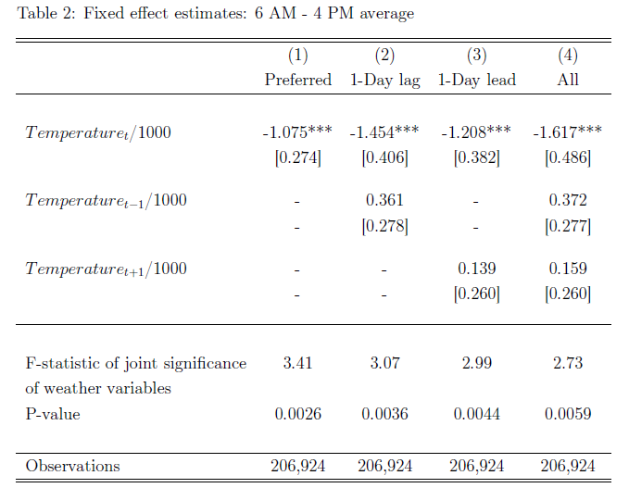
1. Short Summary of Heyes and Saberian (2019)
Viktor Reif, Alfred-Weber Instiute for Economics

Slide 8
1. Short Summary of Heyes and Saberian (2019)
  Interpretation: “A 10°F (5.4°C) warmer temperature implies a 6.59% decrease in expected grant rate”.
  In Relation: 1.4% increase the day after a win for the home NFL team by Eren and Mocan (2018)
Viktor Reif, Alfred-Weber Instiute for Economics
Notes:
This means that if on the day of hearing the outdoor temp is 5.4C higher than the average of that time, grant rates drop significantly
Maybe add slide about robustness tests in huge table if time

Slide 9
2. My results
Viktor Reif, Alfred-Weber Instiute for Economics

Slide 10
2. My results
  Replication: same results
Viktor Reif, Alfred-Weber Instiute for Economics

Slide 11
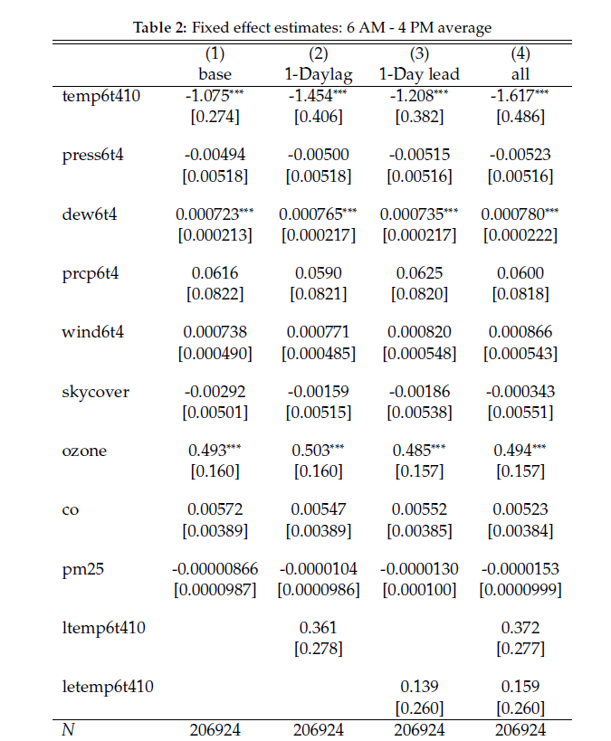
2. My results
Viktor Reif, Alfred-Weber Instiute for Economics

Slide 12
3. Validity of original results
Viktor Reif, Alfred-Weber Instiute for Economics

Slide 13
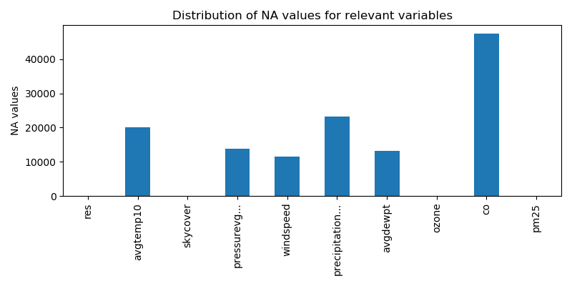
3. Validity of original results
Viktor Reif, Alfred-Weber Instiute for Economics
Notes:
Tell story about yearly effects, how stata drops na automatically

Slide 14
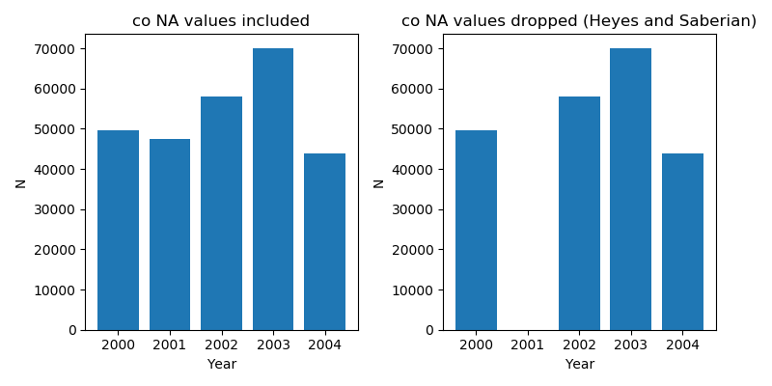
3. Validity of original results
Viktor Reif, Alfred-Weber Instiute for Economics

Slide 15
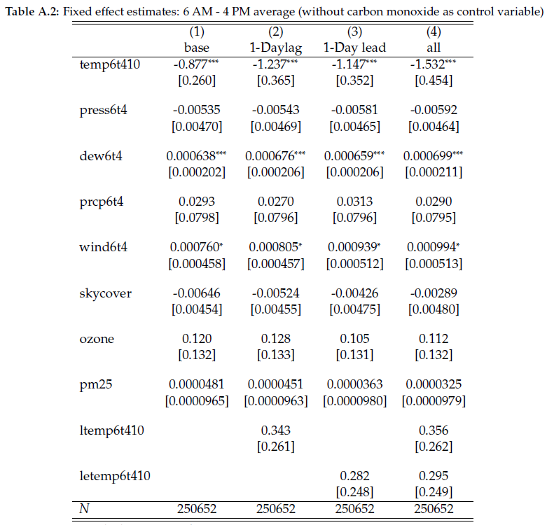
3. Validity of original results
Viktor Reif, Alfred-Weber Instiute for Economics
Notes:
With co-na obs: effect gets more than 10% smaller, but still significant

Slide 16
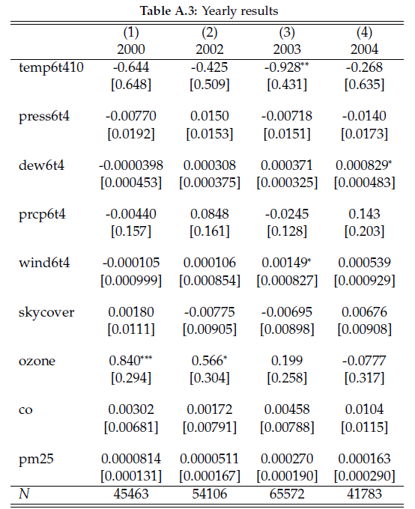
3. Validity checks of original results
Viktor Reif, Alfred-Weber Instiute for Economics
Notes:
Only 2003 significant year

Slide 17
3. Validity of original results
  My analysis: in yearly subsamples mostly no significant temperature effects
  Holger Spamann (2020): in larger sample (1990-2019) no significant temperature effect
Viktor Reif, Alfred-Weber Instiute for Economics

Slide 18
4. Interactive latent factor model
Viktor Reif, Alfred-Weber Instiute for Economics
Notes:
Präsi already over... With climate change this will get more relevant and deserves attention
Example to furhter mine the dataset, and in this case the error term: eg political sentiment of judges

Slide 19
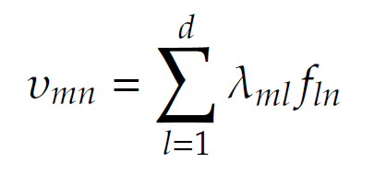
4. Interactive latent factor model
Viktor Reif, Alfred-Weber Instiute for Economics

Slide 20
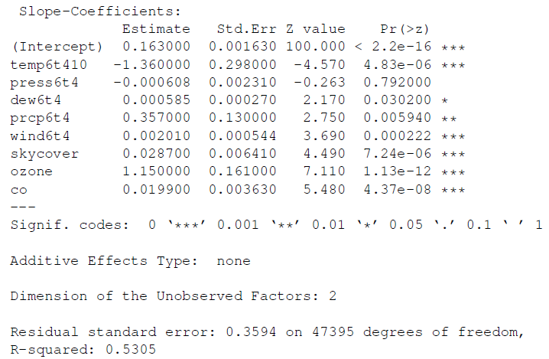
4. Interactive latent factor model
Viktor Reif, Alfred-Weber Instiute for Economics

