Slide 1
JSON
Anna Hakobyan

Slide 2
What is JSON?
JSON stands for JavaScript Object Notation
JSON is a text format for storing and transporting data
JSON is "self-describing" and easy to understand

Slide 3
What is JSON?
JavaScript Object Notation (JSON) is a standard text-based format for representing structured data based on JavaScript object syntax.
It is commonly used for transmitting data in web applications (e.g., sending some data from the server to the client, so it can be displayed on a web page, or vice versa).

Slide 4
What is JSON?
JSON is a text-based data format following JavaScript object syntax, which was popularized by Douglas Crockford. Even though it closely resembles JavaScript object literal syntax, it can be used independently from JavaScript, and many programming environments feature the ability to read (parse) and generate JSON.
JSON exists as a string — useful when you want to transmit data across a network. It needs to be converted to a native JavaScript object when you want to access the data. This is not a big issue — JavaScript provides a global JSON object that has methods available for converting between the two.

Slide 5
What is JSON?
Converting a string to a native object is called deserialization, while converting a native object to a string so it can be transmitted across the network is called serialization.
A JSON string can be stored in its own file, which is basically just a text file with an extension of .json, and a MIME type of application/json.
A MIME type (now properly called "media type", but also sometimes "content type") is a string sent along with a file indicating the type of the file (describing the content format, for example, a sound file might be labeled audio/ogg, or an image file image/png).

Slide 6


JSON Example
This example is a JSON string:
It defines an object with 3 properties:
name
age
Car
Each property has a value.
If you parse the JSON string with a JavaScript program, you can access the data as an object:

Slide 7
JSON structure
As described above, JSON is a string whose format very much resembles JavaScript object literal format. You can include the same basic data types inside JSON as you can in a standard JavaScript object — strings, numbers, arrays, booleans, and other object literals. This allows you to construct a data hierarchy, like so:

Slide 8
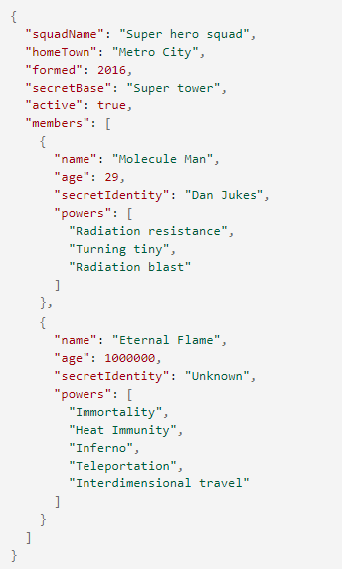

JSON structure
If we loaded this string into a JavaScript program, parsed it into a variable called superHeroes for example, we could then access the data inside it using the same dot/bracket notation.
To access data further down the hierarchy, you have to chain the required property names and array indexes together. For example, to access the third superpower of the second hero listed in the members list, you'd do this:

Slide 9
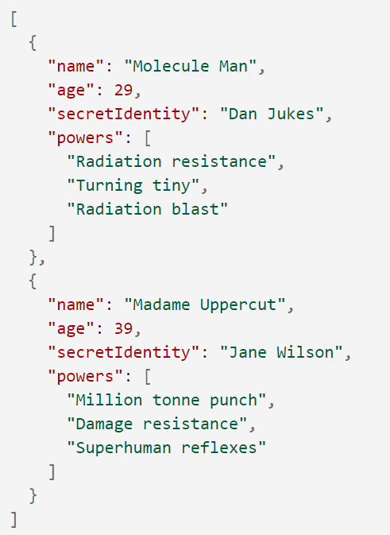
Arrays as JSON
Above we mentioned that JSON text basically looks like a JavaScript object inside a string. We can also convert arrays to/from JSON.
The above is perfectly valid JSON. You'd just have to access array items (in its parsed version) by starting with an array index, for example [0]["powers"][0].

Slide 10
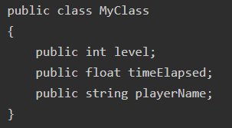
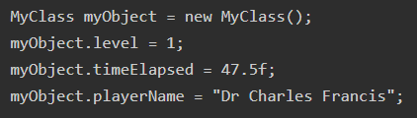
JSON Example

Slide 11
Other notes
JSON is purely a string with a specified data format — it contains only properties, no methods.
JSON requires double quotes to be used around strings and property names. Single quotes are not valid other than surrounding the entire JSON string.
Even a single misplaced comma or colon can cause a JSON file to go wrong, and not work. You should be careful to validate any data you are attempting to use (although computer-generated JSON is less likely to include errors, as long as the generator program is working correctly). You can validate JSON using an application like JSONLint.
JSON can actually take the form of any data type that is valid for inclusion inside JSON, not just arrays or objects. So, for example, a single string or number would be valid JSON.
Unlike in JavaScript code in which object properties may be unquoted, in JSON only quoted strings may be used as properties.

Slide 12
Useful Links
1. Working with JSON
https://developer.mozilla.org/en-US/docs/Learn/JavaScript/Objects/JSON
2. JSON – Introduction
https://www.w3schools.com/js/js_json_intro.asp

