Slide 1
S.O.L.I.D. Principles of Object-Oriented Programming in C#
Anna Hakobyan

Slide 2
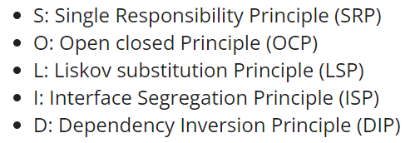
What are SOLID principles?
SOLID principles are the design principles that enable us to manage most of the software design problems. Robert C. Martin compiled these principles in the 1990s. These principles provide us with ways to move from tightly coupled code and little encapsulation to the desired results of loosely coupled and encapsulated real needs of a business properly. SOLID is an acronym of the following.

Slide 3
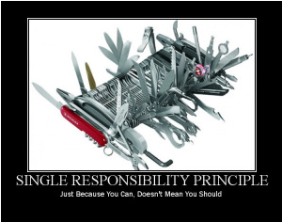
S: Single-Responsibility Principle
SRP says "Every software module should have only one reason to change".
This means that every class, or similar structure, in your code should have only one job to do. Everything in that class should be related to a single purpose. Our class should not be like a Swiss knife wherein if one of them needs to be changed then the entire tool needs to be altered. It does not mean that your classes should only contain one method or property. There may be many members as long as they relate to single responsibility.

Slide 4
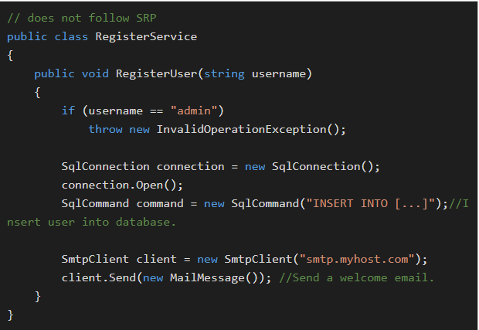
S: Single-Responsibility Principle
The Single Responsibility Principle gives us a good way of identifying classes at the design phase of an application and it makes you think of all the ways a class can change. A good separation of responsibilities is done only when we have the full picture of how the application should work. Let us check this with an example.
The program above does not follow SRP because RegisterUser does three different jobs: register a user, connect to the database, and send an email.

Slide 5
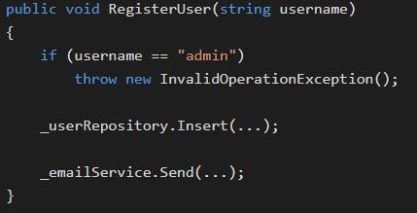
S: Single-Responsibility Principle
This type of class would cause confusion in larger projects, as it is unexpected to have email generation in the same class as the registration.
There are also many things that could cause this code to change like if we make a switch in a database schema or if we adopt a new email API to send emails.
Instead, we need to split the class into three specific classes that each accomplish a single job. Here’s what our same class would look like with all other jobs refactored to separate classes:
This achieves the SRP because RegisterUser only registers a user and the only reason it would change is if more username restrictions are added. All other behavior is maintained in the program but is now achieved with calls to userRepository and emailService.

Slide 6
O: Open-Closed Principle
The Open/closed Principle says, "A software module/class is open for extension and closed for modification".
Here "Open for extension" means, we need to design our module/class in such a way that the new functionality can be added only when new requirements are generated. "Closed for modification" means we have already developed a class and it has gone through unit testing. We should then not alter it until we find bugs. As it says, a class should be open for extensions, we can use inheritance to do this.
Implementation
OCP implementations often rely on polymorphism and abstraction to code behavior at a class level rather than hard-coding for certain situations. Let’s see how we can correct an area calculator program to follow OSP:

Slide 7
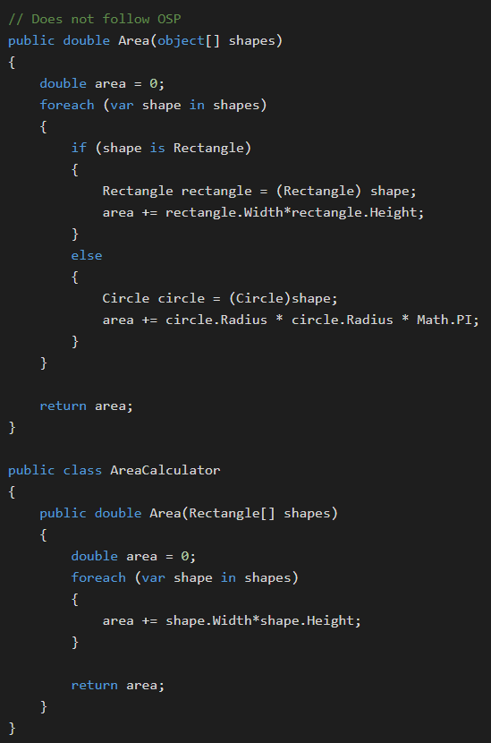
O: Open-Closed Principle
This program does not follow OSP because Area() is not open to extension and can only ever handle Rectangle and Circle shapes. If we want to add support for Triangle, we’d have to modify the method, so it is not closed to modification.
We can achieve OSP by adding an abstract class Shape that all types of shapes inherit.

Slide 8
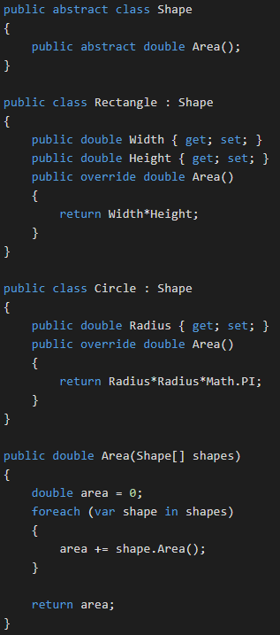
O: Open-Closed Principle
Now each subtype of shape handles its own area calculation through polymorphism. This opens the Shape class to extension because a new shape can easily be added with its own area calculation without error.
Further, nothing in the program modifies the original shape, and it will not need to be modified in the future. As a result, the program now achieves the OCP principle.

Slide 9
L: Liskov Substitution Principle
The Liskov Substitution Principle (LSP) states that "you should be able to use any derived class instead of a parent class and have it behaved in the same manner without modification". It ensures that a derived class does not affect the behavior of the parent class, in other words,, that a derived class must be substitutable for its base class.
This principle is just an extension of the Open Closed Principle, and it means that we must ensure that new derived classes extend the base classes without changing their behavior.
Most implementations of LSP involve polymorphism to create class-specific behavior for the same calls.

Slide 10
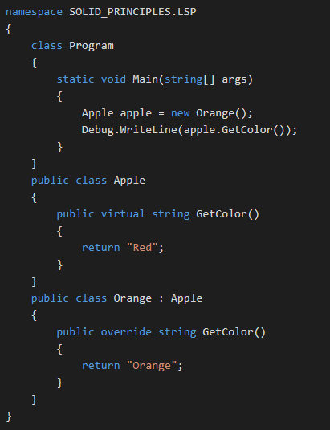
L: Liskov Substitution Principle
This example does not follow LSP:
This does not follow LSP because the Orange class could not replace the Apple class without altering the program output. The GetColor() method is overridden by the Orange class and therefore would return that an apple is orange.
To change this, we’ll add an abstract class for Fruit that both Apple and Orange will implement.

Slide 11
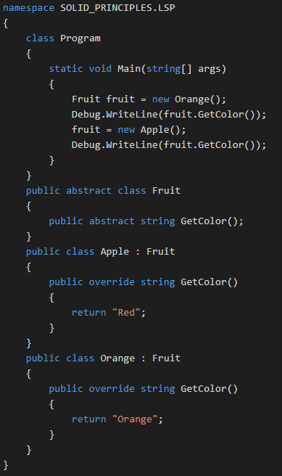
L: Liskov Substitution Principle
Now, any subtype (Apple or Orange) of the Fruit class can be replaced with the other subtype without error thanks to the class-specific behavior of GetColor(). As a result, this program now achieves the LSP principle.

Slide 12
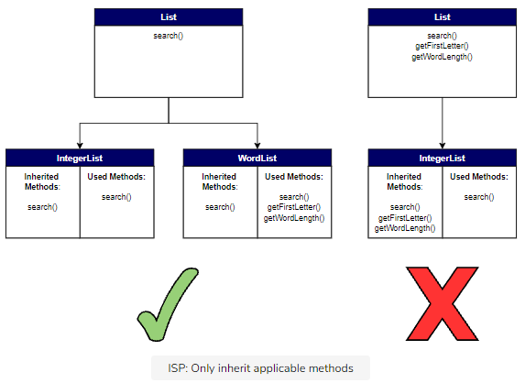
I: Interface Segregation Principle
The Interface Segregation Principle states "that clients should not be forced to implement interfaces they don't use. Instead of one fat interface, many small interfaces are preferred based on groups of methods, each one serving one submodule.".

Slide 13
I: Interface Segregation Principle
We can define it in another way. An interface should be more closely related to the code that uses it than code that implements it. So, the methods on the interface are defined by which methods the client code needs rather than which methods the class implements. So, clients should not be forced to depend upon interfaces that they don't use.
Like classes, each interface should have a specific purpose/responsibility (refer to SRP). You shouldn't be forced to implement an interface when your object doesn't share that purpose. The larger the interface, the more likely it includes methods that not all implementers can do. That's the essence of the Interface Segregation Principle.

Slide 14
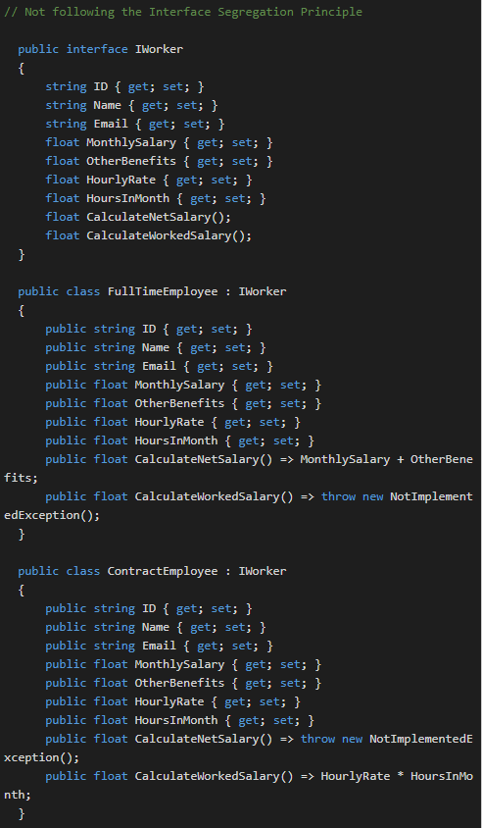
I: Interface Segregation Principle
This program does not follow ISP because the FullTimeEmployee class does not need the CalculateWorkedSalary() function, and the ContractEmployee class does not need the CalculateNetSalary().
Neither of these methods advance the goal of these classes. Instead, they are implemented because they are derived classes of the IWorker interface.
Here’s how we could refactor the program to follow the ISP principle:

Slide 15
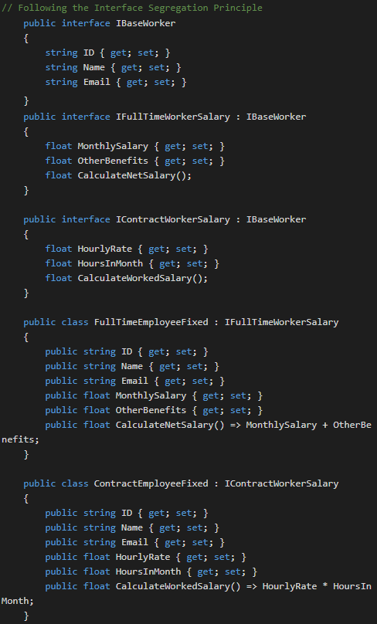
I: Interface Segregation Principle
In this version, we’ve split the general interface IWorker into one base interface, IBaseWorker, and two child interfaces IFullTimeWorkerSalary and IContractWorkerSalary.
The general interface contains methods that all workers share. The child interfaces split up methods by worker type, FullTime with a salary or Contract that gets paid hourly.
Now, our classes can implement the interface for that type of worker to access all methods and properties in the base class and the worker-specific interface.
The end classes now only contain methods and properties that further their goal and thus achieve the ISP principle.

Slide 16
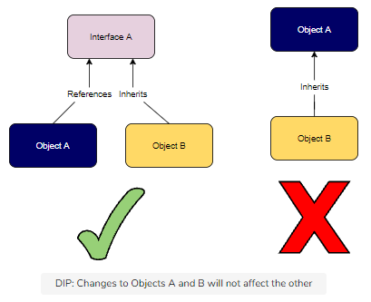
D: Dependency Inversion Principle
“One should depend upon abstractions, [not] concretions.”

Slide 17
D: Dependency Inversion Principle
The Dependency Inversion Principle (DIP) states that high-level modules/classes should not depend on low-level modules/classes. Both should depend upon abstractions. Secondly, abstractions should not depend upon details. Details should depend upon abstractions.
High-level modules/classes implement business rules or logic in a system (application). Low-level modules/classes deal with more detailed operations; in other words, they may deal with writing information to databases or passing messages to the operating system or services.
A high-level module/class that has a dependency on low-level modules/classes or some other class and knows a lot about the other classes it interacts with is said to be tightly coupled. When a class knows explicitly about the design and implementation of another class, it raises the risk that changes to one class will break the other class. So, we must keep these high-level and low-level modules/classes loosely coupled as much as we can. To do that, we need to make both of them dependent on abstractions instead of knowing each other.

Slide 18
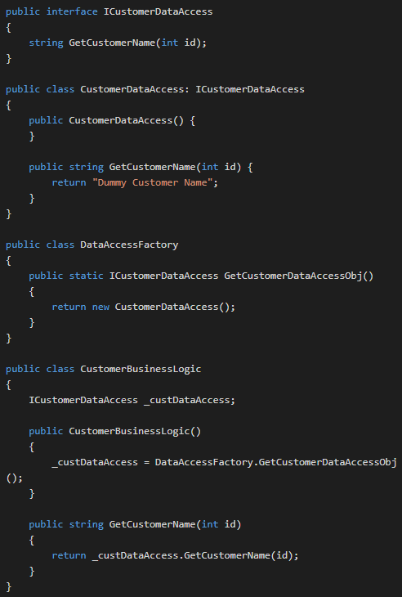
D: Dependency Inversion Principle
First, let’s create an interface with the getCustomerName() method. This will face our users.
Now, we’ll implement details that will depend on the ICustomerDataAccess interface. Doing so achieves the second part of the DIP principle.
We’ll now create a factory class that implements the abstract interface ICustomerDataAccess and returns it in a usable form. The returned CustomerDataAccess class is our low-level component.
Finally, we’ll implement a high-level component CustomerBuisnessLogic that also implements the interface ICustomerDataAccess. Notice that our high-level component does not implement our low-level component but merely uses it.

Slide 19
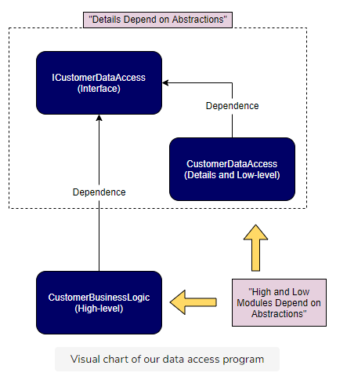
D: Dependency Inversion Principle

Slide 20
Useful Links
1. S.O.L.I.D. Principles of Object-Oriented Programming in C#
https://www.educative.io/blog/solid-principles-oop-c-sharp
2. SOLID Principles In C#
https://www.c-sharpcorner.com/UploadFile/damubetha/solid-principles-in-C-Sharp/

