Slide 1
Software Development Design Principles: DRY; KISS
Anna Hakobyan

Slide 2
What are Software Design Principles?
Software Design Principles are a set of guidelines that helps developers to make a good system design.
Principles tell us, do these and you will achieve this. How you will do it is up to you. Everyone defines some principles in their lives like, "I never lie," or "I never drink alcohol," etc. He/she follow these principles to make his/her life easy, but how will he/she stick to these principles is up to the individual.

Slide 3
DRY - Don't Repeat Yourself
DRY stands for DON’T REPEAT YOURSELF and is a basic principle of software development, aimed to reducing repetition of information.
The DRY principle states that every piece of knowledge must have a single, unambiguous, authoritative representation within a system.
This doesn't only refer to the code repetition. It is also related to the actual knowledge and context of the code being used. For example, we could have a sales product and manufacturing product in our domain.
Both products would have a lot in common and would have the same properties for example. But from the context perspective in the application domain, they represent different things. Leaving them as two separate entities would not be the DRY principal violation.

Slide 4
Violations of DRY
“We enjoy typing” (or, “Wasting everyone’s time."): "We enjoy typing," means writing the same code or logic again and again. It will be difficult to manage the code and if the logic changes then we have to make changes in all the places where we have written the code, thereby wasting everyone's time.
DRY is known by other names as well: Once and Only Once, and Duplication is Evil (DIE).

Slide 5
How to Achieve DRY
To avoid violating the DRY principle, divide your system into pieces. Divide your code and logic into smaller reusable units and use that code by calling it where you want. Don’t write lengthy methods but divide logic and try to use the existing piece in your method.

Slide 6
DRY Benefits
Less code is good, it saves time and effort, is easy to maintain, and reduces the chances of bugs.
One good example of the DRY principle is the helper class in enterprise libraries, in which every piece of code is unique in the libraries and helper classes.
Repetition is the root of all software evil

Slide 7
KISS - Keep It Simple, Stupid
KISS acronym stands for Keep It Simple, Stupid. The other famous alternate acronyms are
Keep it simply stupid.
Keep it short and simple.
Keep it simple and straightforward.
Keep it simple and smart.

Slide 8
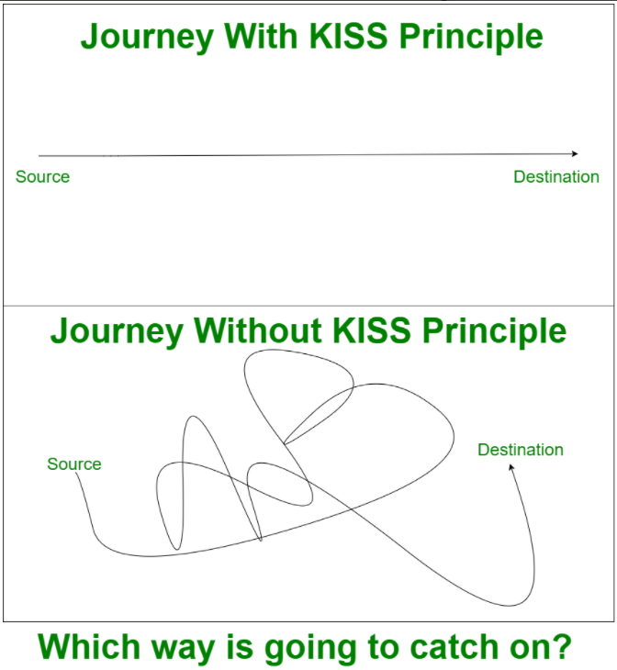
KISS - Keep It Simple, Stupid
KISS suggests not to involve complexity in your code and try avoiding it as much as you can. This is because more complex code is written, more difficult it becomes to modify at any later point of time. There is a very well said quote phrased by Albert Einstein, that will give green light to what has been stated above – If you can’t explain it, you don’t understand it well enough. Therefore, simplicity should be our key goal in designing software.

Slide 9
KISS - Keep It Simple, Stupid
The programming language is for humans to understand, computers can only understand 0 1, so keep coding simple and straight, which should be easily understandable by human beings.
Keep your methods small, each method should never be more than 40-50 lines.
Each method should only solve one small problem, not many use cases. If you have a lot of conditions in the method, break these out into smaller methods. It will not only be easier to read and maintain but also can find bugs a lot faster.

Slide 10
Benefits of KISS
It helps in solving problem quickly.
Since solution is simple, it helps in maintaining code.
It provides flexibility to modify or refactor code.
It provides solution of complex problems in fever lines of code.
At the end it delivers high-quality code.

Slide 11
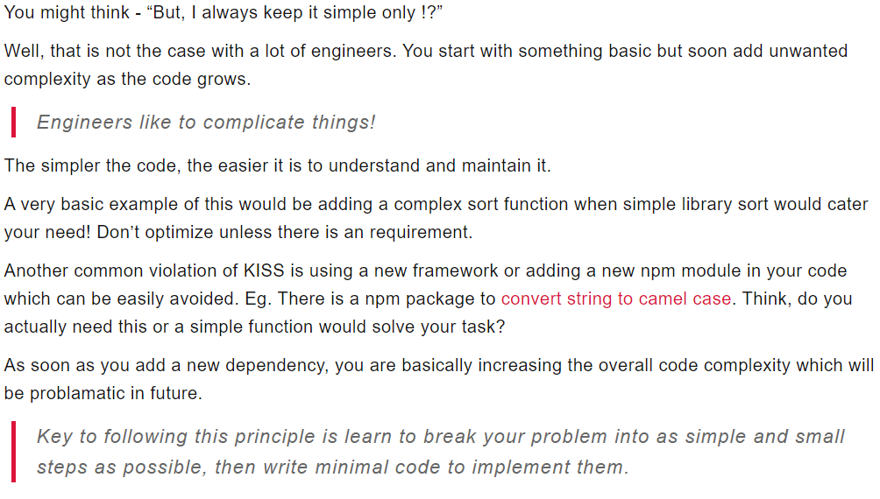
KISS: examples

Slide 12
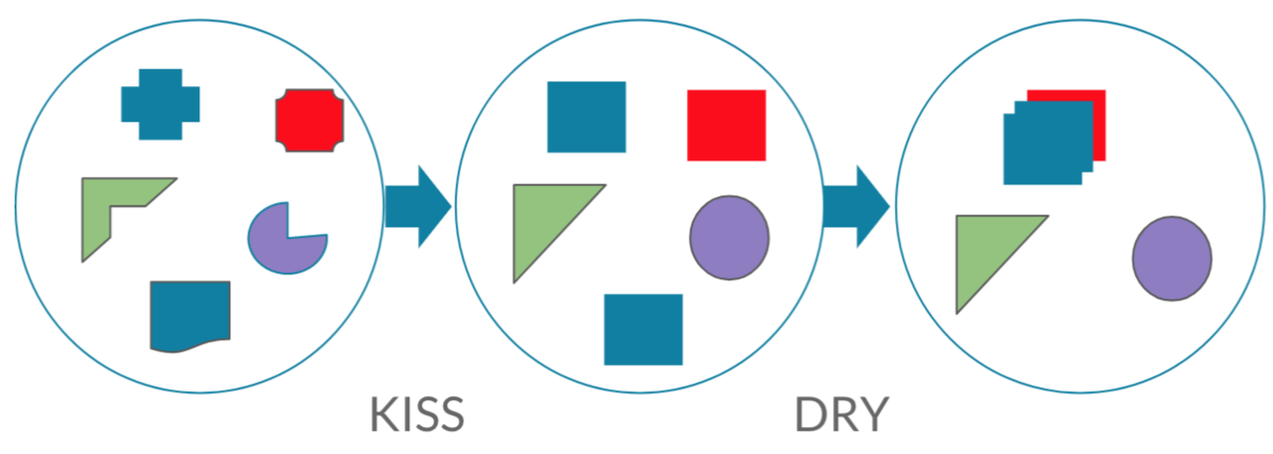
DRY; KISS

Slide 13
DRY
DEMO

Slide 14
Useful Links
1. Object Oriented Design Principles https://www.codeproject.com/Articles/567768/Object-Oriented-Design-Principles
2. Software Design Principles Every Programmer Should Know
https://medium.com/@peterlee2068/software-design-principles-every-programmer-should-know-c164a83c6f87
3. Software Design Principles - The Dry (Don't-Repeat-Yourself) Principle
https://devinduct.com/blogpost/57/software-design-principles-the-dry-don-t-repeat-yourself-principle
4. Software Design Principles DRY, KISS, YAGNI
https://www.c-sharpcorner.com/article/software-design-principles-dry-kiss-yagni/
5. Difference Between Software Design Principles - DRY And KISS
https://www.c-sharpcorner.com/article/dont-repeat-yourself-design-principle/

Slide 15
Useful Links
6. An Introduction to Software Development Design Principles
https://www.geeksforgeeks.org/an-introduction-to-software-development-design-principles/
7. Simplicity in Software Engineering is not Simple!
https://tech.kartenmacherei.de/simplicity-in-software-engineering-is-not-simple-979cf098e4b1
8. Solid Dry Kiss Yagni
https://www.mohitkhare.com/blog/solid-dry-kiss-yagni/

