Slide 1
E-Commerce WEbsite

Slide 2
Team Members : Vikul Dhiman (2200290140178) Vipin Sharma (2200290140179)

Slide 3
Introduction
The "Online E-commerce Website" has been developed to override the problems prevailing in the practicing manual system. This website is supported to eliminate and in some cases reduce the hardships faced by this existing system.

Slide 4
The application is reduced as much as possible to avoid errors while entering the data. It also provides error message while entering invalid data. No formal knowledge is needed for the user to use this system. Thus by this all it proves it is user-friendly. Online E-commerce Website, as described above, can lead to error free, secure, reliable and fast management system. It can assist the user to concentrate on their other activities rather to concentrate on the record keeping.

Slide 5
Technologies / Software Requirements
Html & css
Javascript
mysql
react js
ide (vs code)
64-bit os
internet connection

Slide 6
Modules Description
• Management Module: Used for managing the Food, Clothes etc. details.
• Order Module: Used for managing the details of Order.
• Delivery Address Module: Used for managing the details of Delivery Address.

Slide 7
• Item Category Management Module: Used for managing the information and details of the Item Category.
• Shopping Cart Module: Used for managing the Shopping Cart details • Customer Module: Used for managing the Customer information
• Login Module: Used for managing the login details
• Users Module: Used for managing the users of the system.

Slide 8
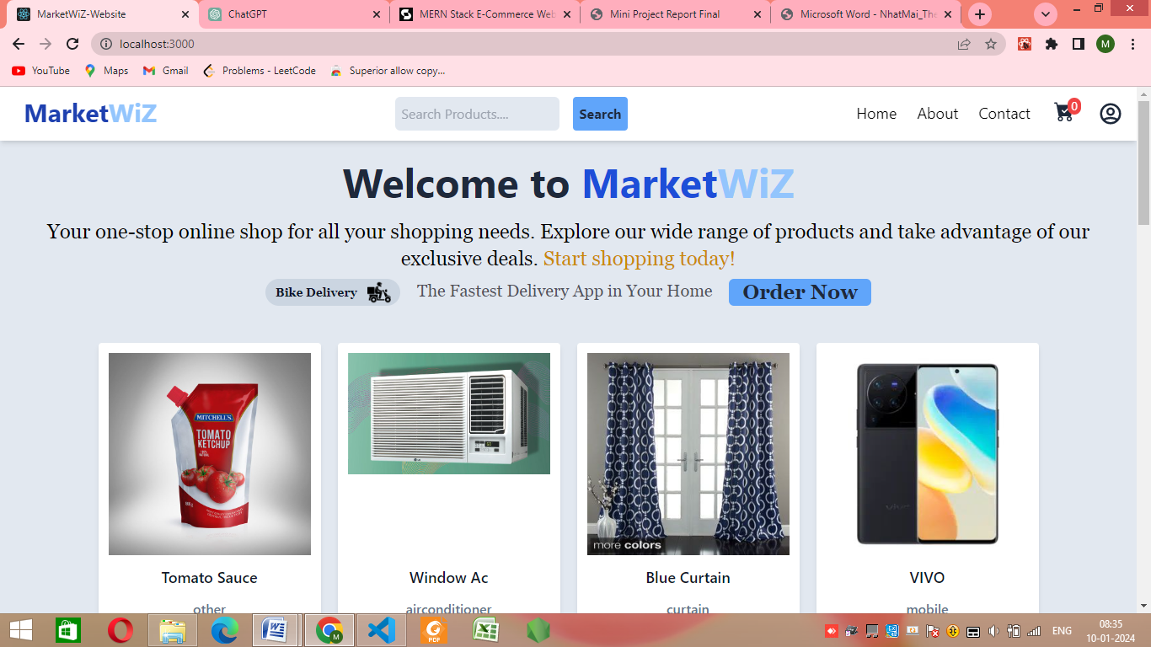
Homepage

Slide 9
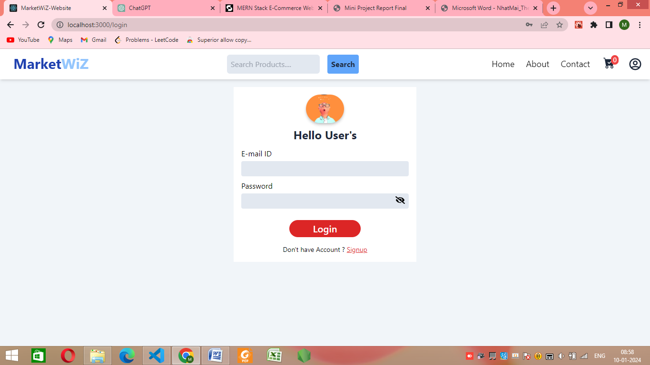
Login page

Slide 10
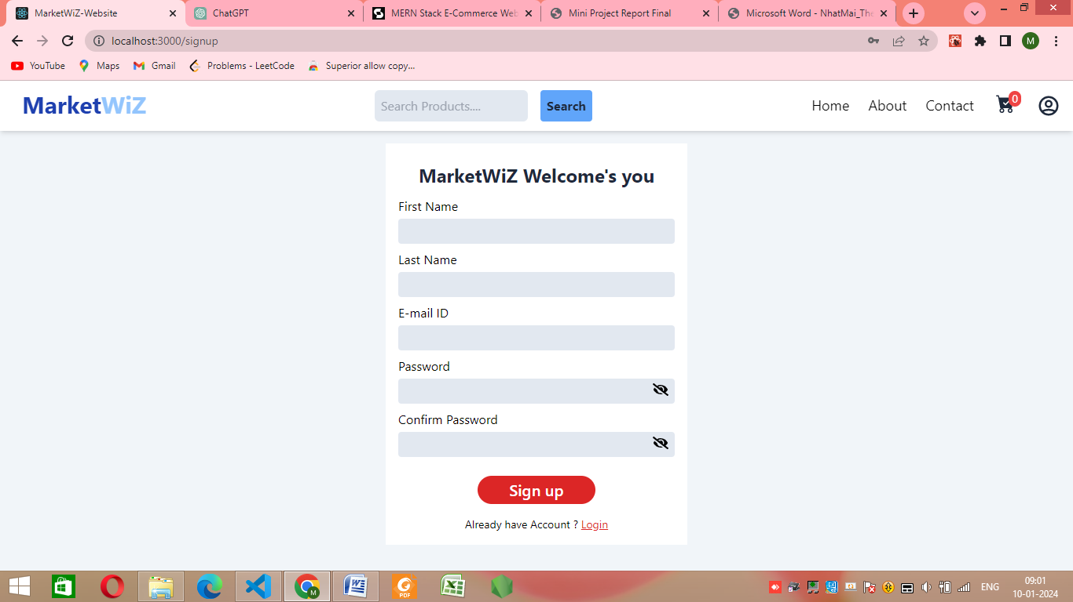
Sign Up Page

Slide 11
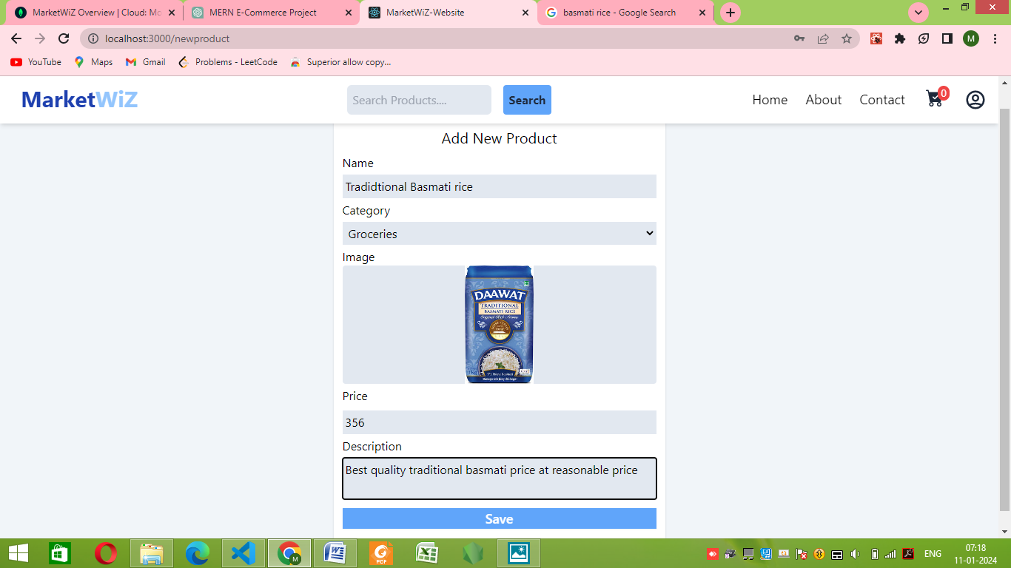
Adding New products

Slide 12
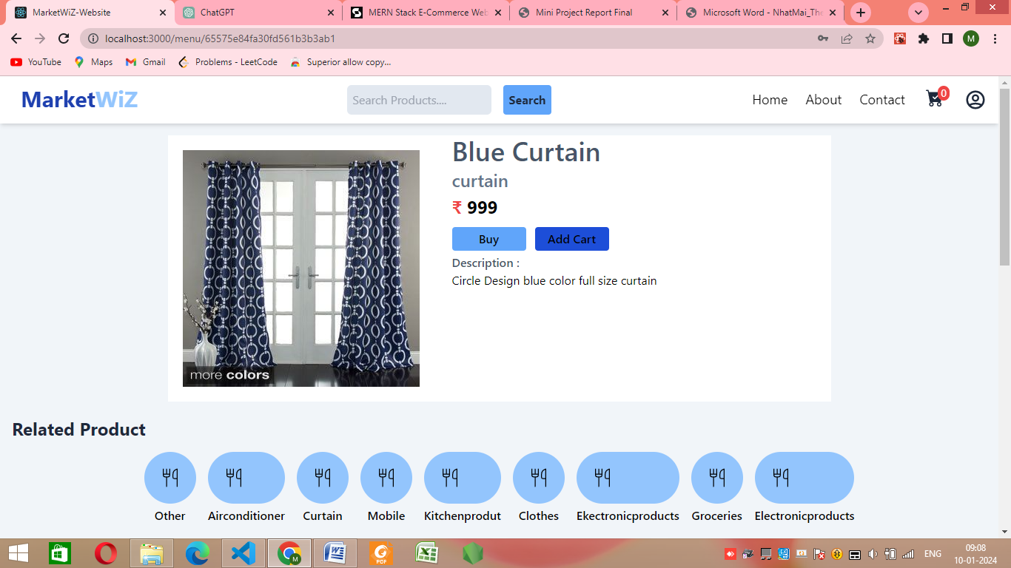
Adding products to the cart

Slide 13
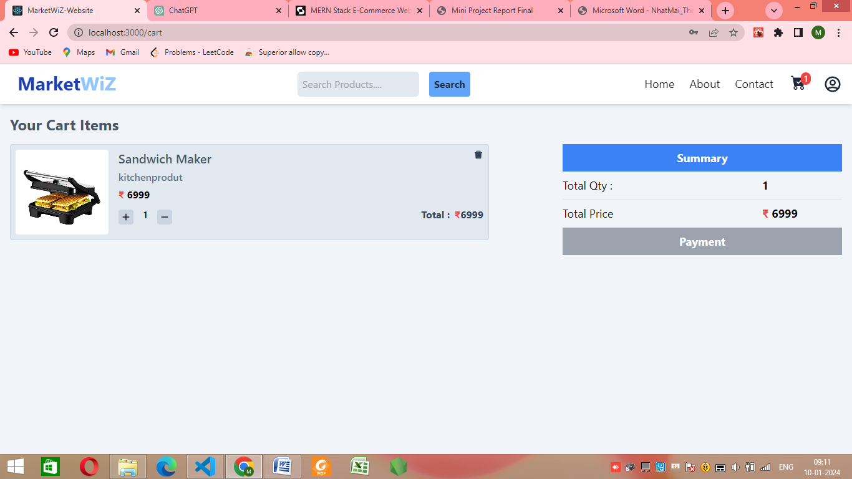
Payment Page

Slide 14
Reports/ outputs
The primary objective of the Online E-commerce Website Project is efficient management of clothing details, item categories, shopping carts, customers, and orders. This web application, accessible only to administrators, eliminates manual tasks associated with handling clothing information, item categorization, delivery addresses, and shopping cart operations. It meticulously tracks and records data pertaining to selected items, delivery addresses, and customer orders. By automating these processes, the project streamlines e-commerce operations, enhancing overall efficiency and customer experience.

Slide 15
Conclusion
In summary, the Online E-commerce Website Project efficiently streamlines online retail administration, handling clothing, categories, shopping carts, customers, and orders. This automation minimizes manual efforts, enhancing the online shopping experience. Accessible only to administrators, it offers a secure platform for digital business growth, marking a substantial step towards optimizing e-commerce operations and meeting evolving needs.

Slide 16
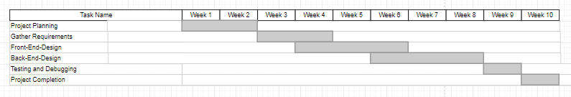
Gantt Chart

