Slide 1
🛡 SmartKYC
AI-Powered KYC/AML
Compliance Platform
Intelligent document extraction · LLM-driven investigation agents
Real-time sanctions screening · Human-in-the-loop review
SmartKYC Compliance Platform

Slide 2
Executive Summary
SmartKYC automates the entire Know Your Customer pipeline — from document upload to human review decision — using a multi-agent AI architecture built on FastAPI, SQLAlchemy, and Gemini Vision.
📄
🧠
🤖
👤
Smart Extraction
LLM-Driven Plans
Parallel Agents
Human Review
Gemini Vision reads passports, Aadhaar, PAN, Emirates ID and 15+ doc types with field-level confidence scoring
Claude / Gemini decides which investigation agents to spawn based on risk profile, nationality and subject type
Sanctions, PEP, Registry, Adverse Media, Transactions agents run concurrently with auto-escalation
Risk-ranked queue routes cases to compliance officers; weighted scores feed the review decision workflow

Slide 3
System Architecture
FRONTEND · React + TypeScript + React Router
Dashboard
New Case
Cases List
Case Detail
Review Queue
Authorities
API LAYER · FastAPI + Python 3.9
/api/cases
/api/documents
/api/reviews
/api/investigations
/api/authorities
SERVICES
AGENTS
document_service
investigation_service
verification_service
Identity
Sanctions
PEP
Registry
LLM Router (Gemini / Anthropic / OpenAI)
Media
Transactions
Aggregation
DATABASE · SQLite / PostgreSQL via SQLAlchemy ORM (Cases · Documents · DocumentExtractions · AgentResults · VerificationSources · HumanReviews · Events)

Slide 4
Multi-Agent Architecture
BaseAgent (ABC)
run() → AgentResult
case_id, subject dict
MANDATORY (always run)
CONDITIONAL (auto-trigger)
OPTIONAL (LLM-decided)
Identity
Agent
Sanctions
Agent
Adverse
Media
PEP
Agent
Registry
Agent
Transaction
Analysis
Agent Weights
⬆ Escalation Loop
Risk Aggregation Agent
sanctions_agent
30%
If any agent score ≥70, LLM is consulted on whether to run remaining optional agents before aggregation
Weighted formula across all agent scores → final risk_score (0–100) + risk_level (low/medium/high/critical)
pep_agent
25%
identity_agent
15%
registry_agent
15%
adverse_media
10%
transactions
5%

Slide 5
End-to-End Investigation Flow
📤
🖼️
🧠
⚡
01 Case Created
02 Document Upload
03 LLM Plans Agents
04 Agents Execute
File sent to /api/documents/upload; Gemini Vision + OCR reads passports, PAN, Aadhaar, driving licenses — extracts fields with confidence scores
Compliance officer verifies subject name, type, nationality, notes via
CasePage
investigation_service calls LLM to decide mandatory + conditional + optional agents for this subject
Each agent calls verification_service (OFAC, World-Check, Companies House, etc.) mock or real
⬆️
📊
👀
05 Escalation Check
06 Risk Aggregation
07 Human Review
If any agent scores ≥70, LLM decides whether to escalate unrun optional agents
RiskAggregationAgent applies weighted formula; case risk_score + risk_level written to DB
Case moves to review queue; compliance officer approves / rejects / escalates

Slide 6
Document Extraction Pipeline (document_service.py)
1 File Read
2 Gemini Vision
3 Tesseract OCR
4 MRZ Parser
5 Regex Parsers
6 Build Result
_read_file()
Detects MIME type
Primary path
Sends image to Gemini
Fallback if Vision
not available
ICAO MRZ lines
→ structured fields
Doc-type specific
extractors
_build_result()
Confidence scores
19 Supported Document Schemas:
🇮🇳 Aadhaar/PAN/Passport/Voter/DL · 🇬🇧 UK Passport/DVLA · 🇺🇸 US Passport/DL · 🇦🇪 Emirates ID/Passport · 🇷🇺 Russian Passport · 🇨🇳 Chinese Passport/ID · 🇪🇺 EU Passport/NID · 🏢 Company Registration
Extraction Confidence by Method:
Gemini Vision
MRZ Parser
PDF Text
Tesseract OCR
Regex
96%
97%
90%
82%
80%
avg confidence
avg confidence
avg confidence
avg confidence
avg confidence

Slide 7
Verification Authorities (verification_service.py)
🛡 Sanctions
👤 PEP
🏢 Registry
🪪 Identity
📰 Media
OFAC SDN (US)
World-Check One
Companies House (UK)
UIDAI Aadhaar
Global News API
UN Consolidated
LexisNexis WorldCompliance
OpenCorporates
India PAN Verify
Dow Jones Risk & Compliance
EU Financial Sanctions
MCA21 India
DVLA (UK)
HM Treasury (UK only)
Passport ICAO
⚙ MOCK vs REAL mode:
Set USE_MOCK_VERIFICATION=false in .env to switch all checks to real APIs. Per-authority API keys configured via environment variables. Automatic fallback to mock if key missing.

Slide 8
Database Schema (models.py)
Case
Document
AgentResult
· id (PK)
· id (PK)
· id (PK)
· case_number (unique)
· case_id (FK)
· case_id (FK)
· subject_name/type
· filename, file_path
· agent_name
· nationality, DOB, notes
· document_type, country_of_issue
· risk_score, flags (JSON)
· status, risk_score, risk_level
· extraction_status
· summary, confidence
· investigation_plan (JSON)
· extracted_data (JSON)
· evidence (JSON)
· created_at, updated_at
· raw_text, uploaded_at [child: DocumentExtraction]
· status, completed_at
VerificationSource
HumanReview
InvestigationEvent
· id (PK)
· id (PK)
· id (PK)
· case_id (FK)
· case_id (FK)
· case_id (FK)
· source_name/type
· reviewer_name
· event_type
· result (clear/flagged/…)
· decision (approved/…)
· event_data (JSON)
· result_detail (JSON)
· comments, risk_override
· message, timestamp
· is_mock
· reviewed_at
· checked_at

Slide 9
How to Extend SmartKYC
Add a New Agent
Add a New Document Type
1. Create class in agents.py extending BaseAgent
1. Add schema entry in DOCUMENT_SCHEMAS (document_service.py)
2. Implement async run() → AgentResult
2. Add filename patterns to detect_document_type_from_filename()
3. Register in AGENT_CATALOGUE (investigation_service.py)
3. Add regex extractor function if needed
4. Set tier: mandatory | conditional | optional
4. Add <country>_<TYPE> option in NewCasePage DOC_TYPES
Switch from Mock to Real APIs
Change the LLM Provider
1. Set USE_MOCK_VERIFICATION=false in .env
1. Set LLM_PROVIDER=anthropic|gemini|openai in .env
2. Add API keys for desired authorities
2. Add corresponding API key
3. Check _run_real() in verification_service.py
3. llm_router.py routes automatically
4. Test with real sandbox credentials first
4. For Vision: Gemini always used (only Vision provider)

Slide 10
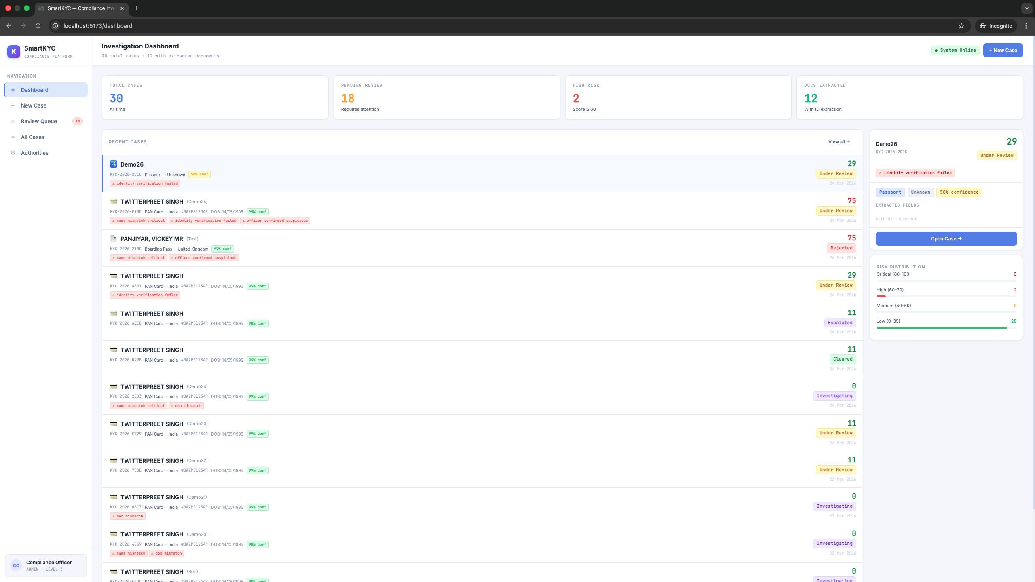
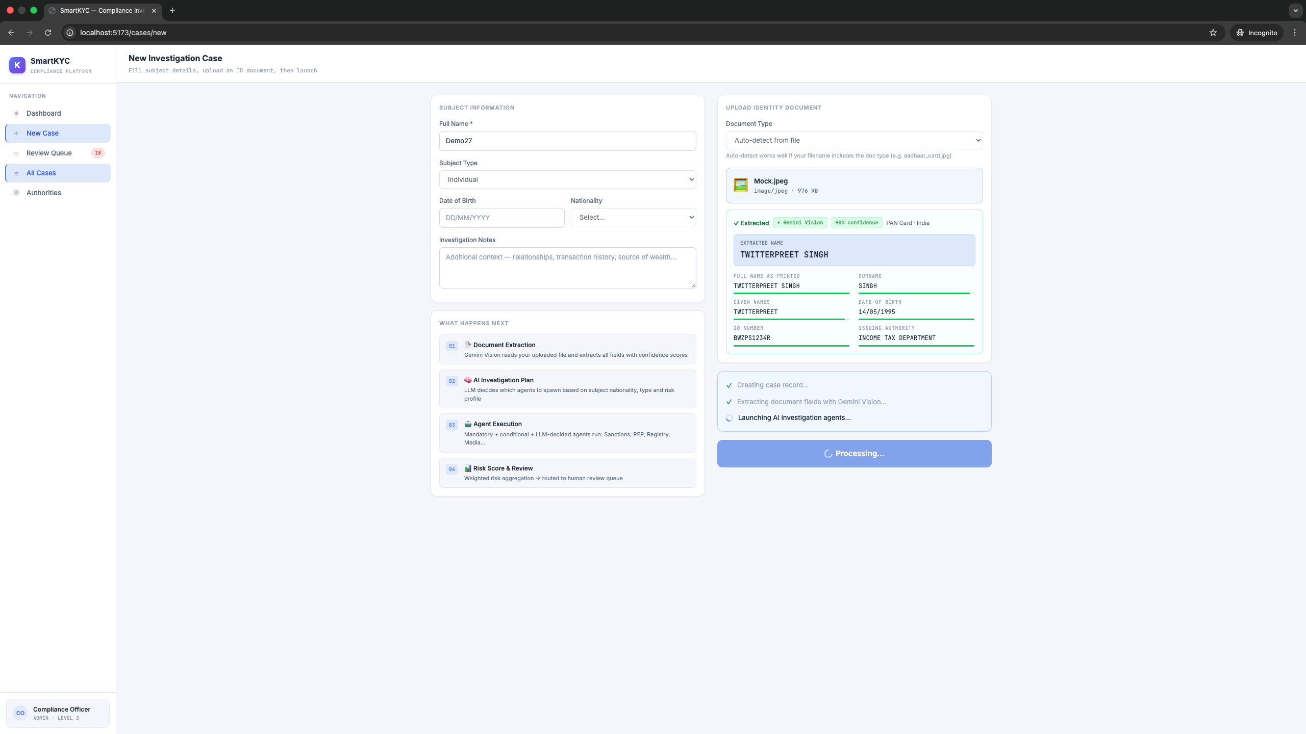
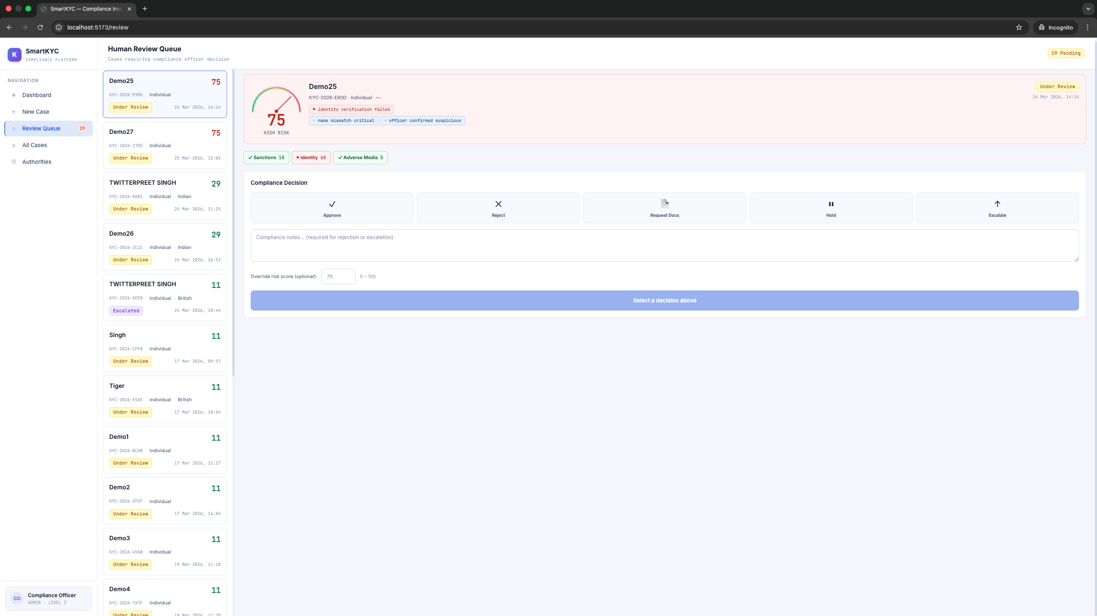
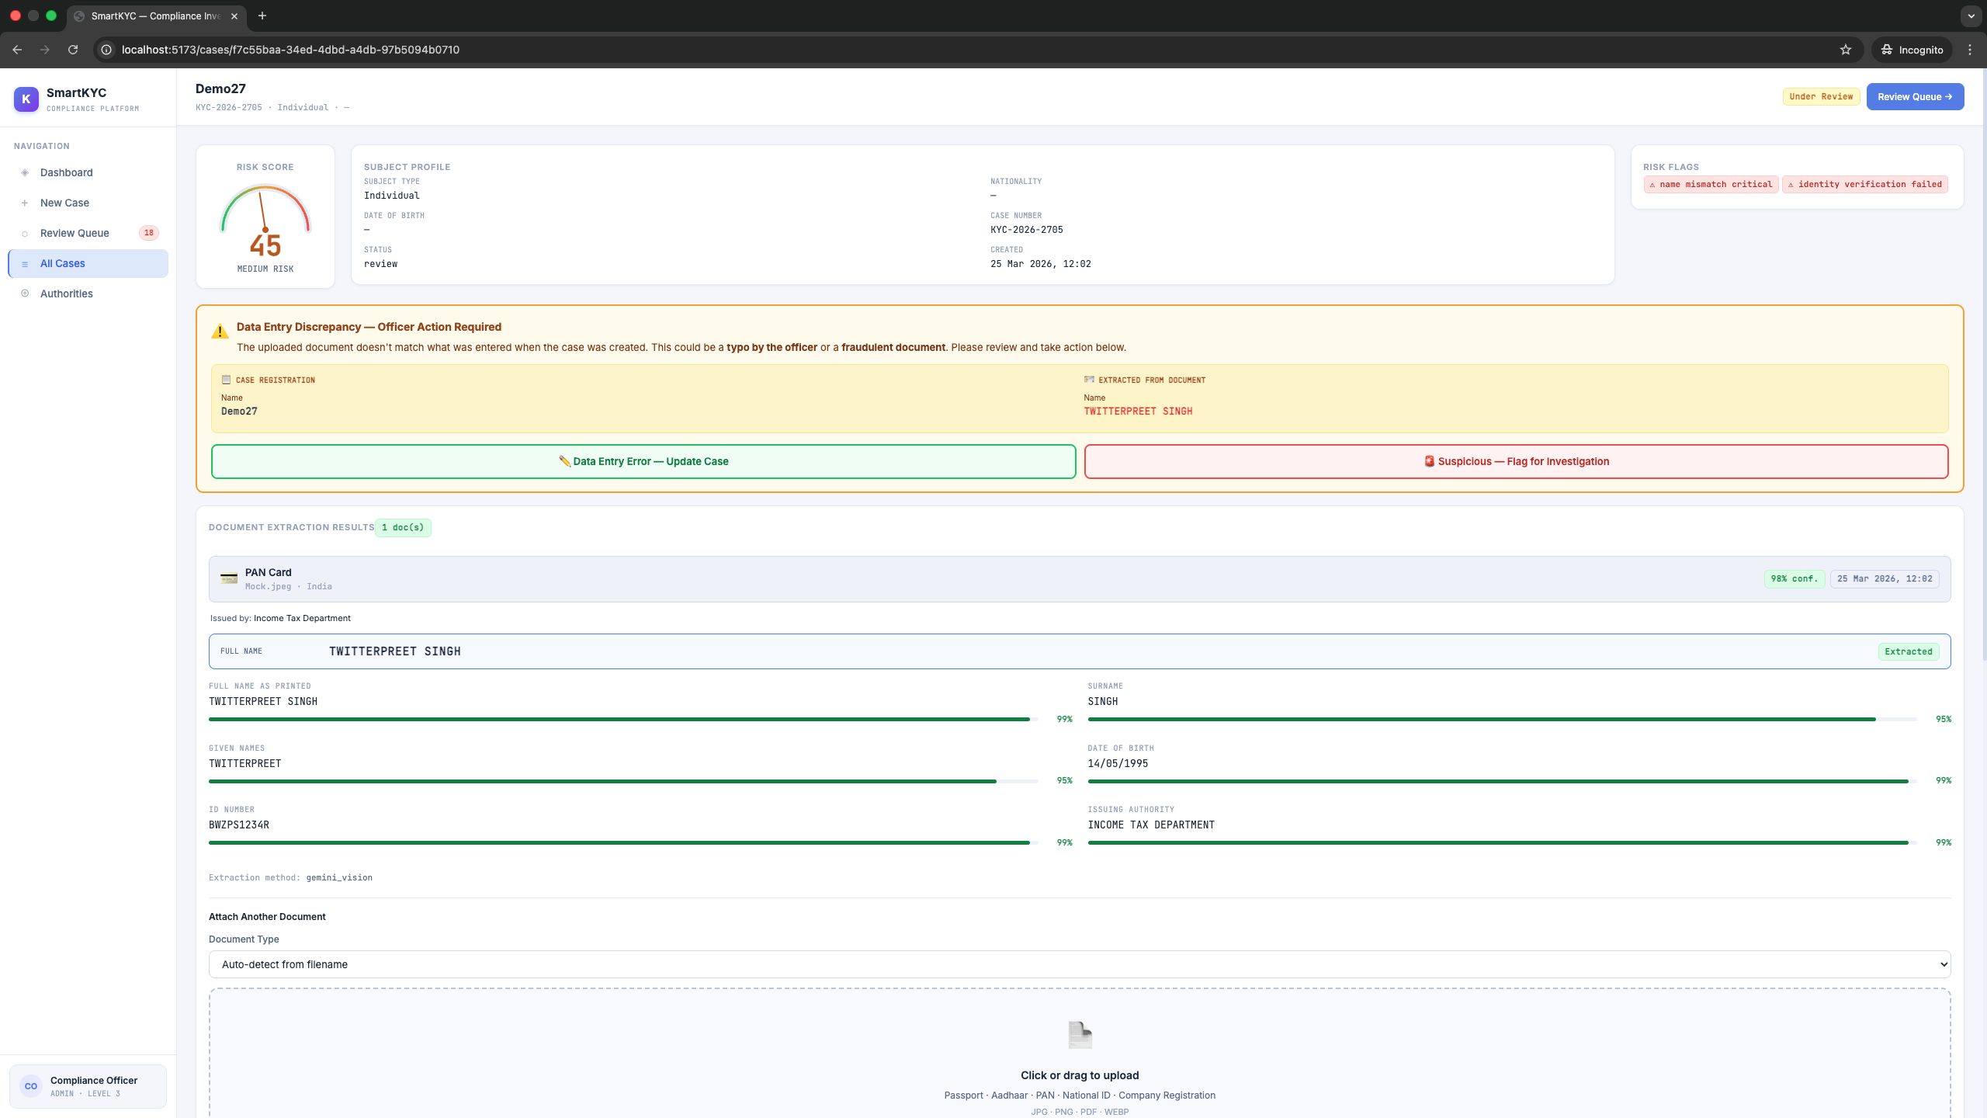
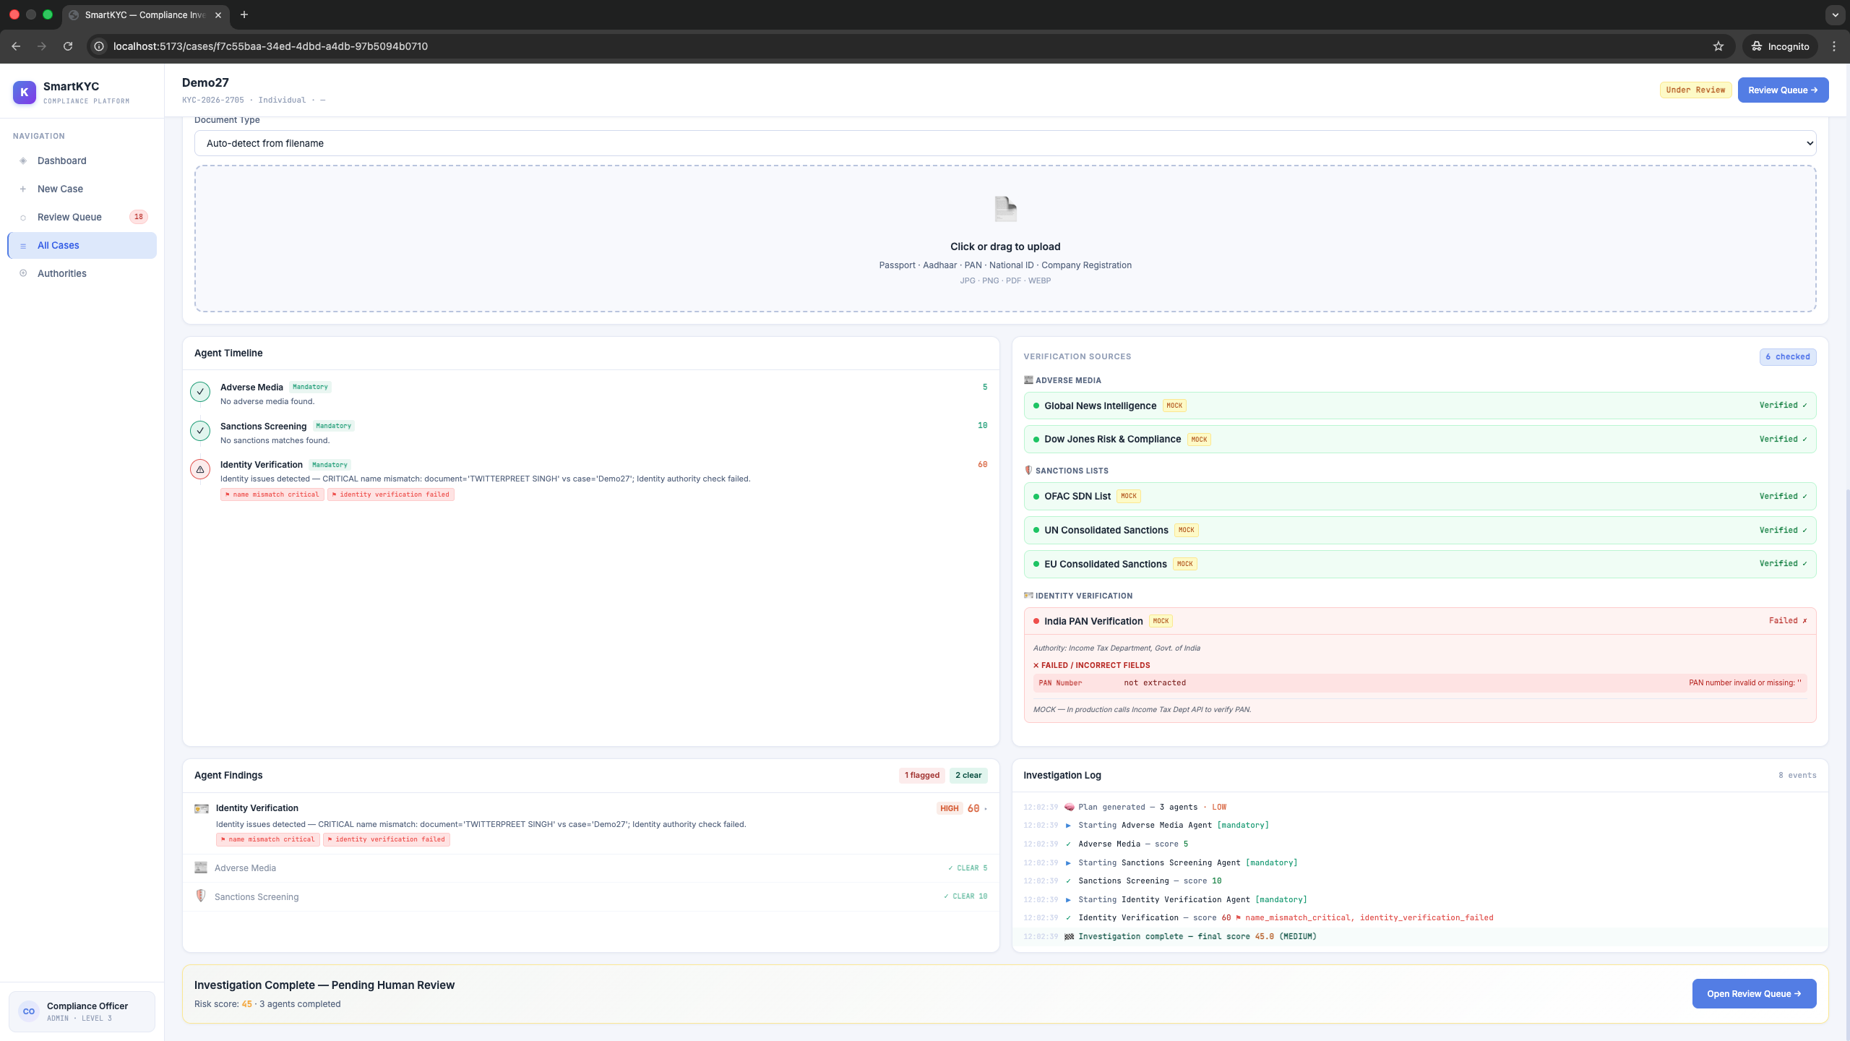
SmartKYC – Run Screenshots & DEMO

Slide 11
🛡 SmartKYC
Thank You
Questions? Let's discuss.
📘 GITHUB
https://github.ibm.com/AISolutions/SmartKYC
By: Vickey Panjiyar
SmartKYC Compliance Platform

