Slide 1
🛡 SmartKYC
AI-Powered KYC/AML
Compliance Platform
Intelligent document extraction · LLM-driven investigation agents
Real-time sanctions screening · Human-in-the-loop review
For Leadership & Engineering Teams · Confidential

Slide 2
Executive Summary
SmartKYC automates the entire Know Your Customer pipeline — from document upload to human review decision — using a multi-agent AI architecture built on FastAPI, SQLAlchemy, and Gemini Vision.
📄
🧠
🤖
👤
Smart Extraction
LLM-Driven Plans
Parallel Agents
Human Review
Gemini Vision reads passports, Aadhaar, PAN, Emirates ID and 15+ doc types with field-level confidence scoring
Claude / Gemini decides which investigation agents to spawn based on risk profile, nationality and subject type
Sanctions, PEP, Registry, Adverse Media, Transactions agents run concurrently with auto-escalation
Risk-ranked queue routes cases to compliance officers; weighted scores feed the review decision workflow

Slide 3
System Architecture
FRONTEND · React + TypeScript + React Router
Dashboard
New Case
Cases List
Case Detail
Review Queue
Authorities
API LAYER · FastAPI + Python 3.12
/api/cases
/api/documents
/api/reviews
/api/investigations
/api/authorities
SERVICES
AGENTS
document_service
investigation_service
verification_service
Identity
Sanctions
PEP
Registry
LLM Router (Gemini / Anthropic / OpenAI)
Media
Transactions
Aggregation
DATABASE · SQLite / PostgreSQL via SQLAlchemy ORM (Cases · Documents · AgentResults · VerificationSources · HumanReviews · Events)

Slide 4
End-to-End Investigation Flow
📤
🖼️
🧠
⚡
01 Case Created
02 Document Upload
03 LLM Plans Agents
04 Agents Execute
Compliance officer enters subject name, type, nationality, notes via NewCasePage
File sent to /api/documents/upload; Gemini Vision extracts all fields with confidence scores
investigation_service calls LLM to decide mandatory + conditional + optional agents for this subject
Each agent calls verification_service (OFAC, World-Check, Companies House, etc.) mock or real
⬆️
📊
👀
05 Escalation Check
06 Risk Aggregation
07 Human Review
If any agent scores ≥70, LLM decides whether to escalate unrun optional agents
RiskAggregationAgent applies weighted formula; case risk_score + risk_level written to DB
Case moves to review queue; compliance officer approves / rejects / escalates

Slide 5
02
Backend Deep Dive
FastAPI services · Agents · LLM orchestration · Database models

Slide 6
Backend File Structure & Responsibilities
main.py
ENTRY POINT
cases.py
ROUTER
FastAPI app factory, CORS middleware, route registration, DB init lifespan
REST API: CRUD for cases, start-investigation trigger, dashboard summary with extraction data, events endpoint
config.py
CONFIG
documents.py
ROUTER
Pydantic Settings — DB URL, LLM provider/keys (Gemini/Anthropic/OpenAI), upload dir, mock mode toggle
File upload handler — saves to disk, calls extract_document(), persists Document + DocumentExtraction rows
models.py
ORM
reviews.py
ROUTER
SQLAlchemy ORM: Case, Document, DocumentExtraction, AgentResult, VerificationSource, HumanReview, InvestigationEvent
Submit review decision (approve/reject/on_hold/escalate), review queue query, history endpoint
session.py
DB
investigations.py
ROUTER
Async SQLAlchemy engine, session factory, init_db() creates all tables on startup
Returns live investigation status: case status, agent count, agents done, verification count
llm_router.py
LLM
authorities.py
ROUTER
LLMRouter class: routes text completions to Gemini/Anthropic/OpenAI + gemini_vision() for document image extraction
Lists all 15 verification authorities with mock/live status, API config state, and subject-based authority selector
logging.py
INFRA
Configures structured stdout logging with timestamp + level + logger name format

Slide 7
Multi-Agent Architecture
BaseAgent (ABC)
run() → AgentResult
case_id, subject dict
MANDATORY (always run)
CONDITIONAL (auto-trigger)
OPTIONAL (LLM-decided)
Identity
Agent
Sanctions
Agent
Adverse
Media
PEP
Agent
Registry
Agent
Transaction
Analysis
Agent Weights
sanctions_agent
30%
pep_agent
25%
identity_agent
15%
⬆ Escalation Loop
Risk Aggregation Agent
registry_agent
15%
If any agent score ≥70, LLM is consulted on whether to run remaining optional agents before aggregation
Weighted formula across all agent scores → final risk_score (0–100) + risk_level (low/medium/high/critical)
adverse_media
10%
transactions
5%

Slide 8
Document Extraction Pipeline (document_service.py)
1 File Read
2 Gemini Vision
3 MRZ Parser
4 Tesseract OCR
5 Regex Parsers
6 Build Result
_read_file()
Detects MIME type
Primary path
Sends image to Gemini
ICAO MRZ lines
→ structured fields
Fallback if Vision
not available
Doc-type specific
extractors
_build_result()
Confidence scores
15+ Supported Document Schemas:
🇮🇳 Aadhaar/PAN/Passport/Voter/DL · 🇬🇧 UK Passport/DVLA · 🇺🇸 US Passport/DL · 🇦🇪 Emirates ID/Passport · 🇷🇺 Russian Passport · 🇨🇳 Chinese Passport/ID · 🇪🇺 EU Passport/NID · 🏢 Company Registration
Extraction Confidence by Method:
Gemini Vision
MRZ Parser
PDF Text
Tesseract OCR
Regex
96%
97%
90%
82%
80%
avg confidence
avg confidence
avg confidence
avg confidence
avg confidence

Slide 9
Verification Authorities (verification_service.py)
🛡 Sanctions
👤 PEP
🏢 Registry
🪪 Identity
📰 Media
OFAC SDN (US)
World-Check One
Companies House (UK)
UIDAI Aadhaar
Global News API
UN Consolidated
LexisNexis WorldCompliance
OpenCorporates
India PAN Verify
Dow Jones Risk & Compliance
EU Financial Sanctions
MCA21 India
DVLA (UK)
HM Treasury (UK)
Passport ICAO
⚙ MOCK vs REAL mode:
Set USE_MOCK_VERIFICATION=false in .env to switch all checks to real APIs. Per-authority API keys configured via environment variables. Automatic fallback to mock if key missing.

Slide 10
03
Frontend Deep Dive
React pages · Component hierarchy · API service layer

Slide 11
Frontend Pages & Components
App.tsx
Root router with React Router v6 routes. Wraps all pages in <Layout />.
/
DashboardPage.tsx
Overview metrics, recent cases with inline extraction previews, risk distribution chart, status breakdown. Polls every 8s.
/dashboard
NewCasePage.tsx
Multi-step form: subject info → doc upload with dropzone → real-time extraction preview → investigation launch.
/cases/new
CasesPage.tsx
Filterable/searchable case table with status badge, risk badge, creation date. Status filter tabs.
/cases
CaseDetailPage.tsx
Full case view: risk ring, subject profile, investigation plan, doc extraction panel, agent timeline, live event log. Auto-polls when investigating.
/cases/:id
ReviewQueuePage.tsx
Split-panel review interface: queue list with risk scores on left, full case detail + ReviewPanel on right.
/review
AuthoritiesPage.tsx
All 15 verification authorities grouped by type. Shows mock/live status, API config, endpoint URLs.
/authorities

Slide 12
04
Data Models & Deployment
Database schema · Configuration · Environment setup

Slide 13
Database Schema (models.py)
Case
Document
AgentResult
· id (PK)
· id (PK)
· id (PK)
· case_number (unique)
· case_id (FK)
· case_id (FK)
· subject_name/type
· filename, file_path
· agent_name
· nationality, DOB, notes
· document_type, country_of_issue
· risk_score, flags (JSON)
· status, risk_score, risk_level
· extraction_status
· summary, confidence
· investigation_plan (JSON)
· extracted_data (JSON)
· evidence (JSON)
· created_at, updated_at
· raw_text, uploaded_at
· status, completed_at
VerificationSource
HumanReview
InvestigationEvent
· id (PK)
· id (PK)
· id (PK)
· case_id (FK)
· case_id (FK)
· case_id (FK)
· source_name/type
· reviewer_name
· event_type
· result (clear/flagged/…)
· decision (approved/…)
· event_data (JSON)
· result_detail (JSON)
· comments, risk_override
· message, timestamp
· is_mock
· reviewed_at
· checked_at

Slide 14
Configuration & Quick Start (config.py + requirements.txt)
.env Configuration
Quick Start (5 minutes)
LLM_PROVIDER=
gemini | anthropic | openai
1
Clone & install
git clone + pip install -r requirements.txt
GEMINI_API_KEY=
your-gemini-key
2
Configure
ANTHROPIC_API_KEY=
your-claude-key
cp .env.example .env → add Gemini API key
OPENAI_API_KEY=
your-openai-key
3
Start backend
USE_MOCK_VERIFICATION=
true (dev) / false (prod)
uvicorn app.main:app --reload --port 8000
DATABASE_URL=
sqlite+aiosqlite:///./smartkyc.db
4
Start frontend
cd frontend && npm install && npm run dev
OFAC_API_KEY=
for real sanctions screening
5
Open browser
WORLD_CHECK_API_KEY=
Refinitiv World-Check One
http://localhost:5173
COMPANIES_HOUSE_API_KEY=
UK Companies House
6
Create case
UPLOAD_DIR=
./uploads
New Case → upload passport → launch investigation
MAX_FILE_SIZE_MB=
20
7
Review results
Cases → Case Detail → Review Queue

Slide 15
05
For New Team Members
Onboarding guide · How to extend the platform

Slide 16
How to Extend SmartKYC
Add a New Agent
Add a New Document Type
1. Create class in agents.py extending BaseAgent
1. Add schema entry in DOCUMENT_SCHEMAS (document_service.py)
2. Implement async run() → AgentResult
2. Add filename patterns to detect_document_type_from_filename()
3. Register in AGENT_CATALOGUE (investigation_service.py)
3. Add regex extractor function if needed
4. Set tier: mandatory | conditional | optional
4. Add <country>_<TYPE> option in NewCasePage DOC_TYPES
Switch from Mock to Real APIs
Change the LLM Provider
1. Set USE_MOCK_VERIFICATION=false in .env
1. Set LLM_PROVIDER=anthropic|gemini|openai in .env
2. Add API keys for desired authorities
2. Add corresponding API key
3. Check _run_real() in verification_service.py
3. llm_router.py routes automatically
4. Test with real sandbox credentials first
4. For Vision: Gemini always used (only Vision provider)

Slide 17
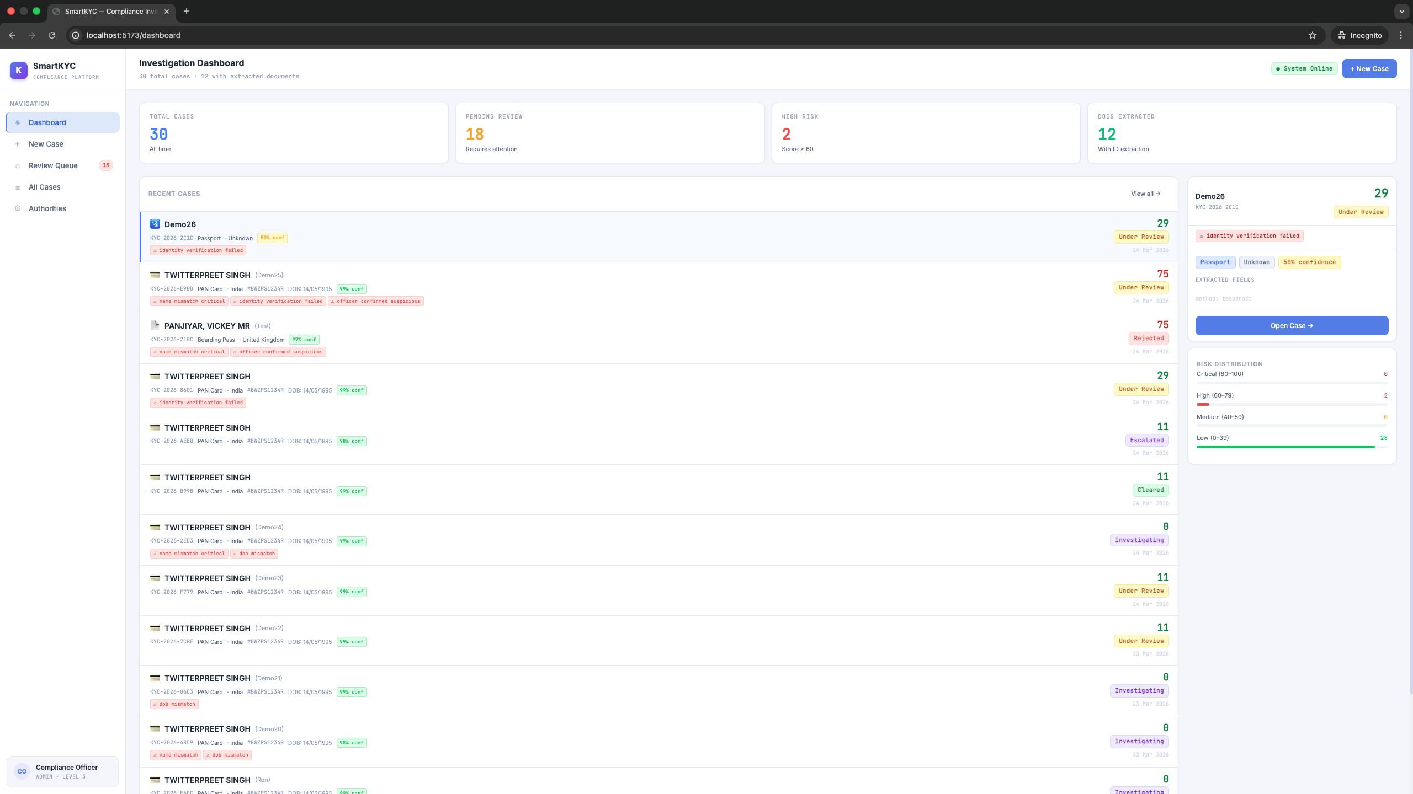
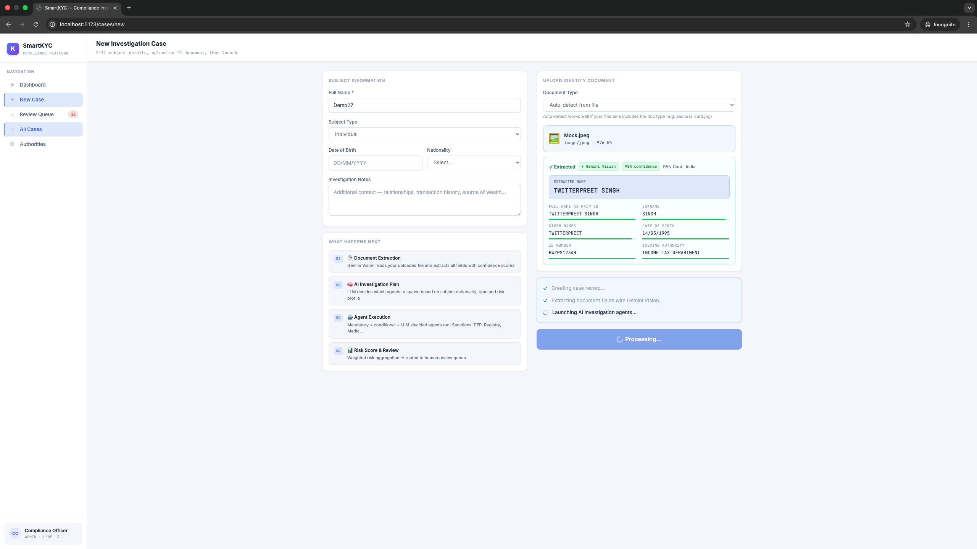
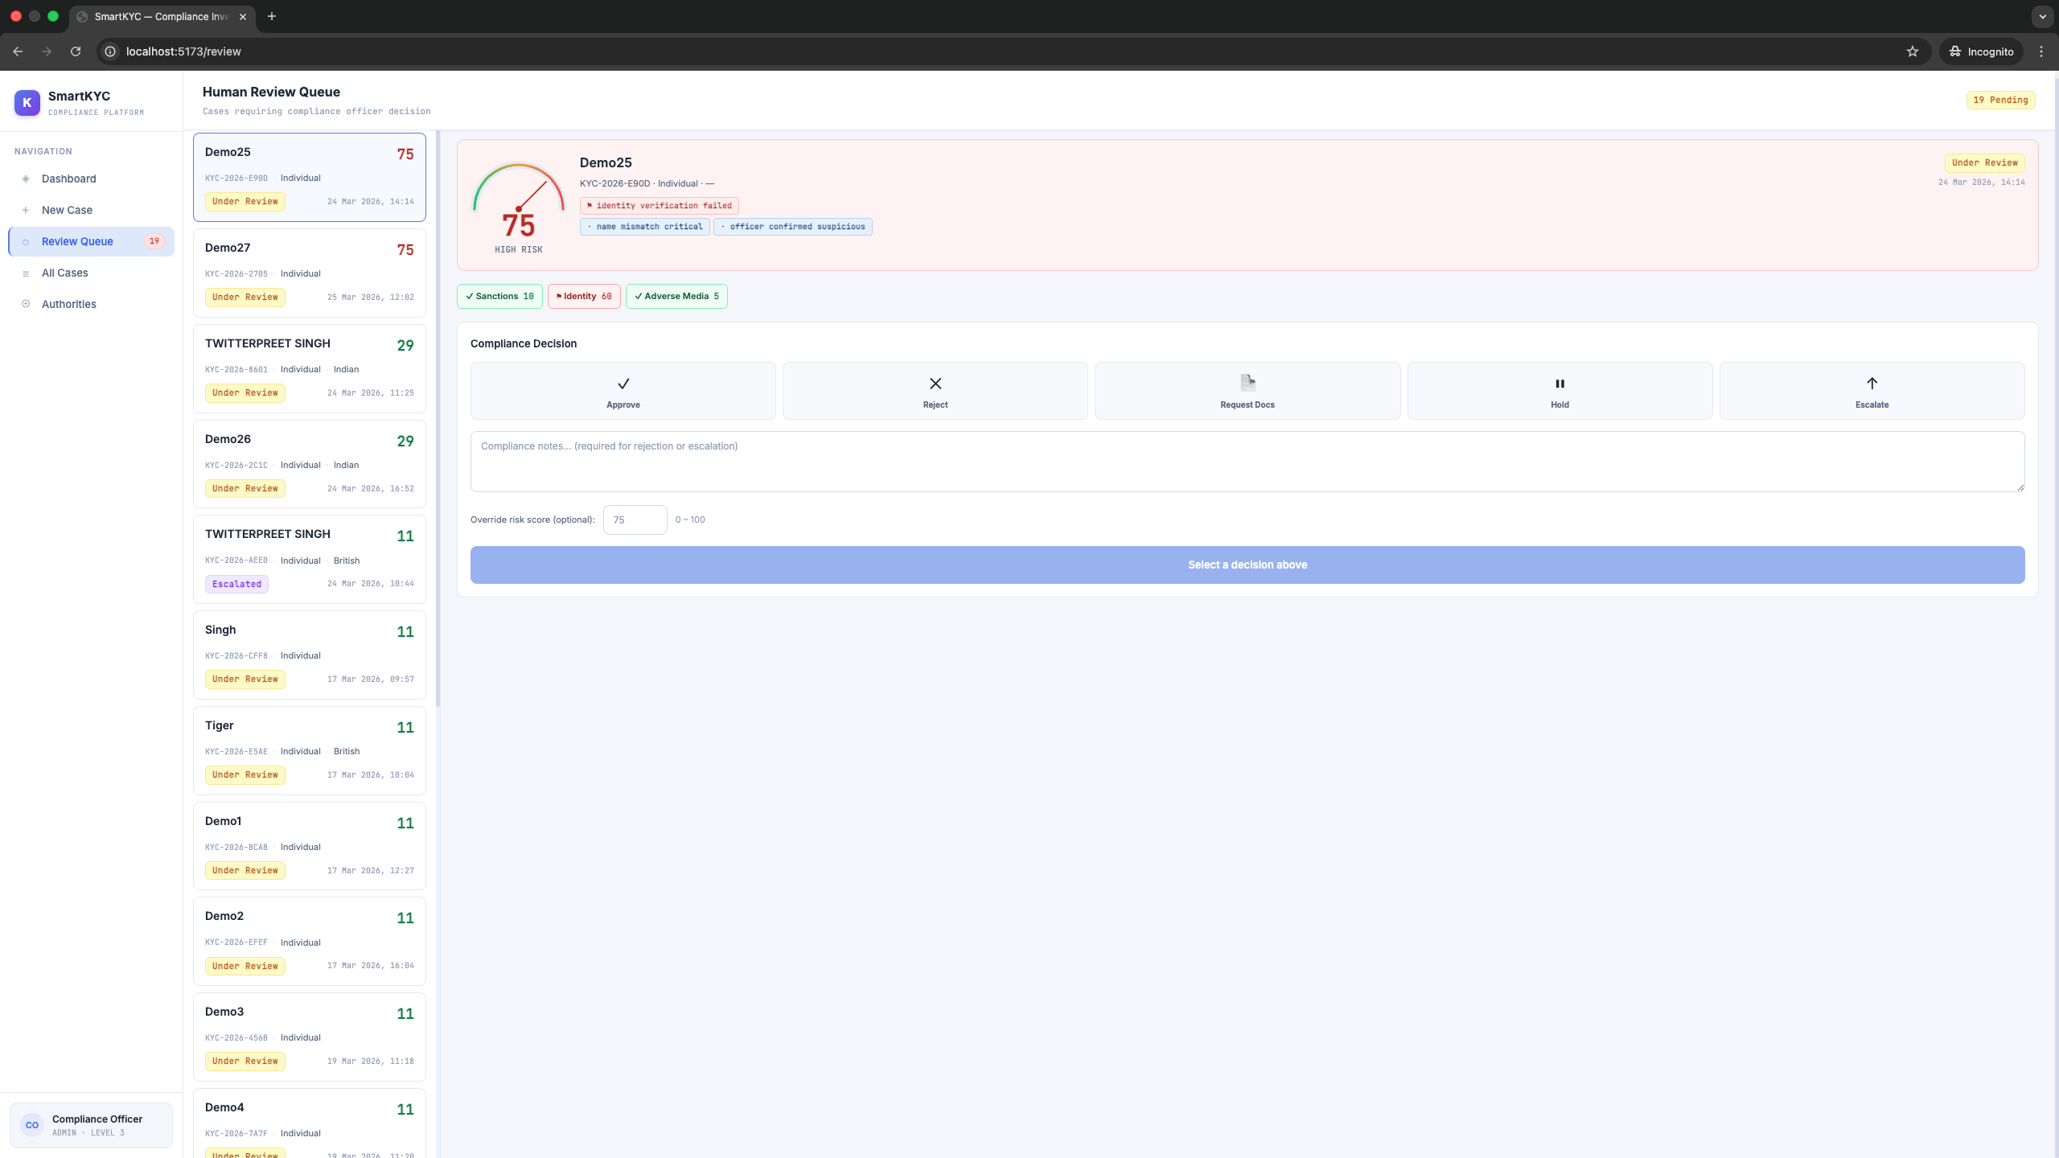
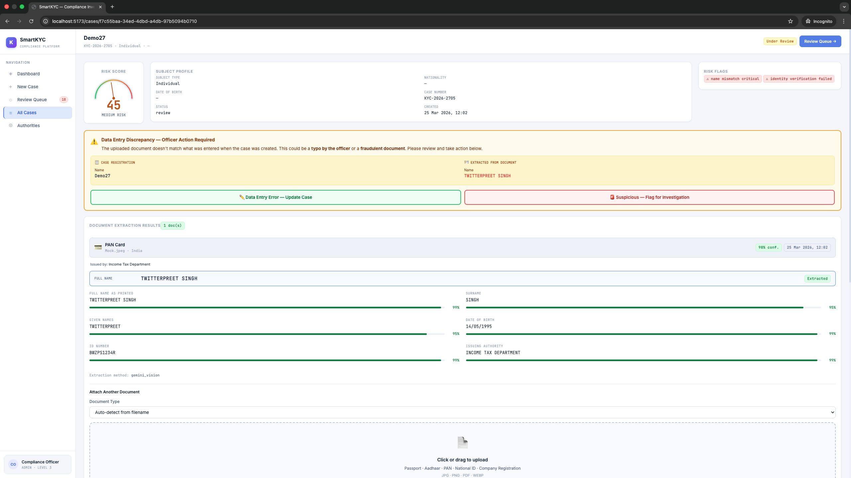
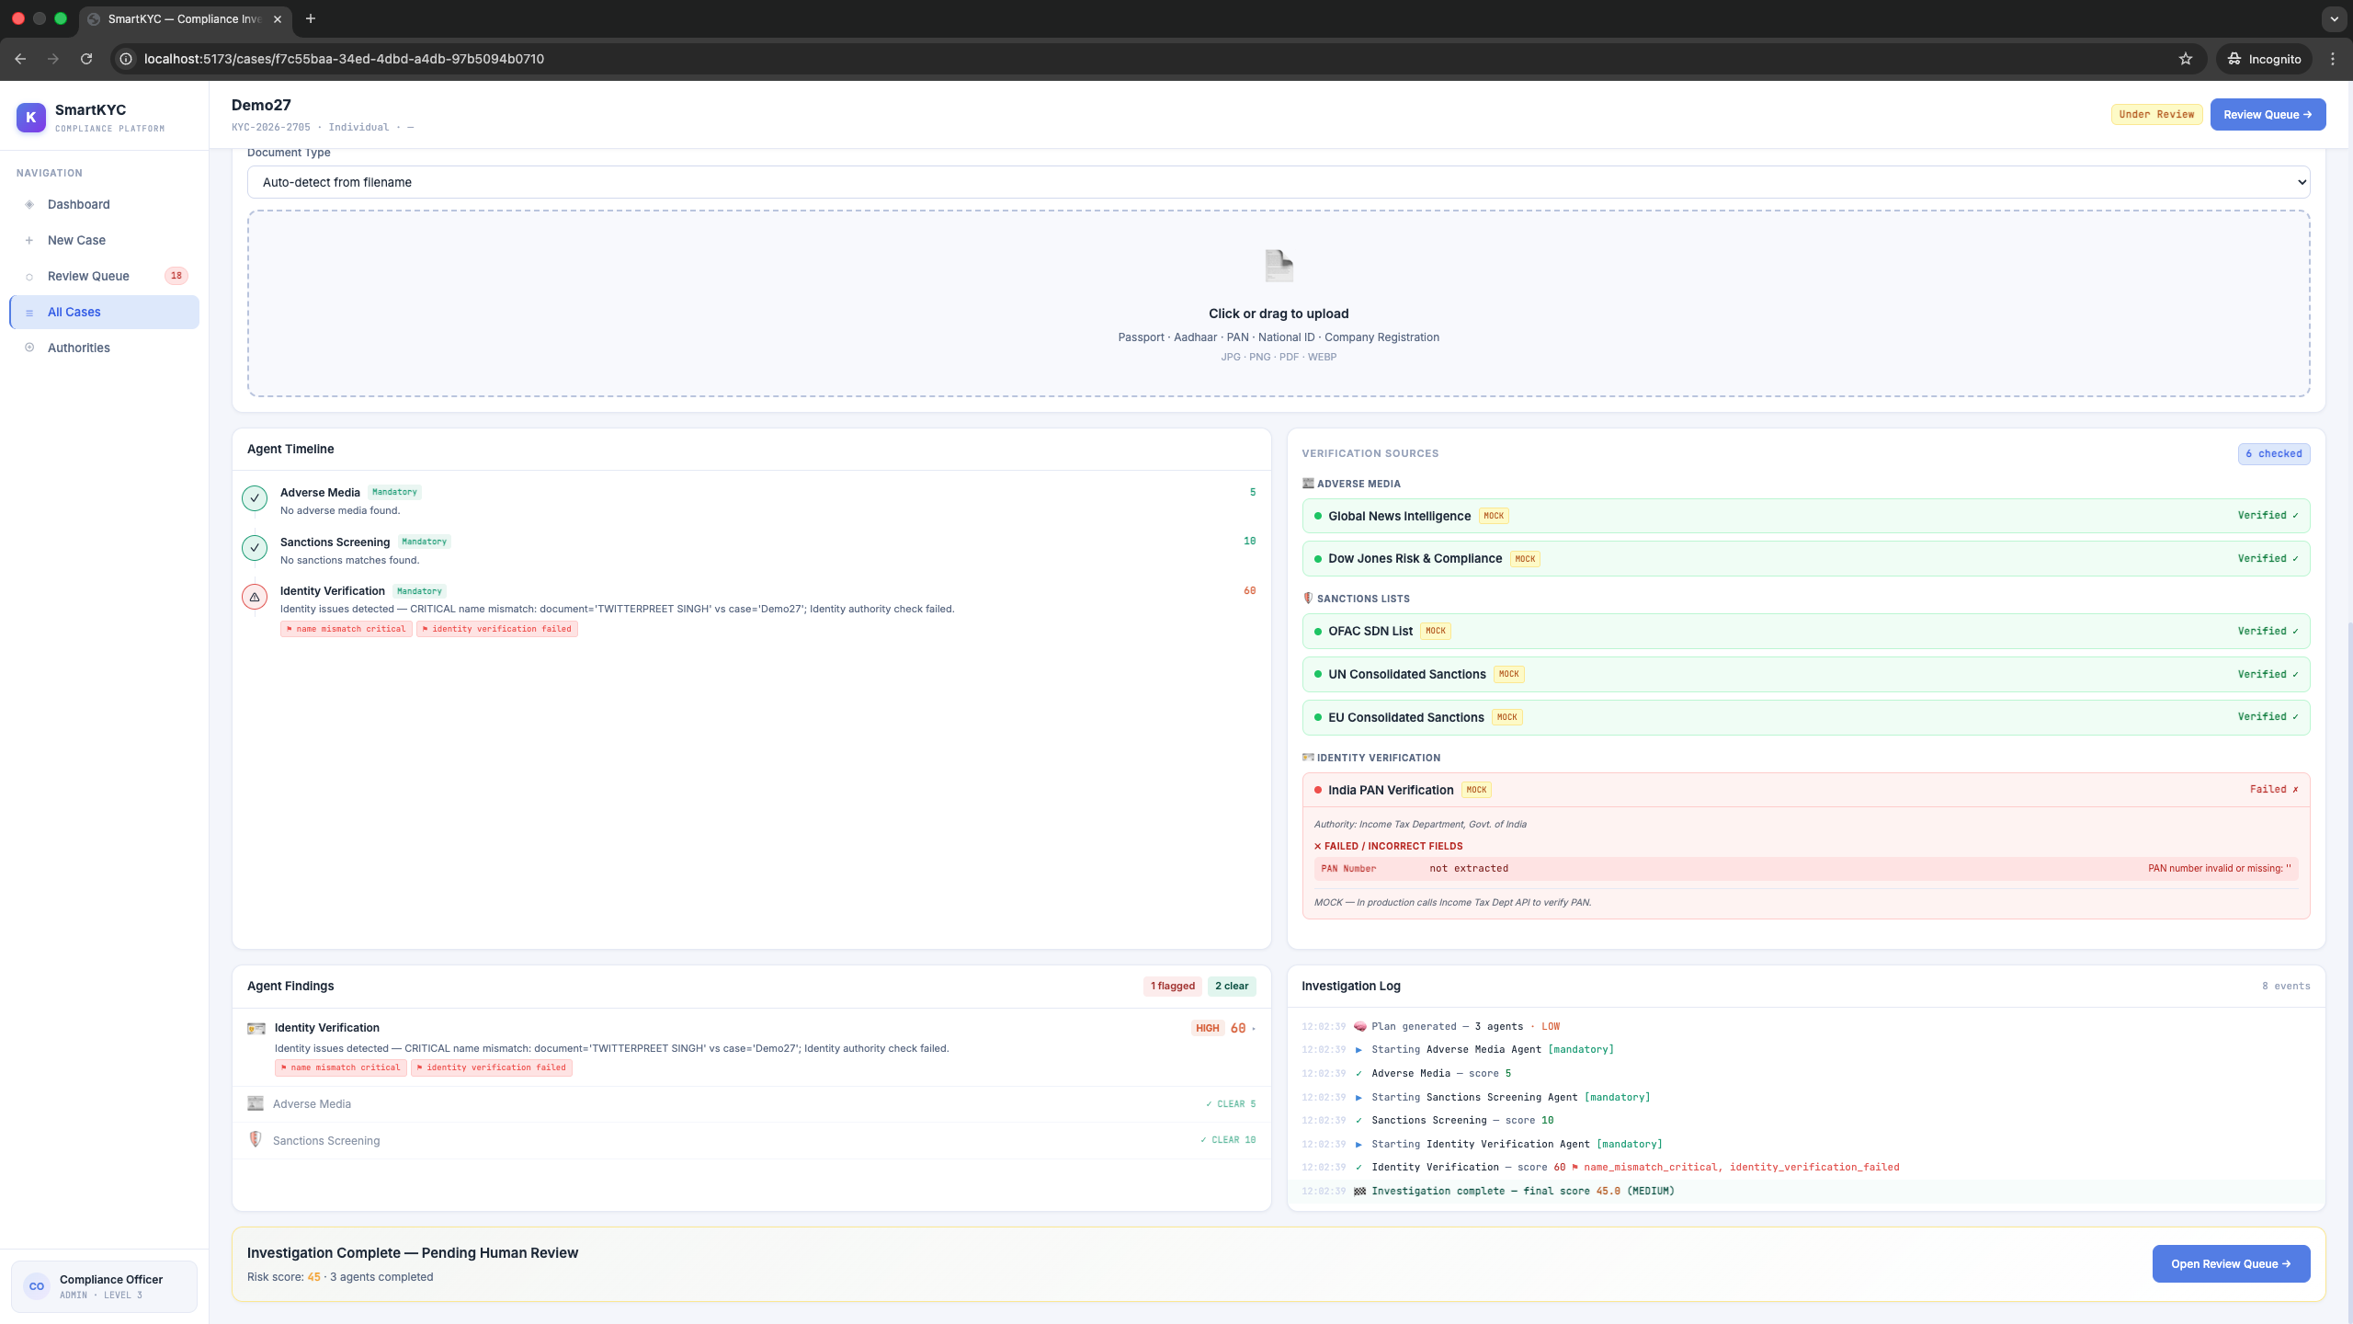
SmartKYC – Run Screenshots

Slide 18
🛡 SmartKYC
Thank You
Questions? Let's discuss.
📘 README
📖 API Docs
🔐 .env Setup
🤖 Add Agents
github.com/your-org/smartkyc
localhost:8000/docs
See config.py
See agents.py
SmartKYC Compliance Platform · Confidential

