Slide 1
OpenGL

Slide 2
What Is OpenGL?
“a software interface to graphics hardware.”
it is a 3D graphics and modeling library that is extremely portable and very fast.
This interface consists of about 150 distinct commands and functions that you use to specify the objects and operations needed to produce interactive three-dimensional applications.
OpenGL is not a programming language; it is an API (Application Programming Interface).
As an API, the OpenGL library follows the C calling convention.

Slide 3
The OpenGL API :Three libraries
Auxiliary or AUX library :sometimes referred to as the “toolkit” library, glaux.lib.
The declarations for this library are contained in the file glaux.h.
The functions contained in this library are not really a part of the OpenGL specification, but rather a toolkit that provides a platform independent framework for calling OpenGL functions.
If your compiler vendor did not supply these files, they can be obtained from the Microsoft Win32 SDK.
All functions from this library begin with the prefix aux.

Slide 4
The OpenGL API :Three libraries
OpenGL: The functions that actually define OpenGL as specified by the OpenGL Architecture Review Board are contained in the library opengl32.dll, and its header gl.h.
Functions from this library are prefixed with gl.

Slide 5
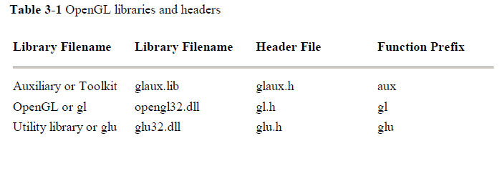
The OpenGL API :Three libraries
Utility library: OpenGL utility library glu32.dll and its header glu.h.
This library contains utility functions that make everyday tasks easier, such as drawing spheres, disks, and cylinders.
The utility library is actually written using OpenGL commands, and thus is guaranteed to be available on all platforms that support the OpenGL specification.
These functions are all prefixed with glu.
All of the functions in the opengl32.dll and glu32.dll libraries are available for use when using the AUX library for your program’s framework.

Slide 6
Example 1-1 : Chunk of OpenGL Code
#include <whateverYouNeed.h>
main() {
InitializeAWindowPlease();
glClearColor (0.0, 0.0, 0.0, 0.0);
glClear (GL_COLOR_BUFFER_BIT);
glColor3f (1.0, 1.0, 1.0);
glOrtho(0.0, 1.0, 0.0, 1.0, -1.0, 1.0);
glBegin(GL_POLYGON);
glVertex3f (0.25, 0.25, 0.0);
glVertex3f (0.75, 0.25, 0.0);
glVertex3f (0.75, 0.75, 0.0);
glVertex3f (0.25, 0.75, 0.0);
glEnd();
glFlush();
UpdateTheWindowAndCheckForEvents();
}

Slide 7
OpenGL Command Syntax
commands use the prefix gl and initial capital letters for each word making up the command name (e.g. glClearColor()).
constants begin with GL_, use all capital letters, and use underscores to separate words (like GL_COLOR_BUFFER_BIT).
some seemingly extraneous letters appended to some command names (e.g. 3f in glColor3f() and glVertex3f()). the 3 part of the suffix indicates that three arguments are given; The f part of the suffix indicates that the arguments are floating-point numbers.

Slide 8
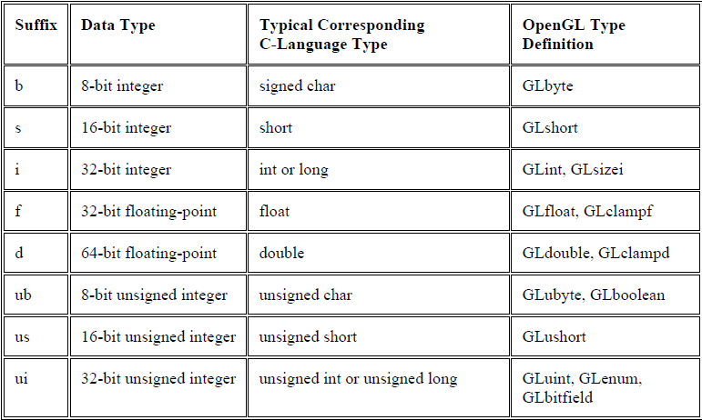
Command Suffixes and Argument Data Types
E.g. : glVertex2i(1, 3);glVertex2f(1.0, 3.0);

Slide 9
OpenGL as a State Machine
OpenGL is a state machine. You put it into various states (or modes) that then remain in effect until you change them.
The current color is a state variable. You can set the current color to white, red, or any other color, and thereafter every object is drawn with that color until you set the current color to something else.
The current color is only one of many state variables that OpenGL maintains.
An object may be rendered with lighting, texturing, hidden surface removal, fog, or some other states affecting its appearance.
By default, most of these states are initially inactive. These states may be costly to activate; for example, turning on texture mapping will almost certainly slow down the speed of rendering a primitive. However, the quality of the image will improve and look more realistic, due to the enhanced graphics capabilities.
To turn on and off many of these states, use these two simple commands:
void glEnable(GLenum cap);
void glDisable(GLenum cap);
glEnable() turns on a capability, and glDisable() turns it off.

Slide 10
OpenGL as a State Machine
There are over 40 enumerated values that can be passed as a parameter to glEnable() or glDisable().
Some examples of these are
GL_BLEND (which controls blending RGBA values),
GL_DEPTH_TEST (which controls depth comparisons and updates to the depth buffer),
GL_FOG (which controls fog),
GL_LINE_STIPPLE (patterned lines),
GL_LIGHTING (you get the idea), and so forth.
You can also check if a state is currently enabled or disabled.
GLboolean glIsEnabled(GLenum capability) Returns GL_TRUE or GL_FALSE

Slide 11
OpenGL as a State Machine
most OpenGL routines set values for more complicated state variables. For example, the routine glColor3f() sets three values, which are part of the GL_CURRENT_COLOR state.
There are five querying routines used to find out what values are set for many states:
void glGetBooleanv(GLenum pname, GLboolean *params);
void glGetIntegerv(GLenum pname, GLint *params);
void glGetFloatv(GLenum pname, GLfloat *params);
void glGetDoublev(GLenum pname, GLdouble *params);
void glGetPointerv(GLenum pname, GLvoid **params);
Obtains Boolean, integer, floating-point, double-precision, or pointer state variables. The pname argument is a symbolic constant indicating the state variable to return, and params is a pointer to an array of the indicated type in which to place the returned data.

Slide 12
OpenGL basic graphics Primitives
To tell OpenGL to create a set of points, a line, or a polygon from those vertices.
To do this, you bracket each set of vertices between a call to glBegin() and a call to glEnd().
The argument passed to glBegin() determines what sort of geometric primitive is constructed from the vertices.
glBegin(GL_POLYGON);
glVertex2f(0.0, 0.0);
glVertex2f(0.0, 3.0);
glVertex2f(4.0, 3.0);
glVertex2f(6.0, 1.5);
glVertex2f(4.0, 0.0);
glEnd();
If you had used GL_POINTS instead of GL_POLYGON

Slide 13
OpenGL basic graphics Primitives

Slide 14
Window Management
glutInit(int *argc, char **argv) : initializes GLUT and processes any command line arguments .glutInit() should be called before any other GLUT routine.
glutInitDisplayMode(unsigned int mode) : specifies whether to use an RGBA or color-index color model. You can also specify whether you want a single- or double-buffered window. (If you’re working in color-index mode, you’ll want to load certain colors into the color map; use glutSetColor() to do this.) Finally, you can use this routine to indicate that you want the window to have an associated depth, stencil, and/or accumulation buffer. For example, if you want a window with double buffering, the RGBA color model, and a depth buffer, you might call
glutInitDisplayMode(GLUT_DOUBLE | GLUT_RGB | GLUT_DEPTH).
glutInitWindowPosition(int x, int y) : specifies the screen location for the upper-left corner of your window.
glutInitWindowSize(int width, int size) : specifies the size, in pixels, of your window.
int glutCreateWindow(char *string) : creates a window with an OpenGL context. It returns a unique identifier for the new window. Be warned: Until glutMainLoop() is called (see next section), the window is not yet displayed.

Slide 15
Window Management
The Display Callback:
glutDisplayFunc(void (* func)(void)) is the first and most important event callback function you will see. Whenever GLUT determines the contents of the window need to be redisplayed, the callback function registered by glutDisplayFunc() is executed. Therefore, you should put all the routines you need to redraw the scene in the display callback function.
If your program changes the contents of the window, sometimes you will have to call glutPostRedisplay(void), which gives glutMainLoop() a nudge to call the registered display callback at its next opportunity
Running the Program:
The very last thing you must do is call glutMainLoop(void). All windows that have been created are now shown, and rendering to those windows is now effective. Event processing begins, and the registered display callback is triggered. Once this loop is entered, it is never exited.

