Slide 1


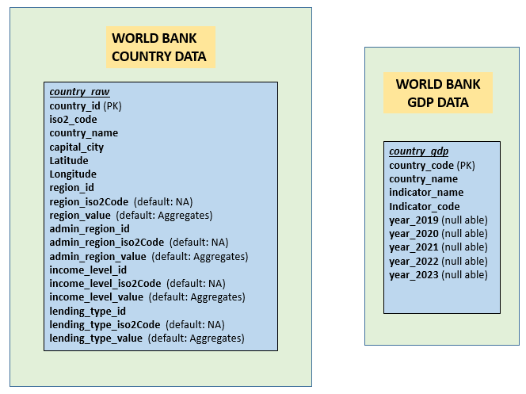
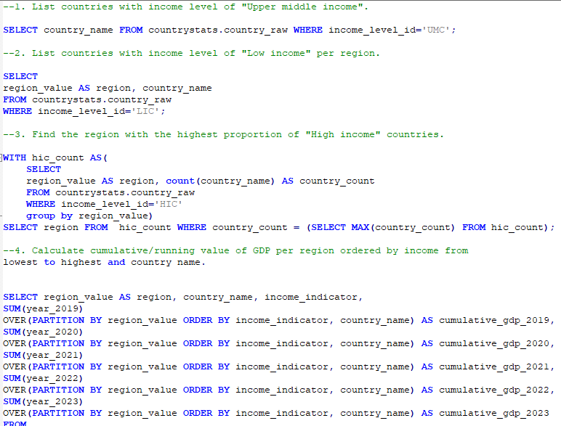
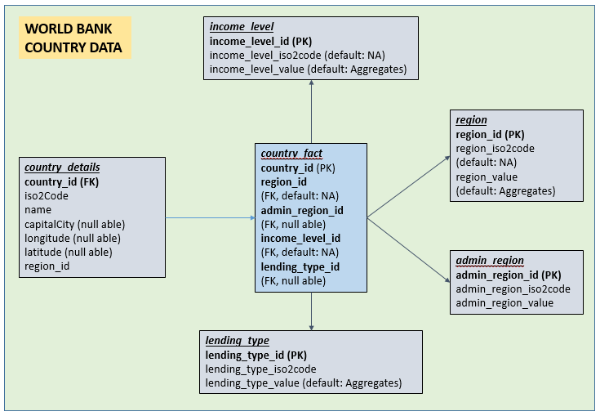
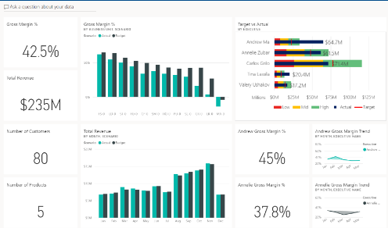
ETL PIPELINE AND ANALYIS - OVERVIEW
SCHEMA
countrystats
ANALYSIS AND INSIGHTS
E
T
L
P
I
P
E
L
I
N
E
jdbc
PSQL
WORLD BANK
PUBLIC DATA
CSV
FILES
pandas
sqlalchemy
JSON
API
pandas
urllib
WORLD BANK RAW DATA
jdbc
support for BI
WORLD BANK COUNTRY WH DATA

