Slide 1
Supply Chain Management
Industry 4.0 and SCM
Sudharshan K - 498753 Desigan V V - 498840

Slide 2
Agenda
Introduction

Slide 3
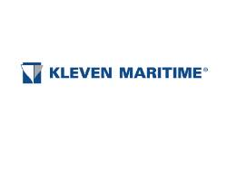
Case Study: Overview of Case Studies
Notes:
To illustrate the impact of Industry 4.0, we studied four Norwegian companies: Kleven Maritime AS, Brunvoll AS, Ekornes AS, and Pipelife Norge AS. These companies represent a diverse range of production environments, from highly customized shipbuilding to highly repetitive plastic pipe production. Let’s compare these companies' approaches and the results they achieved.
We will see how these companies differ in terms of their industry, production strategies, and the specific challenges and opportunities they face with the implementation of Industry 4.0 technologies.

Slide 4
References
Kagermann, H., Helbig, J., Hellinge

