Slide 1
Cybercrime: Understanding Digital Threats
CSIT100
Bianca Vila

Slide 2
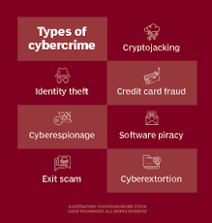
What is Cybercrime?
An illegal activity that uses computers, the internet, or other digital devices to commit crimes, often with financial gain as a motive, but also for political , personal, or malicious reasons.
Common examples include:
    Hacking
    Phishing
    Identity theft
    Ransomware

Slide 3
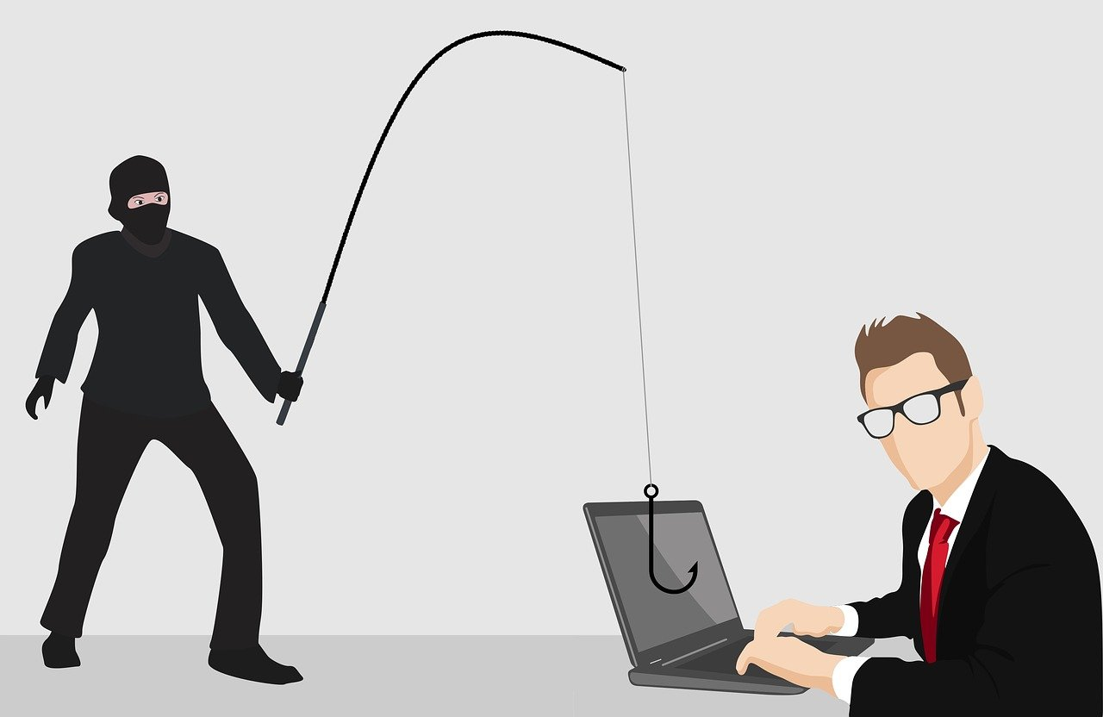


Categories of Cybercrime
Targets
  Individuals
  Businesses
  Government
  Infrastructure
Tools
  Malware
  Phishing
  Spyware
Methods
  Social Engineering
  Physical tools
  Cryptocurrency

Slide 4
Common types of cybercrime
Phishing and Social Engineering
  Is when a user is tricked into giving personal information or click on malicious links.
Malware Attacks
  Software designed to harm systems (viruses, spyware, etc,.)
Ransomware
  Criminals encrypt data and demand payment to unlock it
Identity Theft
  The act of stealing someone’s personal data to impersonate them or commit fraud
Online Scams and Fraud
  Consists of fake websites, tech-supported scams, lottery scams
Cyberstalking and Harassment
  Using digital tools to monitor, intimidate, or abuse someone

Slide 5
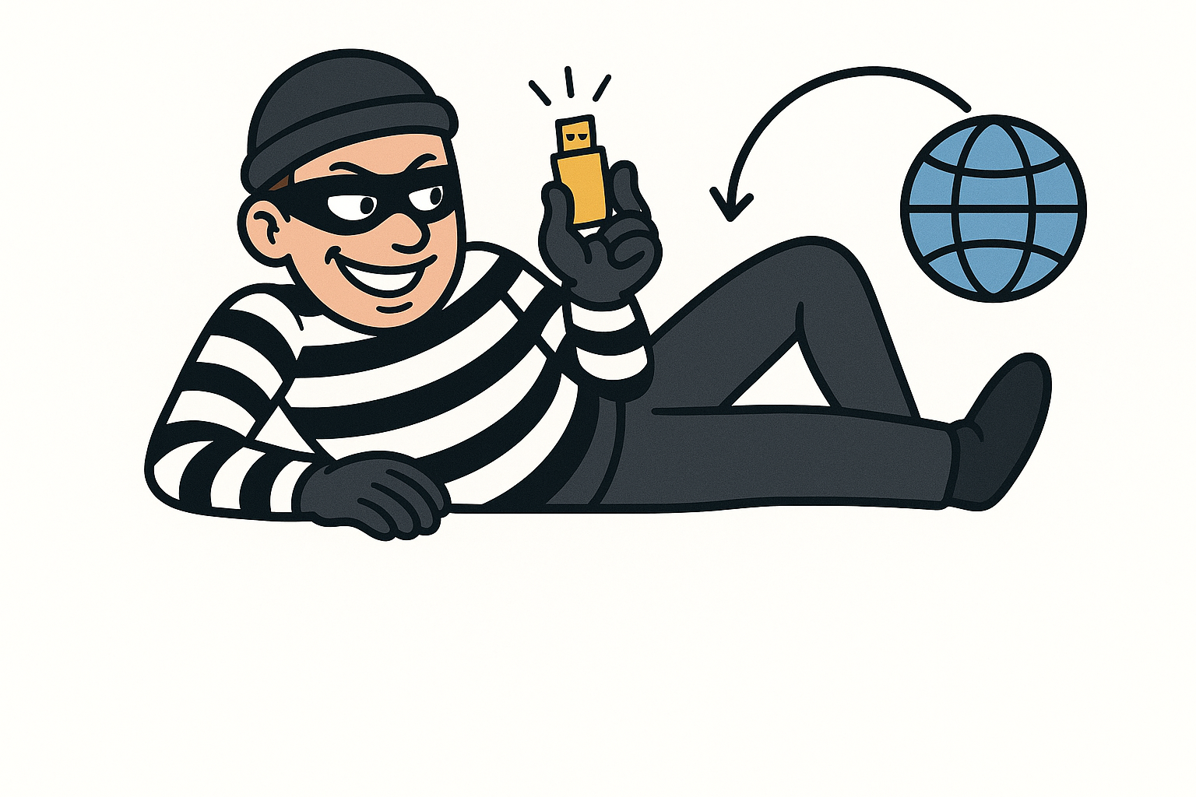
How cybercriminals operate
Planning
  Criminals research their targets and gather information
Gaining access
  Use stolen passwords, phishing, or system exploits
Maintaining access
  Stay connected without being detected
Executing the attack
  Steal data, lock files (ransomware), commit fraud, or disrupt services
Covering their tracks
  Delete logs, hide identity, use VPNs, or dark web tools

Slide 6

Real-world cybercrime cases
WannaCry Ransomware Attack (2017)
  Affected 200,00+ computers in 150 countries
  Targeted hospitals, businesses, and governments
  Locked files ad demanded ransom in Bitcoin
Yahoo Data Breach (2013-2014)
  3 billion accounts compromised
  Included emails, passwords, and security questions
Sony Pictures Hack (2014)
  Hackers leaked unreleased movies, emails, ad employee data
  Was ALLEGDELY politically motivated
  Caused major reputational and financial damage

Slide 7

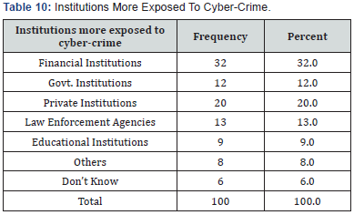

Cybercrime by the numbers
Global Impact
  Cybercrime costs over an estimated $8 trillion annually worldwide in 2023.
  Estimated every 11 seconds a cyberattack is occurring
Data breaches
  50+ billion records exposed globally in 2022
  Average cost of a data breach is $4.45 million per company
Targeted Industries
  Healthcare, finance, education, and government are top targets

Slide 8
Legal response to cybercrime
U.S Laws
  Computer Fraud and Abuse Act (CFAA)
  Electronic Communications Privacy Act (ECPA)
  Identity Theft and Assumption Deterrence Act
Law Enforcement
  FBI Cyber Division
  Secret Service
  DHS/CISA
International Cooperation
  INTERPOL, Europol. UN
  Budapest Convention on Cybercrime
Challenges
  Cybercrime crosses borders
  Criminals often are anonymous
  Technology evolves very quick

Slide 9
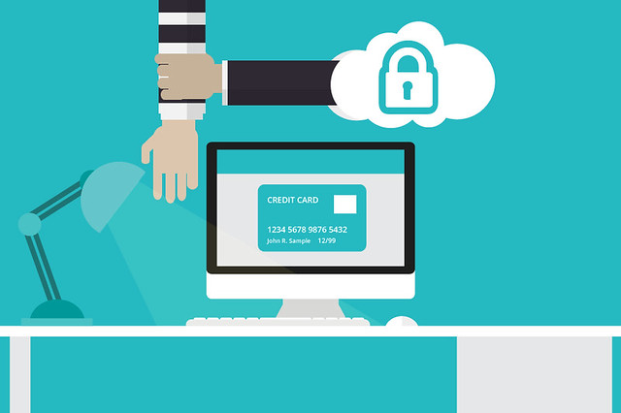
How to protect yourself
Strong, unique passwords
Multi-factor authentication
Avoid suspicious links and/or emails
Update software regularly
  You can also change your password every 70-sih days
Use antivirus and secure Wi-Fi
Back up imported data

Slide 10
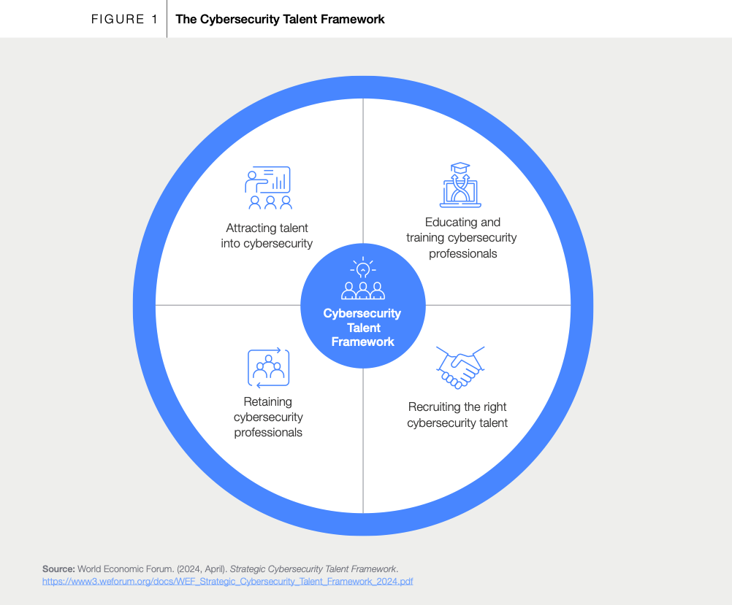
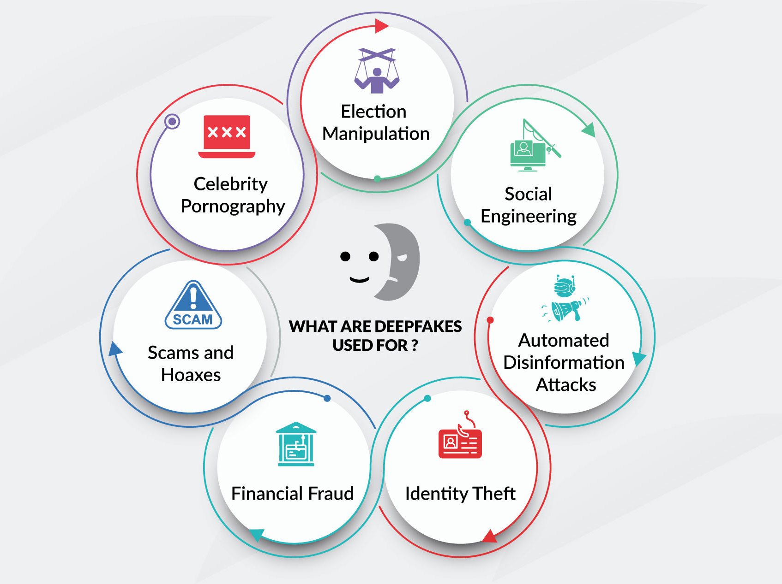
Emerging threats
AI attacks
  Smarter phishing, and deepfakes
Deepfake Impersonation
  Fake videos/voices used for scams, fraud, or misinformation
Crypto related crimes
  Theft, scams, and anonymous transactions
Attacks on healthcare and biotech data
  Theft of medical records, genetic data, or research

Slide 11

Key take-aways
Cybercrime is a growing global threat
Everyone is a potential target
Prevention requires awareness and good digital habits
Staying informed is the best defense
Organizations should combine technology AND training

Slide 12

Famous quote
“Cybercrime is the single biggest threat to every company on earth.”- Ginni Rometty
  Former CEO, IBM.
  This quote underscores the pervasive and significant risk that cybercrime poses to business globally

Slide 13
References
Federal Bureau of Investigation, Internet Crime Complaint Center. (2023). Internet Crime Report 2023. https://www.ic3.gov
Federal Bureau of Investigation, Internet Crime Complaint Center. (2024). Internet Crime Report 2024. https://www.ic3.gov
World Economic Forum. (2024). Strategic cybersecurity talent framework. https://www.weforum.org
Cybersecurity & Infrastructure Security Agency. (n.d.). Cyber hygiene best practices. U.S. Department of Homeland Security. https://www.cisa.gov
Europol. (2024). Internet organised crime threat assessment (IOCTA) 2024. https://www.europol.europa.eu
Symantec. (2024). Internet security threat report. https://www.broadcom.com/company/newsroom/press-releases
Verizon. (2024). Data breach investigations report. https://www.verizon.com/business/resources/
World Economic Forum. (2023). Global cybersecurity outlook 2023. https://www.weforum.org

