Slide 1

Firewall
Adam Ján Vilagi
II.D

Slide 2

Cieľ
Poskytnúť prehľad o firewalloch, ich typoch a funkciách
Ako si správne nakonfigurovať firewall
Poukázať na to prečo je tak dôležitý

Slide 3
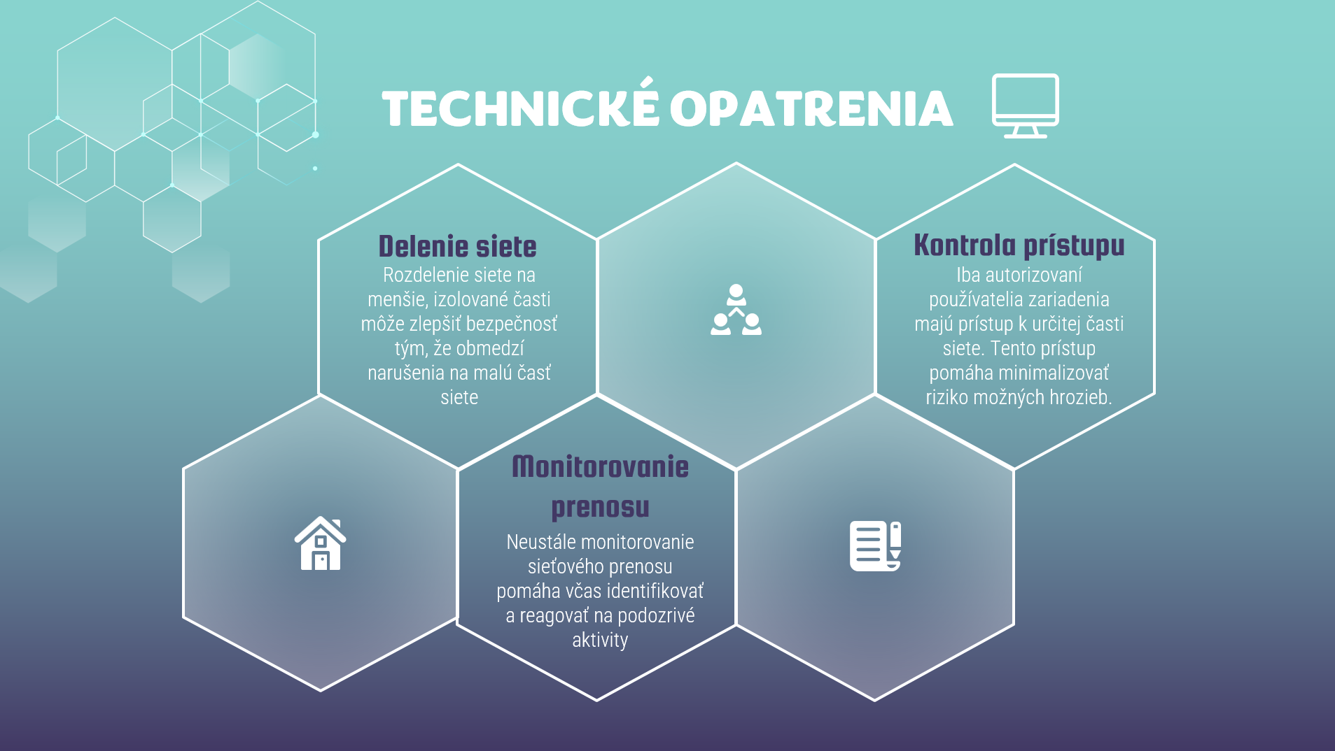
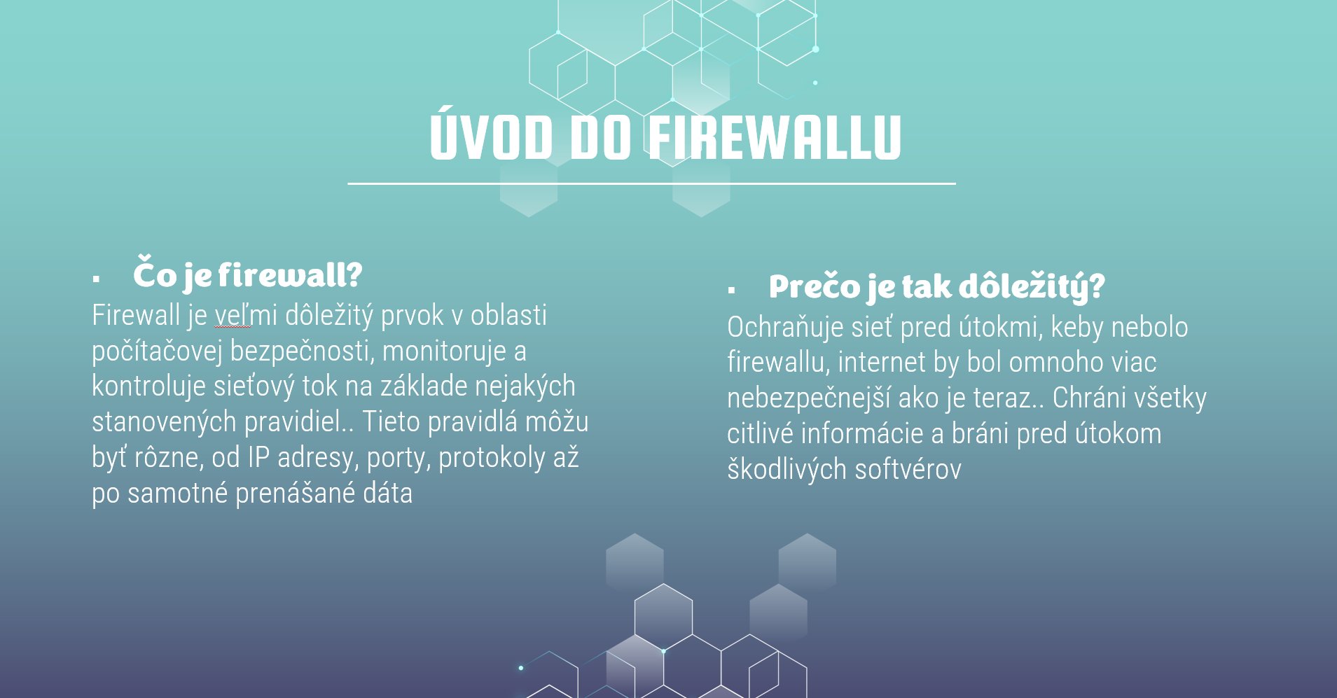
OBSAH PRODUKTU
Definícia Firewallu
Aké sú typy
Konfigurácia a Implementácia
Postup pre správnu ochranu

Slide 4
ZÁKLADY FIREWALLU
TYPY
Je to bezpečnostné zariadenie
Monitoruje a kontroluje sieťový tok na základe zadaných pravidiel
Bráni neoprávnený prístup k sieti
Aplikačný firewall
Sieťový firewall
Proxy firewall
Cloudový firewall

Slide 5

TVORBA PRODUKTU
Vytvorený v programe PowerPoint
Dizajn robení mnou + template
Produkt má 17 slajdov

Slide 6
ZÁVER
Firewall zohráva veľmi kľúčovú úlohu je totižto prvou líniou obrany proti neoprávnenému prístupu
Výber správneho typu firewallu je nevyhnutné pre správne zabezpečenie
Verím že môj produkt prinesie jasný a zrozumiteľný prehľad o tom ako firewally fungujú

Slide 7
Zdroje:
ANNASOFT, WAF – WEB APPLICATION FIREWALL, [cit. 28.4.2024] [online] Dostupné na: https://www.anasoft.com/sk/home/riesenia/IT-Security/WAF-Web-Application-Firewall
The role and security of firewalls in cyber-physical cloud computing,[cit. 12.3.2024] [online] Dostupné na:https://jis-eurasipjournals.springeropen.com/articles/10.1186/s13635-016-0042-3
Stateful vs. stateless firewalls: Understanding the differences, [cit. 21.3.2024] [online] Dostupné na: https://www.techtarget.com/searchsecurity/answer/How-do-stateful-inspection-and-packet-filtering-firewalls-differ?_gl=1*s1su8y*_ga*MTA4OTc0MTQzNy4xNzE2NTM0MjQ2*_ga_TQKE4GS5P9*MTcxNjUzNDI0Ni4xLjEuMTcxNjUzNTIyMy4wLjAuMA..
What are next generation firewalls? How the cloud and complexity affect them, [cit. 20.3.2024] [online] Dostupné na: https://www.csoonline.com/article/566153/what-are-next-generation-firewalls-how-the-cloud-and-complexity-affect-them.html
Log and Monitor Data Center Traffic [cit. 23.4.2024] [online] Dostupné na: https://docs.paloaltonetworks.com/best-practices/10-2/data-center-best-practices/data-center-best-practice-security-policy/log-and-monitor-data-center-traffic
Advanced Firewall Techniques [cit. 1.3.2024] [online] Dostupné na: https://www.linkedin.com/pulse/advanced-firewall-techniques-proinfinc
All You Need to Know About Network Security, Firewalls, and VPNs [cit. 10.2.2024] [online] Dostupné na: https://www.eccu.edu/blog/cybersecurity/network-security-firewalls-vpns/
What Are the 5 Main Types of Firewall? [cit. 10.2.2024] [online] Dostupné na: https://www.makeuseof.com/types-of-firewalls/
Firewall [cit. 10.2.2024] [online] Dostupné na:< https://www.eset.com/sk/firewall-ochrana/>
Introdcution of Firewall in Computer Network [cit. 8.2.2024] [online] Dostupné na:https://www.geeksforgeeks.org/introduction-of-firewall-in-computer-network/
Čo je to brána firewall? [cit. 6.2.2024] [online] Dostupné na:https://www.mcafee.com/sk-sk/antivirus/firewall.html
Types of Firewalls Defined and Explained [cit. 14.4.2024] ] [online] Dostupné na:https://www.paloaltonetworks.com/cyberpedia/types-of-firewalls
Fireawalls defined, explained, and explored [cit. 11.1.2024] ] [online] Dostupné na:https://www.forcepoint.com/cyber-edu/firewall

Slide 8
Ďakujem za pozornosť

