Slide 1
Cost of Living Index
Vaishnavi Vilasagar

Slide 2
Objective: The primary objective of this project is to analyze the Cost of Living Index across various countries in 2024. By examining different indices such as rent, groceries, and local purchasing power, we aim to provide insights into the economic conditions and living standards in these countries. Dataset Overview: The dataset for this project was sourced from Kaggle, and it contains comprehensive information on the Cost of Living Index for different countries in 2024. The key columns include the Rank, Country,Cost of Living Index, Rent Index, Groceries Index, Restaurant Price Index, and Local Purchasing Power Index. Scope: This project focuses on exploring the relationships between various indices and understanding how they impact the overall cost of living in each country. The analysis will highlight trends and patterns that can guide individuals and policymakers in making informed decisions.

Slide 3
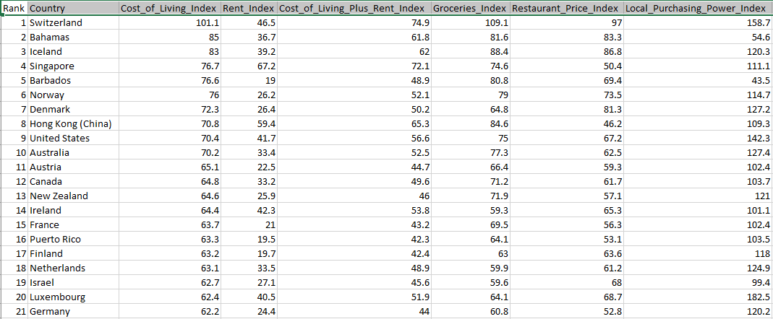
Table

Slide 4
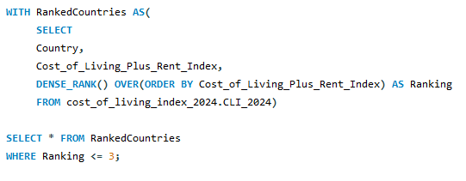
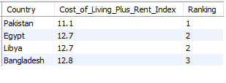
Rank the countries based on cost of living index plus rent index. And find top 3 countries.

Slide 5
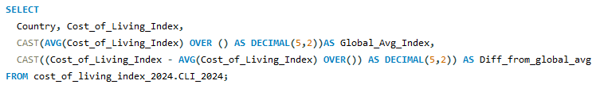
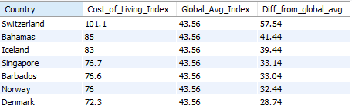
COMPARE A COUNTRY INDEX WITH GOBAL AVEAGE INDEX

Slide 6
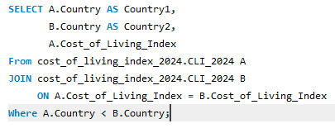
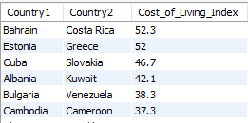
FIND THE COUNTRIES WITH SIMILAR COST OF LIVING INDEX

Slide 7
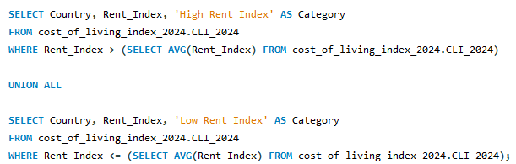
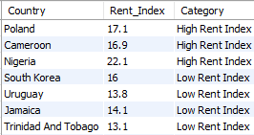
COMBINE THE COUNTRES WITH HIGH AND LOW RENT INDEX

Slide 8
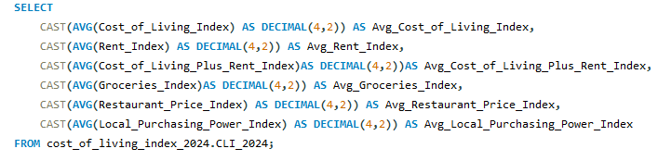
CALCULATE AVERAGE INDEX ACCROSS ALL INDEX

Slide 9
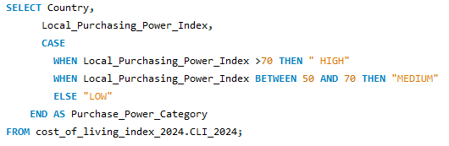
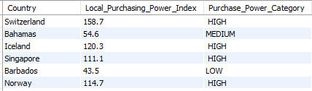
CLASSIFY COUNTRIES BASED ON LOCAL PURCHASE POWER

Slide 10


Find the top 3 countries with the highest ratio of cost of living index to local purchasing power index:

Slide 11
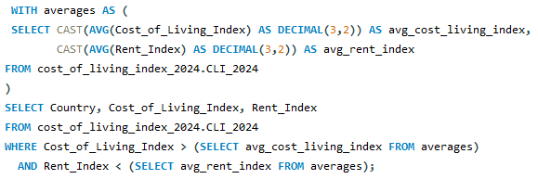
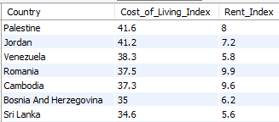
Identify countries where the cost of living index is above the global average, but the rent index is below the global average:

Slide 12
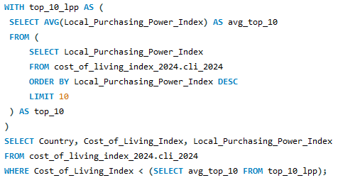
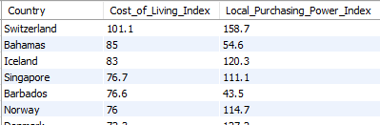
List countries where the cost of living index is less than the average cost of living index of the top 10 countries by local purchasing power index:

Slide 13

Determine the variance in the groceries index across all countries

Slide 14
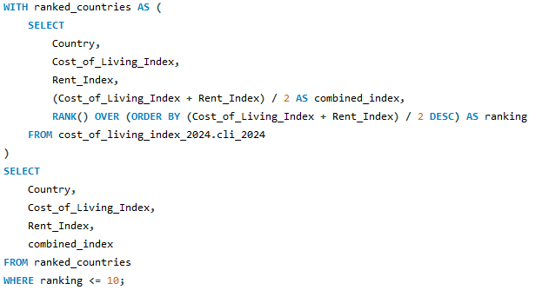
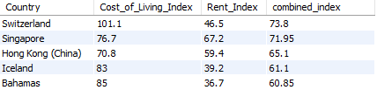
Ranking Countries by Cost of Living and Rent Index

Slide 15
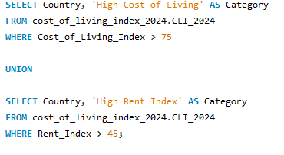
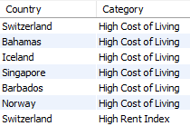
Combine lists of countries with high Cost of Living Index and high Rent Index

Slide 16

Thankyou vaishnavivilasagar@gmail.com

