Slide 1
BRAIN
Dirk Valkenborg

Slide 2
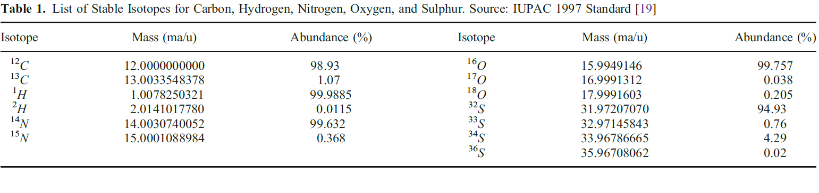
Isotopes
In 1913 Thomson discovered that some atoms had different atomic masses.
Elemental isotopes: variants of atoms with different number of neutrons
C, H, N, O, S are poly-isotopic elements which are incorporated in biomolecules
Thomson JJ. 1913. Bakerian lecture: Rays of positive electricity. Proc R Soc A 89:11–20.

Slide 3
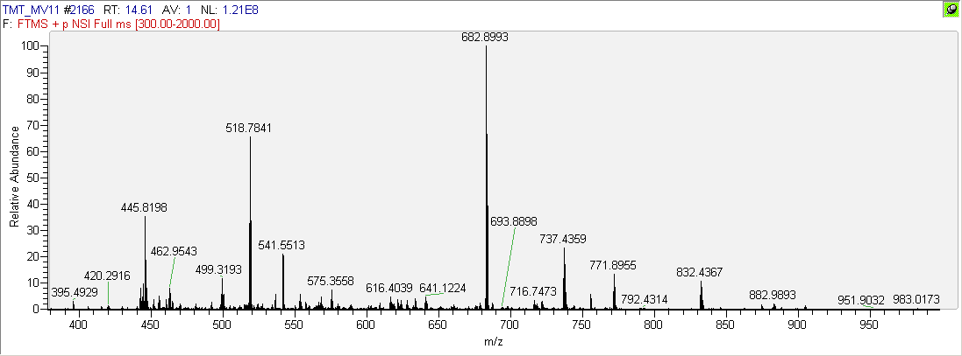
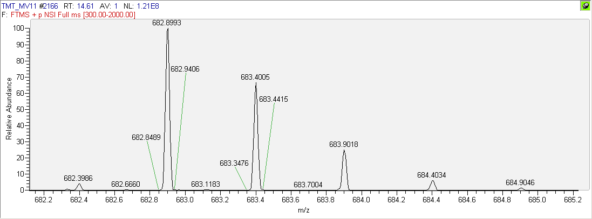
What are the consequences?
[ ¹²C & ¹H & ¹⁴N & ¹⁶O & ³²S ]
m/z : 682.8993
RT: 14.61
AUC: 3.6E8
[ 1 ¹³C | 1 ²H | 1 ¹⁵N | 1 ¹⁷O | 1 ³³S ]
[ 2 ¹³C | … | (1 ¹³C & ¹⁵N) | … ]
dMS

Slide 4
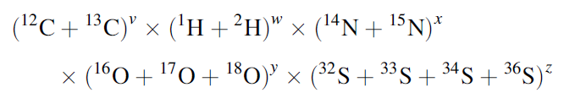
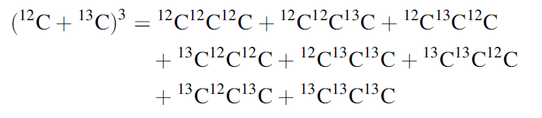
Calculating isotope distributions
Polynomial symbolic expansion:
Example:
Brownawell M, Fillippo JS. 1982. A program for the synthesis of mass spectral isotopic abundances. J Chem Educ 59(8): 663–665.
Yamamoto H, McCloskey JA. 1977. Calculations of isotopic distribution in molecules extensively labeled with heavy isotopes. Anal Chem 49:281.

Slide 5
The aggregated isotope distribution
5 ¹³C
4 ¹³C & 1 ¹⁵N
3 ¹³C & 2 ¹⁵N
Kubinyi H. 1991. Calculation of isotope distributions in mass spectrometry. a trivial solution for a non-trivial problem. Anal Chim Acta 247:107–119.
Rockwood AL, Van Orden SL, Smith RD. 1996. Ultrahigh resolution isotope distribution calculations. Rapid Commun Mass Spectrom 10:54–59.
Olson M, Yergey A. 2009. Calculation of the isotope cluster for polypeptides by probability grouping. J Am Soc Mass Spectrom 20:295–302.

Slide 6





Calculating the aggregated isotope distributions
For molecules with a composition C_{v}H_{w}N_{x}O_{y}S_{z} we introduce polynomial over symbolic indicator I representing the additional neutron content:
where P_{C12} , …, P_{S36} represent the natural abundances of the isotopes.

Slide 7
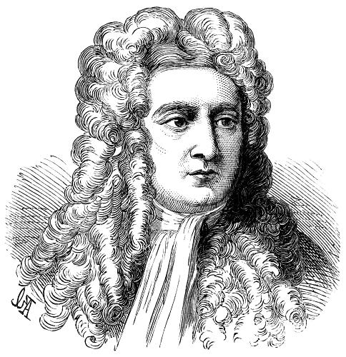
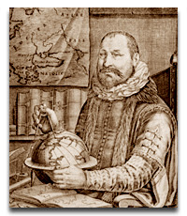
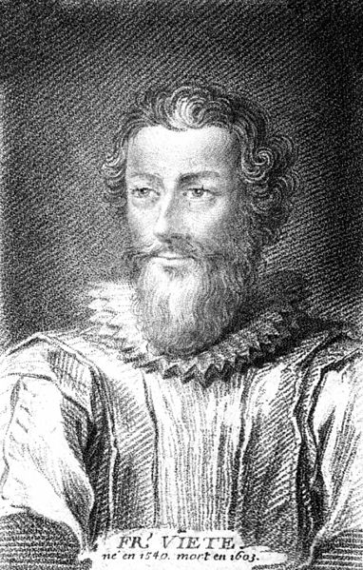
Calculating the aggregated isotope distributions
Still numerically complex regardless representation in nucleon count
High arity, i.e., large powers:
Human dynein heavy chain: C₂₃₈₃₂H₃₇₈₁₆N₆₅₂₈O₇₀₃₁S₁₇₀
Highest order I^{n}, n = 23832 + 3781 + 6528 + 2 x 7031 + 4 x 170
Newton-Girard theorem & Viète formula’s to exploit algebraic identities for symmetric polynomials
François Viète 1540-1603
Isaac Newton 1643-1727
Albert Girard 1595-1632
Figures: www.wikipedia.com

Slide 8


BRAIN
BRAIN: Baffling Recursive Algorithm for Isotope distributioN calculations
Start:
mystery factor

Slide 9




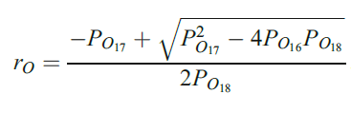








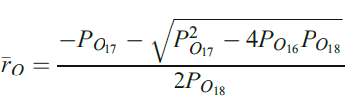
Mystery factor PSI
Power sum of the roots of the polynomials of the elements:
2 pairs of conjugate roots Closed form but complex

Slide 10
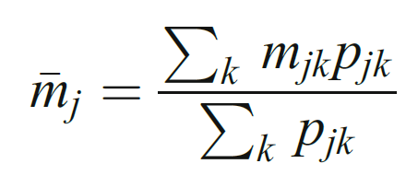
Exact mass problem
List of all contributing isotopes:
(p₄₁, m₄₁)
(p₄₂, m₄₂)
(p_{4k}, m_{4k})
m₄ ≠ m+4
(p₄₃, m₄₃)
probability-weighted sum of the masses of the isotope combinations:
(p₄₂, m₄₂)
(p₄₁, m₄₁)
Roussis SG, Proulx R. 2003. Reduction of chemical formulas from the isotopic peak distributions of high-resolution mass spectra. Anal Chem 75(6): 1470–1482.
Rockwood AL, Haimi P. 2006. Efficient calculation of accurate masses of isotopic peaks. J Am Soc Mass Spectrom 17:415–419.
Rockwood AL, Van Orman JR, Dearden DV. 2004. Isotopic compositions and accurate masses of single isotopic peaks. J Am Soc Mass Spectrom 15:12–21.

Slide 11

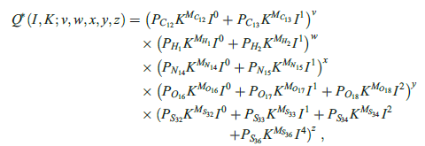



BRAIN

Slide 12
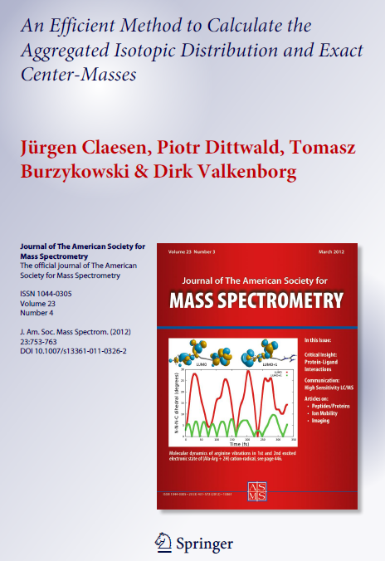

Slide 13
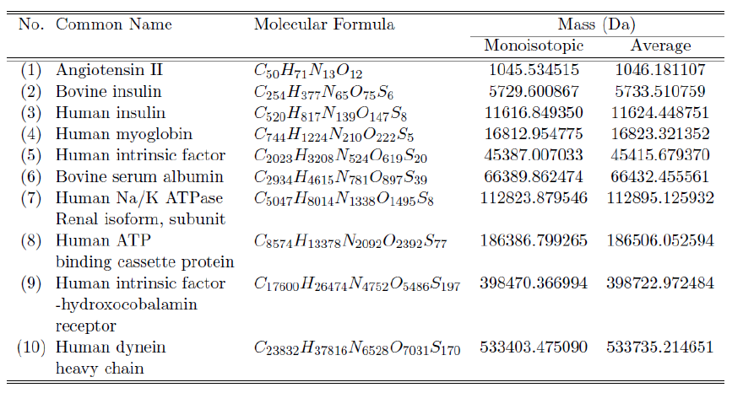
Application of BRAIN

Slide 14
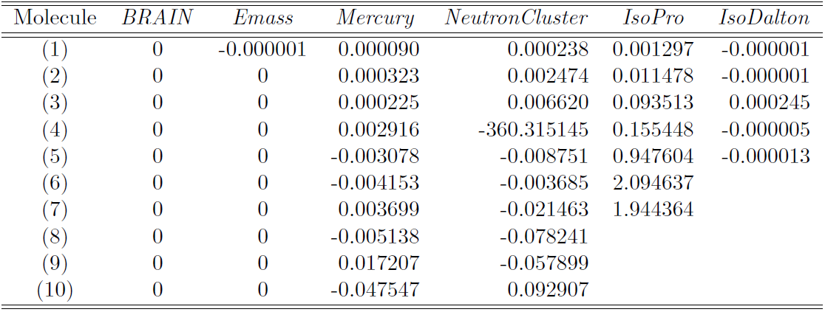
Application of BRAIN
Rockwood AL, Haimi P. 2006. Efficient calculation of accurate masses of isotopic peaks. J Am Soc Mass Spectrom 17:415–419
Rockwood AL, Van Orden SL, Smith RD. 1996. Ultrahigh resolution isotope distribution calculations. Rapid Commun Mass Spectrom 10:54–59.
Olson M, Yergey A. 2009. Calculation of the isotope cluster for polypeptides by probability grouping. J Am Soc Mass Spectrom 20:295–302.
Yergey, J. A. Heller, D. Hansen, G. Cotter, R.J. Fenselau, C.1983 Anal Chem 55:353-356.
Snider, R.K. 2007 Efficient Calculation of Exact Mass Isotopic Distributions . J Am Soc Mass Spectrom 18: 1511–1515.

Slide 15
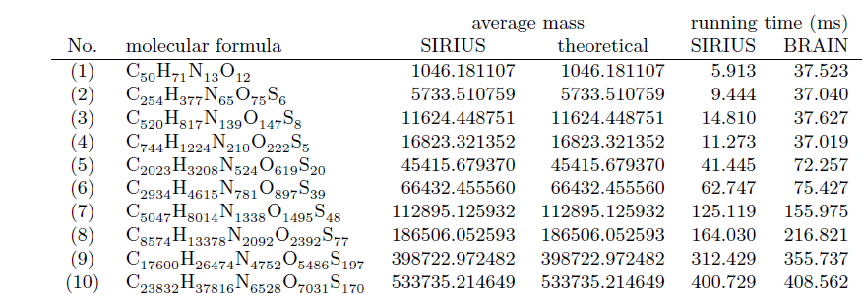
Application of BRAIN
Computational performance in sub-optimal interpreted code
run on Dell Latitude E6500 with an Intel dual core P8400 2.26 GHz and 4 GB RAM
Böcker S., Letzel M., Lipták Z., Pervukhin A. 2009 SIRIUS: decomposing isotope patterns for metabolite identification Bioinformatics 25(2):218-224
Böcker S. 2012 Comment on "An Efficient Method to Calculate the Aggregated Isotopic Distribution and Exact Center-Masses“ JASMS

Slide 16
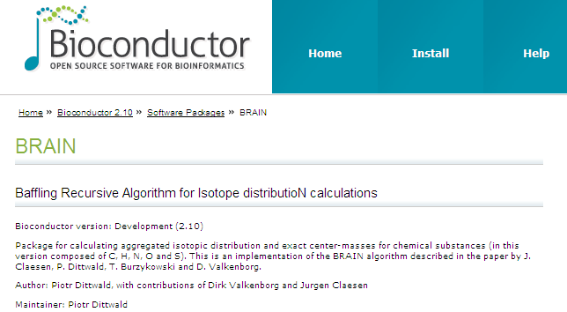
Need BRAIN?
http://bioconductor.org/packages/devel/bioc/html/BRAIN.html

Slide 17
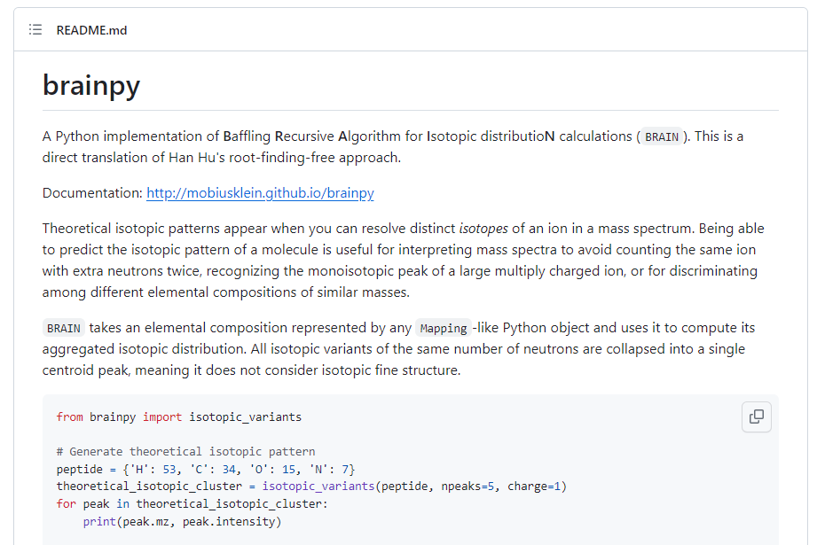
Need BRAIN?
https://github.com/mobiusklein/brainpy

Slide 18
Conclusions
Same accuracy as existing package (Emass, Sirius, ….)
Computation and memory-efficient
No need for solving diophantine equation
Very compact and easy to implement, even in a spreadsheet
16th century mathematics is alive and kicking:
François Viète 1540-1603
Isaac Newton 1643-1727
Albert Girard 1595-1632
Figures: www.wikipedia.com

Slide 19
Future work
y = f(x) x = f⁻¹ (y)
Could it be reversed? iBrain?
#C = 1080
#H = 1699
#N = 268
#O = 310
#S = 6

Slide 20
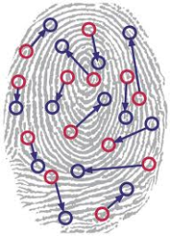
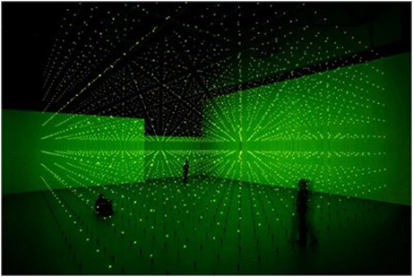
Future work
Patents pending
®
PhosphoMap
Finding evidence in the isotopic fingerprint

Slide 21


Acknowledgements
Center for Statistics, Faculty of Science,
Hasselt University, Belgium
Tomasz Burzykowski
Jürgen Claesen
Computational Biology Group, Faculty of Mathematics,
University of Warsaw, Poland
Ania Gambin
Piotr Dittwald

