Slide 1
A Compositional Model to Predict the Aggregated Isotope Distribution for Average peptides using a compositional spline model

Slide 2
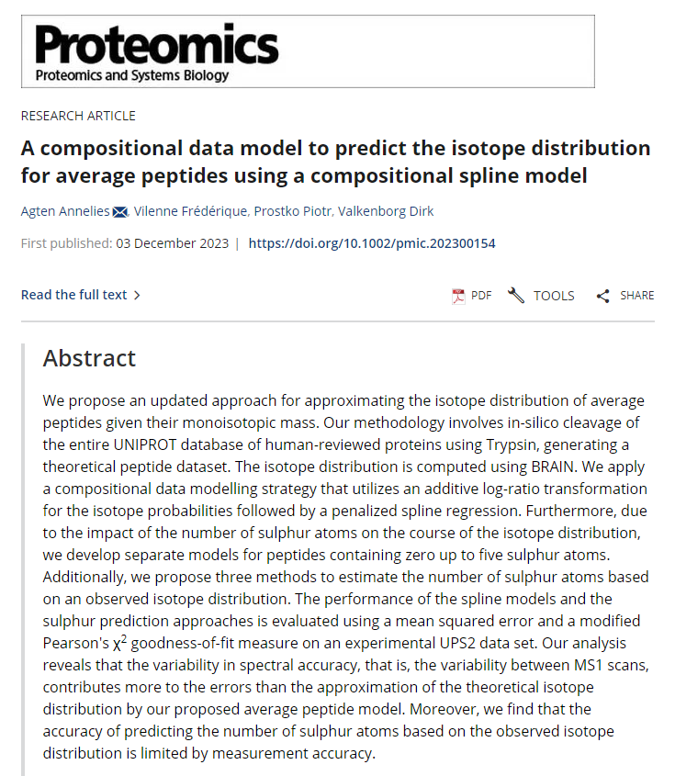
POINTLESS4PEPTIDES
The observed isotope distribution is a valuable tool for pre-processing mass spectrometry data in shotgun proteomics experiments
Identification of a peptide → compare the obtained isotope pattern to the one that is theoretically expected based on its elemental composition.
Impossible when identity of the molecule under investigation is unknown.

Slide 3
POINTLESS4PEPTIDES
The current generation of (high‐resolution) mass spectrometers have yielded increased sensitivity and improved detection limits.
→ The isotope distribution of molecules can be measured with greater sensitivity, resolution and mass accuracy
→ More comprehensive protein databases, refined elemental isotope definitions, and enhancements in algorithmic and statistical methods
A compositional data model to predict the isotope distribution for average peptides

Slide 4



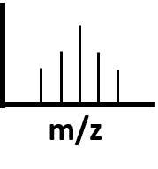
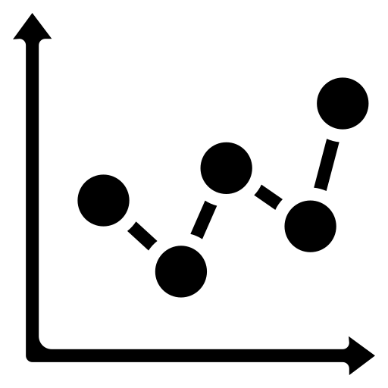

POINTLESS4PEPTIDES
METHOD
Construct models for the prediction of the aggregated isotope distribution and centroid mass for an average peptide when a particular (monoisotopic) mass is available.
THEORETICAL
DATASET
COMPOSITIONAL
DATA TRANSFORMATION
GOODNESS-OF-FIT
AGGREGATED ISOTOPE
DISTRIBUTION
SPLINE REGRESSION
MODELLING
SULPHUR
PREDICTION

Slide 5
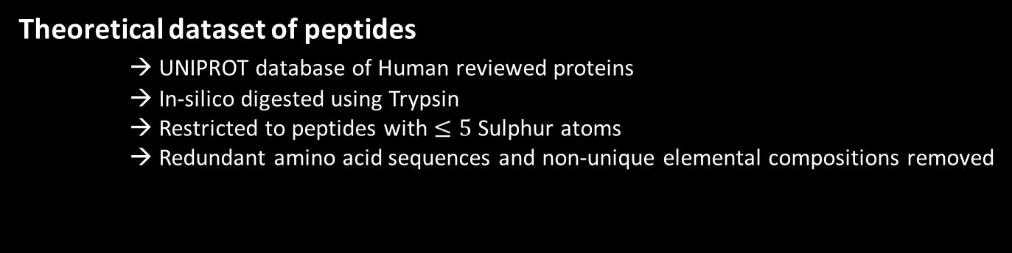
POINTLESS4PEPTIDES
METHOD
Theoretical dataset of peptides
→ UNIPROT database of Human reviewed proteins
→ In-silico digested using Trypsin
→ Restricted to peptides with $≤5$ Sulphur atoms
→ Redundant amino acid sequences and non-unique elemental compositions removed
THEORETICAL
DATASET
284,947 peptides with a mass range from 350.126 Da to 4999.689 Da
Notes:
It should be noted that the choice to only include peptides up to five sulphur atoms is arbitrary. However, by doing so, we cover 99.5% of the unique atomic compositions.

Slide 6
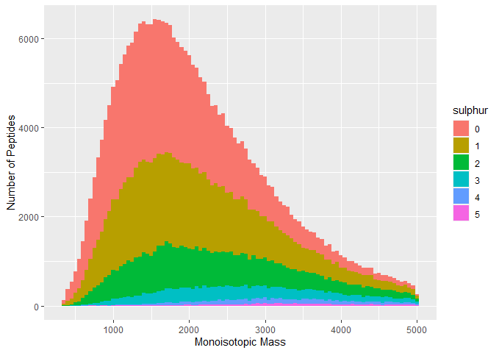
POINTLESS4PEPTIDES
THEORETICAL DATA
Distribution of peptides across different Sulphur categories
Most prevalent mass range: 1500 Da -2500 Da
Unbalanced distribution
0S - 118,256
1S - 92,359
2S - 48,271
3S - 18,051
4S - 5,919
5S - 2,091
Notes:
since longer DNA molecules are depleted from the dataset.

Slide 7
POINTLESS4PEPTIDES
METHOD
For each peptide: Computed using BRAIN¹ First 6 aggregated isotope peaks
AGGREGATED ISOTOPE
DISTRIBUTION
¹Dittwald, P., Claesen, J., Burzykowski, T., Valkenborg, D., & Gambin, A. (2013). BRAIN: A Universal Tool for High-Throughput Calculations
of the Isotopic Distribution for Mass Spectrometry. Analytical Chemistry, 85(4), 1991-1994. doi: 10.1021/ac303439m

Slide 8
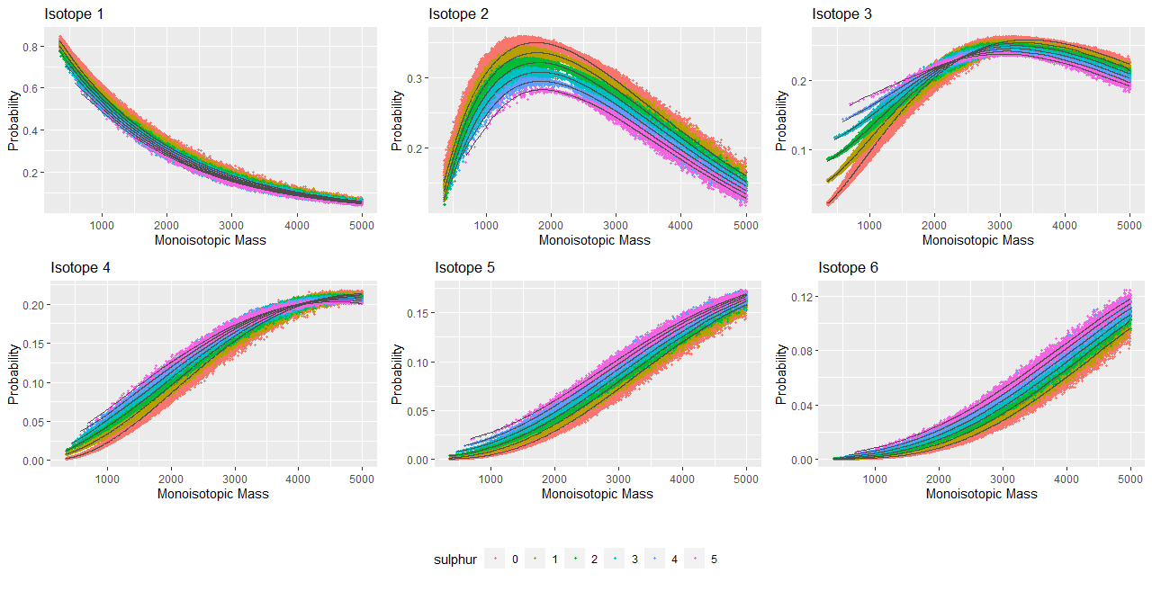
POINTLESS4PEPTIDES
AGGREGATED ISOTOPE DISTRIBUTION

Slide 9

POINTLESS4DNA
POINTLESS4PEPTIDES
METHOD
The theoretical isotope distribution is based on sampling from a multinomial distribution → Compositional data (sum to one)
The number of isotopes and the distribution of the probabilities vary in function of the mass → Sink-hole that contracts the leftover probabilities into one isotope variant → Closure term (pseudo-isotope)
Assumption: 100% of the isotope information is captured by the first 6 isotopic variants and the additional closure component
The theoretical isotope distribution is based on a multinomial expansion → Compositional data (sum to one)
The number of isotopes and the distribution of the probabilities vary in function of the mass. → Introduce sink-hole that contracts the leftover probabilities into one isotope variant, called the closure term (pseudo-isotope) → 100% of the isotope information is captured by the first 20 isotopic variants and the additional closure component.
$$x_{7}= 1−\sum_{i=1}^{6}{x_{i}}$$
COMPOSITIONAL
DATA TRANSFORMATION

Slide 10
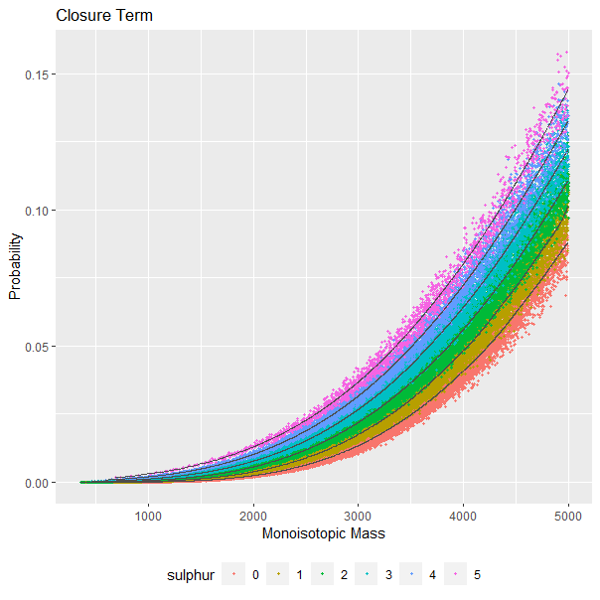
POINTLESS4PEPTIDES
CLOSURE TERM

Slide 11
POINTLESS4PEPTIDES
COMPOSITIONAL DATA

Slide 12
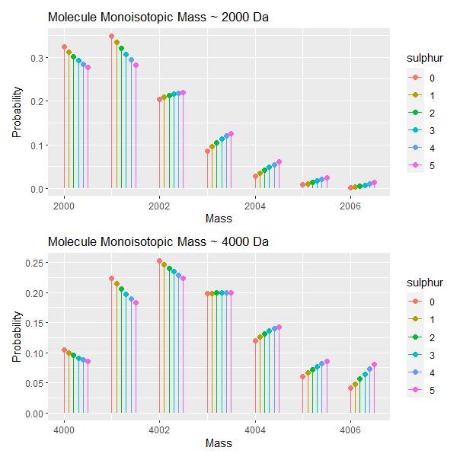
POINTLESS4PEPTIDES
COMPOSITIONAL DATA

Slide 13

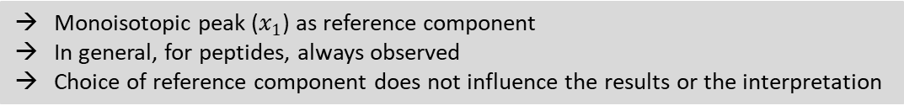
POINTLESS4DNA
POINTLESS4PEPTIDES
METHOD
Isotope probabilities, are nonnegative and constrained to sum to one
A regression modelling approach requires the data to be real-valued
Aitchison: compositional data represented on a high-dimensional simplex
$$S^{6}=\left\{\left(x_{1},...,x_{7}\right) ε ℝ^{7} \right|x_{i}≥0 for (i=1,…,7) and \sum_{i=1}^{7}{x_{i}=1}\}$$
Additive log-ratio transformation
$$S^{6} →{ ℝ}^{6}: (x_{1},x_{2},...,x_{7}) → \left(ln\left(\frac{x_{2}}{x_{1}}\right), ln\left(\frac{x_{3}}{x_{1}}\right), ... , ln\left(\frac{x_{7}}{x_{1}}\right)\right)=(z_{1},z_{2},...,z_{6})$$
The theoretical isotope distribution is based on a multinomial expansion → Compositional data (sum to one)
The number of isotopes and the distribution of the probabilities vary in function of the mass. → Introduce sink-hole that contracts the leftover probabilities into one isotope variant, called the closure term (pseudo-isotope) → 100% of the isotope information is captured by the first 20 isotopic variants and the additional closure component.
COMPOSITIONAL
DATA TRANSFORMATION
Monoisotopic peak ($x_{1}$) as reference component
In general, for peptides, always observed
Choice of reference component does not influence the results or the interpretation

Slide 14
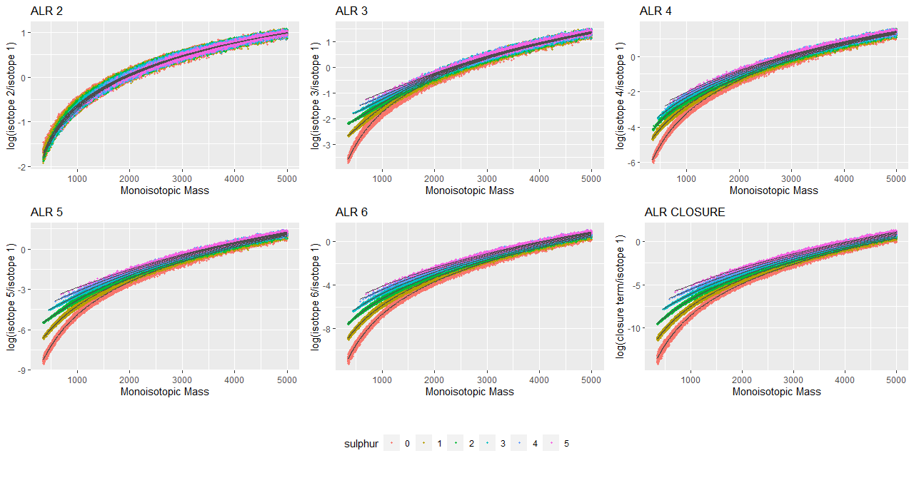
POINTLESS4PEPTIDES
COMPOSITIONAL DATA TRANSFORMATION

Slide 15
POINTLESS4PEPTIDES
METHOD
PENALIZED SPLINE REGRESSION
→ Model the relationship between the monoisotopic mass of a peptide and its corresponding isotopic envelope (containing the first 6 isotopic variants and pseudo-isotope), transformed into ALR space.
→ Order of the spline and the estimation of the smoothing parameters are automatically determined using generalized cross validation
SPLINE REGRESSION
MODELLING

Slide 16
POINTLESS4PEPTIDES
METHOD
IMPACT OF SULPHUR ATOMS ON PATTERN OF ISOTOPE DISTRIBUTION
→ Six distinct models for each Sulphur category
→ Model each ALR univariately
SPLINE REGRESSION
MODELLING
6 X 6 = 36 models

Slide 17
POINTLESS4PEPTIDES
SPLINE MODELLING

Slide 18
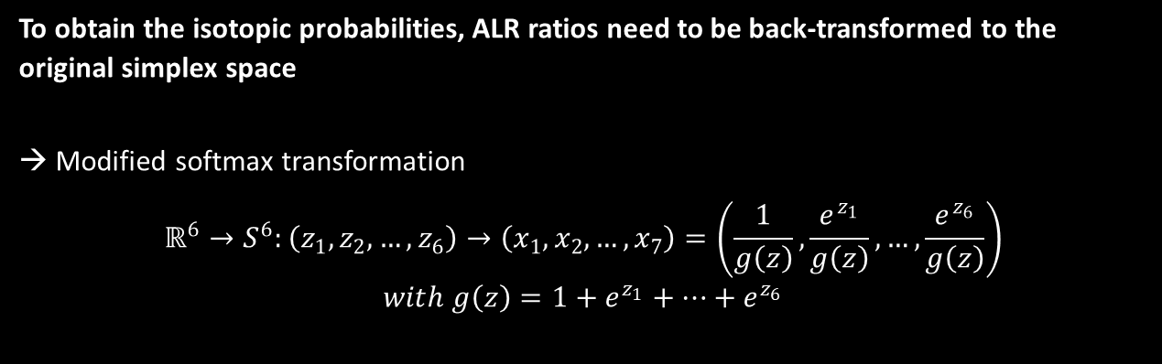
POINTLESS4PEPTIDES
METHOD
To obtain the isotopic probabilities, ALR ratios need to be back-transformed to the original simplex space
→ Modified softmax transformation
$$ℝ^{6}→S^{6}:\left(z_{1},z_{2},…,z_{6}\right)→\left(x_{1},x_{2},…,x_{7}\right)=\left(\frac{1}{g\left(z\right)},\frac{e^{z_{1}}}{g\left(z\right)},…,\frac{e^{z_{6}}}{g\left(z\right)}\right)$$
$$with g\left(z\right)=1+e^{z_{1}}+…+e^{z_{6}}$$
SPLINE REGRESSION
MODELLING

Slide 19
POINTLESS4PEPTIDES
METHOD OVERVIEW
THEORETICAL DATASET
ISOTOPE MODELLING
ALR
MODIFIED SOFTMAX

Slide 20
POINTLESS4PEPTIDES
Beside the probabilities, the model also provides a prediction for the centroid mass of the aggregated isotope variants
The average value of the mass differences between the isotope variant and the monoisotopic variant
For each Sulphur category separately
Compute centroid masses of the predicted isotope probabilities by simple addition to the observed mass of the monoisotopic variant
 | Isotope 1 | Isotope 2 | Isotope 3 | Isotope 4 | Isotope 5 | Isotope 6
0 S atoms | 0 | 1.002891678 | 2.005596818 | 3.008229827 | 4.010806086 | 5.013344473
1 S atom | 0 | 1.00286816 | 2.004629099 | 3.00639507 | 4.008163627 | 5.009999388
2 S atoms | 0 | 1.002843655 | 2.004123027 | 3.00558085 | 4.006825931 | 5.00814229
3 S atoms | 0 | 1.00283248 | 2.004039656 | 3.005395842 | 4.006442102 | 5.007544965
4 S atoms | 0 | 1.002829018 | 2.004165477 | 3.005488558 | 4.006517479 | 5.007537239
5 S atoms | 0 | 1.0028162 | 2.004183866 | 3.005451329 | 4.006430802 | 5.007365125

Slide 21




POINTLESS4PEPTIDES
METHOD
Metrics that are applicable on an only partially observed isotope cluster
Goodness-of-fit in ALR space
Goodness-of-fit in probability space
$$MSE_{ALR}= \frac{1}{l−1}\sum_{i=1}^{l−1}{{\left(t_{i}−z_{i}\right)}^{2}}$$
$$\left(t_{1},…,t_{l−1}\right)=\left(\ln\left(\frac{o_{2}}{o_{1}}\right),…,\ln\left(\frac{o_{l}}{o_{1}}\right)\right)$$
with
GOODNESS-OF-FIT
$$χ_{simplex}^{2}=\frac{1}{l}\sum_{i=1}^{l}{\frac{{\left(O_{i}−E_{i}\right)}^{2}}{E_{i}}}$$
with
$$N=\frac{\sum_{i=1}^{l}{O_{i}}}{\sum_{i=1}^{l}{x_{i}}}$$
Notes:
$(z_{1},…,z_{l−1})$ are the predicted ALR ratios using the spline model

Slide 22


POINTLESS4PEPTIDES
METHOD
Separate models for the isotope distribution for peptides containing zero up to five sulphur atoms
→ Which model to use?
Possibility 1: Based on minimal error
$$\hat{S}=\underset{s}{arg min}\left\{MSE_{ALR,S0}, …, MSE_{ALR,S5}\right\}$$
SULPHUR
PREDICTION
$$\hat{S}=\underset{s}{arg min}\left\{χ_{simplex,S0}^{2},…, χ_{simplex,S5}^{2}\right\}$$
Notes:
, using the squared residuals of the ordinary least squares model as weights

Slide 23

POINTLESS4PEPTIDES
METHOD
Separate models for the isotope distribution for peptides containing zero up to five sulphur atoms
→ Which model to use?
Possibility 2: Based on Bayes theorem
$$P\left(S=n |\left(t_{1},…,t_{l−1}\right) \right)=\frac{\left.P\left(\left(t_{1},…,t_{l−1}\right)|S=n\right)P(S=n\right)}{P\left(t_{1},…,t_{l−1}\right)}$$
SULPHUR
PREDICTION
Notes:
, using the squared residuals of the ordinary least squares model as weights

Slide 24
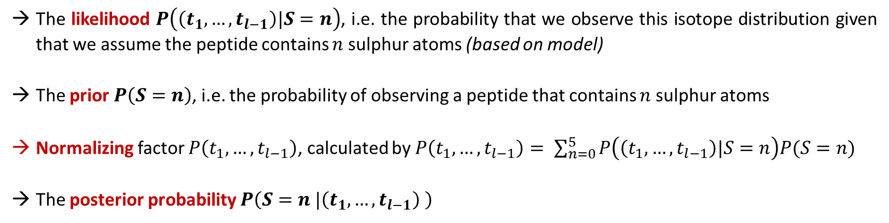
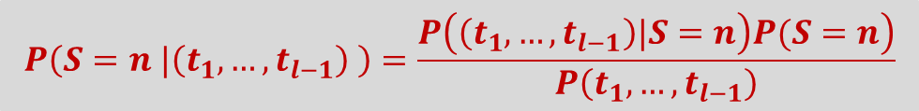
POINTLESS4PEPTIDES
Sulphur Prediction: Bayes Theorem
$$P\left(S=n |\left(t_{1},…,t_{l−1}\right) \right)=\frac{\left.P\left(\left(t_{1},…,t_{l−1}\right)|S=n\right)P(S=n\right)}{P\left(t_{1},…,t_{l−1}\right)}$$
The likelihood $P\left(\left(t_{1},…,t_{l−1}\right)|S=n\right)$, i.e. the probability that we observe this isotope distribution given that we assume the peptide contains $n$ sulphur atoms (based on model)
The prior $P\left(S=n\right)$, i.e. the probability of observing a peptide that contains $n$ sulphur atoms
Normalizing factor $P\left(t_{1},…,t_{l−1}\right)$, calculated by $P\left(t_{1},…,t_{l−1}\right)= \sum_{n=0}^{5}{P\left(\left(t_{1},…,t_{l−1}\right)|S=n\right)P(S=n)}$
The posterior probability $P\left(S=n |\left(t_{1},…,t_{l−1}\right) \right)$
CORRECT MODEL = MODEL WITH MAXIMAL POSTERIOR PROBABILITY

Slide 25
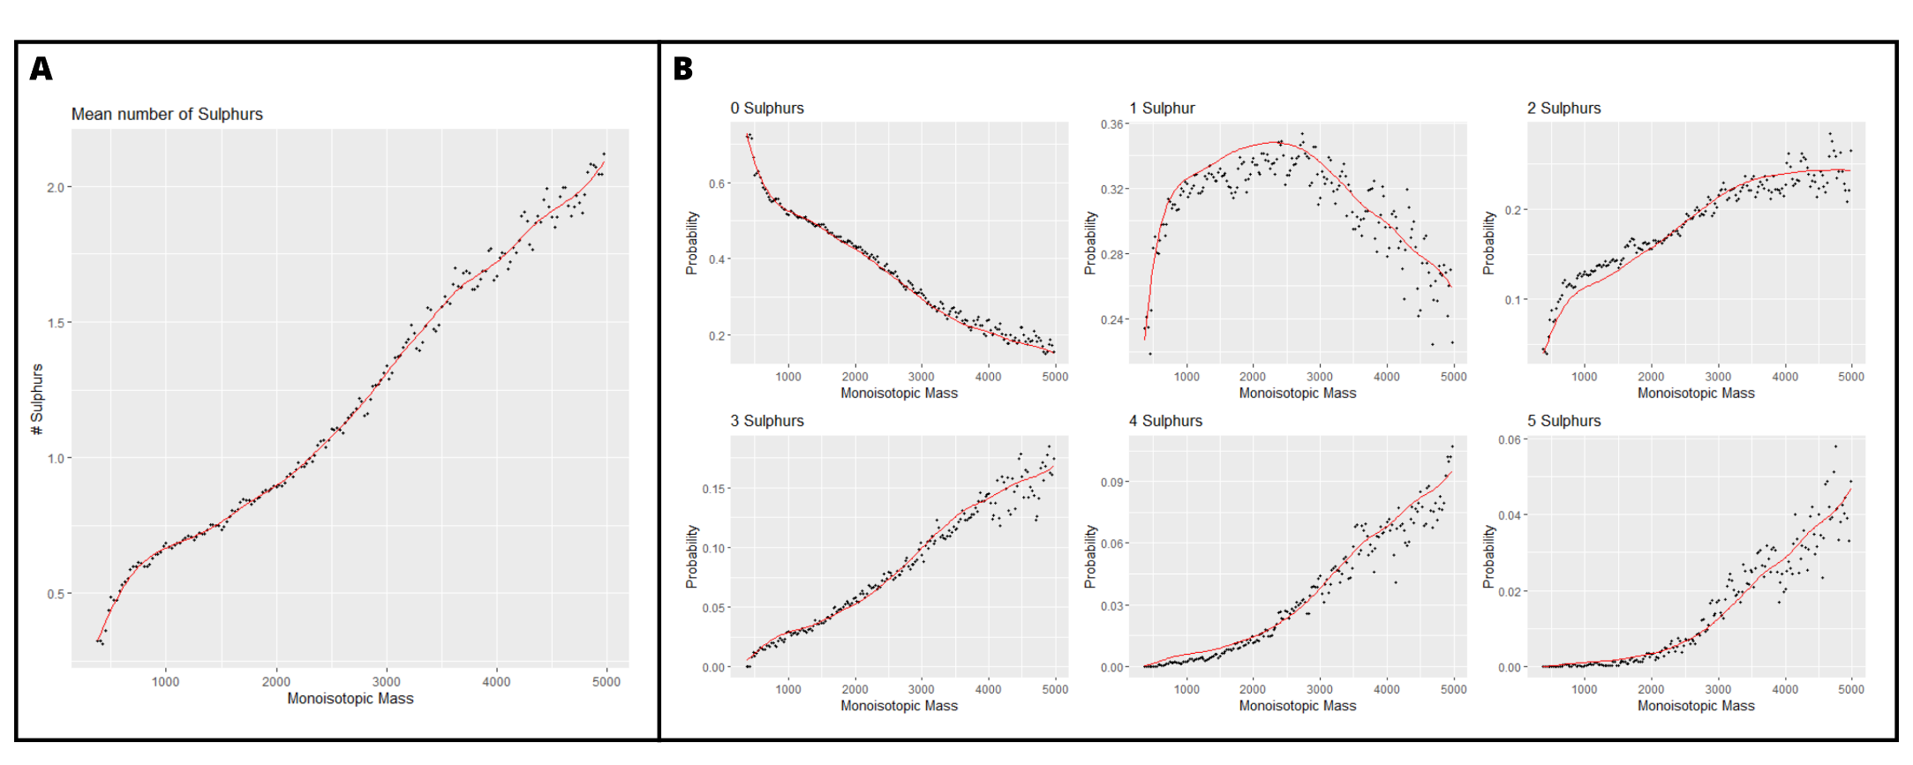
POINTLESS4PEPTIDES
Sulphur Prediction prior probability
The mean number of Sulphur atoms as a function of the monoisotopic mass. The red line shows the result of a penalized spline regression model that uses the monoisotopic mass as input to predict lambda
The probability of observing n Sulphur atoms in relation to the monoisotopic mass. The red lines show the fit of the negative binomial distribution using lambda from (A)

Slide 26
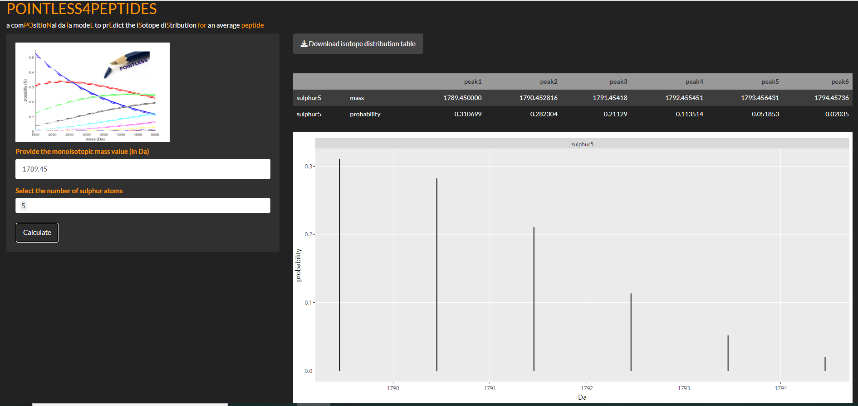
POINTLESS4PEPTIDES
SOFTWARE

Slide 28
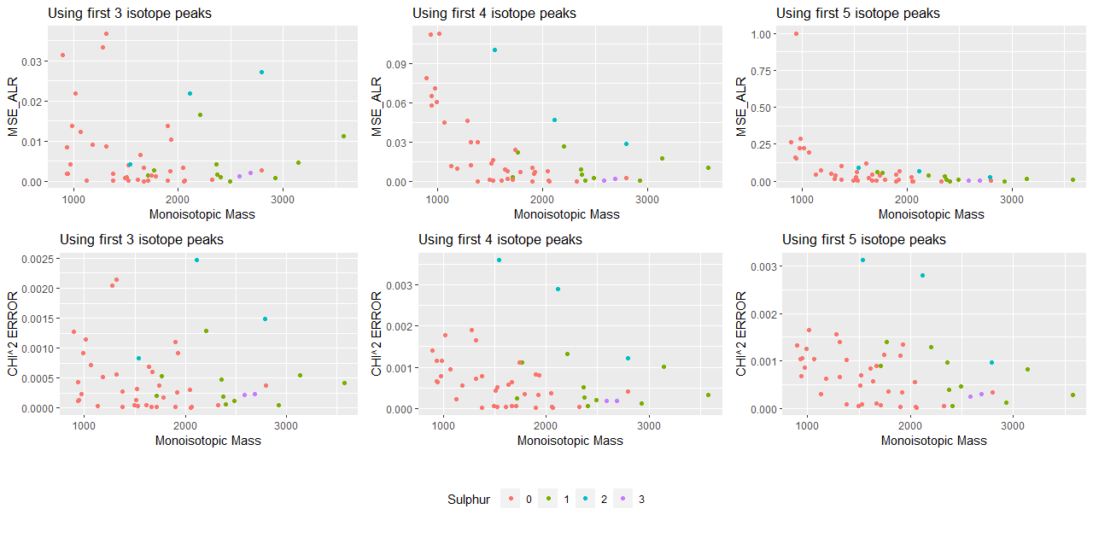
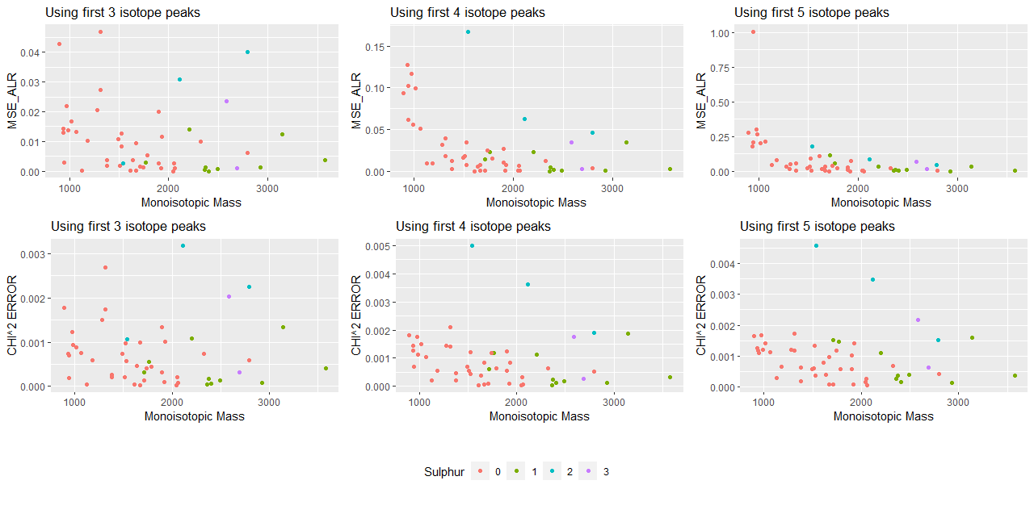
POINTLESS4Peptides
VALIDATION (on UPS2-standard)
Experimental data vs theoretical data
Experimental data vs model predictions

Slide 29
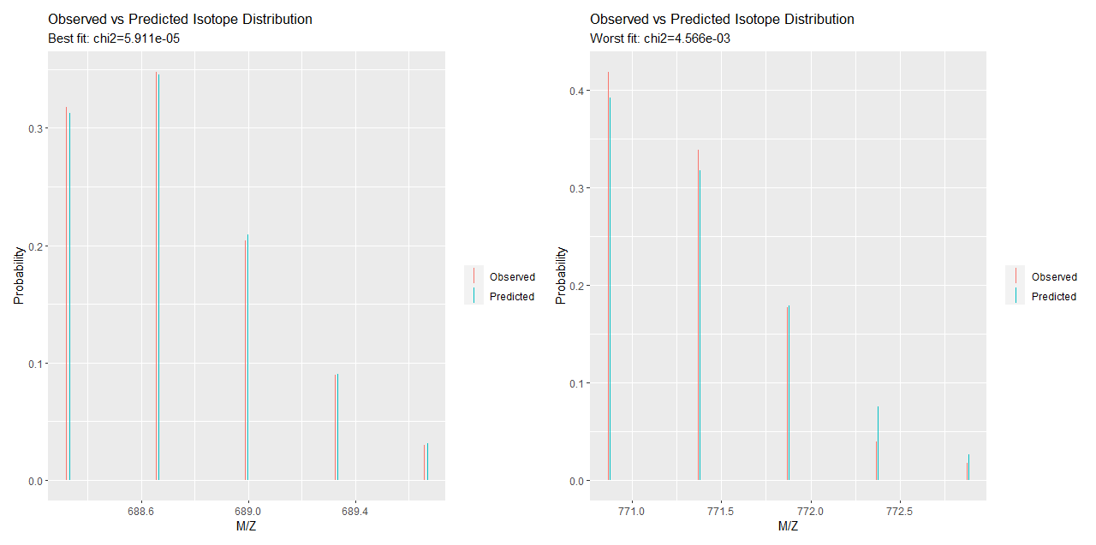
POINTLESS4Peptides
VALIDATION (on UPS2-standard)
Plots illustrating the observed isotope distribution and the predicted isotope distribution using our penalized spline regression approach
Left: best peptide “ILNNGHAFNVEFDDSQDK”
Right: worst peptide “AFTECCVVASQLR

Slide 30
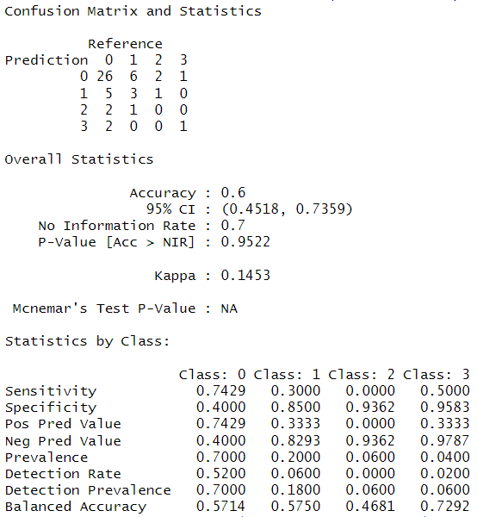
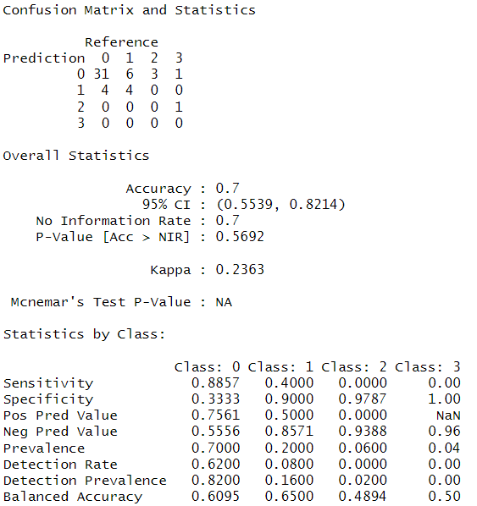
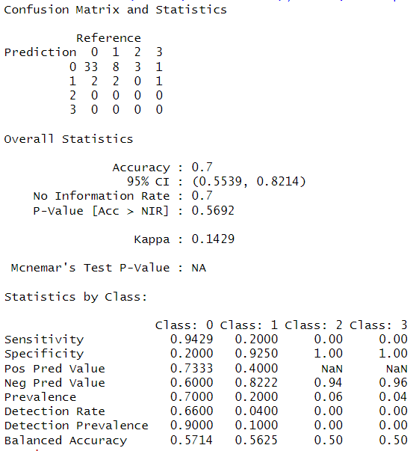
POINTLESS4Peptides
Sulphur Prediction Experimental validation (minimal MSE)

Slide 31
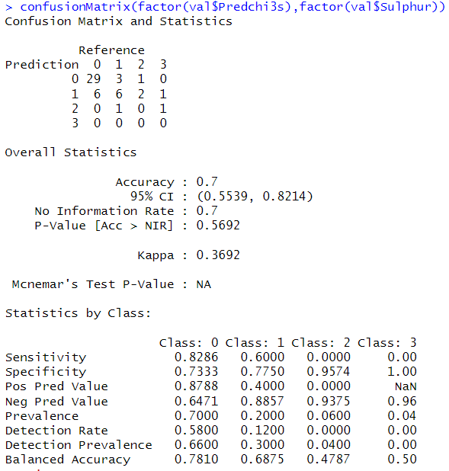
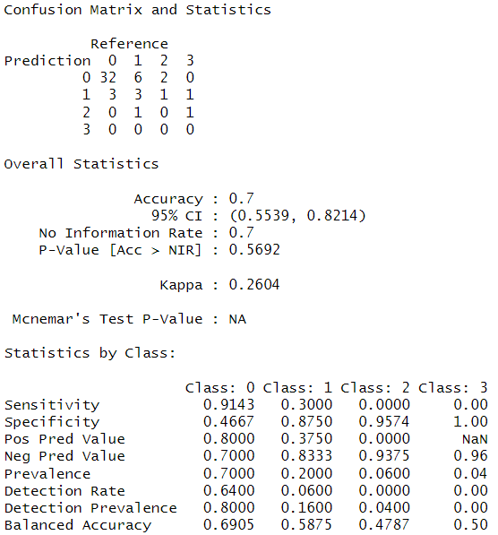
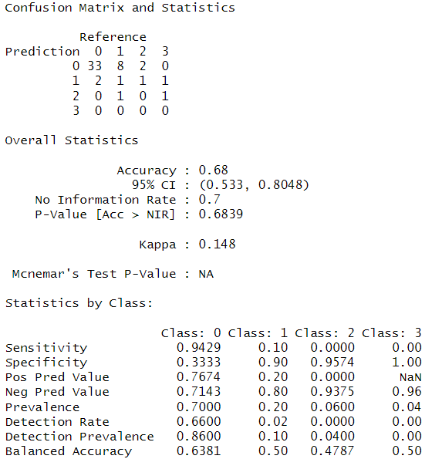
POINTLESS4Peptides
Sulphur Prediction Experimental validation (minimal CHI2)

Slide 32
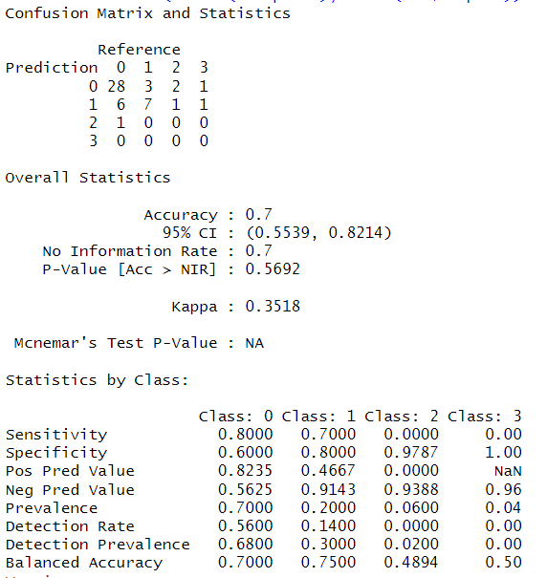
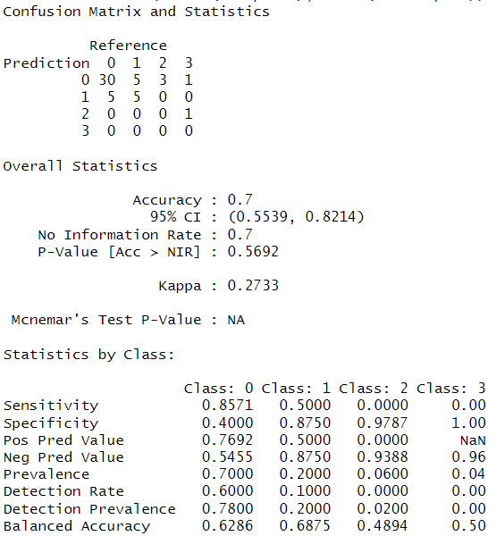
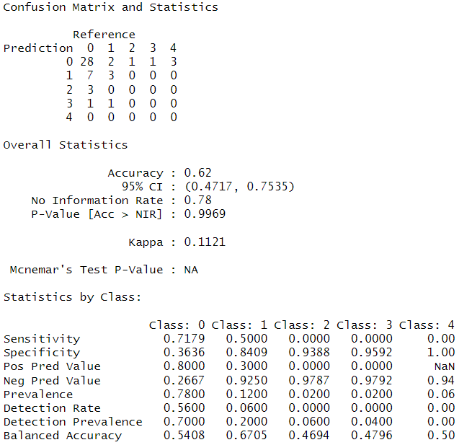
POINTLESS4Peptides
Sulphur Prediction Experimental validation (Bayes)

