Slide 1
Project with Angular 2 Part 3
NRD Akademija 2018
Vilius Arminas
2017-02-09, Kaunas

Slide 2
Authentication and Authorization
Authentication – method to confirm identity. System asks you “who you are and how can you prove it?”
Authorization – granting access to resources. System tells you what you can or cannot do.

Slide 3
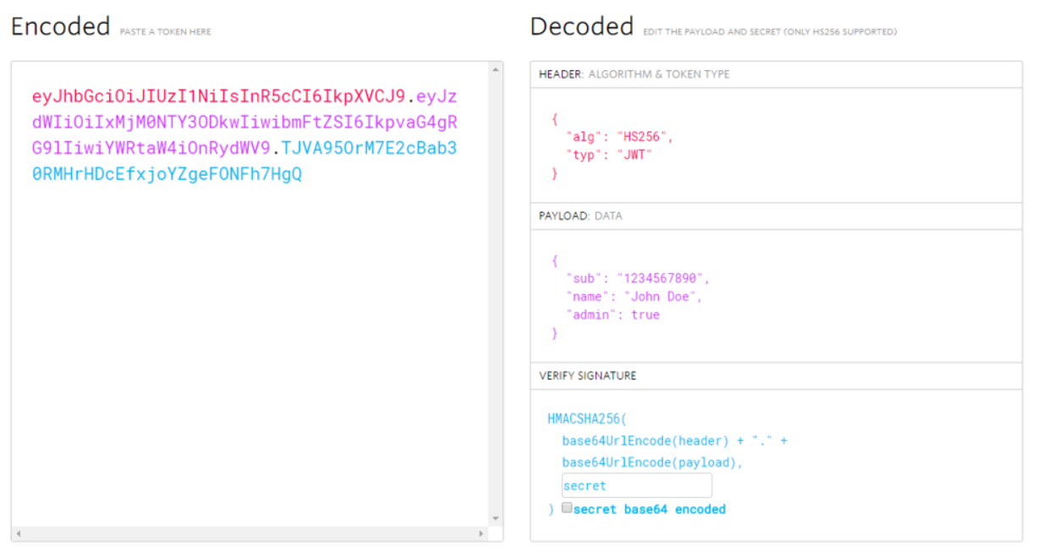
JWT ( JSON WEB TOKENS )
Token is a data structure that:
Can have information about user, supplier, services.
Can have expiration date
JWT token is made of
Header
Data
Signature
https://jwt.io/

Slide 4
Authorization with OAuth
OAuth
Used for both authorization and authentication
Global scale
Oriented to services
OAuth is used when we need to grant access to third parties without giving user credentials.

Slide 5

OAuth with Auth0
Easy way to use Authentication, Authorization services and much more
Integrations with many systems and frameworks
Auth0 integretion to Angular 2+

Slide 6

Authentication with Route Guards
Make an angular service to define if route can be accessed or not
{ path: 'employees', component: EmployeesComponent, canActivate: [AuthGuard] }

Slide 7
References
https://jwt.io/
https://auth0.com/docs/quickstart/spa/angular2/01-login
https://medium.com/@ryanchenkie_40935/angular-authentication-using-route-guards-bf7a4ca13ae3

