Slide 1
Project with Angular 2 Part 2
NRD Akademija 2018
Vilius Arminas
2017-02-09, Kaunas

Slide 2
Services
Components shouldn't fetch or save data directly. They should focus on presenting data and delegate data access to a service.
Services are a great way to share information among classes that don't know each other.
Services can also inject dependencies using @Injectable() decorator.
Returns Observables. Observables open up a continuous channel of communication in which multiple values of data can be emitted over time.

Slide 3
REST API
CRUD - Create, read, update, delete
Used Via HTTP
Action | SQL | HTTP | URL
Create | INSERT | POST | /employee/:id
Show List | SELECT | GET | /employee
Show One | SELECT | GET | /employee/:id
Update | UPDATE | PUT / PATCH | /employee/:id/edit
Destroy | DELETE | DELETE | /employee/:id

Slide 4

JSON Server
“Get a full fake REST API with zero coding in less than 30 seconds (seriously)”
“Created with <3 for front-end developers who need a quick back-end for prototyping and mocking.”
Installation
npm install -g json-server
Edit db.json with your data
Start JSON Server
In directory with db.json run command -> json-server --watch db.json

Slide 5
Nested Components (1)
An application in Angular is a set of custom components glued together in HTML via inputs and outputs.
Breaking up an application into multiple logical components makes it easier to:
Architect an application as it grows in complexity.
Re-use common components in multiple places.

Slide 6
Nested Components (2)
Parent component
@Component({
selector: 'joke-list',
template: `<joke *ngFor="let j of jokes" [joke]="j"></joke>`
})
class JokeListComponent {
jokes: Joke[] = // some data; }
Child components takes [joke] as input with property bindind element @Input()
@Component({
selector: 'joke',
template: `{{joke}}`
})
class JokeComponent {
@Input() joke; }

Slide 7
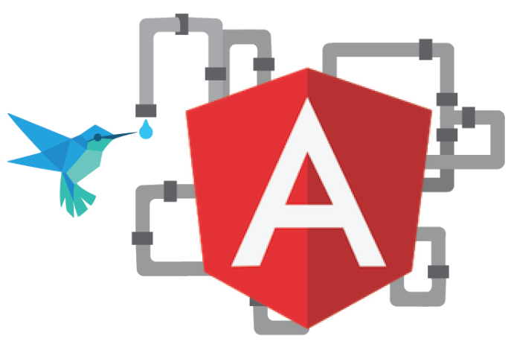
Angular Pipes (1)
Angular pipes, a way to write display-value
transformations that you can declare in your HTML.
A pipe takes in data as input and transforms
it to a desired output.
Angular 2 comes with a stock of pipes such as DatePipe, UpperCasePipe, LowerCasePipe, CurrencyPipe, and PercentPipe.
Pipe is used with symbol “|”:
<p>My name is <strong>{{ name | uppercase }}</strong>.</p>

Slide 8

Angular Pipes (2)
Creating custom pipe
import { Pipe, PipeTransform } from '@angular/core';
@Pipe({name: 'capitalize'})
export class CapitalizePipe implements PipeTransform {
transform(value: string, args: string[]): any {
if (!value) return value;
return value.replace(/\w\S*/g, function(txt) {
return txt.charAt(0).toUpperCase() + txt.substr(1).toLowerCase();
});
}
}

Slide 9
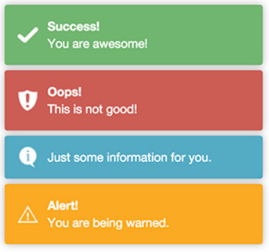
Toastr (1)
toastr is a Javascript library for non-blocking notifications.
Installation
npm install ng2-toastr –save
Including js and css in angular-cli.json
"styles": [
..
"../node_modules/ng2-toastr/bundles/ng2-toastr.min.css"
],
"scripts": [
..
"../node_modules/ng2-toastr/bundles/ng2-toastr.min.js"
],

Slide 10
Toastr (2)
Setting toaster in app module
import {ToastModule} from 'ng2-toastr/ng2-toastr';
@NgModule({
imports: [BrowserModule, ToastModule.forRoot()],
declarations: [AppComponent],
bootstrap: [AppComponent],
})
export class AppModule { }
Setting up app component
import { ToastsManager } from 'ng2-toastr/ng2-toastr';
@Component({
… })
export class AppComponent {
constructor(public toastr: ToastsManager, vcr: ViewContainerRef) {
this.toastr.setRootViewContainerRef(vcr);
}
Using notifications
this.toastr.success('You are awesome!', 'Success!');

Slide 11
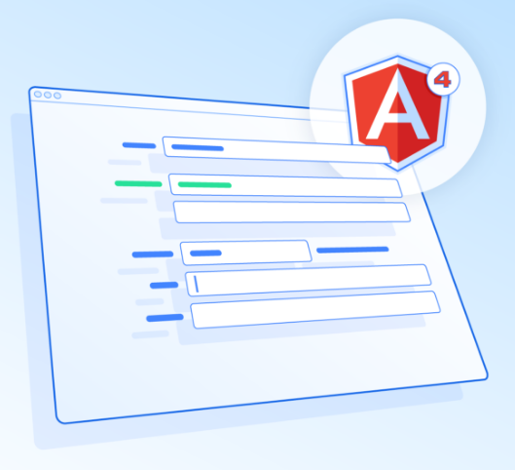
Template driven forms and validation
Bind directives and behaviour to our templates, and let Angular roll with it.
Use HTML 5 attributes to validate inputs
<input pattern="[a-z0-9._%+-]+@[a-z0-9.-]+\.[a-z]{2,3}$" required“>
Use [(ngModel)] for two-way data binding
<input #firstName="ngModel" [(ngModel)]="employee.firstName“>
Use “ngForm” to validate form and ngModel to validate separate inputs
<form novalidate #myForm="ngForm">
To check if form is valid use -> myForm.valid
To check if input is valid use -> firstName.valid

Slide 12
References
https://angular.io/tutorial/toh-pt4
https://angular-2-training-book.rangle.io/handout/observables/
https://github.com/typicode/json-server
https://codecraft.tv/courses/angular/quickstart/nesting-components-and-inputs/
https://angular.io/guide/pipes
https://scotch.io/tutorials/create-a-globally-available-custom-pipe-in-angular-2
https://www.npmjs.com/package/ng2-toastr
https://toddmotto.com/angular-2-forms-template-driven

