Slide 1
Throat Disease Detection Project

Slide 2
MFCC
Linear cosine transform of short term log power spectrum.
Commonly used as features in speech recognition.
Not very robust in the presence of noise.

Slide 3
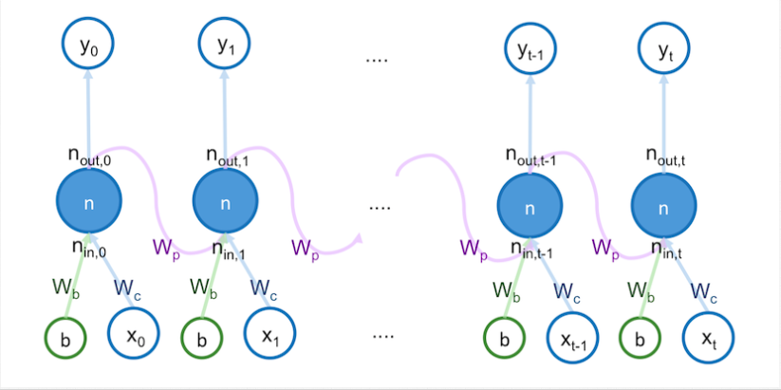
RNN(LSTM)

Slide 4
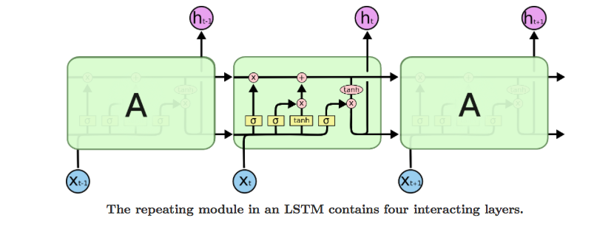
LSTM

Slide 5
Flow Chart
N frames of MFCC
LSTM model
Result
(Argmax)
Normal/Sick
(Single frame)

Slide 6

Experimental Result
11 frames of MFCC
256 dim
256 dim, 2 layer
2 dim
Normal
BLSTM
Sick
…
Accuracy: 0.94$±$0.01

