Slide 1
Reclama
Card disputes
with verifiable evidence
The customer confirms an exact charge.
The reviewer receives an auditable case.
Roberto Villafuerte Jorge Arguello Daniel Andrade
Factored AI & Data Hackathon 2026. Sandbox with no real financial decisions.
Notes:
Reclama prepares card-dispute intake for human review. Demonstrated value: recover a persisted case after an explicitly simulated lost response while retaining source facts, the customer statement and audit trail. Focused engineering contribution, without a claim of unique invention or proven business savings. No fraud adjudication, refund or money movement. Team supplied by user. Official scope: https://www.factored.ai/careers/ai-data-hackathon .

Slide 2
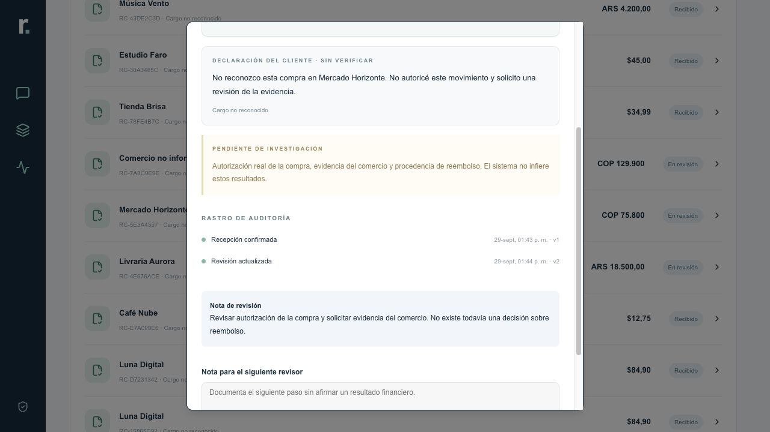
A complete request in Spanish and Portuguese
01
02
03
Identify
Confirm
Record
Customer ownership and exact charge
Separate facts from the customer statement
Write and read back
The agent retains the context
Verifiable facts
Customer statement
Unanswered questions
Sandbox. Team-created demo data. Request intake for human review.
Notes:
Actual local sandbox screenshot with invented fixtures: docs/video/sources/review-es.png. Customer interfaces remain Spanish and Portuguese as required. English narration and exact click path: docs/release/2026-10-05/RECORDING_SCRIPT_EN.md. Exact transaction selection and explicit consent precede writes. Receipt establishes intake, not financial resolution. This screenshot does not establish hosted-account acceptance.

Slide 3
Implemented architecture
ES/PT client
React 19 + TypeScript
TF-IDF + logistic regression
Inference in Worker
Cloudflare Worker
Session, permissions and states
Versioned consent
Idempotency and constraints
Read back before receipt
Agent view
Case file and review
D1 / SQLite
Persistence and audit trail
Local intent inference. Total operating cost remains unmeasured.
Sandbox. Team-created demo data. Request intake for human review.
Notes:
React 19, TypeScript, Vinext, Cloudflare Worker and D1 SQLite. Frozen TF-IDF/logistic regression suggests intent. Deterministic ownership, roles, consent, state constraints and idempotency control writes outside the model. The model cannot authorize a transaction or select a charge. A unique write followed by readback precedes a receipt. No bank connector. No external model API at runtime. Total infrastructure/storage/human-review cost is unknown. Conditional tariff model and exclusions: docs/evidence/CASE_COST_MODEL_2026-09-30.md, last tariff check October 2.

Slide 4
Full corpus review exposes limited intent coverage
7,671
23.5M
47
CSV files inspected
rows across the corpus
distinct customer inputs
13 tables.
Source hashes verified.
Complaints and transcripts:
238,416 rows reviewed.
Spanish only.
Already seen in the sample.
Six intent classes lack AI-consensus reference examples. Portuguese has none.
This retrospective diagnostic cannot establish a valid ES/PT benchmark.
Organizer corpus diagnostics. Repeated rows are not independent customer cases.
Notes:
Full corpus diagnostics from the separate evaluation worker, October 4: 7,671 CSV, 13 tables, 23,495,188 rows. Relevant complaints/transcripts: 2,194 CSV, 238,416 rows, 47 distinct customer inputs, one connected grouping component. All 47 already appeared in the earlier 12-date sample: retrospective, not unseen. Spanish only, zero Portuguese. Two AI reviewers agreed on 25 labels, disagreed on 21, both abstained on one. Agreement supports account_query (21) and other (4). Six unsupported classes: card_lost, credit_query, duplicate, merchant_issue, refund_request, unrecognized. No confidence intervals or population claims. Sanitized provenance: docs/release/2026-10-05/corpus-diagnostic.json and EVIDENCE_LIMITS.md. Earlier sample ownership findings remain in data-pipeline/report.json; they are not extrapolated to the full corpus. Private rows are excluded from this package.

Slide 5
A tested workflow with a conservative model
Exploratory AI reference: 25 texts
15/15
Method | Matches
Rules baseline | 25/25
Frozen model v2 | 21/25
prepared API sequences
70 timed local requests.
Intake, ambiguity and handoff.
AI agreement is not ground truth.
Six classes have no reference support.
47/47 corpus inputs require clarification
No autonomous routing. Independent ES/PT evaluation remains pending.
Software QA does not establish financial resolution or model accuracy.
Sandbox. Team-created demo data. Request intake for human review.
Notes:
Same 25 distinct AI-agreement texts: rules matched 25/25, frozen v2 matched 21/25. Both matched 21 account_query examples. V2 mislabeled four other examples: three unrecognized, one merchant_issue. The remaining 22 inputs lack an agreed label. This is not human gold or an admissible independent benchmark. All 47 inputs trigger clarification, zero acceptances, zero coverage, selective accuracy undefined. No model advantage is established. The archived 256-message AI-authored experiment remains development history. Sources: docs/release/2026-10-05/corpus-diagnostic.json and EVIDENCE_LIMITS.md.
Separate software QA: docs/evidence/full-case-rerun-2026-10-02.json reports five ES intakes, five PT clarification sequences and five PT support handoffs. All 15 pass prepared criteria across 70 timed requests. Sequence p50/p95 milliseconds: normal 110.15/265.60, ambiguity 37.01/54.38, handoff 101.37/104.55. Setup, sign-in, rendering and human time excluded. n=5 per scenario: p95 is the largest observation. Run overlapped a build. These are repeated prepared sequences, not independent customers or financial resolutions. Total cost unknown. Historical 28 HTTP checks and 160 contract assertions are separate software QA.

Slide 6
Reproducible deliverables and next steps
Implemented prototype
Requirements for bank use
ES/PT client and agent view
Persisted cases and traces
Contracts, tests and reproduction
Institutional identity and policies
Case management integration
Validation with representative data
Open prototype
Code and reproduction
Restricted demo and private code. Release and judge access need approval.
Hackathon deadline: October 5, 23:59 UTC−5
Sandbox. Team-created demo data. Request intake for human review.
Notes:
October 5 private release review. Existing demo: https://reclama-factored-2026.villafortech.chatgpt.site . Private repo: https://github.com/VillaforTech/factored-hackathon-2026-reclama . Draft PR #2 targets codex/reclama. Remote head fa53b3578a2ea33c3037a5c4620832d3d3519a27 has successful CI: https://github.com/VillaforTech/factored-hackathon-2026-reclama/actions/runs/36997154601 . Later local English-guide/release edits are neither deployed nor covered by that CI. Existing deployment source: 3ae216e005b9625a9bc68e4bbf082d86dec7e53b. October 4 policy: custom access for owner and one external viewer. Anonymous-denial checks passed. Normal real-account login, reload and two-account isolation remain unverified. No supported authenticated browser is connected here; that does not prove an identity-provider failure.
Official hub requires public repository, working deployed link, 4–6 slides and video at most three minutes: https://www.factored.ai/careers/ai-data-hackathon . English and no face required: https://factored-hackathon.slack.com/archives/C0BUZCY0TUY/p1791153414484629 . Public demo preferred, judges randomly assigned and may contact submitter if access fails: https://factored-hackathon.slack.com/archives/C0BU54YAKMG/p1791153383839789 . This is not an explicit anonymous-access mandate. Publication, invitations, integration, push, deployment and submission still need approval. User will record English demo; no new video produced. Recorded deadline October 5, 23:59 UTC−5: https://factored-hackathon.slack.com/archives/C0BU54YAKMG/p1790614675075619 . No submission receipt. Human language review and real-account A/B tests are internal recommendations, not additional official clauses.

