Slide 1

Fairness Aware Machine learning
Charles Santhakumar
Roberto Villafuerte

Slide 2
Dataset & Sensitive variable
Sensitive variables considered – Race and Sex
Dataset - Census income dataset

Slide 3
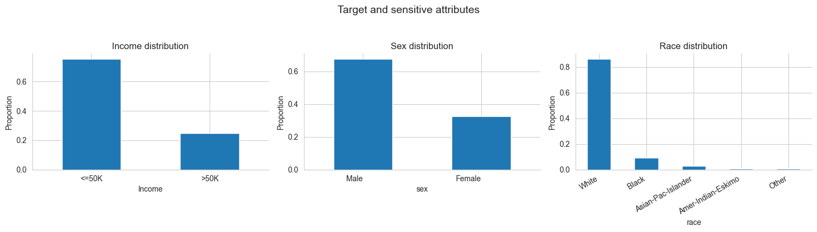
EDA findings

Slide 4
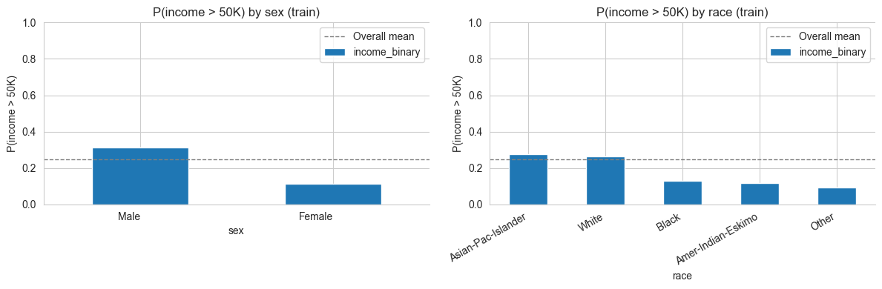
EDA findings

Slide 5
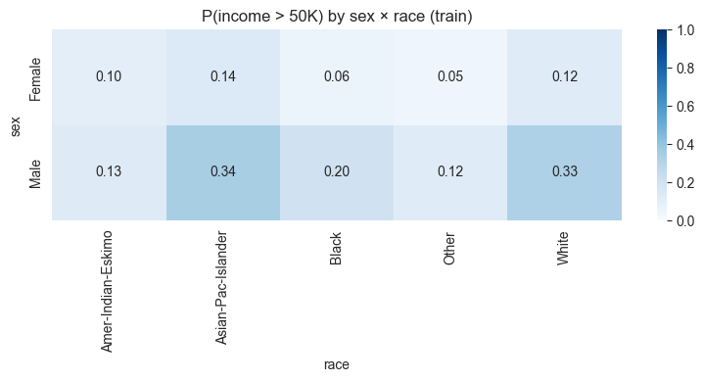
EDA findings

Slide 6


Fairness metrics
Demographic parity as fairness measurement method “How often does each group receives income over the set threshold?”
Metrics:
Statistical parity difference (SPD) “Gap in the positive outcome between privileged vs unprivileged groups”
Disparate Impact (DI) “Ratio – privileged vs unprivileged”

Slide 7

Raw Fairness
Sex: 'DP': 'Female': 0.11, 'Male': 0.30
'SPD': 0.196, 'DI': 0.365
Likelihood ratio 0.30/0.11 =2.73
Race: 'DP': ‘Non-White’: 0.158, 'White': 0.259
'SPD': 0.10, 'DI': 0.61
Likelihood ratio 0.26/0.16 =1.64

Slide 8
Model comparison – Accuracy & Fairness metrics

