Slide 1

Chessy3D
Computer Vision and Cognitive Systems Project
Luca Villani
Matr. 200412
Alessandro Mezzogori
Matr. 200559
Davide Della Casa Venturelli
Matr. 201103

Slide 2
Summary
Our approach…
Section I - Detecting chessboard corners and cell boundaries
Section II - Chess-piece detection pipeline
Section III - FEN procedure
Section IV - Chess image similarity search

Slide 3
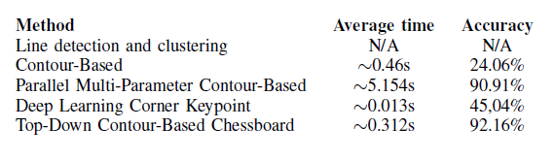
Section I
Detecting chessboard corners and cells boundaries
Explored solutions
Positive match for accuracy the calculation
All 4 corners have been found
All corners must satisfy: the distance between predicted corner and the ground truth <= 30 pixels
Calculated over a dataset of 2k images
Our choice: Top-Down Contour-Based

Slide 4
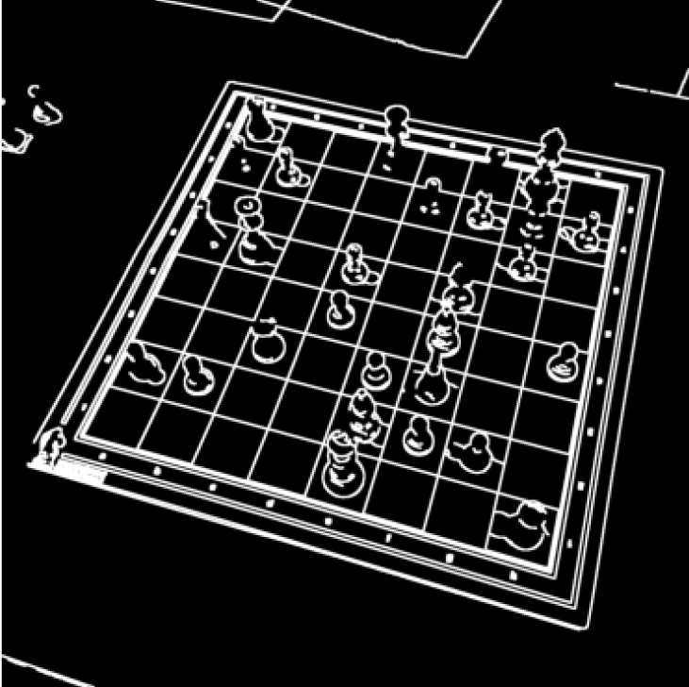
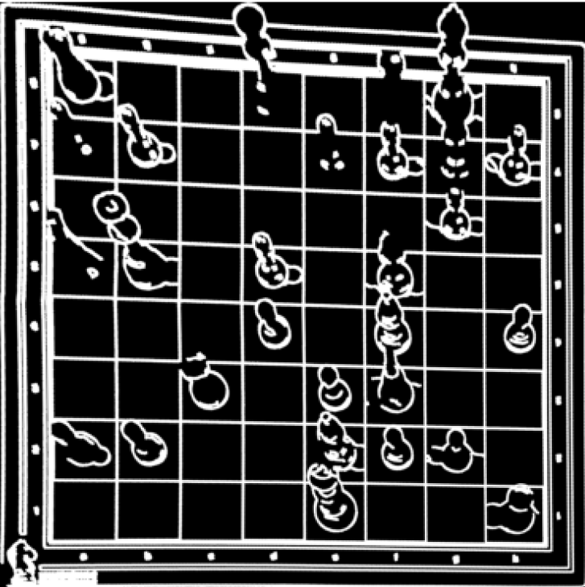
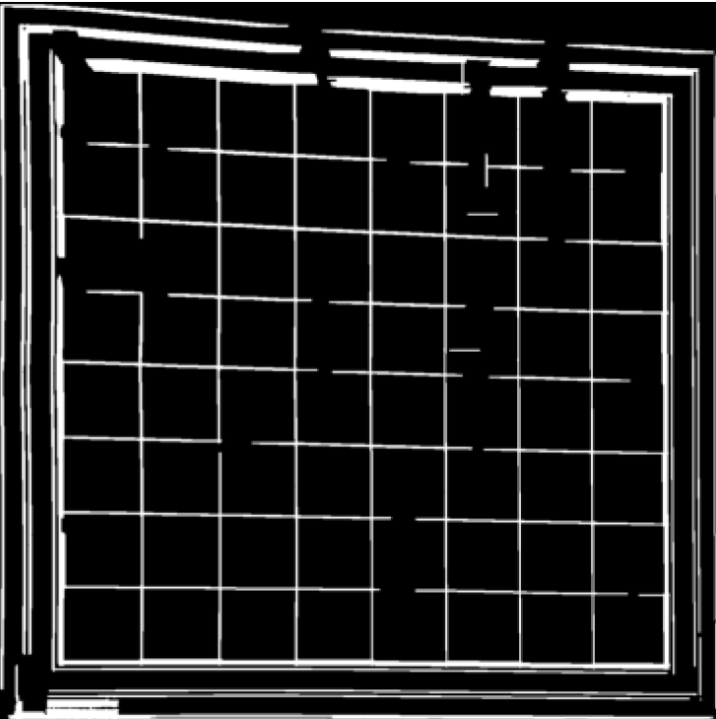
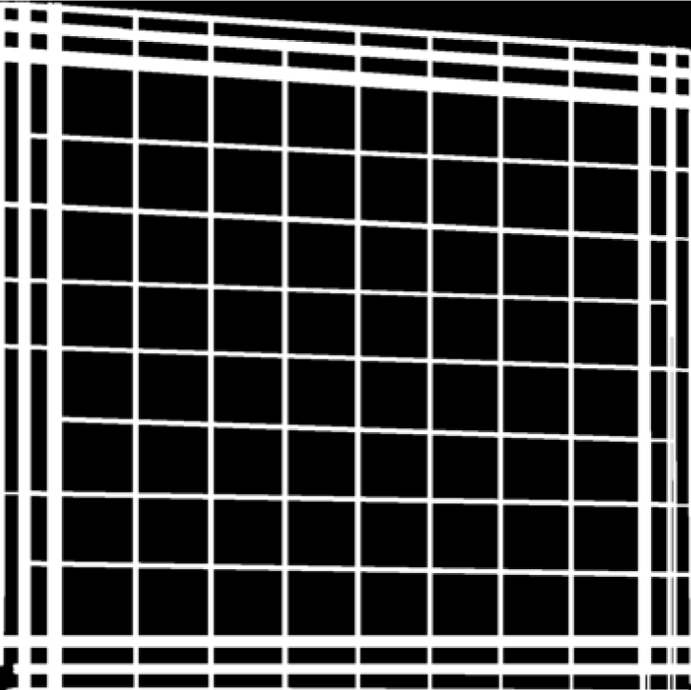
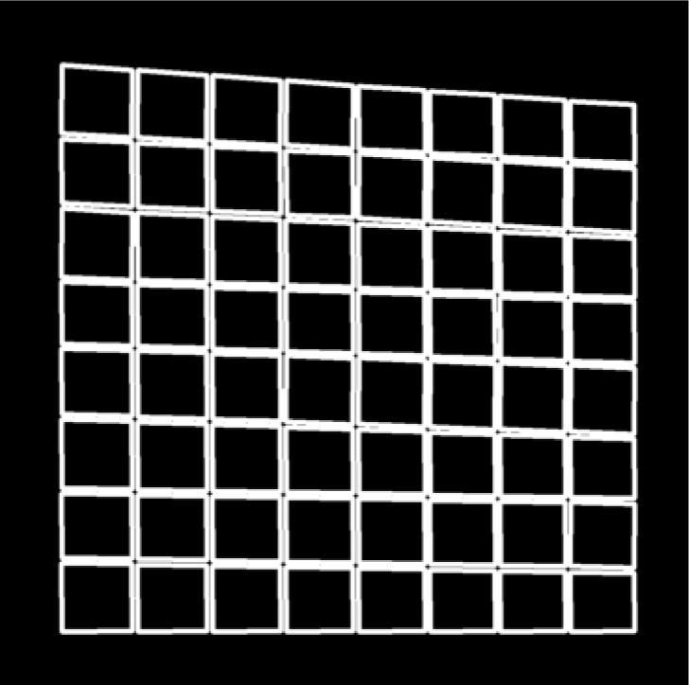
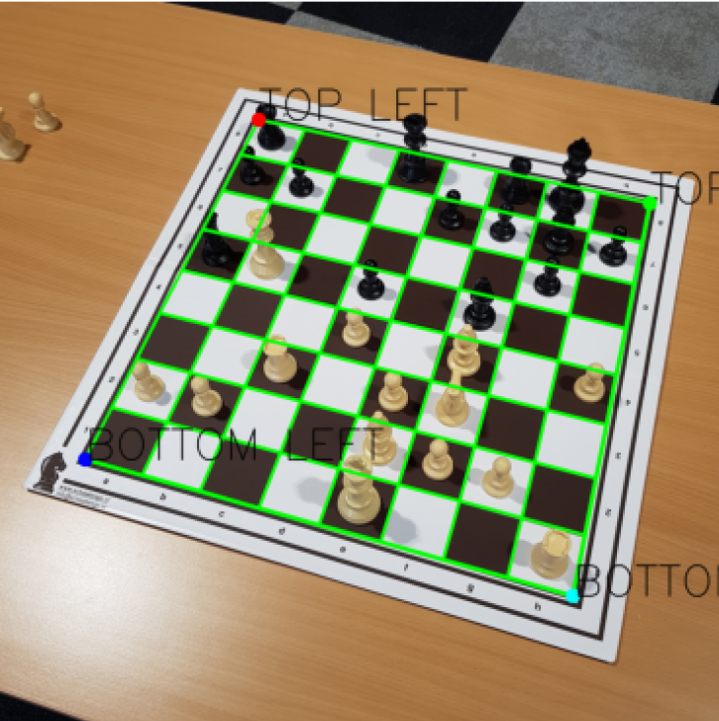
Section I
Top-Down Contour-Based pipeline
Vertical and horizontal lines filtering
Line extension, Cleanup, Hough
Find quads, Extract largest contour, Extract corners
Grayscale, Bilateral, Canny
Visualization
Homography

Slide 5

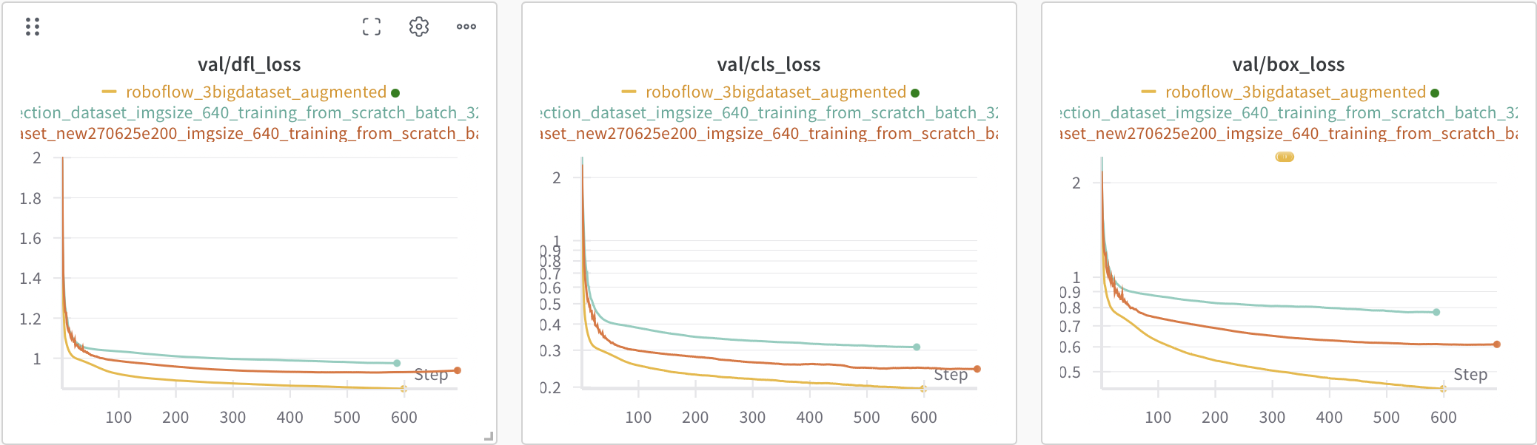

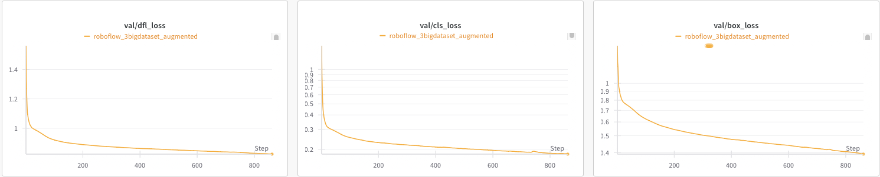
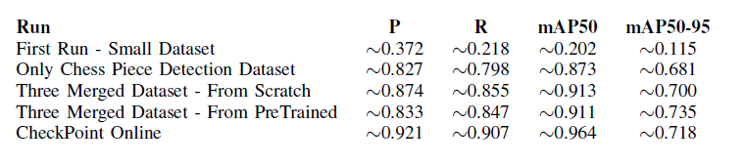
Section II
Chess-piece detection pipeline
Our datasets
PRO
DETR
YOLO
Global model
No empty class
No duplicated objects
Output
How was the training
class
bbox
confidence score
Our final results

Slide 6
Section III
FEN procedure
Object detection bounding boxes
Object detection
Pieces positions assignment
Fen annotation
0-32 pieces
Object detection classes
rnbqkbnr/pppppppp/8/8/8/8/PPPPPPPP/RNBQKBNR w KQkq - 0 1
Grid cells detection
Detected grid cells bounding boxes
~64 cells
Matching grid cells using a scaled point at 30px from the base of the detected object bounding box

Slide 7


Section IV
Chess image similarity search
Embedding
Detected chessboard
Embedding
Distance calculation
Ranking
Similar configurations
Positional one-hot binary embedding for each chessboard cell
64 cells * 12 bits = 96 bytes
Chessboard games database
Distance function
Hamming Distance HNSW indexing
Embedding pre-calculated

Slide 8
Conclusion
Key results
Final chessboard detection: ~92% accuracy
Piece detection: ~92% accuracy
Limitations
Chessboard must be fully visible and centered.
Generalization to all board/piece designs is still a challenge.
Future works
Improve robustness with occlusion handling.
3D reconstruction techniques.

Slide 9
Chessy3D
Thanks for your attention.
Computer Vision and Cognitive Systems Project
Luca Villani
Matr. 200412
Alessandro Mezzogori
Matr. 200559
Davide Della Casa Venturelli
Matr. 201103

