Slide 1
Smart Wildlife Monitoring System
OpenMV N6 • Thermal motion detection • Pre-event recording • AWS recognition
Embedded → Cloud
Ville Karppinen | Metropolia UAS

Slide 2
1. Project Goal
Capture the event — including the seconds before the trigger
Pre-event buffer
Last 5 seconds kept in RAM
Motion detected
Thermal trigger
Event recording
RGB + thermal MJPEG
Main idea: a motion-triggered camera should not lose the beginning of the event.
2

Slide 3
2. Hardware
Three components define the embedded camera system
OpenMV N6
PAG7936 RGB
FLIR Lepton 3.5
Main embedded platform • MicroPython • 64 MiB SDRAM • Camera interfaces • Wi-Fi networking
High-resolution visual recording • 640 × 400 prebuffer • 1280 × 800 live recording • RGB565 pre-event frames
Thermal sensing and event trigger • 160 × 120 • Thermal frame differencing • FFC-aware motion detection
Lepton detects → PAG provides detail → both cameras record the event
3

Slide 4
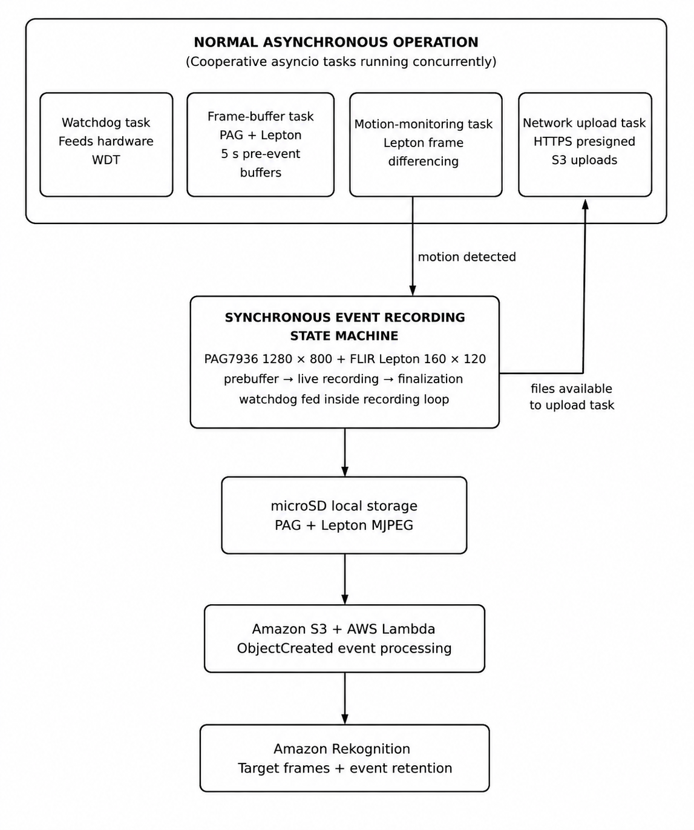
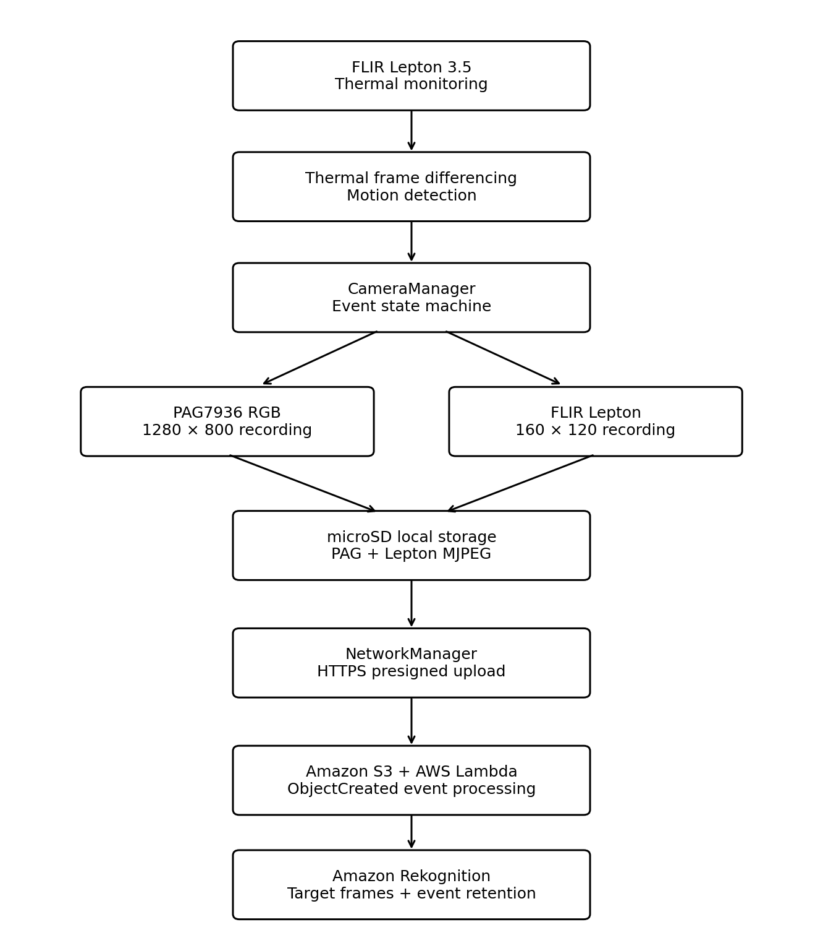
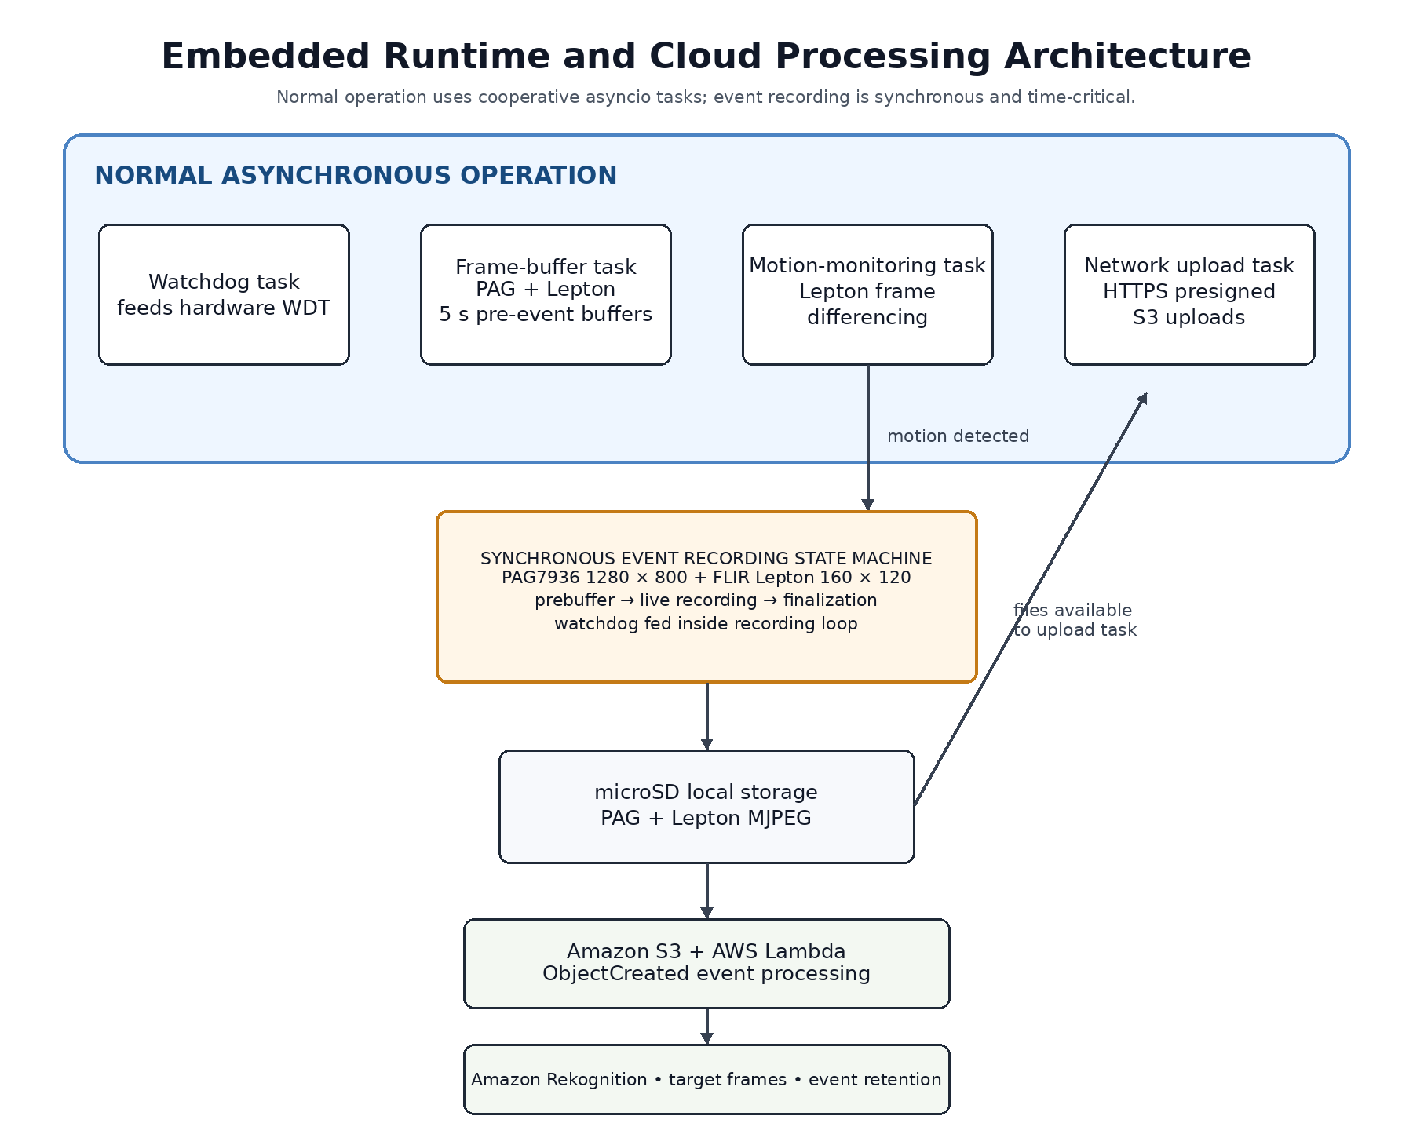
System Runtime Architecture

Slide 5
4. Pre-Event Buffer & Motion Detection
The main embedded design challenge
640 × 400
1280 × 800
18
19
20
21
22
23
24
25
RGB prebuffer ≈ 12.21 MiB
Same 25-frame buffer ≈ 48.83 MiB
Newest 25 frames continuously replace the oldest
5 seconds
Thermal trigger
Adaptive background
5 FPS × 5 s = 25 frames
Frame differencing + histogram percentiles
Slow environmental changes are absorbed
5

Slide 6
5. Engineering Problems Solved
The project became much more than basic motion detection
Lepton FFC
MJPEG / AVI
Memory pressure
Calibration looked like motion. Solution: suspend detection, wait 5 s, rebuild background.
Incorrect timing and missing index. Solution: patch timing fields and generate AVI idx1.
Large RGB buffers exceeded the practical heap. Solution: lower prebuffer resolution and reuse images.
Reliability
Networking
Proactive garbage collection, persistent logging and hardware watchdog recovery.
Asynchronous HTTPS upload, retry handling and local file retention after failures.
6

Slide 7
6. AWS Backend
Temporary credentials on the device — automated processing in the cloud
OpenMV N6
Request upload URL
API Gateway + Lambda
Generate presigned S3 PUT URL
Amazon S3
Store PAG + Lepton MJPEG
Lambda
S3 ObjectCreated event
Rekognition
Analyze selected PAG frames
Configured target found → retain event and save target frames No configured target → reject and delete the event
7

Slide 8
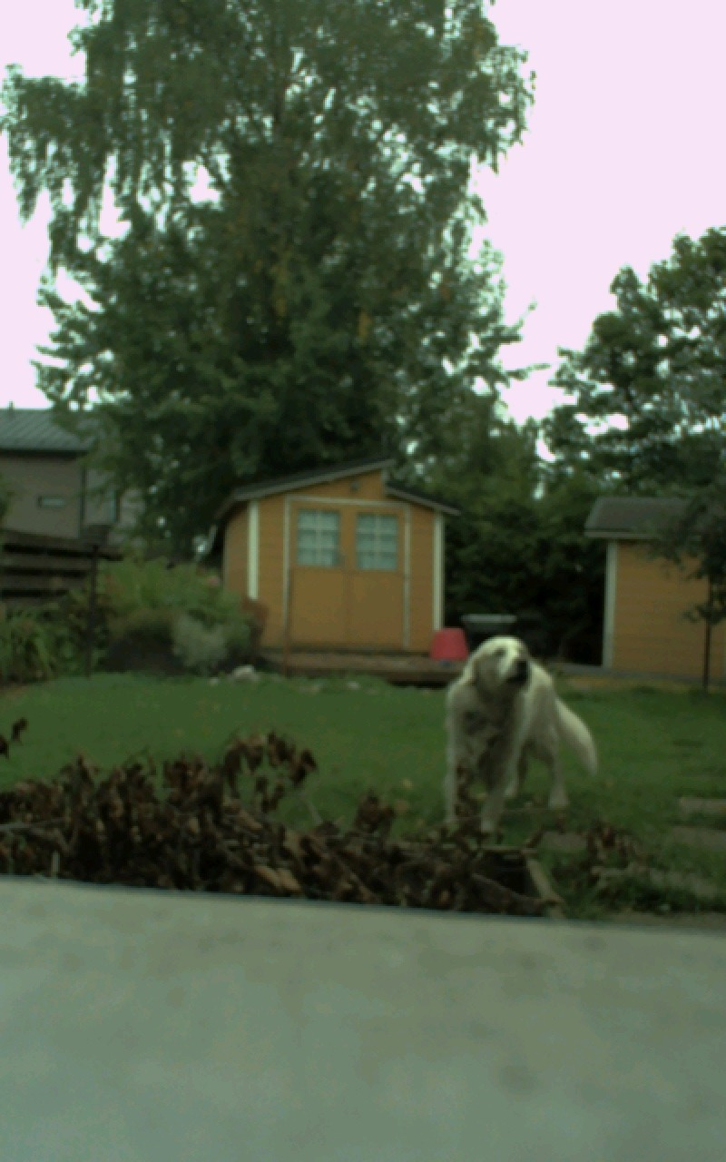
7. Results & Demonstration
Measured results from the completed system
5 s
pre-event buffer
25
frames per full buffer
~4.84 FPS
measured PAG live recording
>10 h
full-system stress test
Thermal detection → pre-event recording → dual-camera MJPEG → S3 → wildlife recognition
Example PAG frame processed by the AWS recognition pipeline
8

