Slide 1
Distr Chat
Ville Kylmämaa

Slide 2
Purpose
Horizontal scaling and high availability of a WebSocket based real-time messaging system
The number of WebSocket connections to a single application server is a common bottleneck
Being able to horizontally scale application servers is valuable
Problem: An application server can only send messages through its own WebSocket clients
Thus, there must be a way of communication between the app servers
High availability: An important system should have no single-point-of-failure

Slide 3
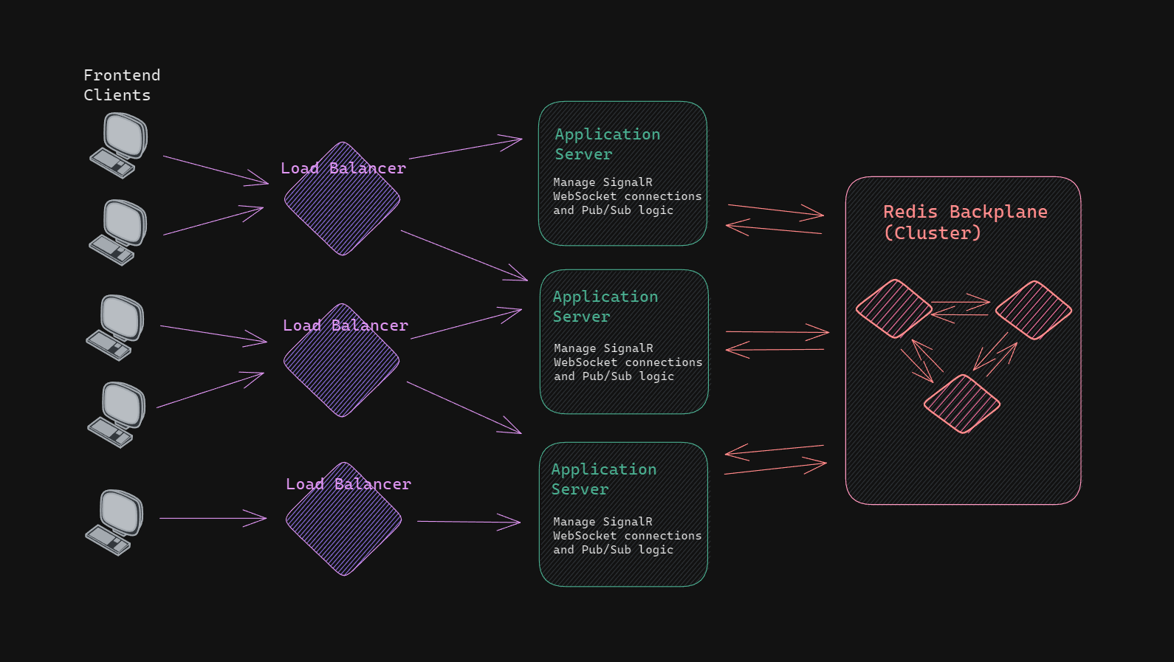
Architecture
Types of nodes
Frontend client
Load balancer
Application server
Backplane

