Slide 1
Distr Chat
Ville Kylmämaa

Slide 2
Purpose
Horizontal scaling and high availability of a WebSocket based real-time messaging system
High availability: System should have no single-point-of-failure
Common bottleneck: The number of WebSocket connections to a single application server is a common bottleneck
Being able to horizontally scale application servers is valuable
Problem: App server can only send messages through its own WebSocket clients
Thus, there must be a way of communication between the app servers

Slide 3
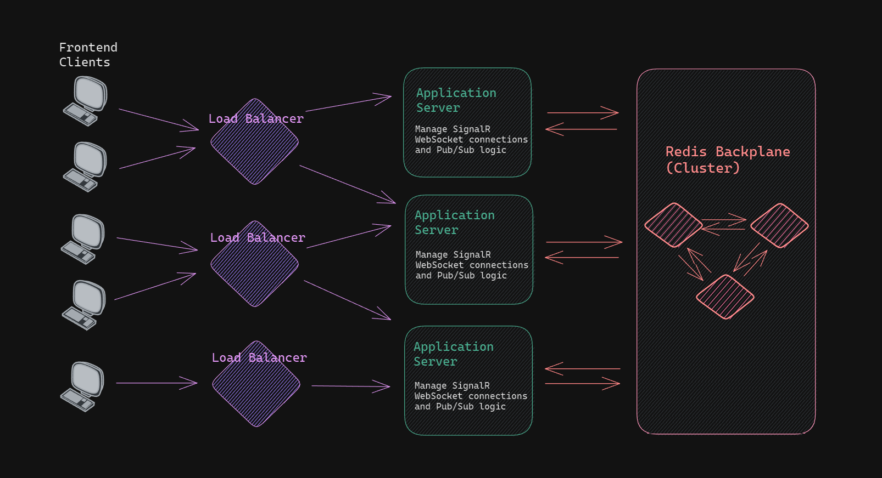
Architecture
Frontend client
TypeScript, React
Load balancer
C# .NET
Application server
C# .NET
WebSocket lib: SignalR
Backplane
Redis (Cluster, Pub/Sub)

Slide 4
Repository
https://github.com/VilleKylmamaa/Distributed-Systems-Project

