Slide 1
Tender Intelligence
Automated Public Sector Tender Monitoring for CGI
Working Proof of Concept — April 2026

Slide 2
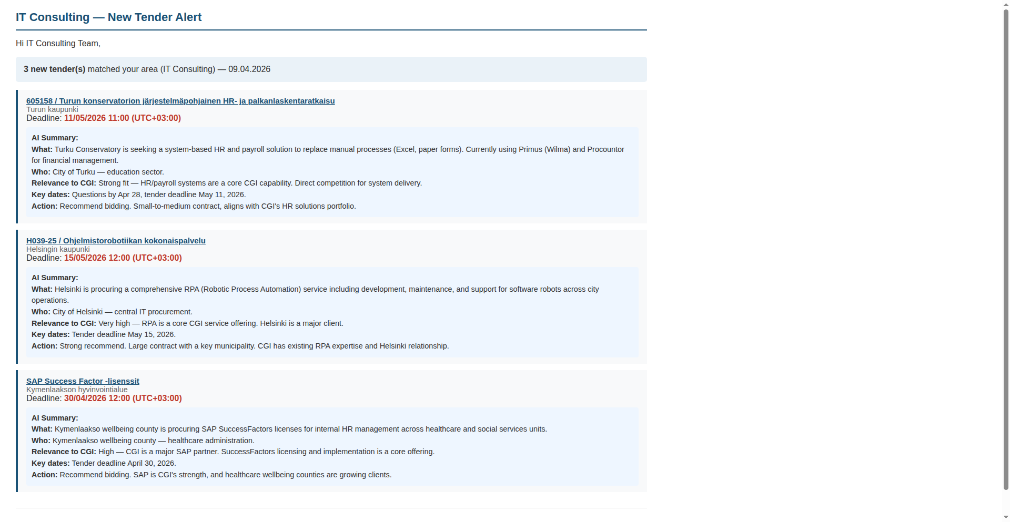
What CGI Experts Receive
Daily email per department:
Each department receives one email containing only their relevant tenders. For each tender: • Clickable link to tarjouspalvelu.fi • Organization and deadline • AI-generated summary: — What is being procured — Relevance to CGI — Recommended action Tier 1A: CGI own products (Aromi, Raindance, Titania, etc.) → Defend existing customers or bid on upgrades/renewals Tier 1B: Partner platforms (SAP, Azure, ServiceNow, etc.) → Bid as implementation partner

Slide 3
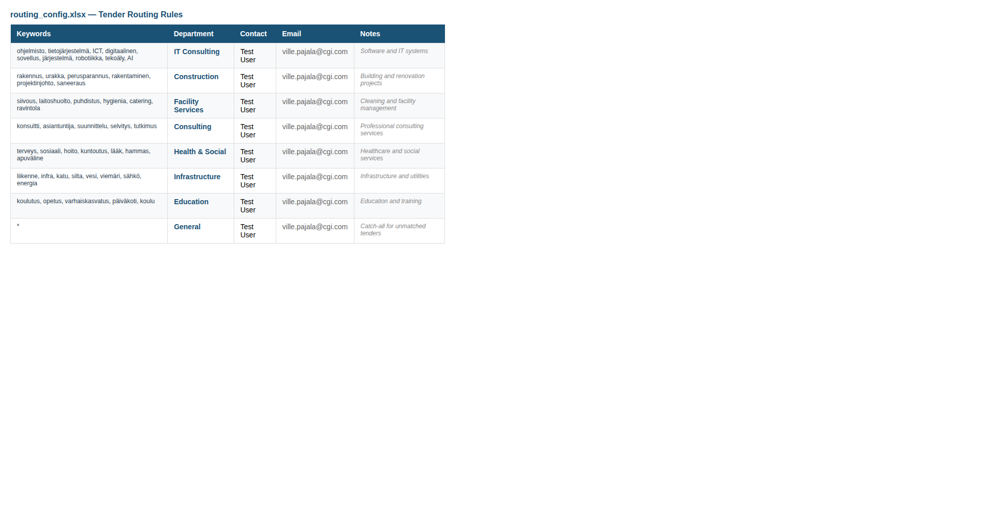
Routing Configuration
Non-technical users edit this Excel file to control who receives which tenders. Keywords are matched against tender name and description. One email per department per day. Tier 1 product alerts (Aromi, SAP, etc.) are handled automatically — no configuration needed.

Slide 4
How It Works: Tender Scraping
tarjouspalvelu.fi (5,000+ tenders)
Automated Scraping
Filtering & Classification
AI Summary
Store & Route
▼ Smart Routing ▼
TIER 1: PRODUCT ALERTS 1A: CGI own products (Aromi, Raindance, Titania, OMNI360...) 1B: Partner platforms (SAP, Azure, ServiceNow, UiPath...)
TIER 2: DOMAIN MATCH Keywords match CGI department (IT, consulting, health, etc.) → Daily email digest
TIER 3: GENERAL No specific match → No email
ANALYTICS Award results feed price intelligence & competitor profiles
CRITICAL
HIGH
LOW
All tenders stored permanently | Deduplication across runs | Historical data grows over time

Slide 5
Tarjouspalvelu.fi
Pipeline:
Open Chrome (automated)
Bypass Cloudflare (auto-resolves)
Login via SSO (Cloudia Services)
Global search (all of Finland)
Extract data
Data extracted per tender:
From listing page (all tenders at once) • Tender name and ID • Organisation • Type (competition, results, DPS, etc.) • Full description text • Publication date and deadline
From detail page tabs (login required, per tender) • Summary with full description and dates • Questions & Answers thread • Terms and conditions / qualification reqs • Procurement object details • Persons in charge / buyer contacts
Solved challenges:
Cloudflare Bot Protection Blocks all standard automation. Our solution auto-resolves it. Tested 5 approaches — only one works.
Login Automation Two-step SSO redirect to Cloudia. Vaadin framework (non-standard UI). Fully automated with credentials.
Production Readiness Needs: service account (not personal), virtual display for server, scheduled nightly runs.

Slide 6
Technical Implementation (demo)
Data Extraction
Python Selenium + undetected- chromedriver
Browser Automation Cloudflare bypass, SSO login, pagination
HTML Parsing JavaScript extraction from listings + detail tabs
SQLite Database Deduplicated storage, change tracking across runs
Processing & Intelligence
Rule-based Classification Python regex (no AI needed)
AI Summarization OpenAI API (GPT-4.1-nano)
Three-Tier Routing Product matching + keyword rules (Excel)
Award Analysis OpenAI API — extract winner, price, bidders
⚡ OpenAI API call
⚡ OpenAI API call
Delivery
Email Digests SMTP — one HTML email per department per day
Tier 1 Alerts Critical notifications for CGI product mentions
Web Dashboard ?
Competitor & Price Intelligence Reports
Stack: Python 3.12 | Selenium + undetected-chromedriver | SQLite | OpenAI API | openpyxl | SMTP Deployment: Linux VM + Xvfb (virtual display) | Cron scheduling | No cloud dependencies beyond OpenAI

Slide 7
Deep Intelligence
Separate analytics mode scrapes award results, builds competitive and pricing intelligence over time.
Analytics Pipeline
Intelligence That Grows Over Time
Scrape Award Results Filter to decided tenders (Results, Contract Awards)
AI Extraction OpenAI parses Finnish text → winner, price, bidders, sector
COMPETITOR PROFILES Each award result updates a rolling database: • Win count per company • Total and average contract value • Sectors they operate in • Most recent win date
⚡ OpenAI API call
Structured data extracted per award:
• Winner company name (preserved in Finnish) • Winning price (EUR, ex. VAT) • Estimated contract value • Number of bidders • Contract duration (e.g. '2 years + 2 option years') • Sector (IT, Construction, Healthcare, etc.) • Confidence level (high / medium / low)
PRICE INTELLIGENCE Contract values grouped by sector: • Average, min, max per sector • Helps size CGI bids competitively • Identifies high-value sectors
How it works in practice:
Week 1 First analytics run: ~100 awards → initial competitor/price data
Month 1 Nightly runs accumulate ~500+ → patterns emerge per sector
Ongoing Historical database grows → benchmark bids, spot trends
Runs as a separate nightly job alongside tender alerts | Same infrastructure, different filter | ~$9/month AI cost

Slide 8
Detail Page Enrichment
Logged-in scraping unlocks structured tender data across 6 content tabs for richer AI analysis.
Listing Page (public, fast)
Detail Page Tabs (login required)
• Tender name, ID, organisation • Type and category • Short description • Publication date and deadline → Enough for routing and basic summaries
• Summary — full description, dates, org details • Q&A thread — buyer answers, competitor signals • Terms & conditions — qualification requirements • Procurement object — scope, volumes, structure • Persons in charge — buyer contacts → Richer summaries, competitor signals, initial bid assessment
How detail scraping works (session-preserving navigation):
On listings page find tender row
Click link (ActionChains — preserves session)
Full detail page all tabs accessible (logged-in view)
Extract text + tab data
Back to listings
What richer data enables:
Better AI Summaries Full tab content instead of short descriptions → more accurate relevance scoring
Initial Bid Assessment Terms & procurement object reveal qualification reqs → AI flags fit or misfit
Competitive Intelligence Q&A threads reveal what competitors are asking about → signals about who's bidding
Note: attached files (PDFs, Excel) are not downloaded — full bid intelligence requires file processing (Level 3)

Slide 9
Narrowing Down Results
We filter in layers — cheapest and fastest first, AI only on what survives. Each layer is configurable.
Layer 1: Notice Type (built-in search filter) Keep only open competitions, planning notices, DPS. Remove awards, cancellations, direct awards.
5,000 → ~2,000
Automatic
Layer 2: Procurement Category (built-in search filter) Keep only categories CGI operates in: Service, Health & Social, IT, etc.
2,000 → ~800
Need your input
Layer 3: CPV Codes — standardized EU procurement categories Filter to IT (72xxx), consulting (79xxx), and other relevant codes.
800 → ~300
Need your input
Layer 4: Keyword + Product Name Matching Tier 1: CGI product names (Aromi, etc.) | Tier 2: department keywords | Tier 3: everything else
300 → routed
Need your input
Layer 5: AI Summary + Relevance Scoring Only for tenders that passed all filters. Costs ~$0.002 per tender.
~$40-70/month total AI cost
Numbers are estimates — actual reduction depends on which categories and codes CGI selects.

Slide 10
AI Costs: Right Model for Each Task
Different tasks need different models. Cheap models handle most work. Total monthly cost is negligible.
Task
Model
Data used
Per tender
300/month
Summarization (Finnish → English)
Basic AI (GPT-4.1-nano)
Detail tabs (all tab text)
$0.002
$18
Classification (categorize tender)
Basic AI (GPT-4.1-nano)
Listing (description)
$0.0002
$1.60
Award Analysis (extract winner + price)
Standard AI (GPT-4.1-mini)
Detail tabs (award text)
$0.003
$9
Relevance Scoring (relevant to CGI?)
Standard AI (GPT-4.1-mini)
Detail tabs (all tab text)
$0.003
$9
Bid Recommendation (should CGI bid?)
Advanced AI (GPT-4.1 / 4o)
Tabs + files (Level 3)
$0.01
$30+
Daily pipeline (summarize + classify + score): ~$40-70/month. Runs as a nightly scheduled job. Bid recommendation (future) is the only premium task — runs only on tenders CGI decides to pursue.

Slide 11
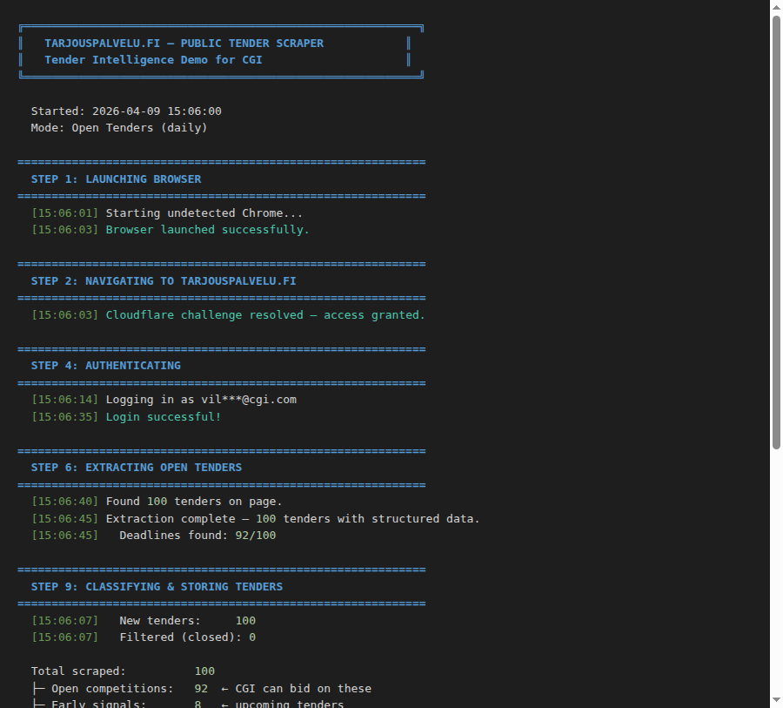
Automated Pipeline Run
What happens in one run:
1. Browser launches and logs in automatically to tarjouspalvelu.fi 2. Scrapes all open tenders across Finland (100+ per run) 3. Classifies each tender: open / signal / closed 4. AI summarizes in English 5. Three-tier routing: product alerts, department match, or dashboard only 6. Sends emails per department Runs nightly as scheduled job. Total time: ~2 minutes.

