Slide 1


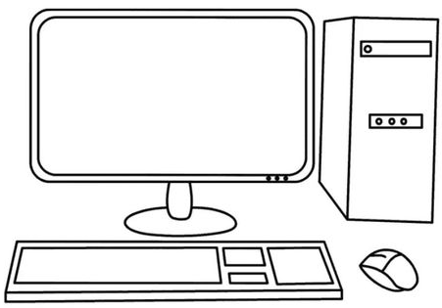

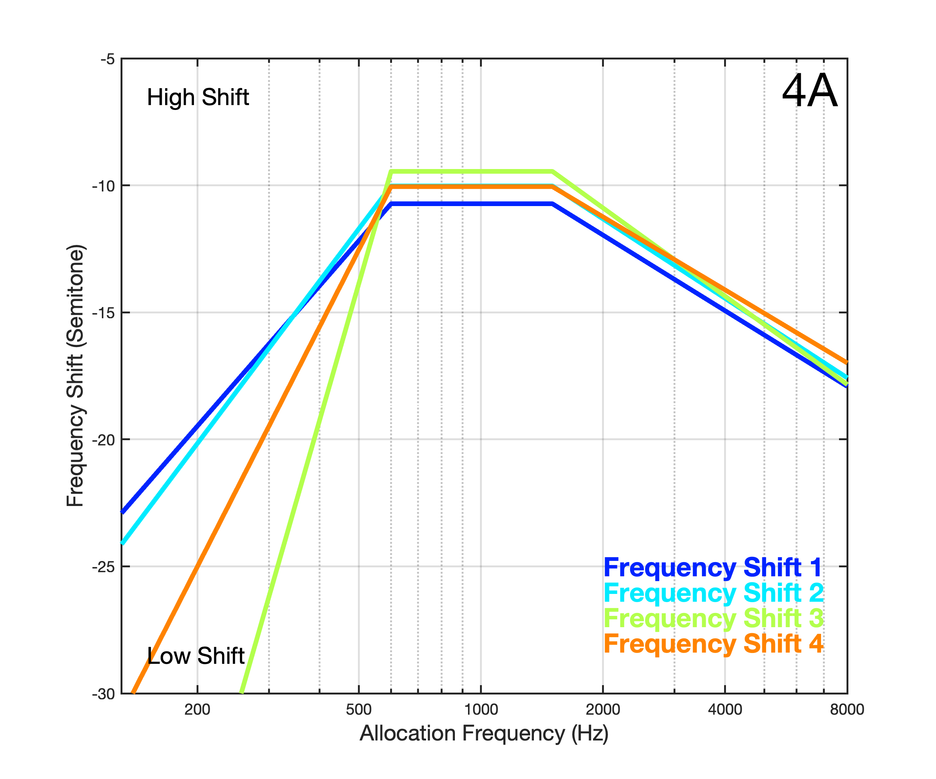
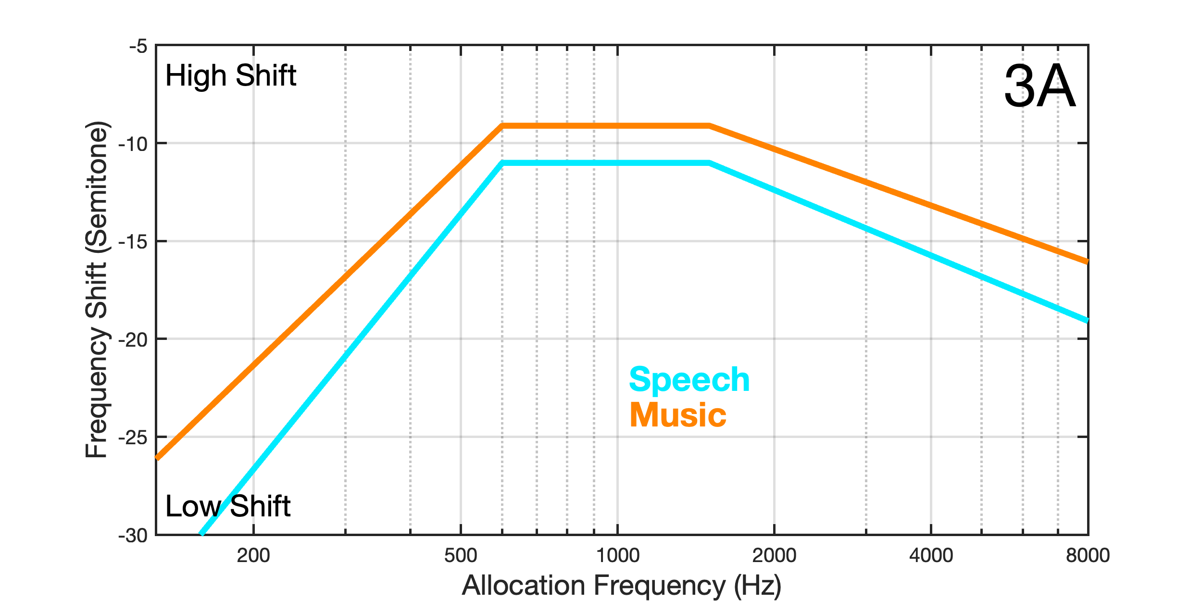
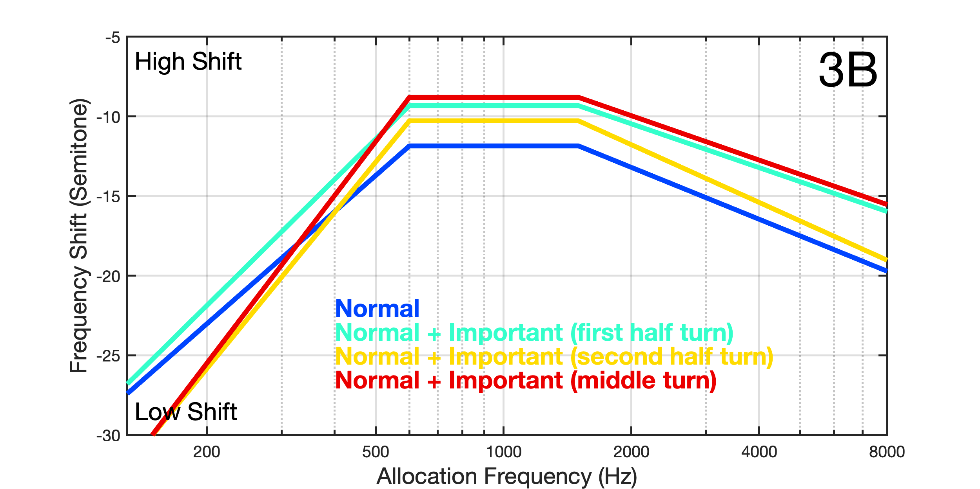
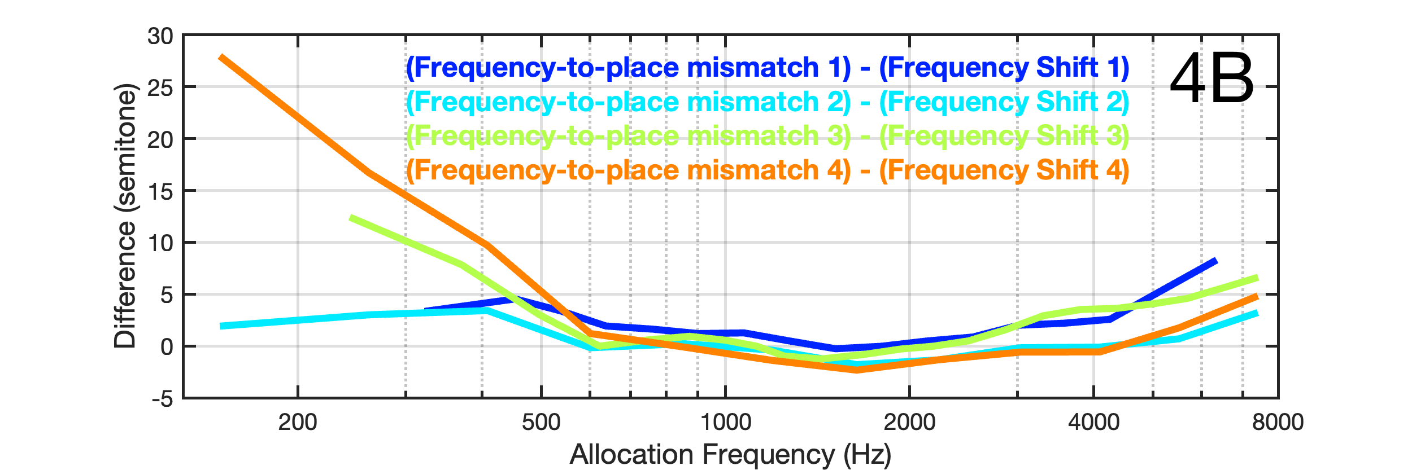
Characterization of frequency-to-place mismatch using frequency shifted music: a vocoder study
Louis Villejoubert¹, Ben Williges¹, Nicholas Haywood¹, Lorenzo Picinali², Kathleen Faulkner Scalzo³, Deborah Vickers¹
¹ Department of Clinical Neurosciences, University of Cambridge, UK, ² Dyson School of Design Engineering, Imperial College London, London, UK, ³ Oticon, Ballerup, Denmark
Contact: lv362@cam.ac.uk
Introduction
Although many cochlear implant (CI) recipients can achieve high levels of speech perception in quiet, performance tends to be poorer for more complex listening situations. The signal processing is responsible for some of the difficulties but there are other factors that can potentially be addressed by re-programming if there is a good understanding of the issue faced. Some of these factors include the frequency-to-place mismatch (FTPM) between frequencies presented and the intended characteristic frequency and compromised electrode-neuron interface (ENI).
The impact on perceptual abilities of FTPM is already well documented: it limits speech performance in CI users and in normal hearing (NH) subjects listening to CI simulations [1] and could partially affect poor melody encoding by CI patients [2]. Moreover, evidence suggests that a significant FTPM reduces sound quality and increases the time and rate at which users reach asymptotic level of speech perception. Unfortunately, FTPM is not easily investigated in routine clinical work. This research explores whether modifications of the frequency content distribution can be used to explore this distortion.
The goal of this pilot study is to investigate the relationship between the degree of frequency-to-place mismatch and a previously frequency shifted degree.
Speech Female
Classical Music
To this end, our first hypothesis is that a better sound quality should be obtained with a lower FTPM. Our second hypothesis is that a lower FTPM could be obtained by moving the frequency information inside a sound.
Frequency Shift
Parameter 1 Linear Frequency shift (20Hz - 20kHz)
Parameter 2 Non-Linear Frequency Shift (20Hz – 600Hz)
Method
Sound processing. The first step is the frequency shift processing. Each sound used in this experiment was first divided into 64 channels. Then, a specific pitch shift value was applied to each channel. These pitch shift values were chosen according to realistic FTPM shapes extracted from Landsberger et al. (2015) [3] . Based on this publication, different linear pitch shifts were applied to the whole frequency spectrum and different non-linear pitch shifts were applied to the low and high frequencies. In a second step, the sounds were vocoded [4] (Figure 1).
Conditions tested. 2 different sounds were used in this experiment: the first one was extracted from an audiobook read by a woman. The second one was a classical instrumental music. Four representative profiles of FTPM, with different locations of poor ENI, were simulated [3].
Testing procedure. In order to evaluate the sound quality of the shifted and vocoded sounds, participants had to perform a paired comparison between two stimuli. Taking into account the fact that each condition was constituted by 2500 combinations of shift values, compare sample side-by-side was not possible. We decided to applied an Artificial Intelligence (AI) algorithm to optimize the testing procedure.
Interactive Differential Algorithm (IDE). Differential evolution (DE) is a recent AI proposed in 1995 [5]. An adaption of IDE using paired comparison was proposed by Tagaki & Pallez (2009) [6]. IDE starts with a population of Np solution candidates (here Np = 5). Each solution candidate is composed by 3 random values from the parameters previously described. One “child” is then created for each parent, using mutation and crossover processes. Then, the parent and the child are compared (Figure 2). In a second round, named generation here, the chosen solution is used to generate a new child. This comparison is repeated 5 times per generation over 5 generations. In total, 25 paired comparison are performed per condition. At the end of the final generation, the 5 solutions chosen are averaged and are considered as the “best sound quality” configuration for this specific condition.
Sound Processing
Parameter 3 Non-Linear Frequency Shift (1.5kHz – 20kHz)
Vocoder
Frequency-to-place mismatch: 4 conditions
Current Spread: 4 conditions
Figure 1. Overview of the sound processing used in this experiment.
Presentation of 2 shifted sounds
Subjective evaluation
Sample 1
Sample 2
Calculation of Differential Evolution
“Which one has the best sound quality?”
Figure 2. A scheme of the interactive differential evolution method.
Results
For now, we have only the data from one participant. The results are represented in the figures 3 and 4.
We can see different trends with this first participant:
Firstly, for each condition the best sound quality configuration seems to be obtained with a low frequency shift.
Secondly, the sound material seems to influence the degree of shifting for the best configuration (Figure 3A).
Thirdly, the frequency ranges where the current spread is “important” show less frequency shift (Figure 3B).
Finally, the degree of FTPM in the low frequencies seems to influence the frequency shift in the same frequency range (Figure 4A). However, we cannot see any clear relationship between the values (Figure 4B).
Figure 3. Aspect of the frequency shift applied to the sound which were chosen by the participant: for the sound material (3A) and the degree of current spread (3B).
Figure 4. Aspect of the frequency shift applied to the sound which were chosen by the participant for the different FTPM configurations (4A) and representation of the difference between the FTPM and the frequency shift (4B)
References:
[1] D. Baskent and R. V. Shannon, “Speech recognition under conditions of frequency-place compression and expansion,” The Journal of the Acoustical Society of America, vol. 113, no. 4, pp. 2064–2076, Apr. 2003, doi: 10.1121/1.1558357.
[2] V. Looi, H. McDermott, C. McKay, and L. Hickson, “Comparisons of Quality Ratings for Music by Cochlear Implant and Hearing Aid Users,” Ear and Hearing, vol. 28, no. 2, p. 59S, Apr. 2007, doi: 10.1097/AUD.0b013e31803150cb.
[3] D. M. Landsberger, M. Svrakic, J. T. J. Roland, and M. Svirsky, “The Relationship Between Insertion Angles, Default Frequency Allocations, and Spiral Ganglion Place Pitch in Cochlear Implants,” Ear and Hearing, vol. 36, no. 5, p. e207, Oct. 2015, doi: 10.1097/AUD.0000000000000163.
[4] B. Williges and T. Jürgens, “Pulsatile Cochlear Implant Vocoder v 1.0.1.” Zenodo, May 29, 2019. doi: 10.5281/zenodo.3234499.
[5] R. Storn and K. Price, “Differential Evolution – A Simple and Efficient Heuristic for global Optimization over Continuous Spaces,” Journal of Global Optimization, vol. 11, no. 4, pp. 341–359, Dec. 1997, doi: 10.1023/A:1008202821328.
[6] H. Takagi and D. Pallez, “Paired comparison-based Interactive Differential Evolution,” in 2009 World Congress on Nature & Biologically Inspired Computing (NaBIC), Dec. 2009, pp. 475–480. doi: 10.1109/NABIC.2009.5393359.

