Slide 1
using reanalysis to accelerate structural optimization
Project in solid mechanics

Slide 2
Summary
SO problem
Reanalysis and Combined Approximation
Examples and results
Future work

Slide 3
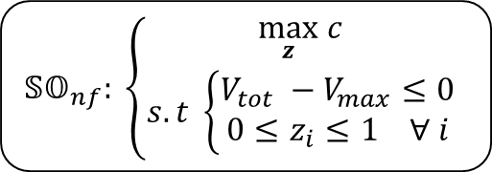
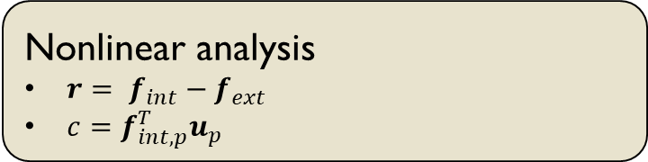
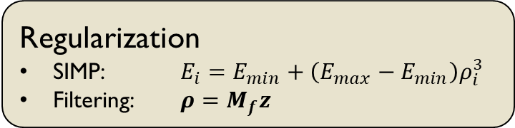
Introducing the SO problem
$𝕊𝕆_{nf}: \left\{\begin{aligned}\max_{z} c \\ s.t \left\{\begin{aligned}V_{tot} −V_{max}≤0 \\ 0≤z_{i}≤1 ∀ i\end{aligned}\right.\end{aligned}\right.$
Regularization
SIMP: $E_{i}=E_{min}+\left(E_{max}−E_{min}\right)ρ_{i}^{3}$
Filtering: $ρ=M_{f}z$
Nonlinear analysis
${r= f}_{int}−f_{ext}$
$c=f_{int, p}^{T}u_{p}$
Notes:
Displacement controlled scheme is used -> compliance is maximized
End compliance

Slide 4
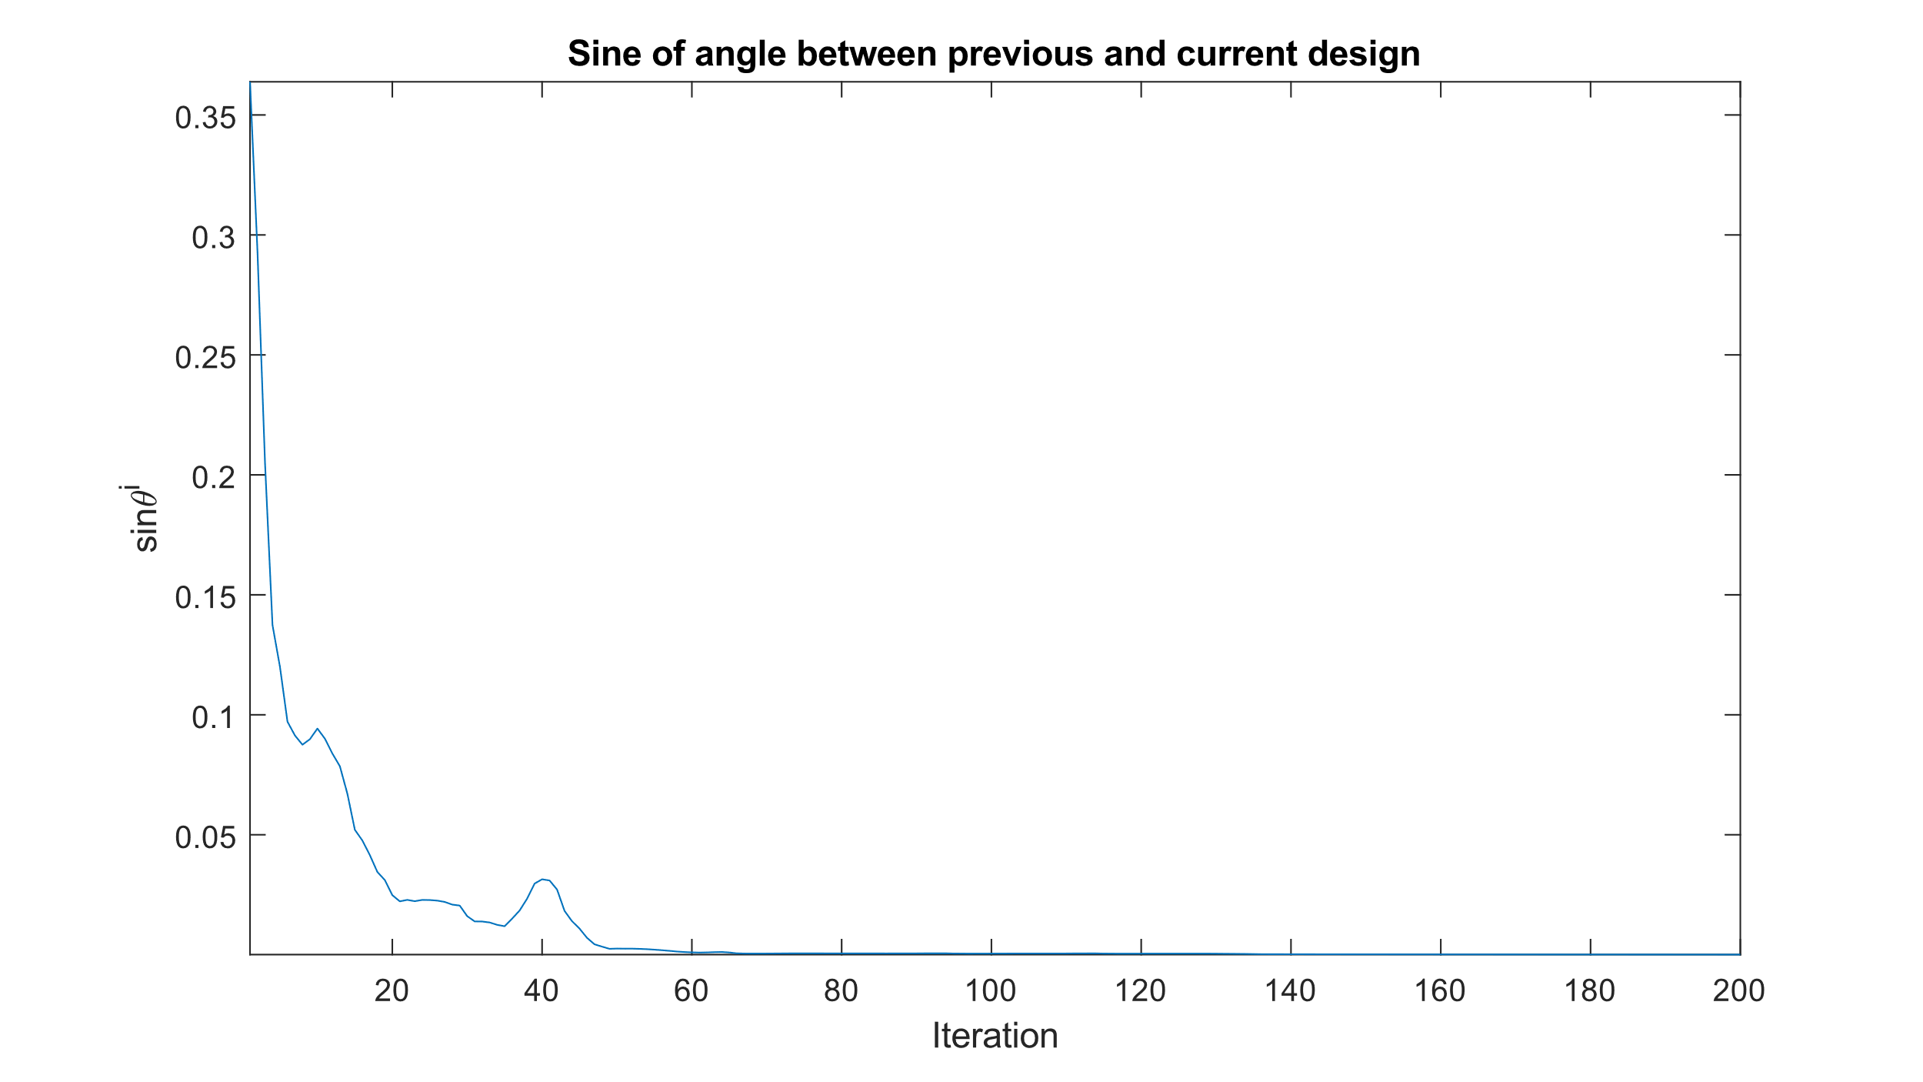
Repeatedly solving equilibrium equations is expensive!
Notes:
Reuse factorization from earlier optimization step

Slide 5
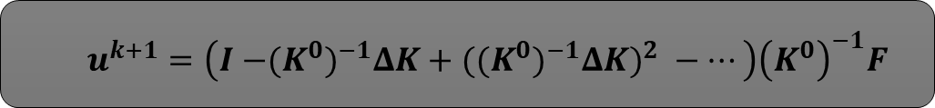
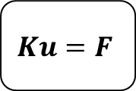
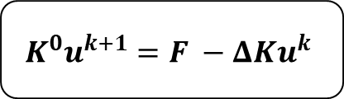
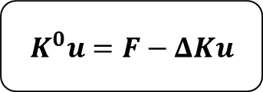
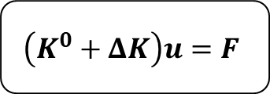
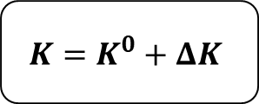
Combined Approximation
$$Ku=F$$
$$\left(K^{0}+ΔK\right)u=F$$
$$K=K^{0}+ΔK$$
$$K^{0}u=F−ΔKu$$
$$K^{0}u^{k+1}=F −ΔKu^{k}$$
$u^{k+1}=\left(I {{−(K}^{0})}^{−1}ΔK+{{{((K}^{0})}^{−1}ΔK)}^{2} −…\right){\left(K^{0}\right)}^{−1}F$
Notes:
Assuming u^0 = 0

Slide 6
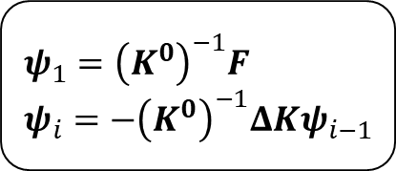
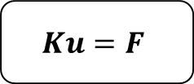
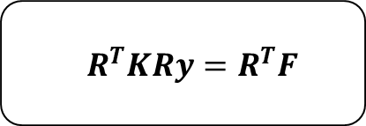
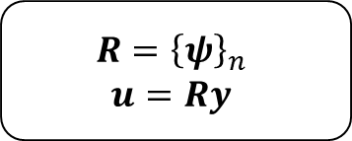
Combined Approximation
$$ψ_{1}={\left(K^{0}\right)}^{−1}F$$
$$ψ_{i}=−{\left(K^{0}\right)}^{−1}ΔKψ_{i−1}$$
$$Ku=F$$
$$R={\left\{ψ\right\}}_{n}$$
$$u=Ry$$
$$R^{T}KRy=R^{T}F$$
Notes:
K0, R0 known computing basis is cheap.
Orthogonalisation + backward substitution ~ns^2 flops
Solving full system n^3 flops
Orthogonalization – stabilizes solution
Orthogonalizing with K as core makes the problem easy
Criteria for when to use CA and when to factorize, coth(zold, z)

Slide 7
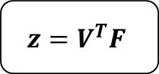
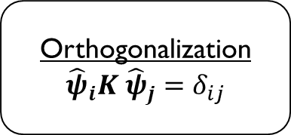
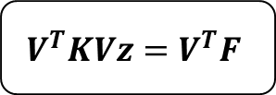
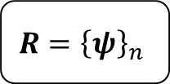
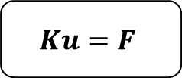
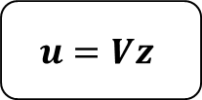
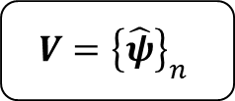
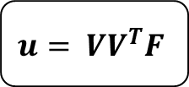
Combined Approximation
Orthogonalization
$${\hat{ψ}}_{i}K {\hat{ψ}}_{j}=δ_{ij}$$
$${R=\left\{ψ\right\}}_{n}$$
$$V={\left\{\hat{ψ}\right\}}_{n}$$
$$Ku=F$$
$$V^{T}KVz=V^{T}F$$
$$z=V^{T}F$$
$$u=Vz$$
$$u= VV^{T}F$$

Slide 8
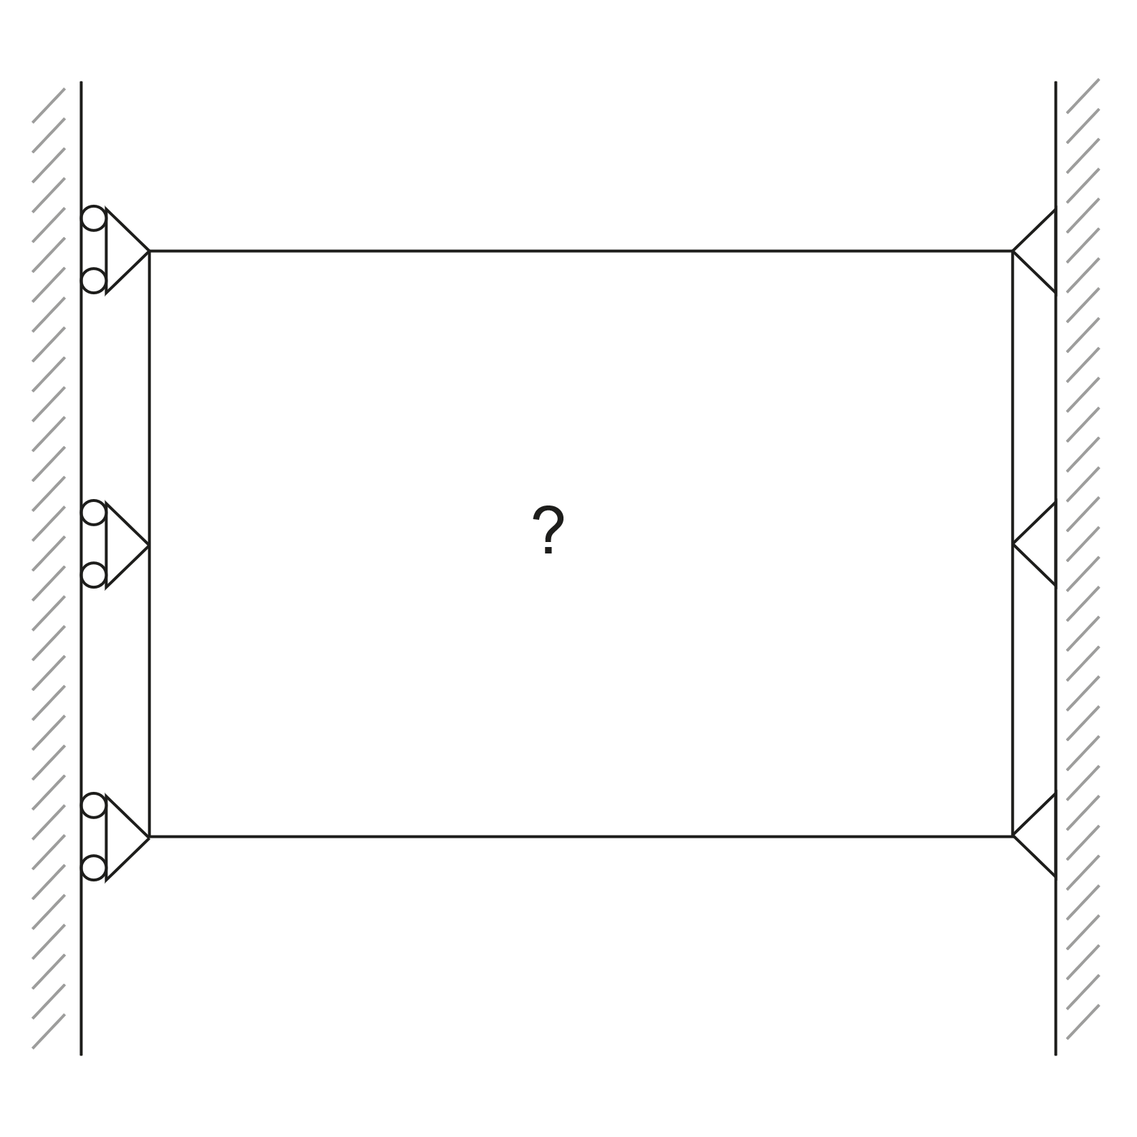
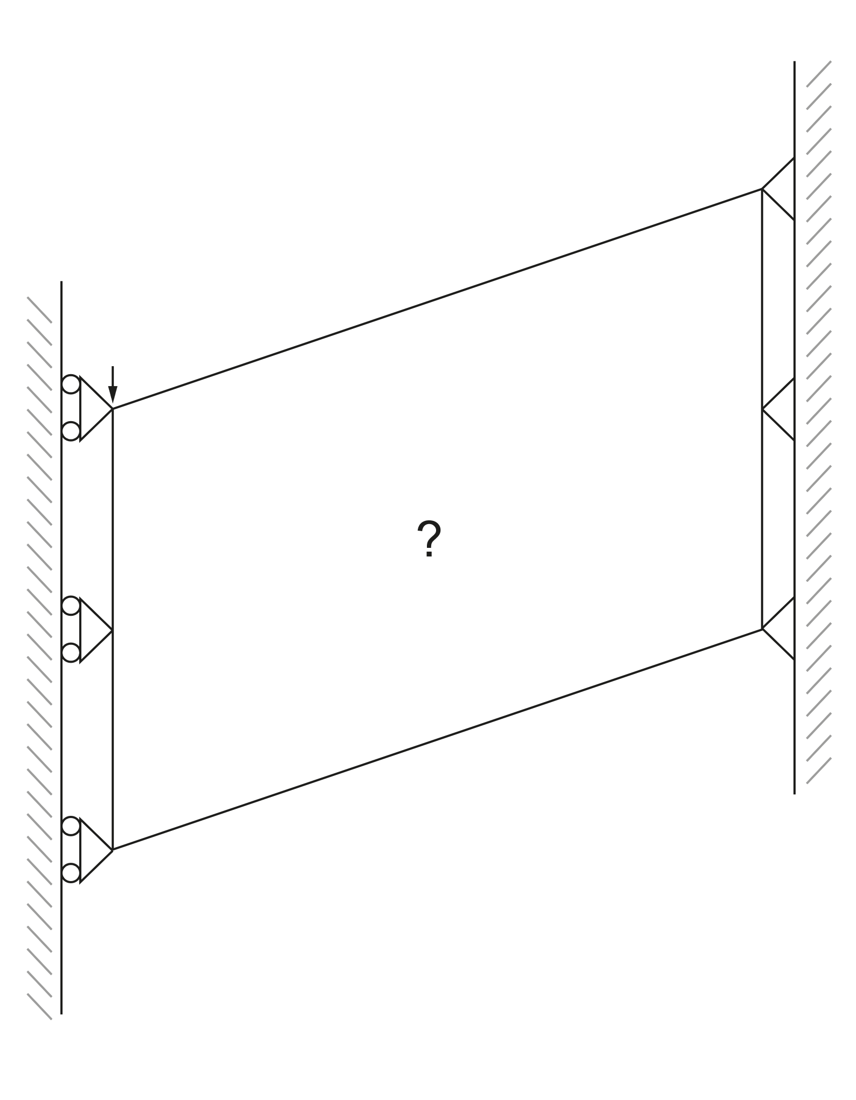
Benchmark problem
Resting State
Deformed State

Slide 9
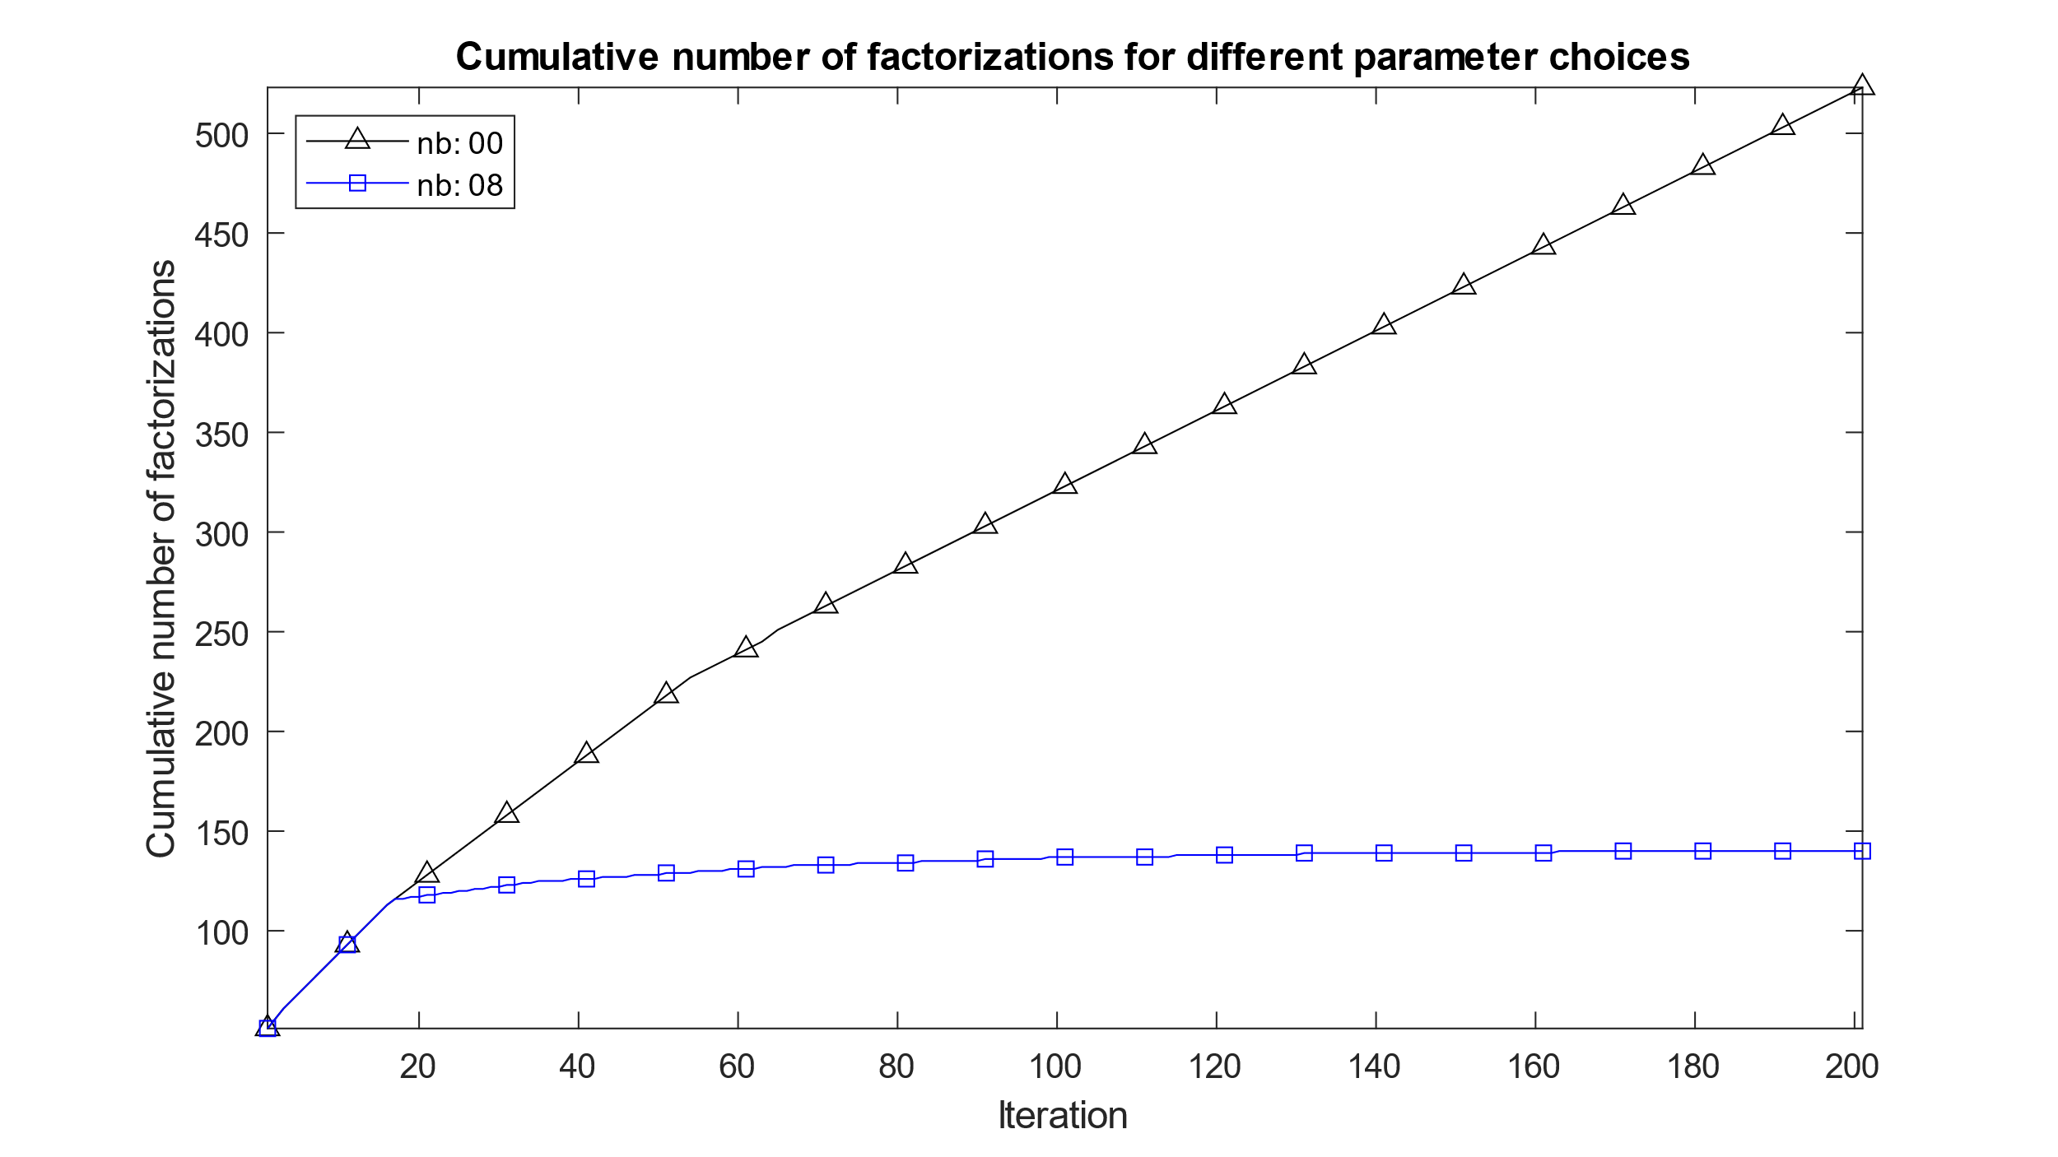
Results

Slide 10
Future Work
Transient problems
Refining the method

