Slide 1




Vilnius.js Meetup January 2023
PESPA on the Edge
by Rokas Muningis
January 26th, 18:30 (GMT +3)
Wix.com Office, Didžioji str. 28, Vilnius, 3rd floor
Powered by
and

Slide 2



Vilnius.js Meetup December 2022
PWA: IS IT DEAD ALREADY?
by Nedas Šimkus
December 22th, 18:30 (GMT +3)
Wix.com Office, Didžioji str. 28, Vilnius, 3rd floor
Powered by

Slide 3
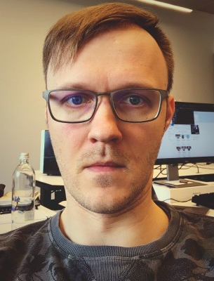
Vilnius.js Meetup May 2022
MAKING IMPOSSIBLE
STATES IMPOSSIBLE:
TYPESCRIPT EDITION
by Vaidas Kublinskas
May 26th, 18:30 (GMT +3)
Wix.com Office,
Didžioji str. 28, Vilnius,
3rd floor

