Slide 1
Looking for limits in branch prediction with the GTL predictor
张绍磊
2016211392

Slide 2
GEHL和TAGE最终预测计算功能不同。
GEHL使用树加法器作为预测计算功能。TAGE使用（部分）标签匹配。
对于实际的存储预算，TAGE比GEHL更准确。但是，对于非常大的存储预算和非常多​​的预测器组件，GEHL在大多数基准测试中比TAGE更准确。
GTL预测器，由GEHL预测器，TAGE预测器和循环预测器组合。

Slide 3
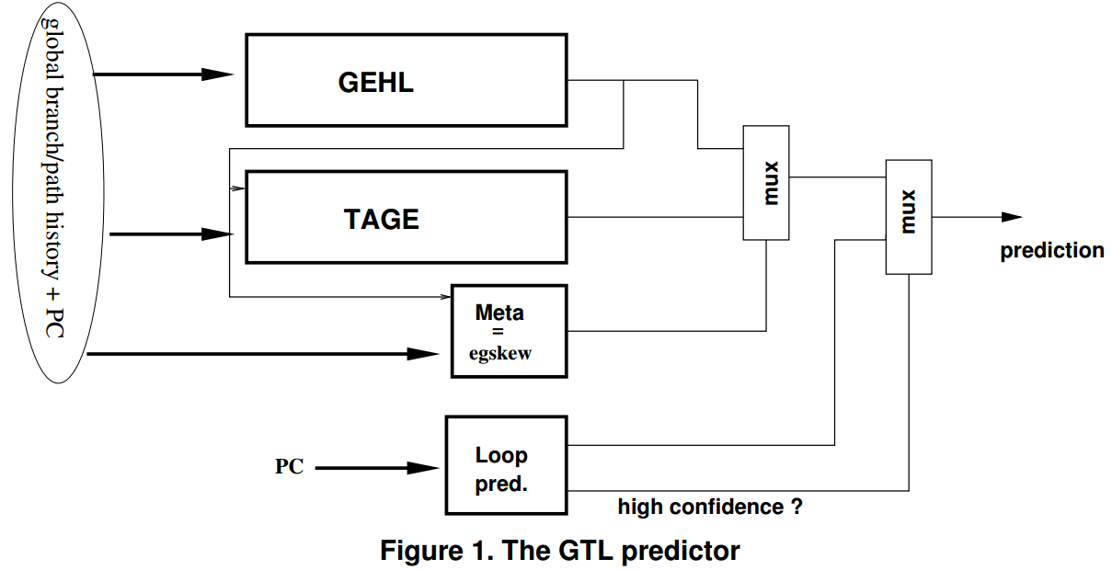
GTL predictor
As for the TAGE predictor component, the output of the GEHL predictor is used to index the meta-predictor.

Slide 4

The GEHL branch predictor
The GEometric History Length (GEHL) branch predictor features M distinct predictor tables Ti, 0 <= i < M indexed with hash functions of the branch address and the global branch history.
To compute a prediction, A single counter C(i) is read on each predictor table Ti.
The prediction is taken if S is positive and not-taken if S is negative.

Slide 5
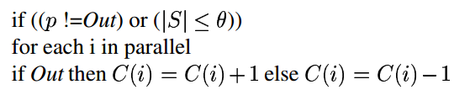
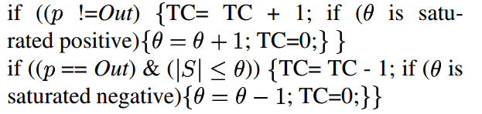
Updating the GEHL predictor
The GEHL predictor is only updated on mispredictions or when the absolute value of the computed sum S is smaller than a threshold θ .
The number of updates on mispredictions NU_{miss}; the number of updates on correct predictions NU_{correct}
A single saturated counter TC 。

Slide 6
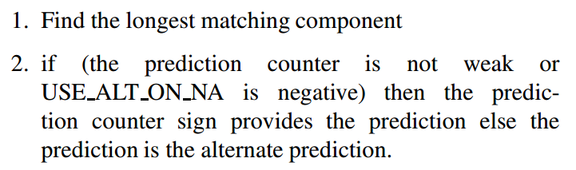
Tage predictor
The overall prediction is provided by the hitting tagged predictor component that uses the longest history, or in case of no matching tagged predictor component, the default prediction is used.
Newly allocated entries provide poor prediction accuracy and that on these entries, using the alternate prediction is more efficient.
The prediction computation algorithm:

Slide 7
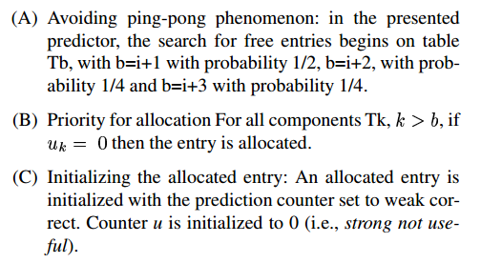
Updating the TAGE predictor
Updating the useful counter u The useful counter u of the provider component is updated when the alternate prediction altpred is different from the final prediction pred. Updating the prediction counters The prediction counter of the provider component is updated. For large predictors also updating the alternate prediction when the useful counter of the provider component is null results in a small accuracy benefit.
Allocating tagged entries on mispredictions For a 64 Kbits 8-component predictor or 256 Kbits TAGE predictors, allocating a single entry is the best tradeoff. For the very large predictor considered here, allocating all the available entries is more effective.

Slide 8
The loop predictor
The loop predictor simply tries to identify regular loops with constant number of iterations.
The loop predictor provides the global prediction when the loop has successively been executed 8 times with the same number of iterations.

Slide 9
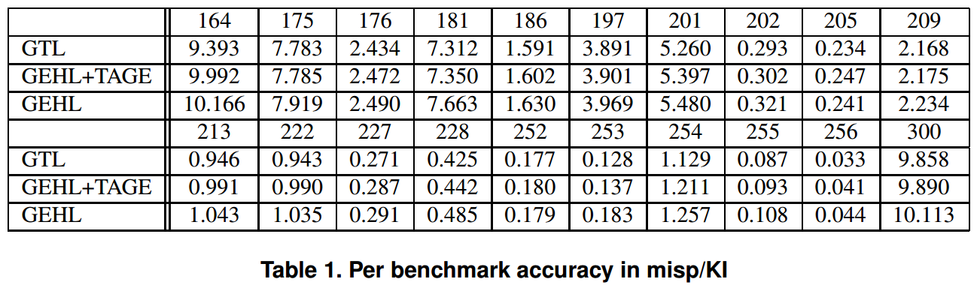
The average predictor accuracy of GTL is 2.717 misp/KI on the distributed set of traces.
Removing the loop predictor and the static prediction, i.e., GEHL+TAGE, one will still obtain 2.774 misp/KI, the accuracy of the GEHL predictor component alone being 2.891 misp/KI.
A GEHL predictor alone using a 2,000 branch history length achieves 2.842 misp/KI.

