Slide 1

Department of Computer Science and Engineering Nandha Engineering College (Autonomous) – Erode.
ADVANCED JAVA PROGRAMMING LABORATORY
(Project Based Learning )
Batch – Review
TYPING SPEED CALCULATOR WEBSITE PRESENTED BY
ASHWIN S(23CS076) BALASANJEEV C(23CS077)
DHARINISH S(23CS081)

Slide 2
INDEX
Scenario
Introduction
Objective
System Feature
Flow Diagrams
Methodology of Implementation
Modules
Conclusion

Slide 3
ABSTRACT
The Typing Speed Calculator website is a web-based application designed to assess and improve users' typing skills. It provides a user-friendly interface where individuals can take typing tests and receive real-time feedback on their typing speed (words per minute), accuracy, and error count. The system captures keystroke input, compares it against a reference paragraph, and dynamically calculates performance metrics. It also stores user details and test results in a backend database for progress tracking and analytics. Built using HTML, CSS, and JavaScript for the frontend, and Node.js with MySQL for the backend, the website offers a smooth and responsive experience. This platform is especially useful for students, professionals, and anyone aiming to enhance their typing proficiency through regular practice and performance monitoring.

Slide 4
INTRODUCTION
Typing is an important skill in today's digital world. Whether it's for school, work, or personal use, being able to type fast and accurately can save time and improve efficiency. The Typing Speed Calculator website is a tool that helps users check how fast and accurately they can type.
This website allows users to take a typing test using a given paragraph. It calculates their typing speed in words per minute (WPM), accuracy percentage, and shows the number of mistakes. The website gives instant feedback so users can see how well they typed and where they need to improve.
The frontend is made using HTML, CSS, and JavaScript, and the backend uses Node.js and MySQL to store and manage user data. This project is useful for anyone who wants to improve their typing skills in a simple and fun way.

Slide 5
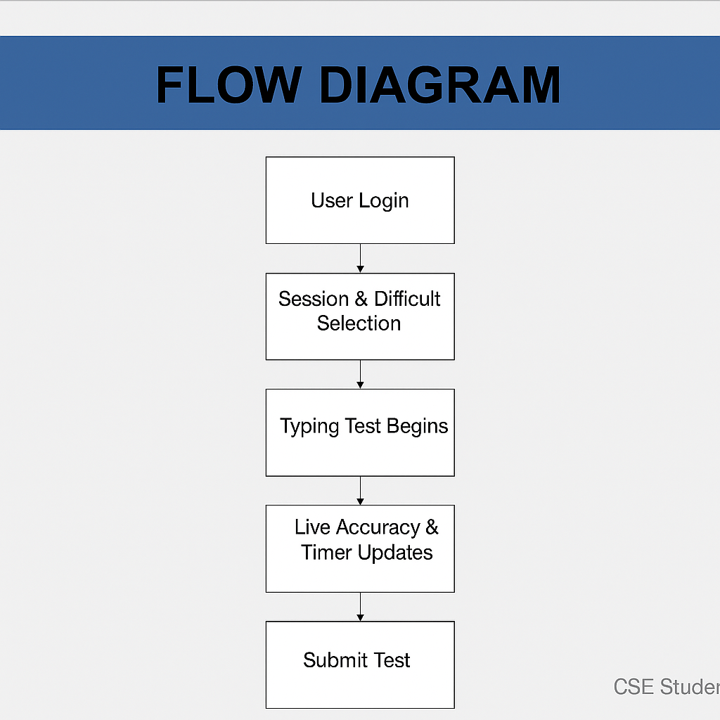
FLOW DIAGRAMS

Slide 6
METHODOLOGY
User Login
The user enters their name and mobile number.
Select Test
The user chooses a session type (Practice or Contest) and difficulty level (Easy, Medium, Hard).
Start Typing
A paragraph appears, and the user starts typing.
Track Performance
The website shows a timer and calculates typing accuracy while the user types.
Submit Test
When the user finishes typing, they submit the test.
Show Results
The website shows typing speed (WPM), accuracy, and time taken.

Slide 7
MODULES
User Authentication Module
Typing Test Module
Result and Feedback Module

Slide 8
CONCLUSION
Our typing speed calculator website offers a simple and interactive way to test and improve your typing skills. By measuring your words per minute (WPM) and accuracy, the tool gives you instant feedback on your performance. Whether you're a student, professional, or just looking to boost your productivity, this website helps you track your progress and become a faster, more accurate typist. With regular use, you can build confidence and efficiency in your typing abilities—all in one convenient online platform.

Slide 9
REFERENCES
[1]. K. Agarwal and t. Kumar, “heart disease prediction using machine learning,” in 2nd international conference on intelligent computing and control systems(iciccs). Ieee, 2018.
[2]. S. Rajput and a. Arora, “effective heart disease prediction using hybrid machine learning techniques,” international journal of computer applications, vol. 75, no. 10, pp. 6–12, 2013.
[3]. M. Mohamad and a. Selamat, “heart disease prediction using machine learning algorithms,” in international conference on computer, communications, and control technology (i4ct). Ieee, 2015, pp. 227–231.
[4]. J. Ramos et al., “efficient prediction of cardiovascular disease using machine learning algorithms with relief and lasso feature selection techniques,” in proceedings of the first instructional conference on machine learning, vol. 242. Piscataway, nj, 2003, pp. 133–142.
[5]. T. Kumaresan and c. Palanisamy, “heart disease prediction,” international journal of bio-inspired computation, vol. 9, no. 3, pp. 142–156, 2017.

