Slide 1
Vimal D
REG NO:211521205187
DEPARTMENT:INFORMATION TECHNOLOGY

Slide 2
PROJECT TITLE
SENTIMENT ANALYSIS OF PRODUCT REVIEWS

Slide 3


AGENDA
Problem Statement
Project Overview
End Users
Our Solution and Proposition
Key Features
Modelling Approach
Results and Evaluation
Conclusion
3/21/2024 Annual Review

Slide 4

PROBLEM STATEMENT
Customer feedback is invaluable for businesses, yet the sheer volume of product reviews across various platforms poses a significant challenge in distilling meaningful insights. Understanding the sentiment expressed in these reviews is crucial for companies to gauge customer satisfaction, identify areas for improvement, and make informed business decisions. However, manually analyzing large volumes of reviews is time-consuming and prone to bias. Additionally, the nuances of language, including sarcasm and context, further complicate sentiment analysis.

Slide 5

PROJECT OVERVIEW
Our project aims to tackle the challenge of sentiment analysis in product reviews by leveraging machine learning and natural language processing techniques. By developing an automated system to analyze sentiment, we seek to provide businesses with actionable insights derived from customer feedback. The project involves collecting and preprocessing a diverse range of product reviews, training machine learning models to accurately classify sentiment, and evaluating the performance of these models.

Slide 6
WHO ARE THE END USERS?
Our solution caters to a diverse set of end users within organizations, including product managers, marketing teams, customer support departments, and executives. Product managers can use the sentiment analysis results to prioritize feature enhancements and address pain points identified by customers. Marketing teams can tailor their messaging and campaigns based on the sentiment expressed by customers. Customer support departments can proactively address negative feedback to improve customer satisfaction, while executives can use sentiment analysis to inform strategic decision-making.
3/21/2024 Annual Review

Slide 7

OUR SOLUTION AND ITS VALUE PROPOSITION
Our approach to sentiment analysis involves leveraging state-of-the-art natural language processing techniques, with a particular focus on Support Vector Machines (SVM) as our primary classification algorithm. SVM has proven to be highly effective in handling high-dimensional data and nonlinear relationships, making it well-suited for sentiment classification tasks. By harnessing the power of SVM, we aim to achieve accurate sentiment analysis results while maintaining computational efficiency.
3/21/2024 Annual Review

Slide 8

THE WOW IN OUR SOLUTION
Automated sentiment analysis of product reviews across multiple platforms.
Accurate sentiment classification, including positive, negative, and neutral sentiments.
Granular insights into specific aspects of products or services mentioned in reviews.
Visualization of sentiment trends over time to identify emerging patterns.
Integration with existing customer feedback systems and analytics platforms.
3/21/2024 Annual Review
8

Slide 9
MODELLING
Our modelling approach consists of several key steps:
Data Collection: We gather product reviews from various online platforms, ensuring a diverse and representative dataset.
Preprocessing: We clean and preprocess the text data, including tokenization, stemming, and removal of stop words and special characters.
Feature Engineering: We extract relevant features from the text data, such as word embeddings or TF-IDF vectors, to represent the reviews in a format suitable for machine learning models.
Model Selection: We experiment with different machine learning algorithms, including support vector machines (SVM), logistic regression, and deep learning architectures like LSTM and BERT, to identify the most effective model for sentiment classification.
Training and Evaluation: We train the selected model on labeled data and evaluate its performance using metrics such as accuracy, precision, recall, and F1 score.
9

Slide 10
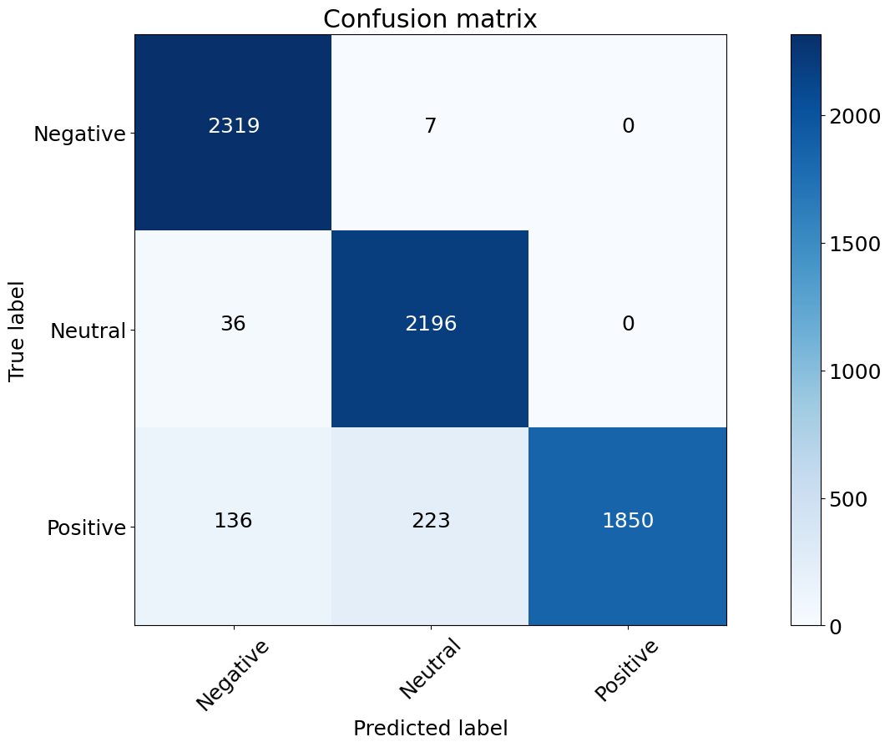
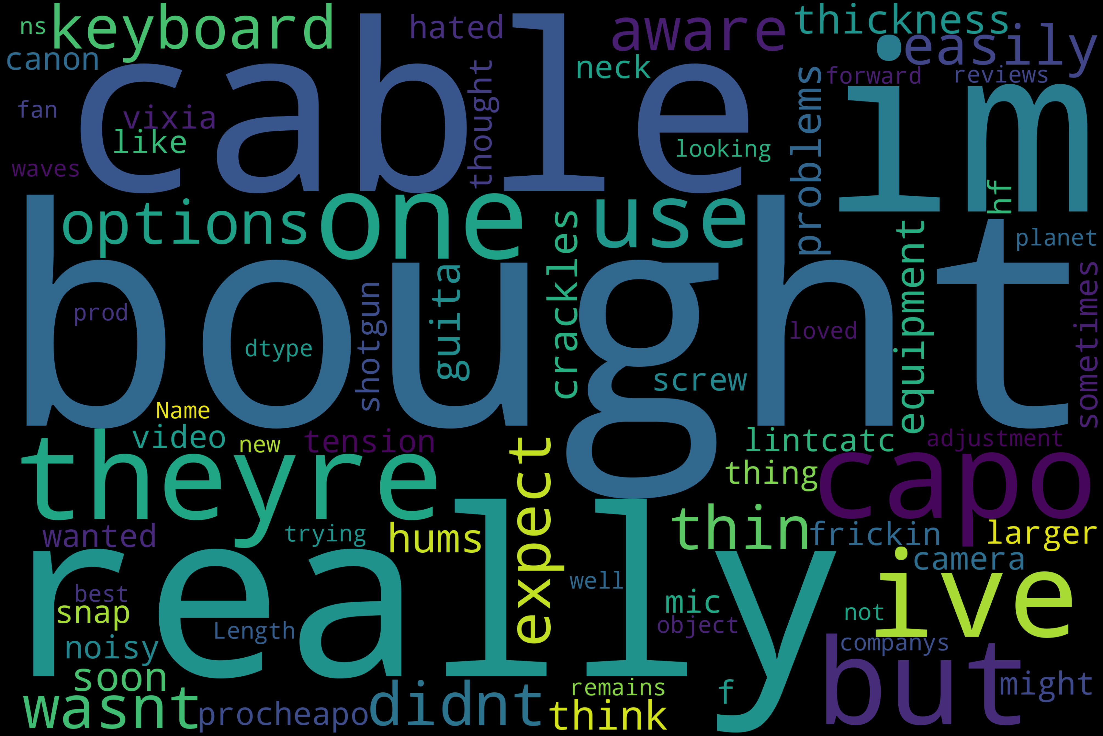
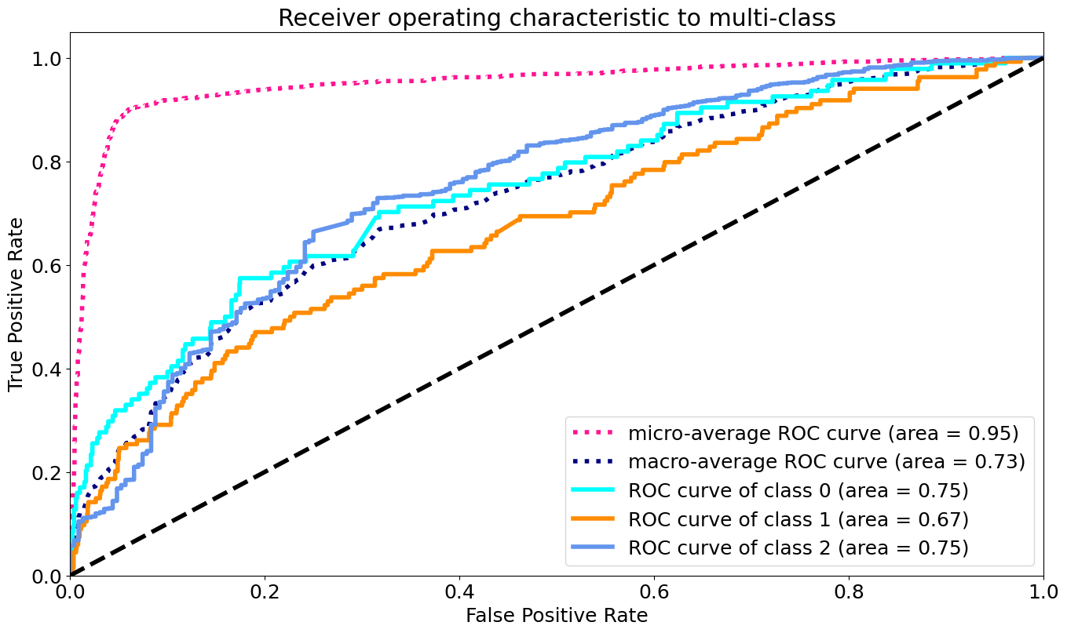
RESULTS
10

Slide 11
Conclusion
our project demonstrates the power of sentiment analysis in extracting actionable insights from product reviews. By automating the process of sentiment classification, we enable businesses to harness the wealth of customer feedback available online and make data-driven decisions to enhance their products and services. Moving forward, we plan to continue refining our models and expanding our analysis to encompass a wider range of products and industries, ultimately empowering businesses to better understand and serve their customers.

