Slide 1
Functional requirements
As a user I want to send the emails in a bulk immediately or at a future date and time
As a user I want to choose an email template from a gallery available
As a user I want to track open rate of emails
Non-function requirements
Scalability: Thousands or even millions of emails can be sent and even thousands of jobs can be scheduled.
Durability: emails shouldn’t get lost
Reliability: Email must not be sent much later than expected or dropped (how long the item performs its intended function) -> we need a fault-tolerant system
Fault tolerance : capable of supporting uninterrupted functionality of your applications despite failures of components
Availability: It should always be possible to send emails (horizontal scaling)
Emails must not be sent multiple times (or such occurrences should be kept to a minimum)

Slide 2
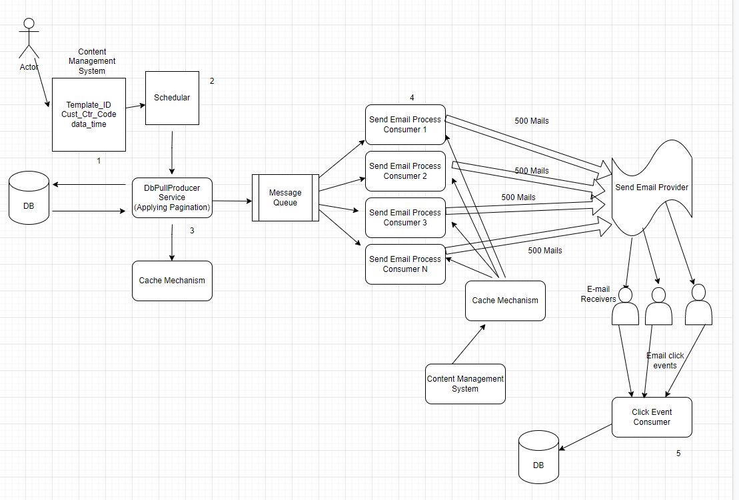

Slide 3
Content Manage system (UI component)
User logs in to the content manage system, based up on the template id and customer category, user will schedule a job to send emails.
2) Schedular takes the request from the UI and sets its alarm to trigger the job when timer expires
3) Dbpullproducer Service
This service pull the users from the DB chunk by chunk by pagination, produces to Message Queue (Kafka) and holds the state in the cache system. So in any case if the db-fetching process goes down, after it restarts , We check the state of the user in the cache, if present we wont process that user , if not we process to queue for email.
4) SendEmailProcess Consumers reads the messages from the message, reads the email template from continent management system and fires the 3rd party email server bulk.
5) When a user opens the email, image-tag mechanism call the Client Event consumer service with necessary parameter in the request and the event is being stored for analytics purpose.
Image Tag mechanism
Image tag is embedded in the email body which has source pointing to an external resource(example a restful web service like http://external-resource:8080/email-tracker/email-track/{message_identifier}) which captures information about the mail you have sent.
connection between the db-fetching-process and email process is a bottleneck of our system so we introduce Message Queue
Say, we have to send 20,000 emails. We get all the 20,000 email id from the database and start publishing them to the Queue. Now say after publishing 10,000 email id, our db fetching process is down. But now, we are not stuck. Because we have email id already inside the Queue
Redis to maintain the states.
if the db-fetching-process crashes and becomes down, your email process will still be able to send the email to the email id that’s been inside the Queue. But when the db-fetching-process reboot, it will fetch all the email id of the users who are part of this campaign again from the database and will push them inside the Queue again which the email process will pick again and will send email again to the email id. So we need to keep a state. The state denotes to which users the email has already been sent. Therefore, if our db-fetching-process goes down and it reboots, it will again take all the desired users from the database and check to which uses the email has already been sent. Therefore, it will not push the same email id to the Queue.

Slide 4
Pagination - we will read the rows chunk by chunk.
At one point in time, we are reading all our rows of the user table at once. If we have 100~200 rows, that’s ok. But if you have millions of rows, is our current way of reading the table will perform well?
CMS (Content Management Server)
From campaign to campaign, the email template is different. By using template_id fetch our desired content which is the email message body from our CMS before sending the email.
You can't bombard the 3rd Party API, they always have rate limit
Hit the API once and the payload will contain the email id for 1000
Kafka (Message Queue)
Be able to scale the consumer and producer nodes independently (in Kafka we have Topics which can be horizontally partitioned and scale by that)
We decouple the consumer and producer from each other
Lower latency for the producer (doesn't have to wait for a response)
Durability and Reliability: When a Consumer Node crashes another Node can process the Message which otherwise would be lost (see Offset in Kafka). The Messages are persisted.
We can throttle/limit the number of messages the consumers process (see Backpressure)
Kafka offers message ordering
Kafka is a distributed system. The topic is divided into partitions and kept in different brokers. If any broker fails, data should not be lost. For fault-tolerance purposes, the partition is replicated and stored in different brokers. If leader brokers fail, then the controller will elect one of the replicas as the leader. Even controller brokers can fail, in this case, Zookeeper will help in electing the broker as the controller.

Slide 5
Benefits of Apache Airflow (Scheduling system)
Programmatic Workflow Management
Task Dependency Management
Monitoring & Management Interface
Extendable Model
Easy Interface To Interact With Logs
Security
Principle of least privilege
Monitoring and Alerting
Securing the build
Building secure code
Network infrastructure
Role based access
Securing secrets
Encryption in transit ( SSL) & Encryption in rest (key management server)
Applying Static application security testing (SAST) , Dynamic Application security testing (DAST), Git sectrets scanning, Container registry scanning and infrastructure security probes

Slide 6
Kafka Security– With any communication between the brokers and clients the following three steps needs to happen.
Authentication – Simple authentication and security layer (SASL) validation
Authentication - Transport layer security (TLS) connection
Authorization – Kerberos verification
API Secrutiy
Oauth – delegates the authorization using access token
OpenIdConnect – Authentication with ID token.
Web application security, other services security
Infrastructure security

Slide 7
Deployment
DevOps or DevSecOps
Canary deployment or blue green deployment
Infrastructure as code implementation – Terraform (Cloud agnostics)
Containerization
Enable Autoscaling - Horizontal, vertical and cluster auto scaler
Consider Multi regions and multiple available zones.
Observability (Monitoring, alerts, log aggregation, distributed tracing)
Automated testing
Implement chaos engineering.
Performance testing
Baseline testing
Load testing
Stress testing
Scalability testing.

Slide 8
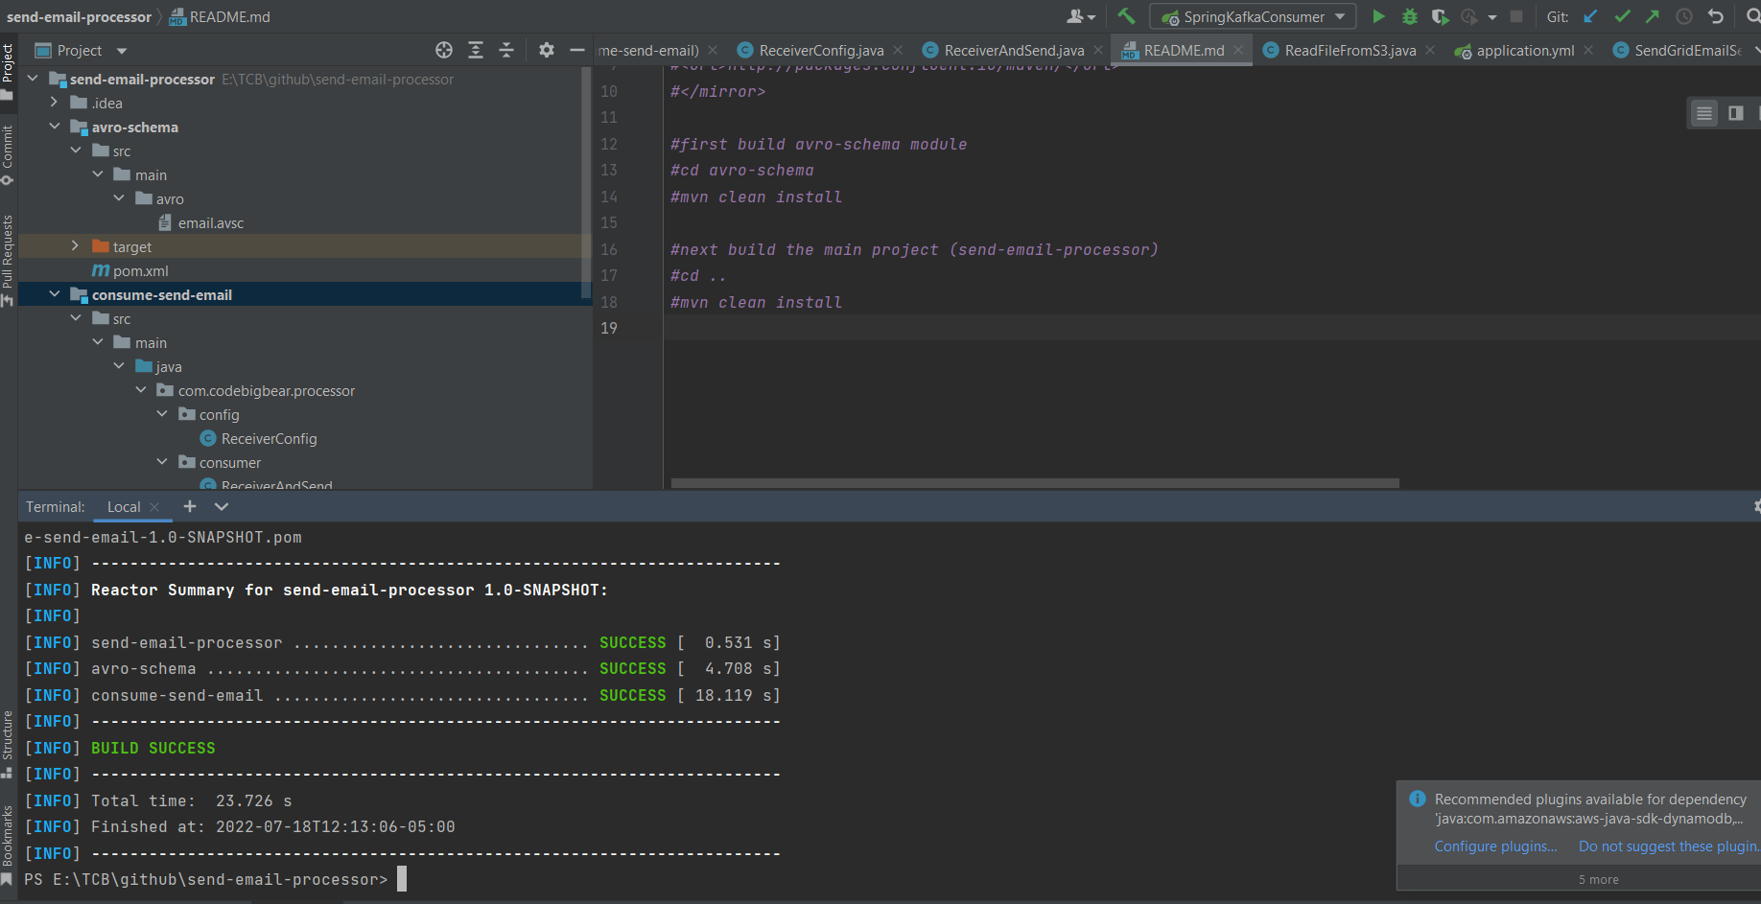
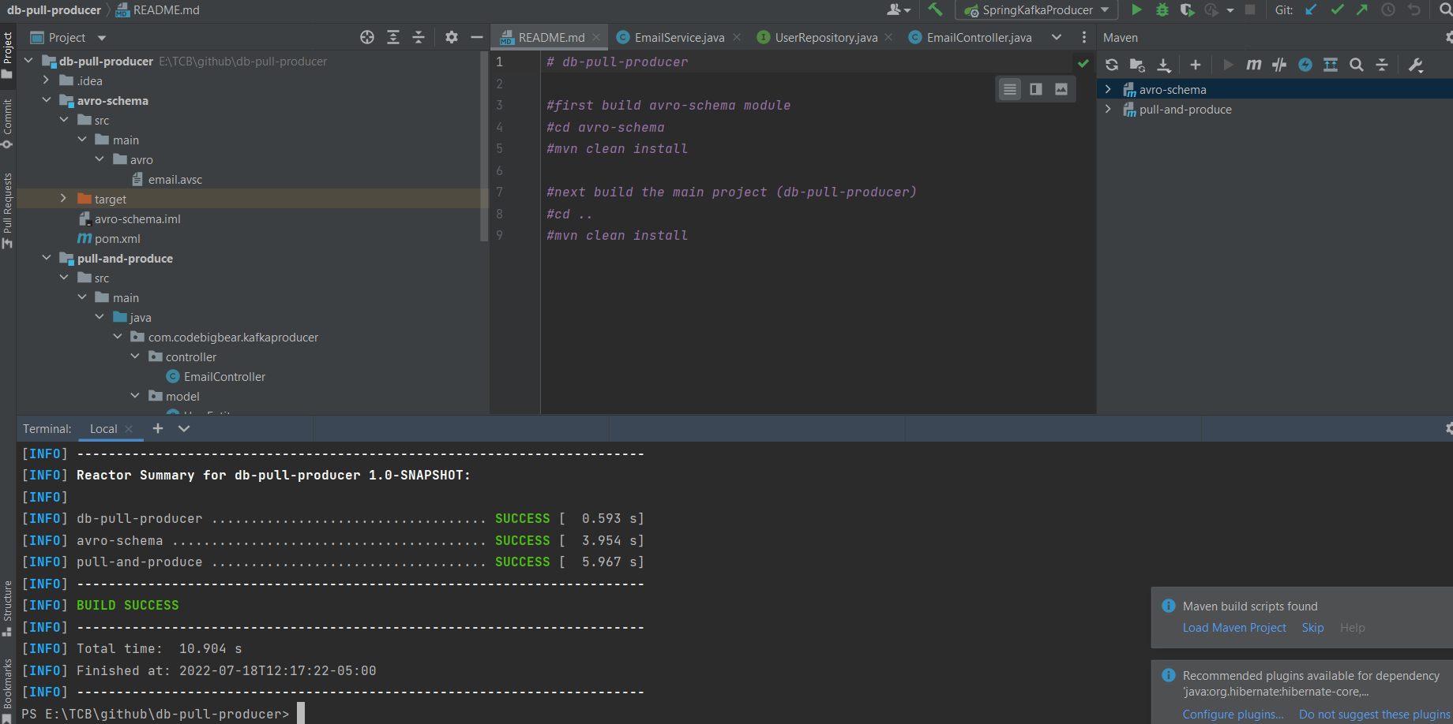
Code samples
Architecture and presentation
https://github.com/VimalDwarampudi/campaign-management-system-docs
Code sample
https://github.com/VimalDwarampudi/db-pull-producer
https://github.com/VimalDwarampudi/send-email-processor

