Slide 1
Title: Sales Analysis Dashboard
Name: Vimal Ram P
Roll Number: 160324CBR006
Date: 07/08/2024

Slide 2
Introduction
The aim of a Sales Analysis Dashboard is to provide a comprehensive and visual representation of a company’s sales performance. Overall, the dashboard aims to empower businesses with the information needed to make informed decisions, optimize sales strategies, and drive growth.

Slide 3
Tools & Limitations
Data Sources: The sales data was sourced from various channels including online sales and retail stores, based on the year of 2018.
Data Cleaning: The data was cleaned to remove any inconsistencies, duplicates, and errors to ensure accuracy.
Visualization Techniques: Various visualization techniques such as bar charts, donut charts, and line graphs were used to present the data clearly and effectively.

Slide 4
Business Questions
Which product categories are generating the highest sales and profits?
How do sales and profit trends vary across different states?
What are the monthly trends in sales and profit?
Which payment modes are most popular among customers?
How does the quantity sold by category?

Slide 5
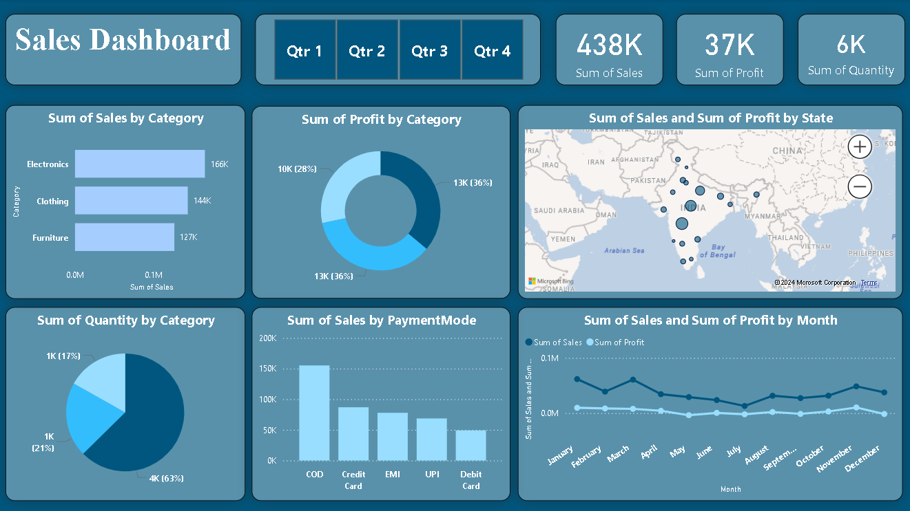

Slide 6
Results and Outcomes
Sum of Sales by Category: A horizontal bar chart showing sales for Clothing, Electronics, and Furniture.
Sum of Profit by Category: A donut chart displaying profit percentages for each category.
Key Performance Indicators (KPIs): Total sales, Total Profit and Total Quantity Sold.
Sum of Quantity by Category: Pie chart showing quantities sold by category.
Sum of Sales by Payment Mode: A vertical bar chart illustrating sales by different payment methods.
Sales and Profit by State: A map highlighting sales and profit levels across various states.
Sales and Profit by Month: A line graph depicting monthly sales and profit trends.

Slide 7
Thank you...

