Slide 1
Big Data Analytics
Ph.D. Research Scholar:
Vikas Kumar (201651001)
SEAS Ahmedabad University
Ahmedabad
Vikas.tyagi@ahduni.edu.in
Supervisor:
Prof. Sanjay Chaudhary
SEAS Ahmedabad University
Ahmedabad
sanjay.chaudhary@ahduni.edu.in

Slide 2
OUTLINE
INTRODUCTION
DATA ANALYTICS
BIG DATA ANALYTICS
OPEN RESEARCH ISSUES
CONCLUSIONS
REFERENCES

Slide 3
INTRODUCTION
(Big data analytics)

Slide 4
Big Data Definition
(Fisher et. Al.)
Big data means that the data is unable to be handled and processed by most current information system or methods
Most of the traditional data mining methods or data analytics developed for a centralized data analysis process may not be able to be applied directly to big data.

Slide 5
Big Data Definition (Cont…)
(Laney et. Al.)
A well known definition of Big Data known as 3Vs
Volume (Data is Huge)
Velocity (Data is changing with time and coming with a velocity)
Variety (Data is coming from multiple sources in multiple forms)

Slide 6
Big Data Definition (Cont…)
(Latest Enhanced Definition)
The 3Vs definition was incomplete so following dimensions to the data are added in definition:
Veracity
Validity
Value
Variability
Venue
Vocabulary and
Vagueness
The data satisfying set of all these properties is known as Big Data.

Slide 7
Sources of Big Data
(Big data analytics)

Slide 8
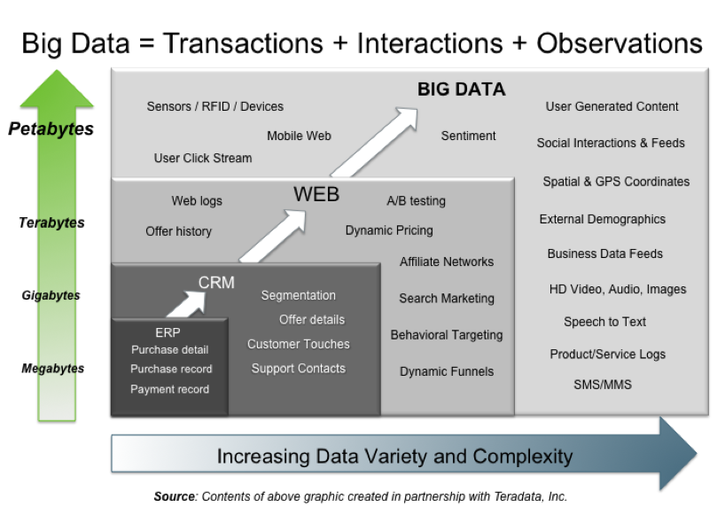
https://www.google.de/search?q=evolution+of+business+intelligence&newwindow=1&tbm=isch&tbo=u&source=univ&sa=X&ei=gEGoU5KXBuTb4QSGsoH4BQ&ved=0CDsQsAQ&biw=1366&bih=64

Slide 9
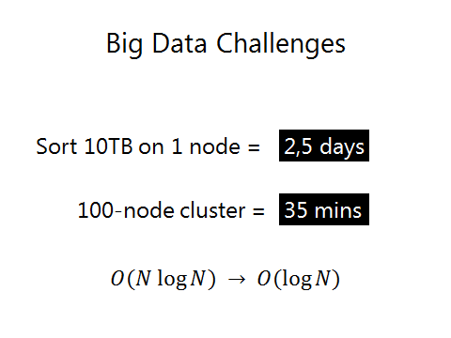

Slide 10
Application domains of Big Data

Slide 11



http://www.meltinfo.com/ppt/ibm-big-data

Slide 12
Big Data in Business Intelligence

Slide 13
Interesting, right?
This is just a sneak preview of the full presentation. We hope you like it! To see the rest of it, just click here to view it in full on PowerShow.com. Then, if you’d like, you can also log in to PowerShow.com to download the entire presentation for free.

