Slide 1

VIMALRAJ . A

Slide 2
What is Testing?
Testing is the process of evaluating a system or its component(s) with the intent to find whether it satisfies the specified requirements or not.
In simple words, testing is executing a system in order to identify any gaps, errors, or missing requirements contrary to the actual requirements.

Slide 3
Software Testing - Types of Testing
There are three types of Testing.
  Manual Testing
  Automation Testing
Types of Testing
Manual Testing
Automation Testing

Slide 4
Manual Testing
Manual testing includes testing software manually, i.e., without using any automated tool or any script. In this type, the tester takes over the role of an end-user and tests the software to identify any unexpected behavior or bug. There are different stages for manual testing such as unit testing, integration testing, system testing, and user acceptance testing.
Testers use test plans, test cases, or test scenarios to test software to ensure the completeness of testing. Manual testing also includes exploratory testing, as testers explore the software to identify errors in it.

Slide 5
Automation Testing
Automation testing, which is also known as Test Automation, is when the tester writes scripts and uses other software to test the product. This process involves the automation of a manual process. Automation Testing is used to re-run the test scenarios that were performed manually, quickly, and repeatedly.

Slide 6
Software Testing Methods
There are three types of software testing methods.
  Black-Box Testing
  White-Box Testing
  Grey-Box Testing

Slide 7
White-box testing:
The white box testing is done by the Developer, where they check every line of a code before giving it to the Test Engineer. Since the code is visible for the Developer during the testing, that's why it is also known as White box testing.
Black box testing
The black box testing is done by the Test Engineer, where they can check the functionality of an application or the software according to the customer /client's needs. In this, the code is not visible while performing the testing; that's why it is known as black-box testing.
.Gray Box testing
Gray box testing is a combination of white box and Black box testing. It can be performed by a person who knew both coding and testing. And if the single person performs white box, as well as black-box testing for the application, is known as Gray box testing.

Slide 8
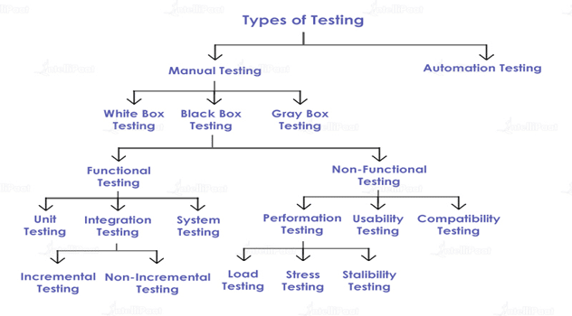
Types of Software Testing

Slide 9
Unit Testing
Unit testing involves the testing of each unit or an individual component of the software application. It is the first level of functional testing. The aim behind unit testing is to validate unit components with its performance.
A unit is a single testable part of a software system and tested during the development phase of the application software.
The purpose of unit testing is to test the correctness of isolated code. A unit component is an individual function or code of the application. White box testing approach used for unit testing and usually done by the developers.
Whenever the application is ready and given to the Test engineer, he/she will start checking every component of the module or module of the application independently or one by one, and this process is known as Unit testing or components testing.

Slide 10
Integration Testing
Integration testing is the second level of the software testing process comes after unit testing. In this testing, units or individual components of the software are tested in a group. The focus of the integration testing level is to expose defects at the time of interaction between integrated components or units.

Slide 11
System Testing
System Testing includes testing of a fully integrated software system. Generally, a computer system is made with the integration of software (any software is only a single element of a computer system). The software is developed in units and then interfaced with other software and hardware to create a complete computer system.
In other words, a computer system consists of a group of software to perform various tasks, but only software cannot perform the task; for that software must be interfaced with compatible hardware. System testing is a series of different types of tests with the purpose to exercise and examine the full working of an integrated software computer system against requirements.

Slide 12
Performance Testing
Checking the behavior of an application by applying some load is known as performance testing.
While doing performance testing on the application, we will concentrate on the various factors like Response time, Load, and Stability of the application.
Response time: Response time is the time taken by the server to respond to the client's request.
Load: Here, Load means that when N-number of users using the application simultaneously or sending the request to the server at a time.
Stability: For the stability factor, we can say that, when N-number of users using the application simultaneously for a particular time.

Slide 13
Usability Testing
Nowadays, we have n-numbers of applications available in application store in order to help the people in their works.
And where they can gives a negative response or a poor rating, which leads a particular product towards their ends before it is downloaded or installed by a limited number of end-users.
In short, we can say that one bad review can damage all the resources skill, extended hours of planning, enthusiasm to develop the product, and so on.
That is why Usability testing comes into the picture to resolve these types of issues, as usability testing has a vibrant significance and is executed by the test engineers throughout the STLC (Software Testing Life Cycle).

Slide 14
Compatibility Testing
Checking the functionality of an application on different software, hardware platform, network, and browsers is known as compatibility testing.
Why we use compatibility testing?
Once the application is stable, we moved it to the production, it may be used or accessed by multiple users on the different platforms, and they may face some compatibility issues, to avoid these issues, we do one round of compatibility testing.
.

Slide 15
Other types of Testing
Regression Testing
Smoke Testing
Sanity Testing
Adhoc Testing.

Slide 16
Regression Testing
Regression testing is a black box testing techniques. It is used to authenticate a code change in the software does not impact the existing functionality of the product. Regression testing is making sure that the product works fine with new functionality, bug fixes, or any change in the existing feature.

Slide 17
Smoke Testing
Smoke Testing comes into the picture at the time of receiving build software from the development team. The purpose of smoke testing is to determine whether the build software is testable or not. It is done at the time of "building software.
It is a time-saving process. It reduces testing time because testing is done only when the key features of the application are not working or if the key bugs are not fixed. The focus of Smoke Testing is on the workflow of the core and primary functions of the application.

Slide 18
Sanity Testing
which is used to check whether the bugs have been fixed after the build or not.
Sanity testing is performed on stable builds and it is also known as a variant of regression testing.
Sanity testing was performed when we are receiving software build (with minor code changes) from the development team. It is a checkpoint to assess if testing for the build can proceed or not.

Slide 19
Adhoc Testing
Ad hoc Testing is an informal or unstructured software testing type that aims to break the testing process in order to find possible defects or errors at an early possible stage.
Ad hoc testing is done randomly and it is usually an unplanned activity which does not follow any documentation and test design techniques to create test cases.

Slide 20


Thank You

