Slide 1
CGB1221-DATABASE MANAGEMENT SYSTEMS
Department of Artificial Intelligence and Data Science
Academic Year: 2024 – 2025
Register Number : 2303811724322122
Name : VIMALSHREE M
Year : II
Semester : IV
Section : B
Date : 04.06.2025

Slide 2
Title Of The Project
VEHICLE PRE-BOOKING APPLICATION

Slide 3
Problem Identification
Manual vehicle booking systems lack transparency and efficiency.
Users have difficulty checking vehicle availability in real-time.
Vehicle booking, cancellation, and status tracking are not user-friendly.
Admins struggle with managing bookings, users, and vehicle data efficiently.

Slide 4
Objective
Enable users to register/login securely.
Allow users to pre-book available vehicles by type and date.
Admin can approve or reject bookings.
Provide real-time availability of vehicles.
Support features like payments, feedback, and reviews.
Clean and simple UI with role-based access.

Slide 5
Requirement Analysis
Functional Requirements :
User Registration and Authentication Allows users to create accounts and securely log in.
Vehicle Listing and Availability Displays available vehicles with details like name, price, and status.
Vehicle Booking Enables users to book vehicles for specific dates.
Payment Processing Simulates payment for bookings and stores payment details.
Notifications Shows messages to users for booking or payment events.

Slide 6
Requirement Analysis
Non-Functional Requirements:
Usability Easy to use interface with a simple layout.
Performance Fast response time and efficient database operations.
Security Secure login, input validation, and (optional) password hashing.
Reliability Stable and error-free application behaviour.
Scalability Can handle more vehicles/users with minimal changes.

Slide 7
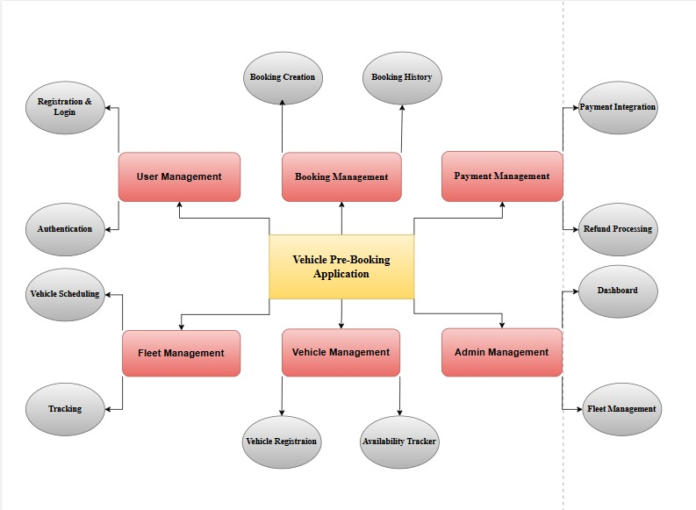
Proposed Architecture

Slide 8
List of Modules
Authentication Module
Booking Management Module
Vehicle Management Module
Admin Dashboard Module
User Feedback Module

Slide 9
Module 1 Description
AUTHENTICATION MODULE:
User and Admin login system
Password hashing and session control
Email-based account recovery

Slide 10
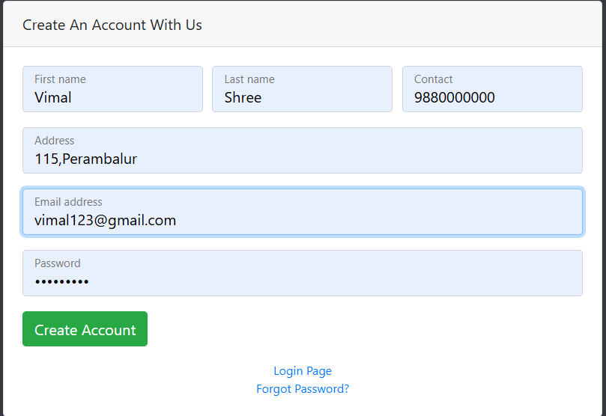
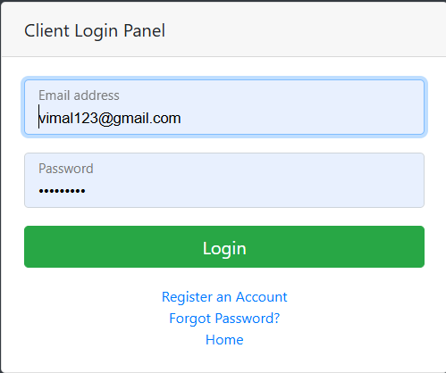
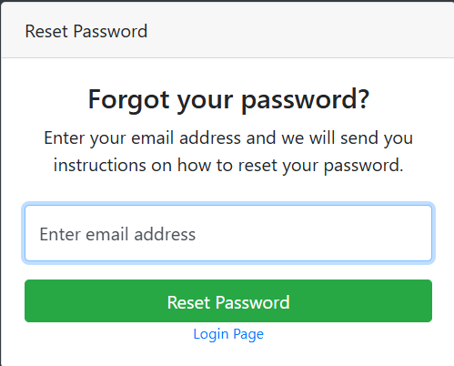
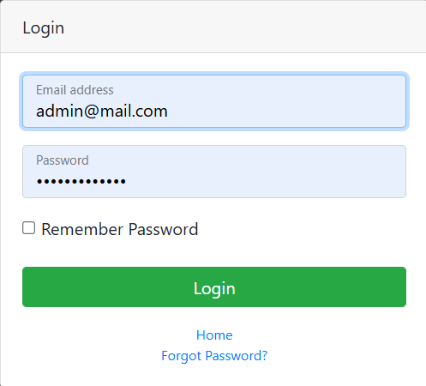
Module 1 Implementation
CGB1221-DATABASE MANAGEMENT SYSTEMS

Slide 11
Module 2 Description
BOOKING MANAGEMENT MODULE:
Users can select vehicle type, registration number, and book for a date
Status updates: Pending → Approved/Rejected
Booking history visible to users and admin

Slide 12
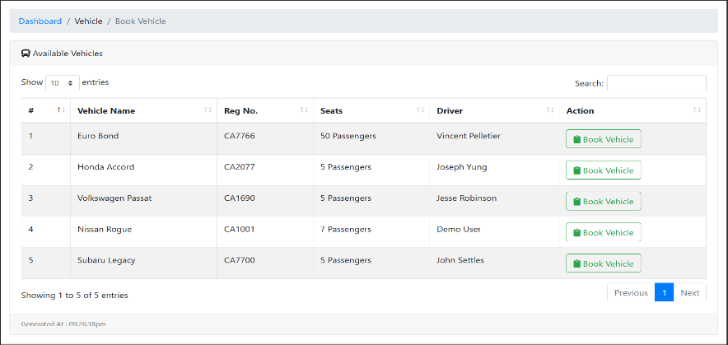
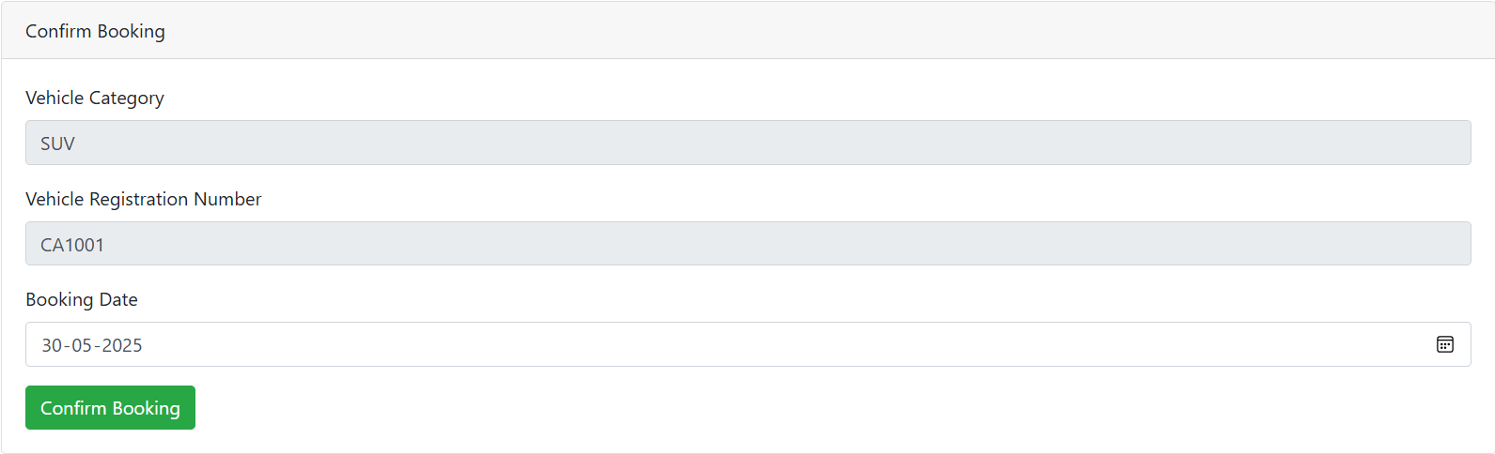
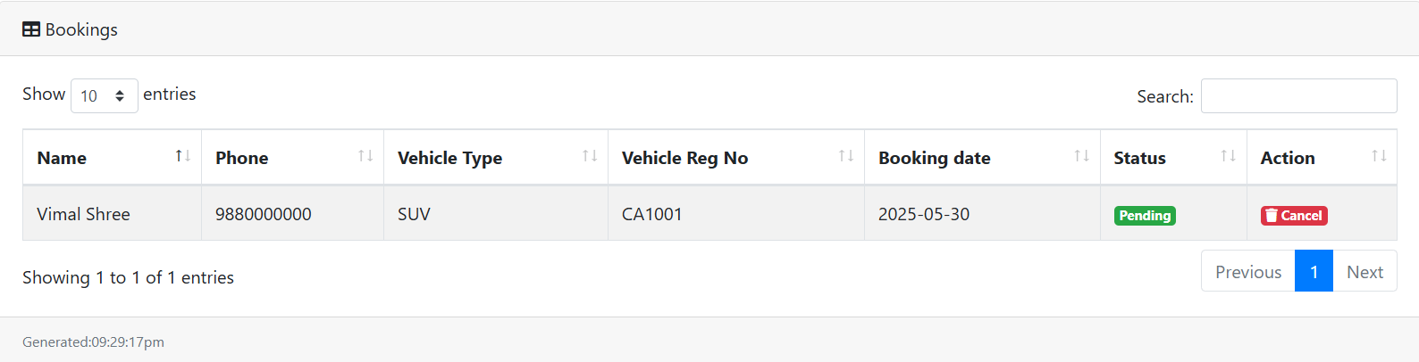
Module 2 Implementation
CGB1221-DATABASE MANAGEMENT SYSTEMS

Slide 13
Module 3 Description
USER BOOKING HISTORY MODULE:
Shows vehicle type, registration number, booking date, and status.
Displays past and current bookings made by the logged-in user.
Helps users track their booking history independently.

Slide 14
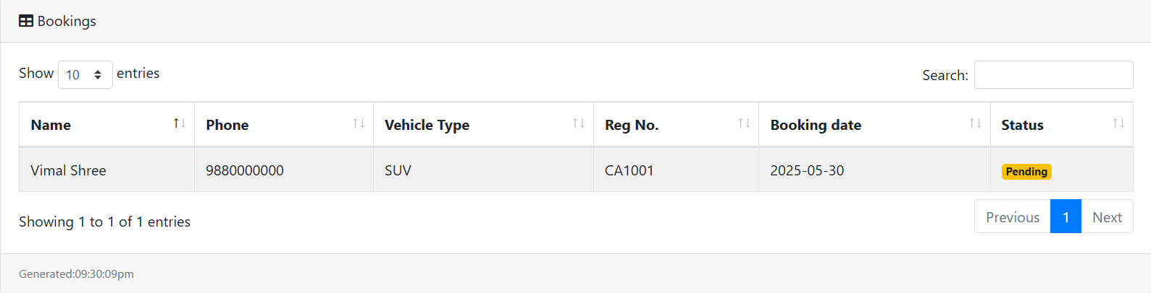
Module 3 Implementation
CGB1221-DATABASE MANAGEMENT SYSTEMS

Slide 15
Module 4 Description
ADMIN DASHBOARD MODULE:
View/manage users, bookings, vehicles
Approve/reject bookings
Monitor system logs and reset passwords

Slide 16
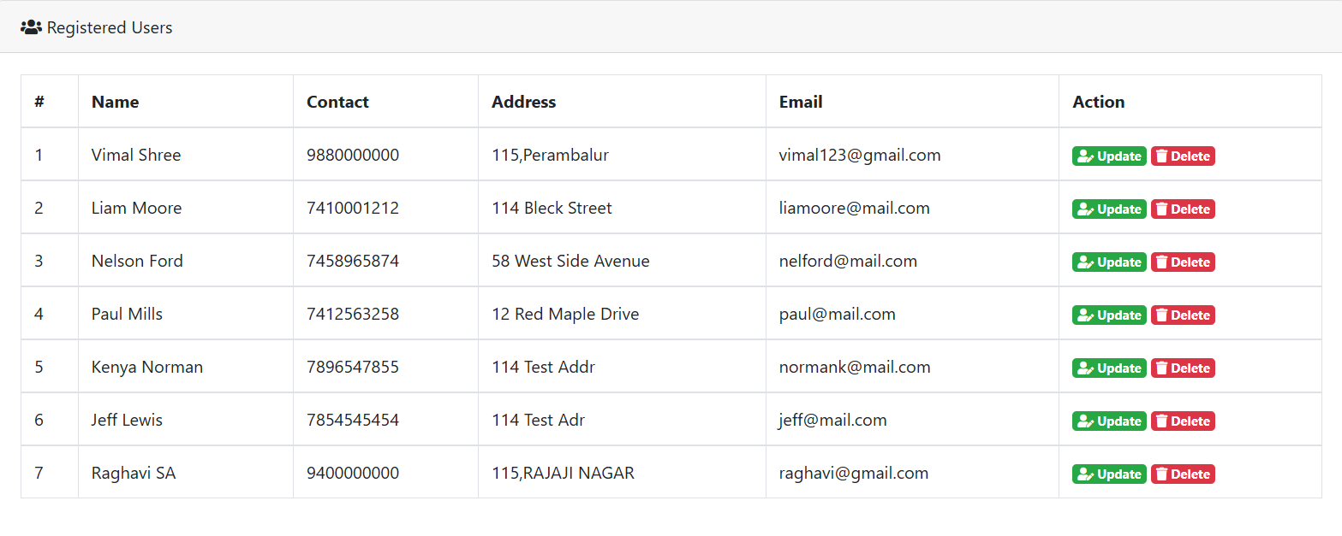
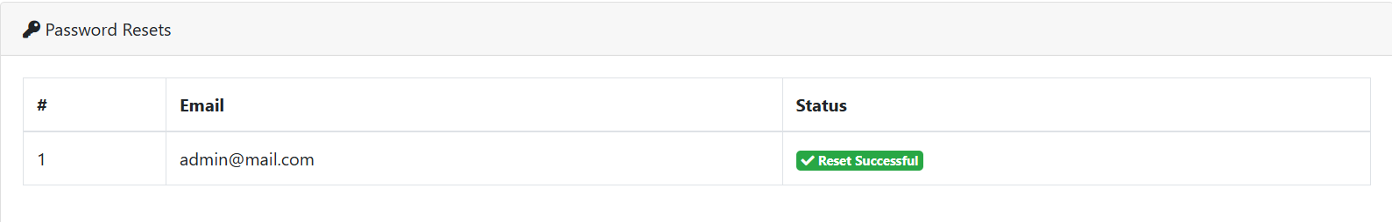
Module 4 Implementation
CGB1221-DATABASE MANAGEMENT SYSTEMS

Slide 17
Module 5 Description
USER FEEDBACK MODULE:
Collect feedback from users
Status as Published/Hidden
Display comments on admin panel

Slide 18
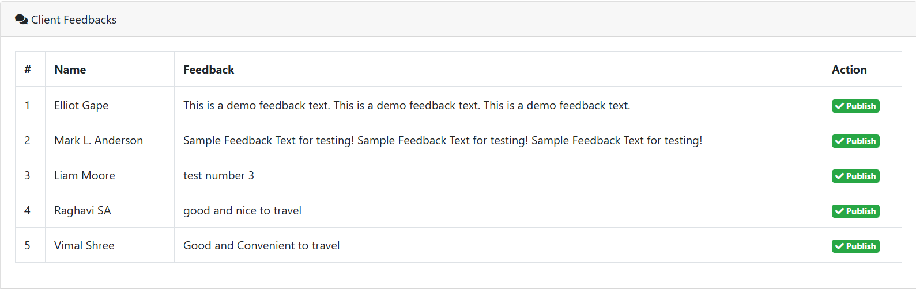
Module 5 Implementation
CGB1221-DATABASE MANAGEMENT SYSTEMS

Slide 19
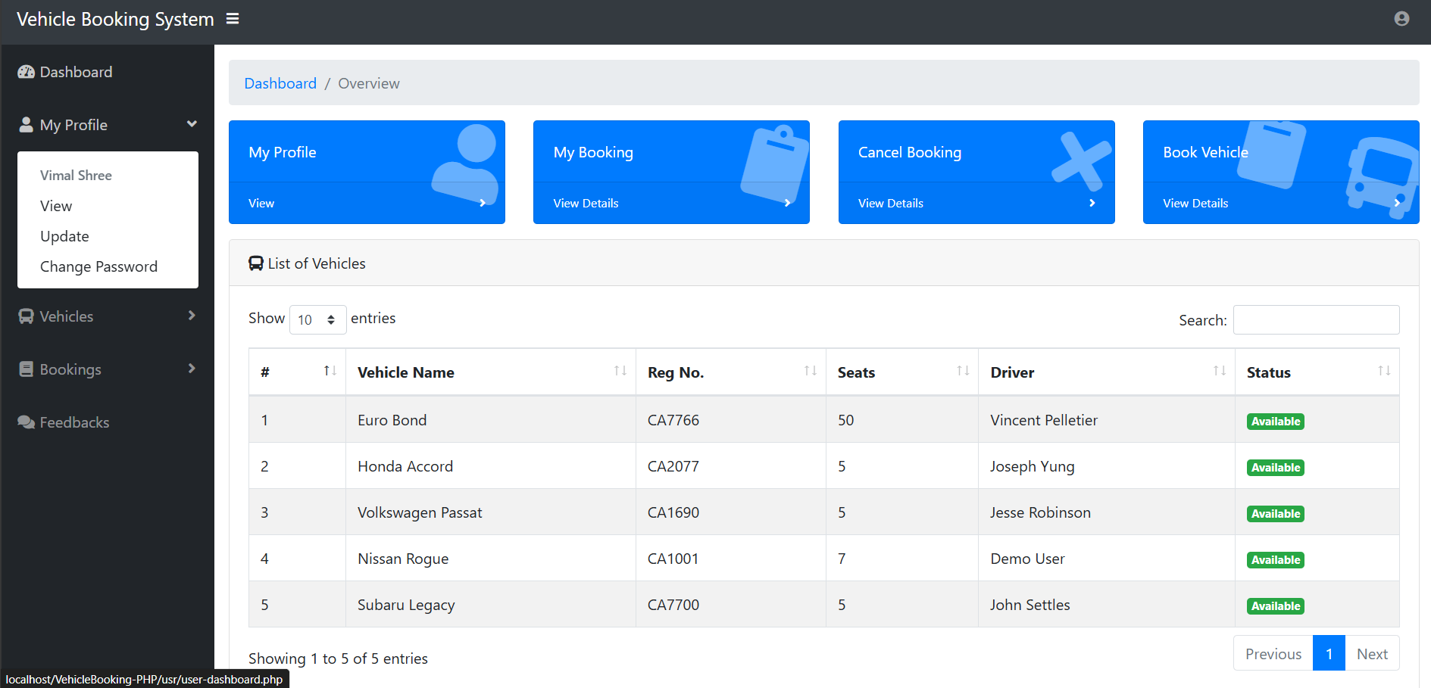
Results

Slide 20
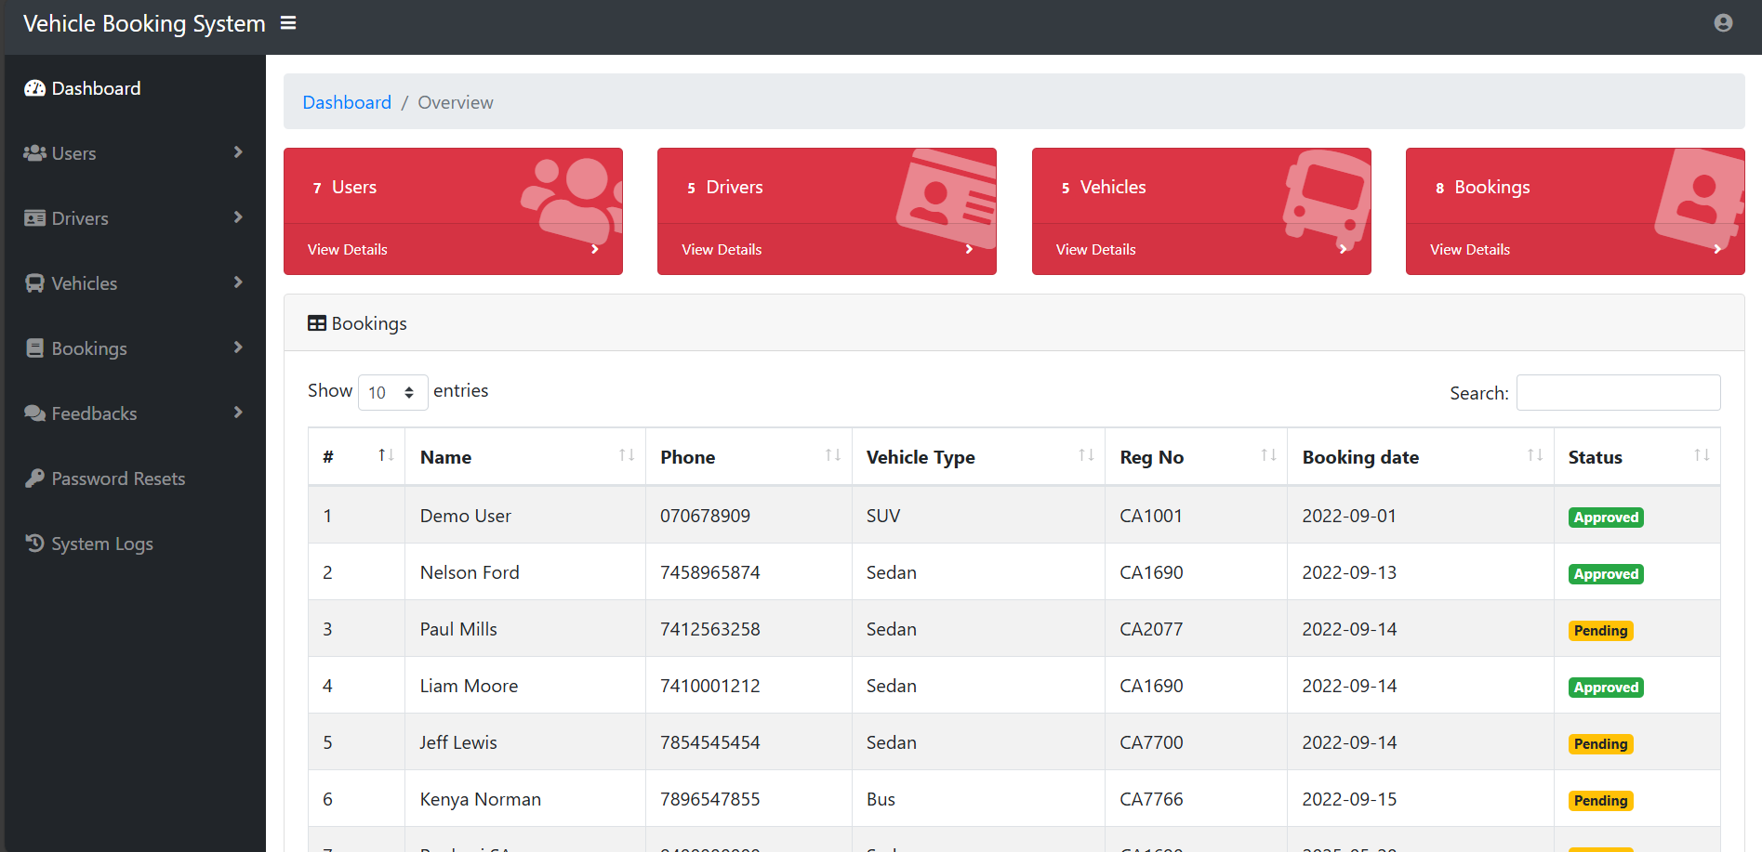
Results

Slide 21
Conclusion
The Vehicle Pre-Booking System is a reliable platform for managing vehicle reservations.
With modules supporting real-time booking, admin approval, and user feedback, the system streamlines the entire process.
Built with Flask and SQLite, the platform is lightweight, secure, and efficient — ready for real-world use or future scaling.

Slide 22
Thank You

