Slide 1
Quantum teleportation
Name : Vimaleswar A
Roll No : 20305
Instructor : DR. ANKUR RAINA

Slide 2
Single qubit quantum teleportation
Suppose there are two communicating parties named Alice and Bob, and Alice wants to send her quantum state to Bob. The quantum teleportation protocol enables Alice to do exactly this in a very elegant manner, and it can be described in four steps:
1. State preparation: Alice initializes her qubit to the state(Single Qubit) she wishes to teleport.
2. Shared entanglement: A Bell state is created and distributed to Alice and Bob (one qubit each).
3. Change of basis: Alice converts her two qubits from the Bell basis to the computational basis.
4. Measurement: Alice measures her two qubits, then tells Bob how to convert his qubit to obtain the desired state. Note that it is only the quantum information being teleported, and not a physical particle.

Slide 3
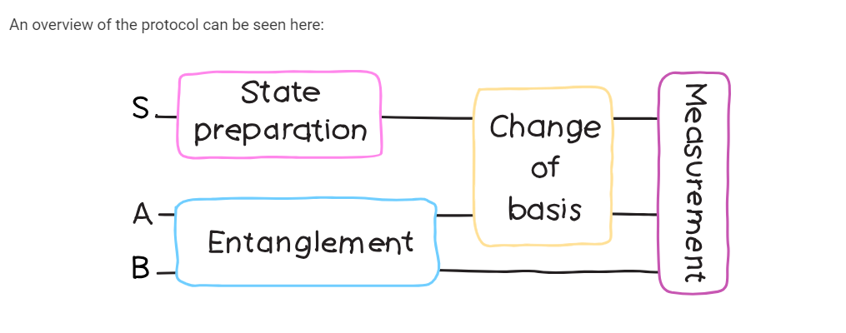
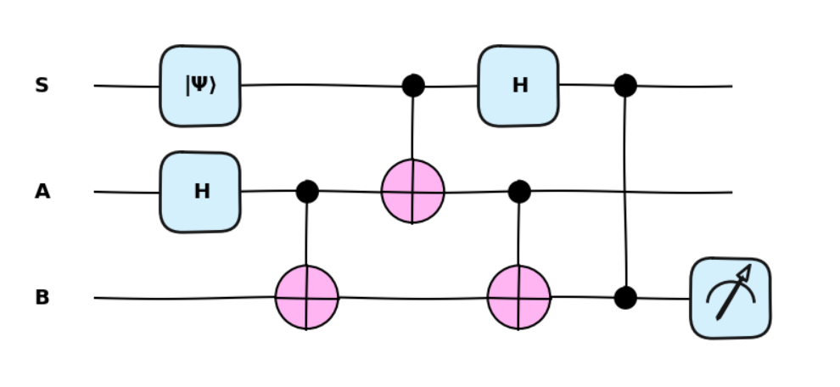
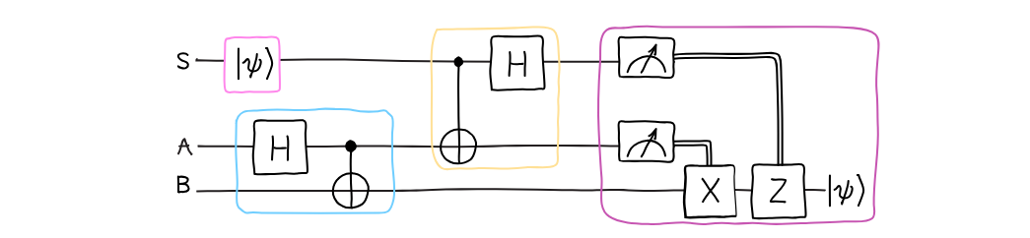

Slide 4
Two qubit quantum teleportation
Here, Alice (sender) sends her qubits information to Bob (receiver) under control, supervision of Charlie (controller) through the shared quantum channel between them. We use cluster states as quantum channels shared between three parties Alice, Bob and Charlie. The cluster state has been remotely prepared at the Alice place, where she performs all the necessary unitary operations including the deferred measurement. Afer performing all the operations, Alice sends the respective qubits to the respective parties. Then Alice immediate measures her qubits in computational basis, which destroys her qubits, making her incapable of any further communication. Now, after receiving qubits from Alice, Charlie measures his qubits in |± > basis. If the measurement outcome is |− >, then Charlie sends a classical bit of information to Bob within a certain time period. After receiving Charlie’s classical information in a certain time period, Bob gets that Charlie’s measurement outcome is |− >, and he has to perform phase (Z-gate) change unitary operations on his qubits. If the measurement outcome is |+ > , then Charlie does not need to send any classical information to Bob. After waiting for a certain time period and have not received any classical information, Bob understands that Charlie’s measurement outcome is |+ > and he has to perform another set of unitary operations on his qubits. By the above analysis, we conclude that the classical communication is taking place between Charlie and Bob, only when Charlie’s measurement outcome is |− >. Hence, the average classical communication cost necessary for our protocols is 0.5 bit.

Slide 5
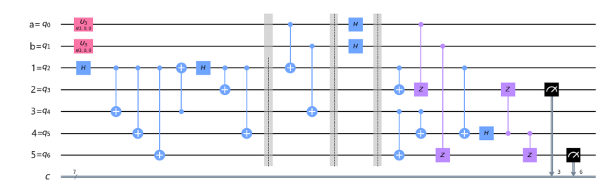
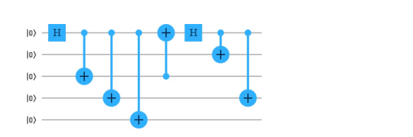
The cluster state is shared between three parties Alice, Bob and Charlie which are far apart from each other. Alice shares two qubits (1st and 3rd qubit), Charlie shares one qubit (4th qubit), and Bob (2nd and 5th qubit) shares the remaining two qubits. Now, Bob takes the information of the classical channel into account and decides which set of unitary operations he has to perform on his qubits. Here, if Charlie wants to cheat and sends the wrong information to Bob through the classical channel, then after Bob’s unitary operation and consulting with Alice, Bob finds out that Charlie cheated. Thus, even if Charlie wants to, he cannot cheat without getting caught, and this is the beauty of quantum communication
Quantum circuit generating the five-qubit cluster state, |C5 >12345.

Slide 6
Three qubit quantum teleportation
Here, we consider a seven-qubit cluster state which we used as a quantum channel for teleportation of three-qubit state. The cluster state is shared between as usual Alice (sender), Bob (receiver), and Charlie (controller) which are far apart from each other. More precisely, Alice and Bob each share three qubits and Charlie shares one qubit of the seven-qubit cluster state. The procedure is the same as for the previous scheme, i.e. Alice remotely prepared the cluster state at her place. After applying the required unitary operations between the cluster state and the three-qubit state, Alice sends the respective qubits to the respective parties. And after that, she immediately measured her qubits state and the whole state is get collapsed. Next, Charlie measures his qubit in |+ > or |− > basis, and when his measured state is |− >, then Charlie sends his qubit information in one bit to Bob within a certain time period through a secure classical channel. After receiving the information from Charlie, Bob gets that Charlie’s qubit is in |− > state, and he has to apply a phase-change (Z-gate) unitary transformation on qubit 6 followed by CNOT operation on qubits (2, 4) and (4, 6). If Charlie measurement outcome is |+ >, then he does not have to send any classical information to Bob. Whereas Bob after waiting for a certain time period and have not received any information from Charlie, he gets that Charlie’s qubit is in |+ > state. And he has to apply an identity gate unitary transformation on qubit 6 followed by CNOT operation on qubits (2, 4) and (4, 6). Herein, the qubits 1, 3 and 5 belong to Alice, the qubits 2, 4 and 6 belong to Bob, and the qubit 7 belongs to Charlie.

Slide 7
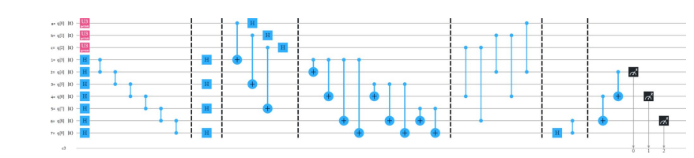
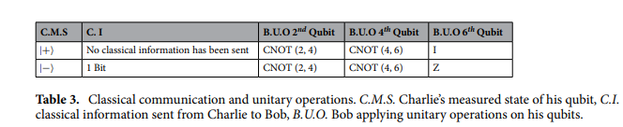
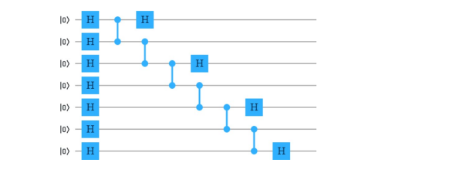
A generalized circuit for teleporting arbitrary three-qubit state using seven-qubit cluster state
Quantum circuit generating the seven-qubit cluster state, |C7 >123456

Slide 8
REFERENCES
Quantum Computation and Quantum Information by Michael A. Nielson & Isaac L. Chuang
https://pennylane.ai/qml/demos/tutorial_teleportation/
https://doi.org/10.1038/s41598-020-70446-8

Slide 9
Thank you

