Slide 1

CS5403 – Machine Learning
PBL Project Review–II
VoiceGuard: ML-Based Deepfake Voice Detection
Presentation by
A Vimanthan (2104251040013) & Sriram Jeganathan (2104251040966)
2104251040013 & 2104251040966
CSE L
Mentor
Dr. S. Prabha
Assistant Professor
Computer Science and Engineering

Slide 2
Project Progress Overview
Current Progress: 25%
Completed Milestones:
- Environment Setup & GitHub Initialization
- Audio Dataset Prep & Generation
- Exploratory Data Analysis & Spectrograms
- MFCC Feature Extraction implementation
Remaining Work:
- Model Training (Random Forest, SVM)
- Evaluation Metrics (F1, Accuracy)
- UI Implementation
Project Timeline

Slide 3
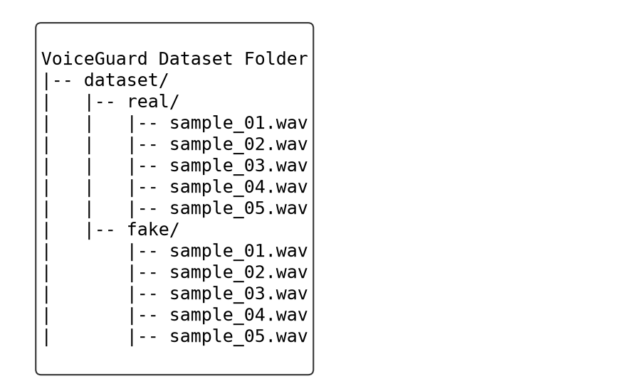
Data Collection & Analysis
Dataset Screenshot
Dataset Description: We have set up a subset of real vs. fake speech audio files to test the initial signal processing pipeline.
Total Number of samples: Small test subset (Full scale uses 25GB ASVspoof)

Slide 4
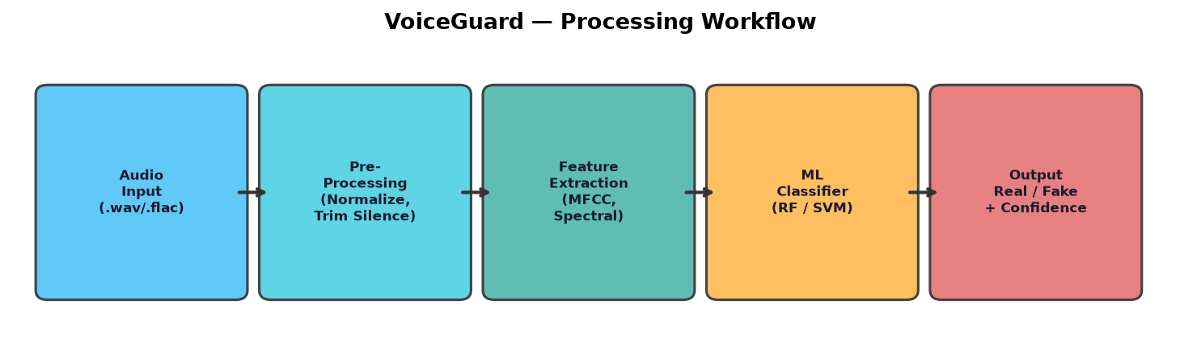
Methodology & Design
Workflow:
1. Load audio → 2. Resample to 16 kHz → 3. Trim silence
4. Extract MFCCs (13 coefficients) → 5. Extract Mel-Spectrogram
6. Build feature matrix → 7. Train RF / SVM classifiers
8. Predict Real/Fake with confidence score
Algorithmic Flow:
• Audio signal → Short-Time Fourier Transform (STFT)
• STFT → Mel filter bank → Log scale → DCT → MFCCs
• Feature vector fed to supervised classifiers
Technology Stack:
• Python 3.14 | librosa | scikit-learn
• matplotlib | scipy | python-pptx

Slide 5
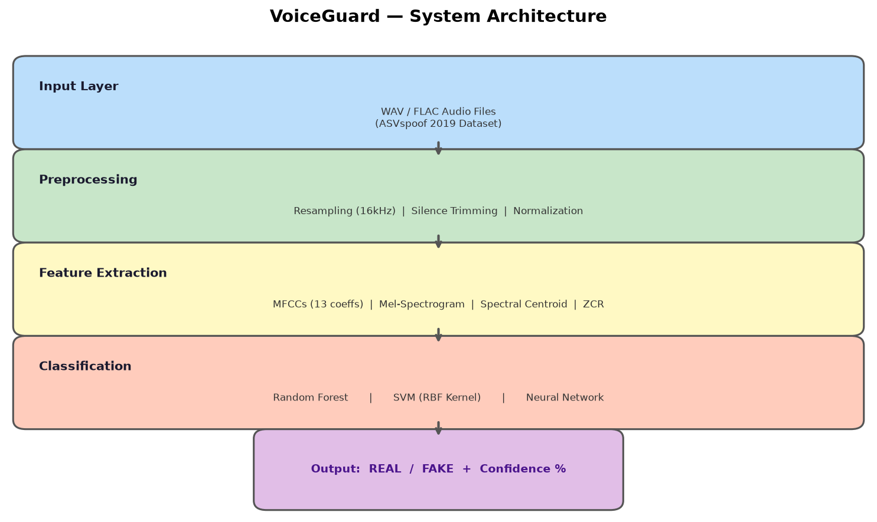
System Architecture & Module Design
Architectural Diagram: (see image below)
APIs & Libraries Used:
• librosa — Audio loading, MFCC & Mel-Spectrogram extraction
• scikit-learn — Random Forest, SVM classifiers, metrics
• scipy.signal — Spectrogram computation, signal processing
• matplotlib — Visualization of waveforms & spectrograms
Hardware & Software Components:
• OS: Windows 11 | IDE: VS Code
• CPU: Intel / AMD (no GPU required for RF/SVM)
• Python 3.14 | pip package manager
• Dataset: ASVspoof 2019 (Logical Access subset)

Slide 6
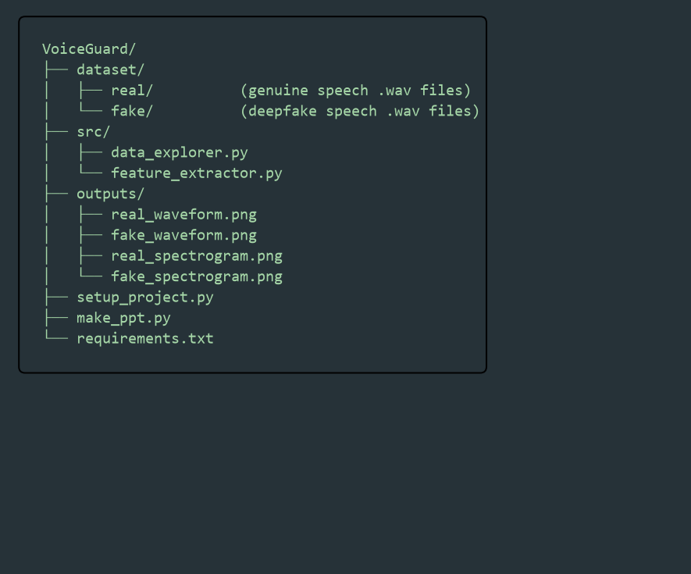
Implementation Environment
Code Architecture:
• src/data_explorer.py — Waveform & spectrogram generation
• src/feature_extractor.py — MFCC feature extraction module
• setup_project.py — Dataset folder creation & audio generation
• make_ppt.py — Automated presentation builder
IDE Used: Visual Studio Code
Libraries:
• librosa 0.11 | matplotlib 3.11 | scikit-learn 1.8
• scipy 1.17 | numpy 2.4 | python-pptx 1.0
GitHub Repository: github.com/vimanthan/VoiceGuard

Slide 7
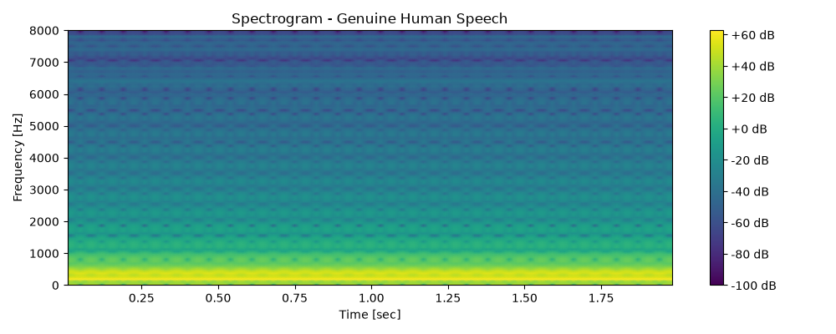
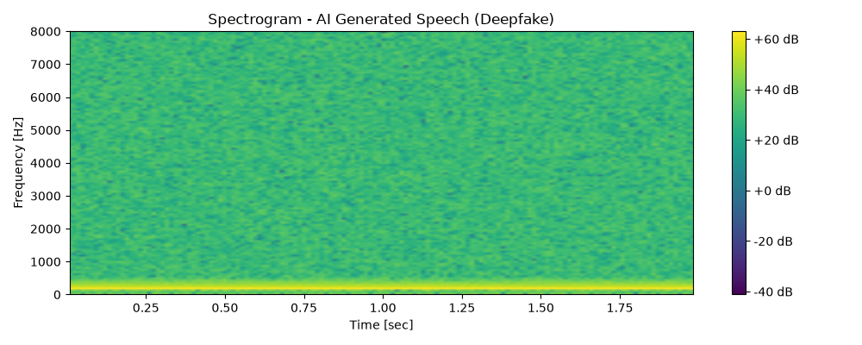
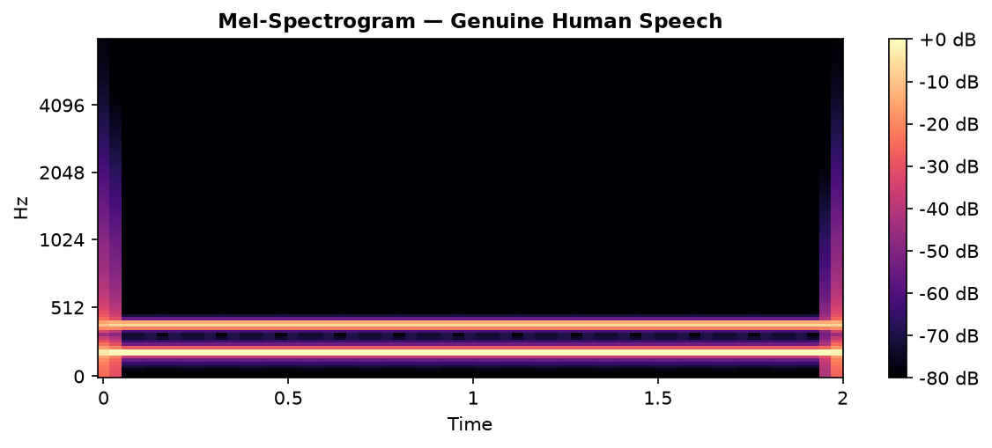
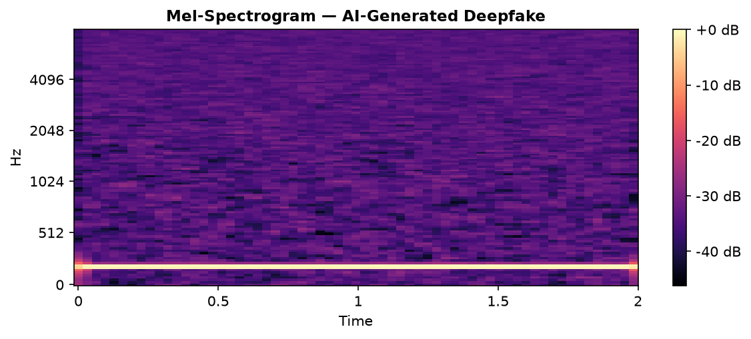
Implementation Progress
Extracted Mel-Spectrograms (Real vs Fake):
(see images below — left: genuine speech, right: deepfake)
Working Prototype:
• Feature extraction pipeline fully functional
• MFCC vectors of shape (13,) generated per sample
• Waveform & Mel-Spectrogram visualizations generated
Prediction Result:
• Model training is the next milestone (Review 3)
• Target: >90% accuracy on ASVspoof LA subset

Slide 8
Current Challenges & Future Direction
Challenges:
Tech Challenges:
• Large dependency sizes (librosa, numba, llvmlite)
• Handling diverse audio formats & sample rates
Dataset Challenges:
• ASVspoof 2019 full dataset is 25 GB
• Class imbalance between bonafide & spoof samples
Implementation Challenges:
• Feature engineering — choosing optimal MFCC count
• Generalizing to unseen TTS/VC attack types
Next Plan:
Model Training & Optimization:
• Train Random Forest & SVM on extracted features
• Hyperparameter tuning (GridSearchCV)
Performance Evaluation:
• Accuracy, Precision, Recall, F1-Score
• Confusion Matrix & ROC-AUC analysis
Testing:
• Cross-validation on ASVspoof LA subset
• Test with real-world voice clone samples

Slide 9

A Vimanthan (2104251040013) & Sriram Jeganathan (2104251040966)
<viman.workspace@gmail.com | sriramjeganathan@outlook.com>

