Slide 1

Note: The data and information in this document is reflective of a hypothetical situation and client. This document is to be used for KPMG Virtual Internship purposes only.
Sprocket Central Pty Ltd
Data analytics approach
[Division Name] - [Engagement Manager], [Senior Consultant], [Junior Consultant]

Slide 2
Note: The data and information in this document is reflective of a hypothetical situation and client. This document is to be used for KPMG Virtual Internship purposes only.
Agenda
Introduction
Data Exploration
Model Development
Interpretation

Slide 3

Note: The data and information in this document is reflective of a hypothetical situation and client. This document is to be used for KPMG Virtual Internship purposes only.
Introduction
Analyze the sales data of Sprocket Central Pty Ltd in different angles
Data: Transaction, Customer Demographic
With these data we can analyze the monthly sales , variation in sales according to customer factor and profit.
Place any supporting images, graphs, data or extra text here.

Slide 4
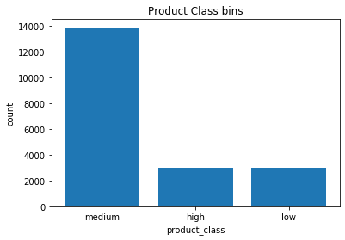
Note: The data and information in this document is reflective of a hypothetical situation and client. This document is to be used for KPMG Virtual Internship purposes only.
Data Exploration
01. Product class vs Sales
This bar graph shows how sales vary with product class. Medium class products sold more than other two class.
Manufacturing more Medium product class will be benefit to company.

Slide 5
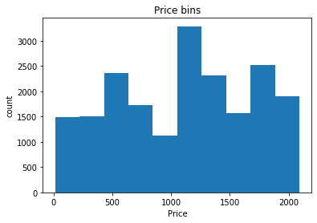
Data Exploration
02.Price Range class vs Sales
More sales happened in Price range between $1100 to $1300. Other than that $400 to $600 and $1700 to $1800 ranges also gave more sales.

Slide 6
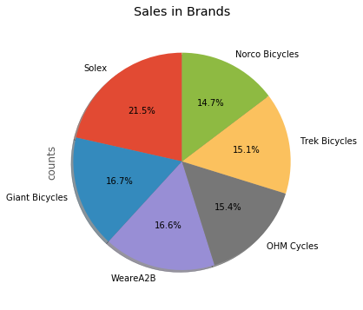
03.Brand vs Sales
5 Brands are in this category and each brand have approximately equal sales. But 21.5% of sales happened to Solex brand which is liked by most of the customers.

Slide 7
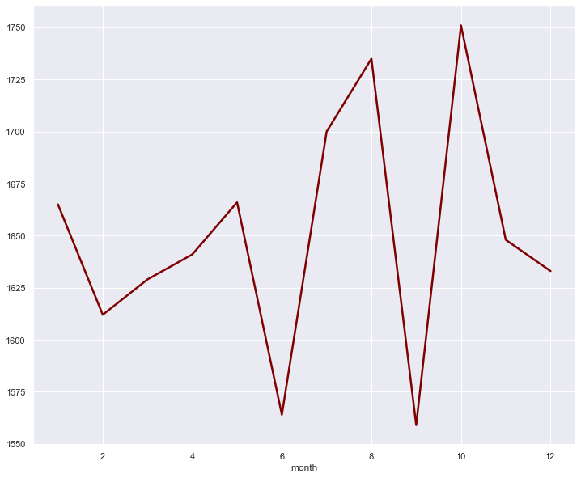
04.Monthly Sales
According to the line graph monthly sales came to peak point in October. Next highest point is in August. But in September, we can see huge drop in sales.

Slide 8
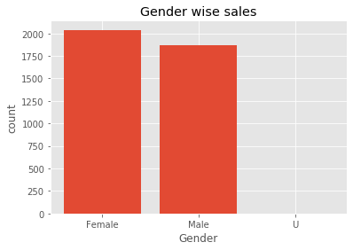
05.Customer Gender vs Sales
Company have more female customers than male.

Slide 9
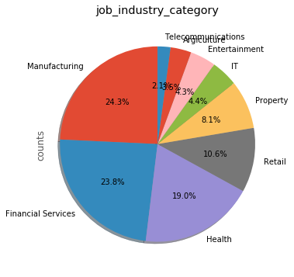
06.Customer job vs Sales
Most of the customers are working in Manufacturing Industry and Financial Services. Almost 50% of customers come in to theses two industries.

Slide 10
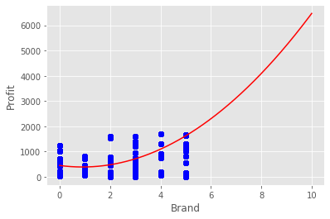
Note: The data and information in this document is reflective of a hypothetical situation and client. This document is to be used for KPMG Virtual Internship purposes only.
Model Development
Polynomial Regression and Decision Tree
We cant make a model with most of the categorical variables and graphs doesn't with polynomial line. Here you can see brand vs profit graph. Points doesn't fit in to line.
If we predict the brand preference according to the customer details, Model accuracy is 0.4 which should be more than 0.8 for good model. So we cant take that model for the predictions.

Slide 11
Note: The data and information in this document is reflective of a hypothetical situation and client. This document is to be used for KPMG Virtual Internship purposes only.
Interpretation
Female customers are mor than male.
Most of the Customers are working in Manufacturing Environment.
Most of the customers are living in New South Wales, Australia.
Solex Brand is best seller of the year.

