Slide 1

EXPLORATORY DATA ANALYSIS ON NEW YORK STOCK EXCHANGE
Team Name: NYSE
Name: Vimarsha R USN:PES1201701590
Name: Varsha C USN: PES1201701387

Slide 2
Dataset link : https://www.kaggle.com/dgawlik/nyse Dataset The data set we have chosen is New York Stock Exchange abbreviated as NYSE. It contains data about various companies involved in Trade and Stocks and the cash and investments. The data set mainly consisted about many companies and their annual reports for the years 2012,2013,2014,2015,2016. It had data about the debts, investments, taxes, profits , loss, liabilities ,assets.
Kind of Analysis
The idea behind the analysis of this data set was to find how each term in the companies report affected it’s growth.
So, we plotted the columns against random companies in the beginning and then went on to plot the the top 5 companies vs bottom 5 companies to see how terms has an effect on the position of the company. This was mainly achieved by use of line charts, bar charts, pie charts , stacked bar graphs.

Slide 3
Before we could start off with data analysing, there were many terms in our dataset that we had to explore. Our dataset had 79 columns and 1782 rows. Here, we will be defining few of the terms that we made use of for data analytics:
Columns : Index or the number of rows.
Ticker Symbol : Used to uniquely identify publicly traded shares of a particular stock on a particular stock market.
Period Ending : An accounting period is the span of time covered by a set of financial statements. This period defines the time range over which business transactions are accumulated into financial statements.
Accounts Payable : Is money owed by a business to it suppliers shown as a liability on a company’s balance sheet.
Accounts Receivable : Is the balance of money due to a firm of goods or services delivered or used but not yet paid for by customers.

Slide 4
For year : The year where they publish the annual report.
Cash Ratio : The ratio of the liquid assets of accompany to its current liablilities .
After Tax ROE: After Tax Return on equity is the amount measures how much profit a company generates with the money shareholders have invested after paying the tax.
Capital Expenditures : Are the funds used by a company to acquire, upgrade and maintain physical assets such as equipment , property.
Total Assets, Total Liabilities: Assets refer to the total amount of assets owned by a person or entity, liabilities represent all monies owed to businesses outside of a company.
Total Revenue : Refers to the total receipts from sales of a given quantity of goods or services.
Inventory : Is the goods that a business holds for the ultimate goal of resale.

Slide 5
Net Income : Is the residual amount of earnings after all expenses have been deducted from sales.
Gross profit : Is the profit accompany makes after deducting the costs associated with making and selling its products , or costs associated with providing its services.
After Tax Earnings: Calculated by subtracting all expenses and income taxes from the revenues the business has earned.
Cash Flow : Is the difference in amount of cash available at the beginning of a period and the amount at the end of the period.
Net Cash Flow : Refers to the difference between a company’s cash inflows and outflows in a given period.
PreTax Margin: The amount of earnings that company has prior to taking into account taxes.
Capital Surplus: Account which may appear on a corporation’s balance sheet, as a component of a shareholder’s equity.

Slide 6
Data Cleaning
In our dataset , first we plotted the histogram for each of the column to find if any outliers existed. Based on the columns that we were going to use , we cleaned the data of those columns accordingly.
For example, firstly, every company had 4 rows according to the years. So we had to group the data by the Ticker Symbol using the the “groupby” function of pandas. Which we called as single object and used this object for plotting graphs .
Cleaning Accounts Receivable:
This column had negative values implied that the data there could simply be added to the Accounts Payable because that is what is meant to be. Basically, it is cleaning the Accounts Payable column also.
Code: df = pd.read_csv ('fundamentals.csv’)
for index, row in df.AccountsPayable.iteritems():
if df.AccountsReceivable [index]<0:
df.AccountsPayable [index]+=df.AccountsReceivable[index]
df.AccountsReceivable[index]=0

Slide 7
Cleaning For Year:
The For Year column had many missing data, so we used the if statements to fill the data values as they were consecutive years for a given company.
Cleaning Cash Ratio Column:
Even this column had many missing values, so we replaced those by dividing respective value of total assets by total liabilities.
Cleaning Pre-Tax Margin:
This column had many outliers when we plotted the boxplot for this column. So, we found the mean, median , mode and standard deviation of this column.
Mean: 16.24749, Median:14, Mode:0, 10
And we replaced the outlier values with the mean value as outlier value were extending upto 400.
As a result, we were able to get rid of only some of the outliers.

Slide 8
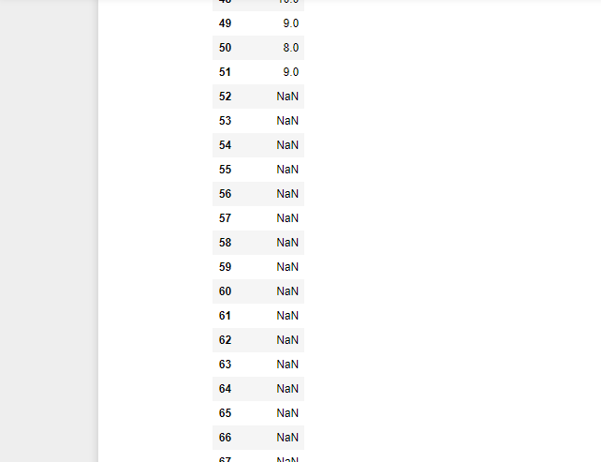
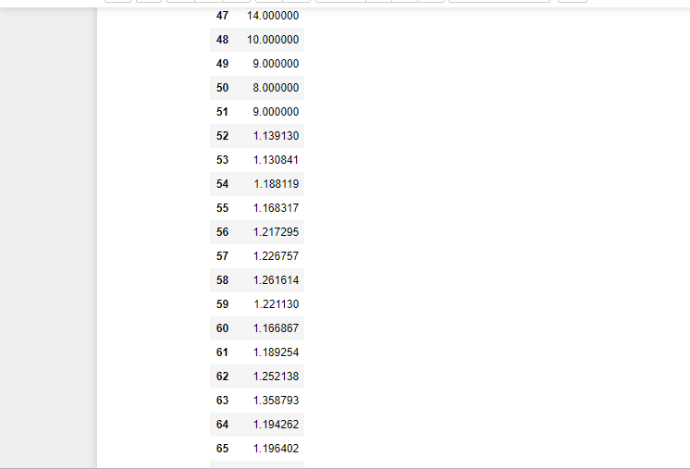
Cash Ratio
Before Cleaning
After Cleaning

Slide 9
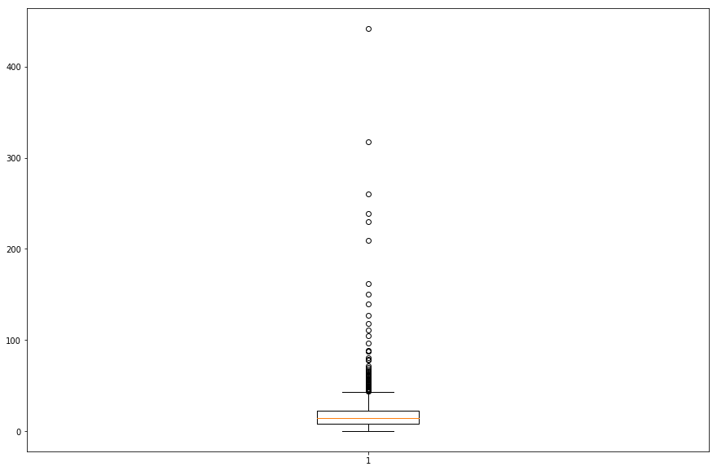
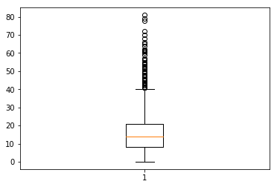
Boxplot for PreTax Margin
Before cleaning
After Cleaning

Slide 10
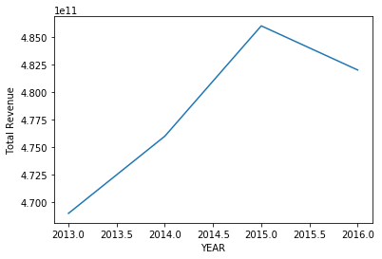
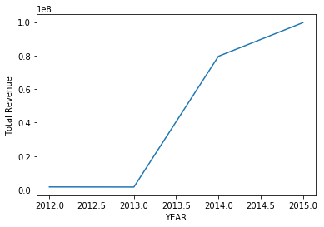
Data Visualization Line Chart : Total Revenue vs For Year for Maximum and Minimum Companies. Maximum Company: WMT Minimum Company : COTY

Slide 11
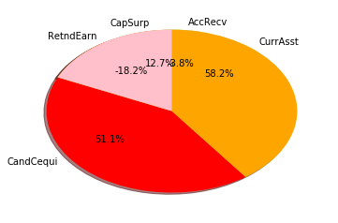
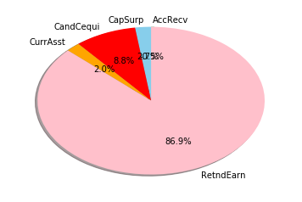
Pie Chart for some columns:
For Maximum Average Total Revenue Company
For Minimum Average Total Revenue Company

Slide 12
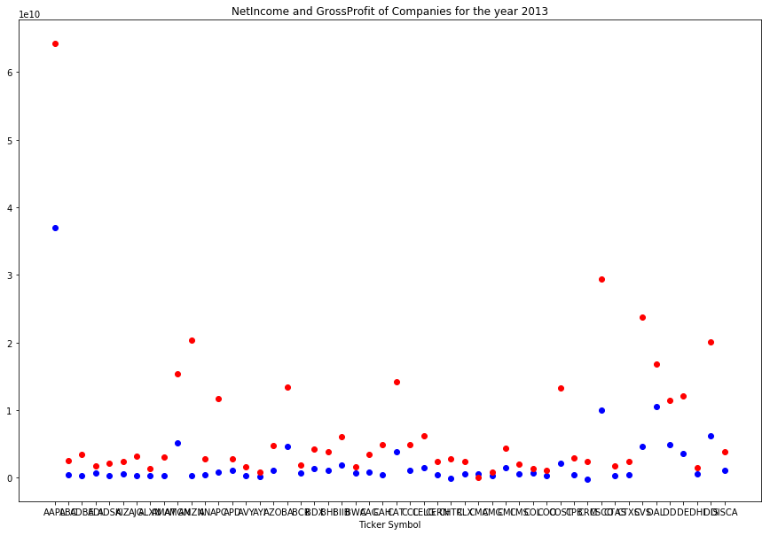
Scatter plot Net Income and Gross Profit for the year 2013 Net Income : Blue Gross Profit : Red The gross profit is higher than net income for many companies because net income is after we subtracted expenses, whereas grossprofit is before we subtract expenses.

Slide 13
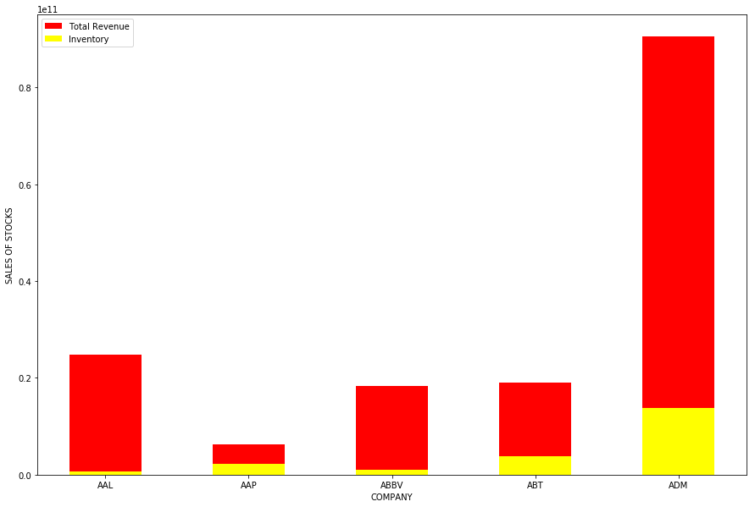
Stacked Bar Chart Total Revenue vs Inventory

Slide 14
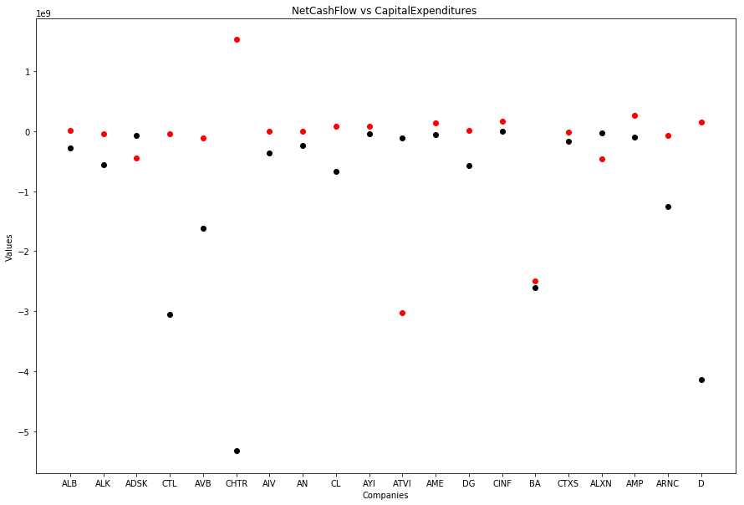
Capital Expenditures vs Net Cash Flow NetCashFlow : Red Capital Expenditures: Black From the graph, we see that most companies have more net cash flow rather than capital expenditure indicating that they might in profit.

Slide 15
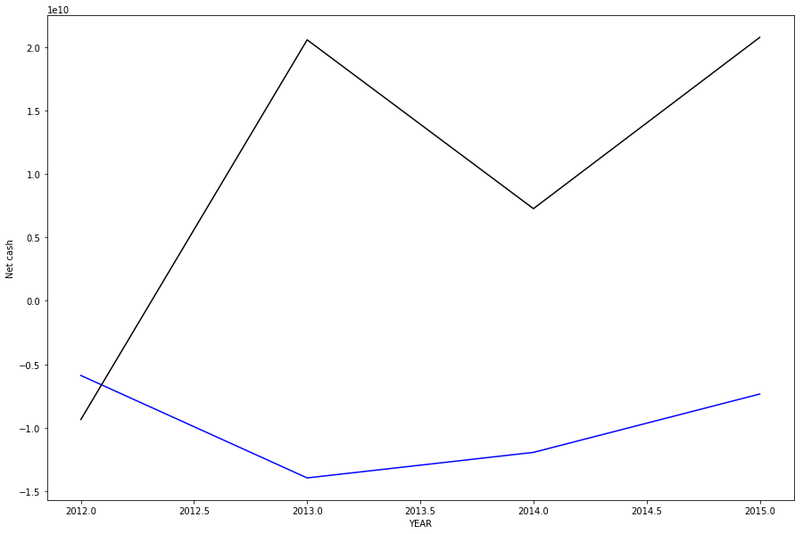
Cash Flow for Lowest Minimum and Maximum Company Minimum company is JPM : blue Maximum company is BAC : black

Slide 16
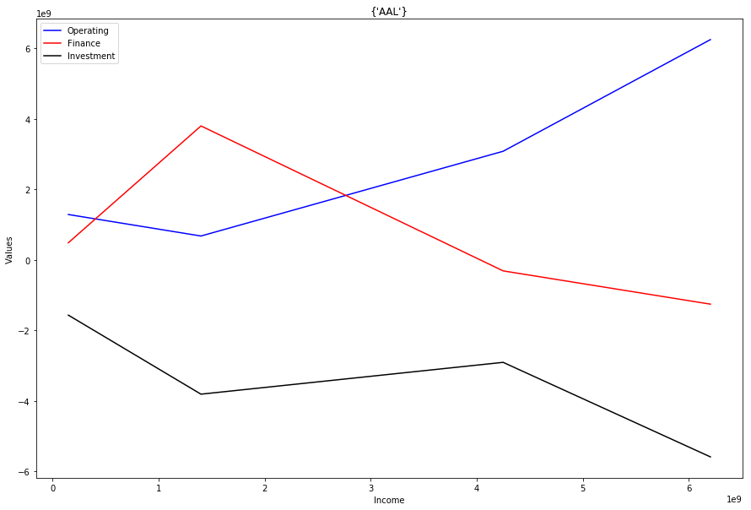
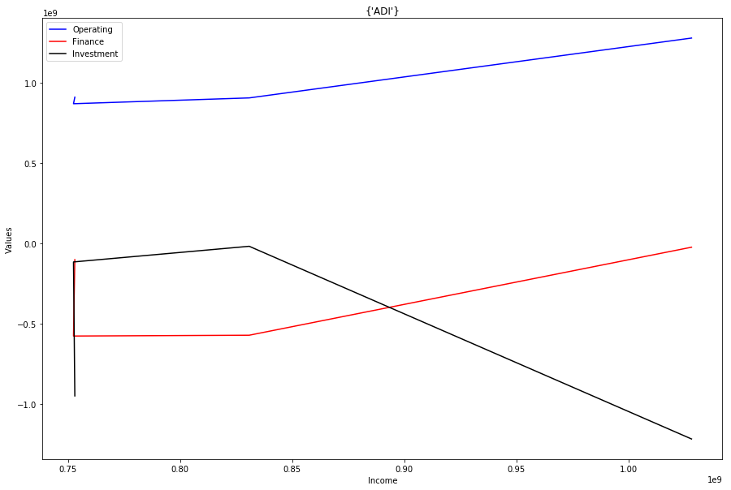
Operating Income vs Net Cash Flow By these graphs we visualize how different values change relate with respect to income.
AAL
ADI

Slide 17
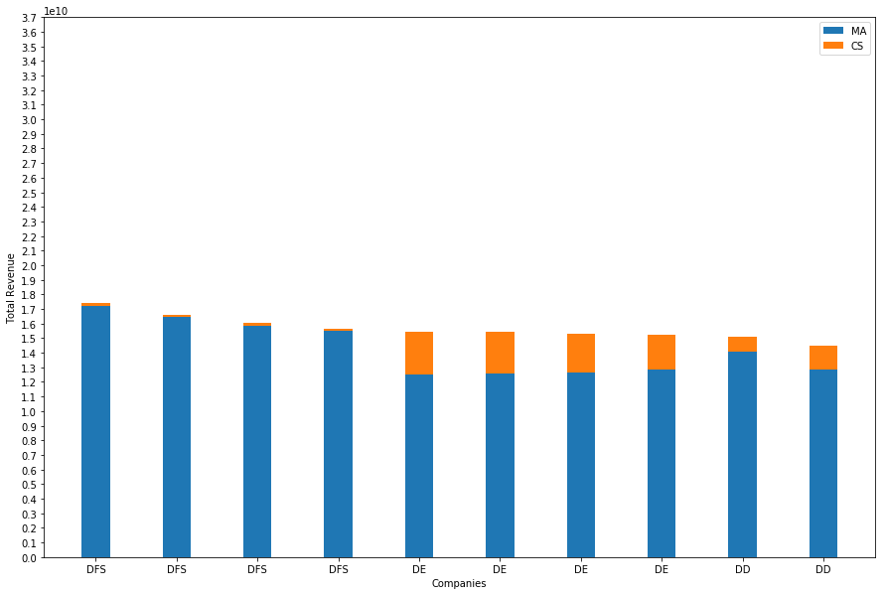
Hundred moving Averages vs Capital Surplus More level of blue than orange indicates that company isn’t selling much premium stocks and is getting profit by other means

Slide 18
Conclusions
Hypothesis Testing:
Here, we considered z-test for hypothesis testing since the sample size is greater than 30.
We first applied the one-tailed hypothesis test for Cash Ratio column considering a significance level of 0.05.
Null Hypothesis: mu<=population mean
Alternate hypothesis: mu>population mean
Result: Failed to reject null hypothesis.
H0 : mu<= 62.192709111704744 H1 : mu > 62.192709111704744 alpha value is : 0.05 actual z value : 1.6448536269514729 hypothesis z value : -0.227060520939052 Failed to reject NULL hypothesis

Slide 19
When we applied the two tailed test, with the same signifance level
and sample size is 100, even then we had to reject null hypothesis.
Null Hypothesis: mu=population mean
Alternate hypothesis: mu!=population mean
Result: Failed to reject null hypothesis.
Conclusion : The null hypothesis failed to get rejected.
H0 : mu = 74.4574898785425 H1 : mu != 74.4574898785425 alpha value is : 0.05 actual z value : 1.9599639845400545 hypothesis z value : -1.803764946109895 Failed to reject NULL hypothesis

Slide 20
Overall conclusion
The conclusion we reached from the data was that there is not just one criterion to determine how a company is faring in the stock market. We have to look at many factors and also see the previous trends(which may not work all the time- as there were cases where a completely in loss company suddenly was sky high in its stock values or vice versa) and based on these, we can find the company which has had very high profits/income and try invest in those shares.
The parameters which most stock holders looked at were the ones used in graphs. From gross profit margin to cash ratio, almost every term effected the company’s stock value.

Slide 21
THANK YOU

