Slide 1
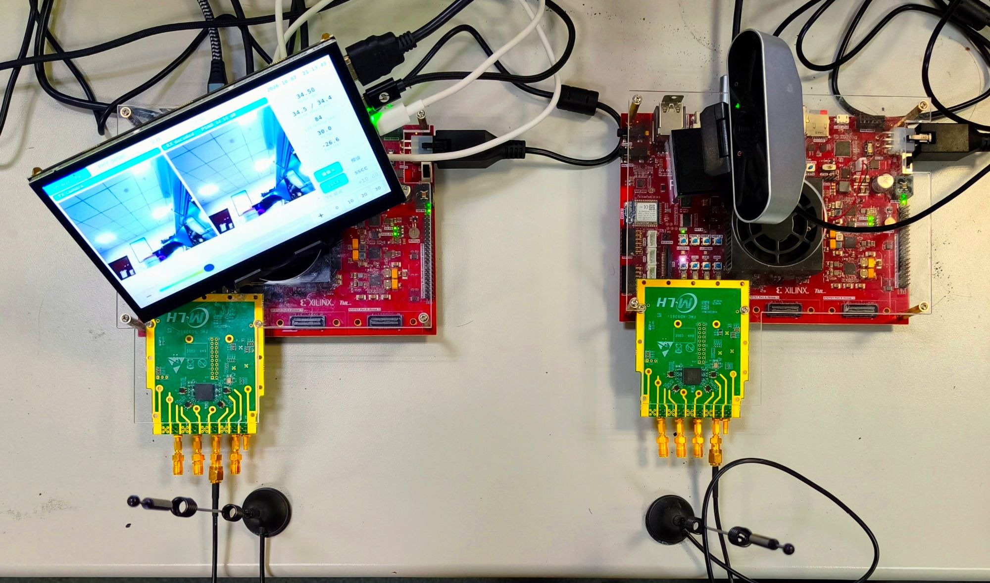
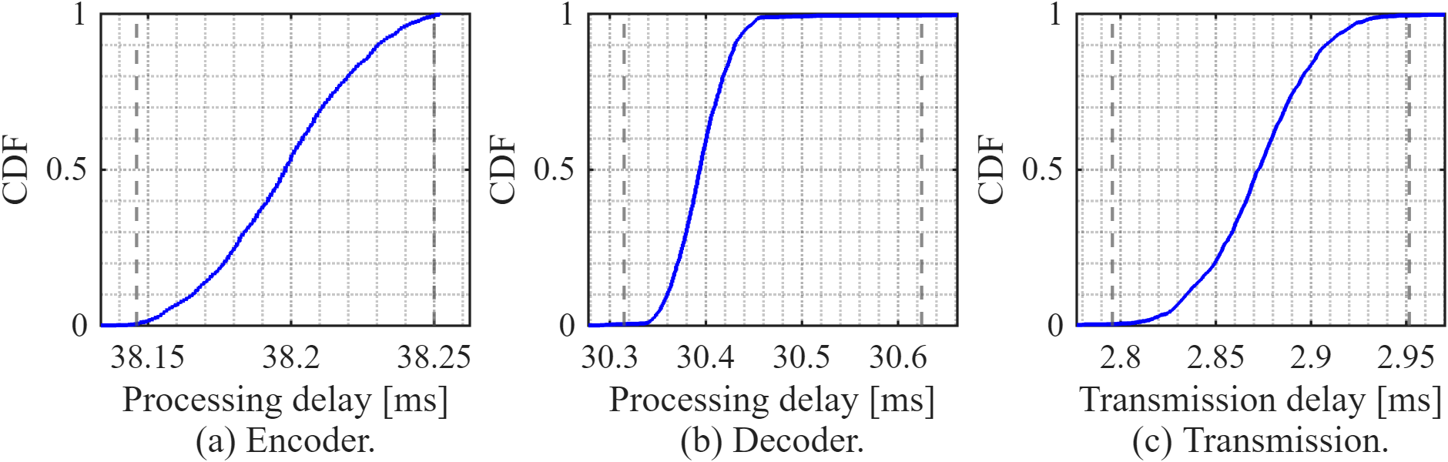
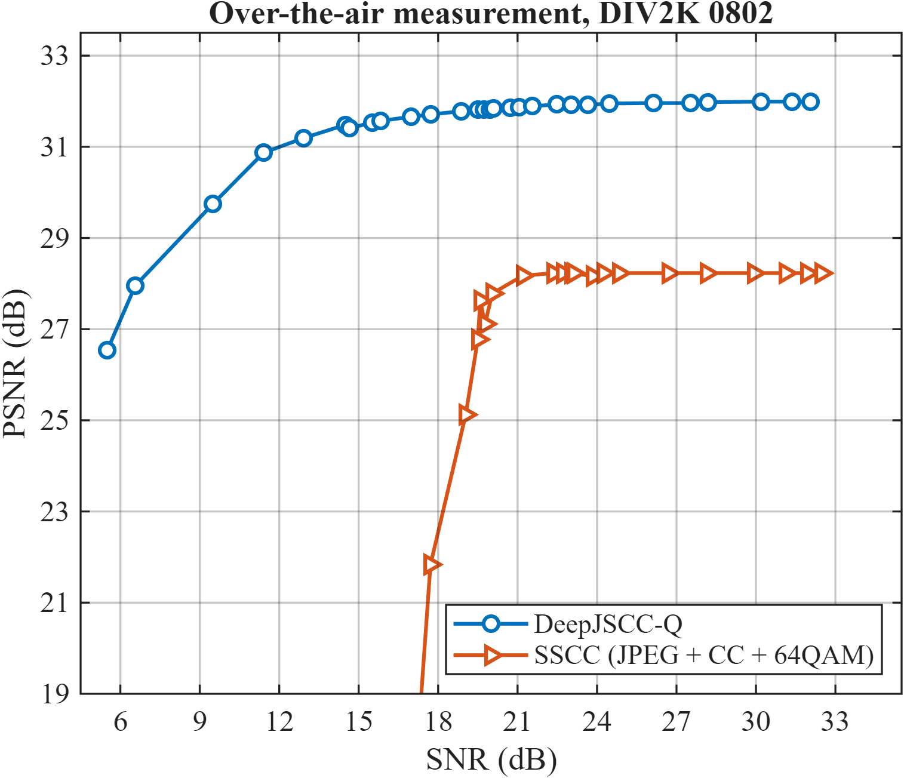
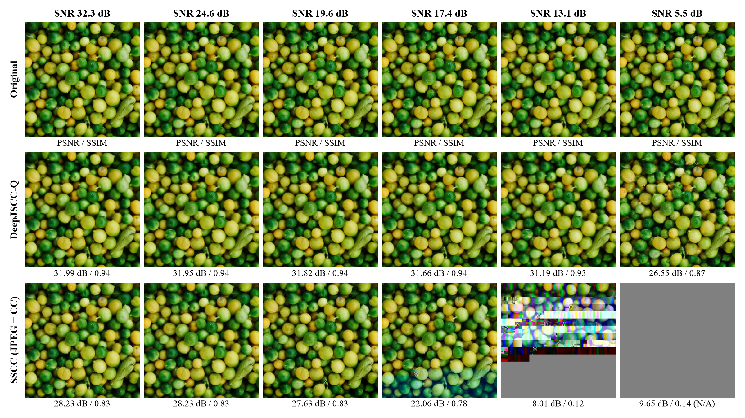
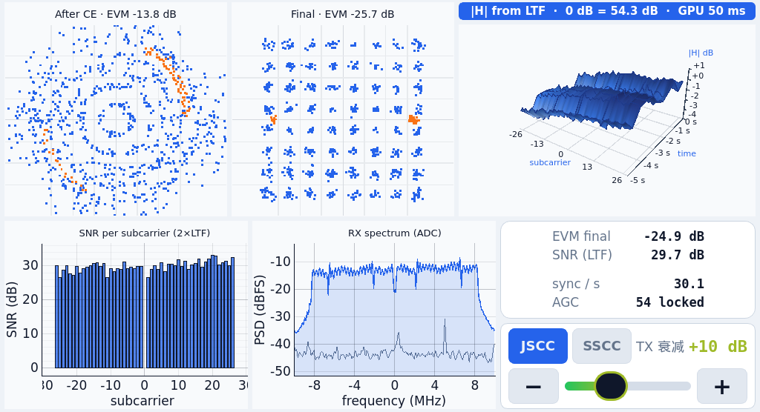
Real-Time Over-the-Air Image Transmission with DeepJSCC-Q on FPGA
Separate source and channel coding (JPEG + FEC) fails abruptly once the SNR drops below its code threshold; DeepJSCC-Q maps pixels straight to 64-QAM symbols and degrades gracefully. The CNN codec, an 802.11a-like OFDM PHY and the RF front-end control all run on two Zynq UltraScale+ boards.
30 fps
71.5 ms
+3.8 dB
2.33 GMAC
4.5 / 4.9 W
256×256 RGB images over a 915 MHz air link
PL latency: encode 38.2 + air 2.9 + decode 30.4 ms
PSNR over JPEG + convolutional code, with no cliff
per frame, 114 convolutions, W8A12 fixed point
TX / RX on-chip power (Vivado estimate)
1
Hardware
5
Layer-streaming CNN engine
6
Latency and throughput
One engine per layer, chained by AXI-Stream with back-pressure: only line buffers, no frame storage.
Output-channel parallelism P chosen per layer: the smallest P that meets 30 fps at 250 MHz.
Branches that read the same input share one window reader; weights in LUT, BRAM or packed BRAM + gearbox; large activation buffers in URAM.
Medians from PL frame counters on both boards (1701 frames).
30.0 fps sustained: 18,000 frames received in 600 s.
Line buffer
K-1 rows
Window
K×K×Cin
P MAC lanes
weights x P
Requantize
bias, act., shift
Left: RX (PYNQ-ZU + AD9361 + touch screen). Right: TX (PYNQ-ZU + AD9361 + USB camera). 915 MHz antennas in front.
per layer; groups of P output channels re-read the window
7
vs. FPGA DeepJSCC [3]
Optimization steps (encoder / decoder)
2
System
Step | Before | After
Per-layer P: MAC lanes | 1120 / 1191 | 217 / 296
Weight gearbox: DSP, enc. | 255 | 223
Activations to URAM: BRAM36 | 114 / 149 | 97.5 / 99.5
 | [3] GLOBECOM 25 | This work
Conv. work / frame | 0.22 GMAC | 2.33 GMAC
DSP enc. / dec. | 1597 / 874 | 233 / 312
BRAM enc. / dec. | 1039 / 1012 | 100 / 100
Latency enc. / dec. | 39.6 / 52.9 ms * | 38.2 / 30.4 ms
PHY | external 5G | own OFDM in PL
TX board
RX board
Camera / video
PS: crop to 256×256
Touch-screen GUI
PS: display, control
DeepJSCC-Q encoder
PL, W8A12, 250 MHz
DeepJSCC-Q decoder
soft I/Q in, no hard decision
Full TX / RX designs (xczu5eg, routed)
OFDM transmitter
PN flip, IFFT, frame buffer
OFDM receiver
sync, 2×LTF CE, SFO / CPE
 | LUT | BRAM36 | URAM | DSP | WNS
TX | 52.7k | 104.5 | 10 | 243 | +0.15
RX | 70.8k | 123.5 | 25 | 394 | +0.23
Network cores; different devices and precision (INT8 vs W8A12): absolute counts, not a controlled comparison. * median including PS processing; ours: PL only.
AD9361
915 MHz, 20 MSPS
air
AD9361
fast AGC
8
Graceful degradation, no cliff (measured over the air)
One frame = one image = 32,768 64-QAM symbols = 683 OFDM symbols (2.75 ms on air). The coded image crosses the air link only; Ethernet carries control and the TX preview used for PSNR.
DeepJSCC-Q: 32.0 dB at 32 dB SNR and still 26.5 dB at 5.5 dB - the image quality follows the channel.
SSCC (JPEG + K=7 convolutional code + 64-QAM) on the same PHY with the same 32,768 symbols per image: 28.2 dB, lost within 3 dB (SNR 20 -> 17 dB).
With the same channel-symbol budget, DeepJSCC-Q is 3.8 dB better even at high SNR.
SNR is data-aided: received constellation against the known reference of a still image (DIV2K 0802), attenuator swept from 32 dB down.
Below: decoded images from the same sweep - rows original, DeepJSCC-Q, SSCC; PSNR / SSIM under each image; an undecodable SSCC frame is scored as mid-gray.
3
DeepJSCC-Q network
Encoder: 256x256x3 image -> 64x64x16 latent (55 conv)
RG
RB
RG
ATT
RB
RG
RB
RG
ATT
ATT
32,768 64-QAM symbols (0.5 symbol / pixel)
RB
RU
RB
RU
ATT
RB
RU
RB
RU
Decoder: soft I/Q -> image (59 conv)
RG/RB residual (+GDN), ATT attention, RU PixelShuffle (+IGDN)
C = 32, 16 latent channels, 4× down-sampling; 387k parameters; trained at 10 dB AWGN with a constellation-entropy (KL) penalty.
W8A12 post-training quantization: 0.05 dB below float (DIV2K); RTL bit-exact against the integer model.
4
OFDM PHY and RF front end
64-pt FFT, 48 data + 4 pilots; PN sign flip: 99 % PAPR 10.1-10.7 -> 9.4-9.8 dB.
Per-symbol SFO tracking: frame-end EVM within 1.7 dB of the start (683 symbols).
AGC lock -14 dBFS: mid-frame gain steps 9/45 -> 0/44; PHY alone: 0 errors in 7.15×10^8 bits.
Live RX GUI: constellations, |H| vs time, per-subcarrier SNR, spectrum
Developed with AI coding agents: Claude Code (PHY, RF, PYNQ software, measurements) and Codex (training, quantization, RTL generator); the human set the goals and constraints, made the key technical calls and did all hardware handling; the two models cross-reviewed the report. Hardware: 2× PYNQ-ZU (xczu5eg) + 2× AD-FMCOMMS3, Vivado 2025.2. Open source (MIT).
[1] E. Bourtsoulatze, D. B. Kurka, D. Gunduz, IEEE TCCN, 2019. [2] T.-Y. Tung, D. B. Kurka, M. Jankowski, D. Gunduz, "DeepJSCC-Q," IEEE JSAIT, 2022. [3] T. Isobe et al., "FPGA-based deep joint source-channel coding for real-time 5G image transmission," IEEE GLOBECOM, 2025.

