Slide 1
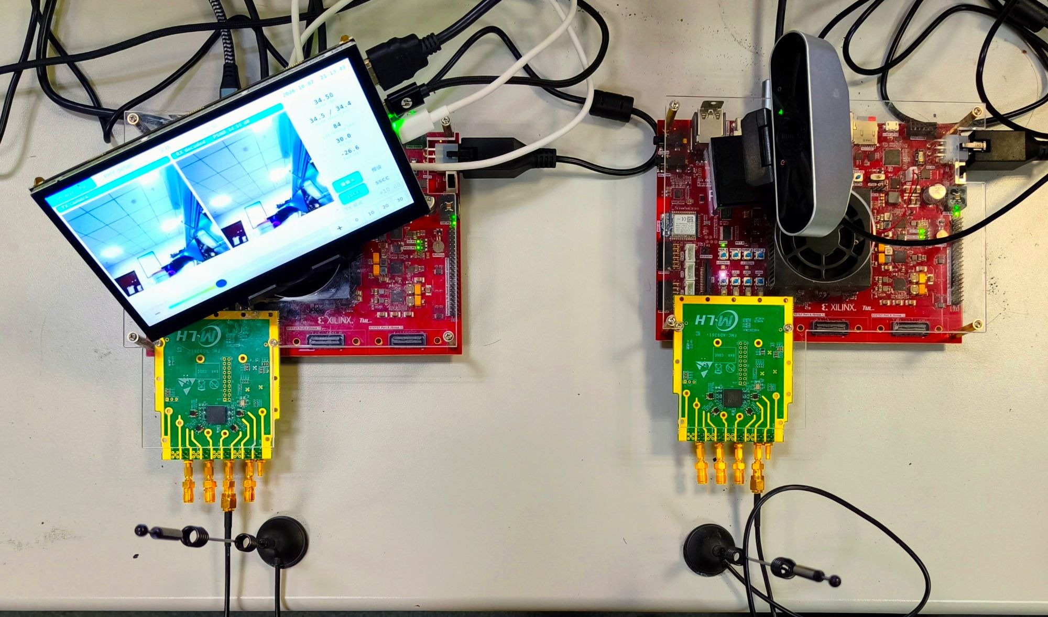
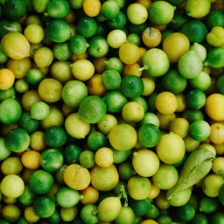

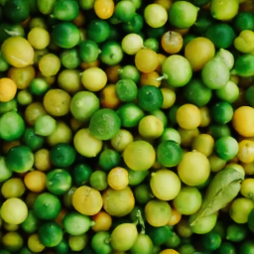

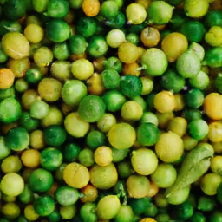

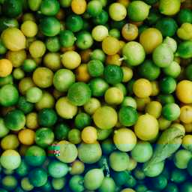

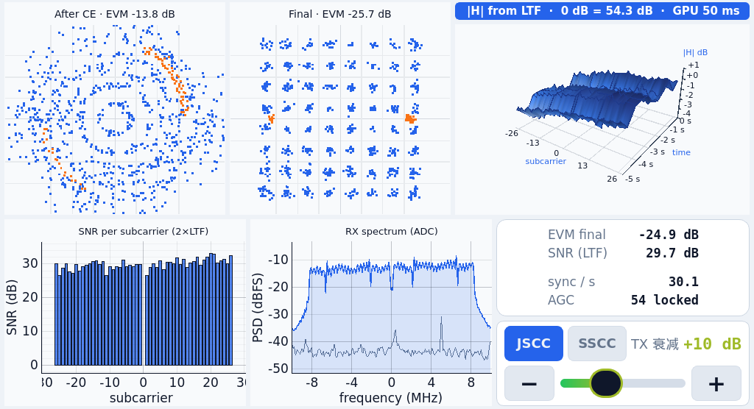
Real-Time DeepJSCC-Q on FPGA
Wireless image transmission on two Zynq boards
30 fps
71.5 ms
+3.8 dB
256 × 256 RGB
18,000 frames in 600.06 s
PL frame latency
Frames overlap in the pipeline
High-SNR PSNR gain over SSCC
DIV2K 0802; equal symbol budget
Two-board wireless link
Measured quality over the air
DIV2K 0802; same PHY and 32,768 symbols/image.
SSCC: JPEG + convolutional code + 64-QAM.
Original
RX (left), TX (right).
2 × PYNQ-ZU + 2 × AD-FMCOMMS3.
TX board
RX board
256 × 256
RGB
Camera/video
Touch screen
Reconstruction at four channel conditions
RGB input
Image + PHY
CNN encoder
CNN decoder
32.3 dB
17.4 dB
13.1 dB
5.5 dB
64-QAM symbols
Soft I/Q
OFDM TX
OFDM RX
DeepJSCC-Q
Buffer + IFFT
Sync + equalize
AD9361
air
AD9361
31.99 / 0.94
31.66 / 0.94
31.19 / 0.93
26.55 / 0.87
915 MHz
Fast AGC
32,768 complex symbols/image
683 OFDM symbols/frame
20 MSPS PHY sample rate
SSCC
No decodable
frame
Soft I/Q enters the decoder without hard decisions. Ethernet carries control and the reference preview.
28.23 / 0.83
22.06 / 0.78
8.01 / 0.12
N/A
Matched TX attenuation; column SNR averages both schemes.
Curve: window means. Images: frame PSNR (dB) / SSIM.
Decode failures are scored as mid-gray.
PL latency excludes app/display.
Transfer includes buffers + RX PHY.
Streaming FPGA implementation
PL frame latency: 71.5 ms
250 MHz, W8A12, 2.33 GMAC/frame
Encode 38.20
Transfer 2.87
Decode 30.39
Weight ROM
Live PHY diagnostics
Line buffer
Window
P MAC lanes
Requantize
K or K+1 rows
K × K × Cin
P accumulators
Bias, act., shift
Layer engines form a pipeline; P meets 30 fps.
On-chip buffers avoid full intermediate feature maps.
Routed TX / RX totals on xczu5eg
Design | LUT | BRAM36 | URAM | DSP
TX | 52,679 | 104.5 | 10 | 243
RX | 70,768 | 123.5 | 25 | 394
Measured rails: TX 3.06 W / RX 3.71 W
PL + PS + DDR; excludes RF and input conversion losses.
DeepJSCC: TCCN 2019. DeepJSCC-Q: JSAIT 2022. Developed with Claude Code and Codex under human direction.
Notes:
A4 edition reflowed for print readability from the approved A0 poster. Text is larger, repeated statements are consolidated, and all archived scientific evidence is retained.
All photographs, reference images and reconstructions are repository assets. No image content has been synthesized or retouched.
PSNR chart: data/measurements/psnr_snr/k0802_v3_da.json, results[].snr_da_db against results[].psnr_shown, separately for mode jscc and sscc. Each point is the archived measurement window mean.
Image comparison: decoded_img/tx_reference.png and jscc/sscc_00.00db_p0.png, _20.00db_p0.png, _24.00db_p0.png, _32.00db_p0.png. These suffixes denote TX additional attenuation, not SNR. Labels 32.3,17.4,13.1,5.5 dB are mean SNR across the two schemes at matching attenuation. SSCC has no decoded image at 32 dB attenuation; the gray field is a failure placeholder, not a recovered image. PSNR/SSIM are representative single-frame values, not curve means.
Main gain claim: 31.99-28.23=3.76 dB, rounded to 3.8 dB. This is high-SNR performance on the single DIV2K 0802 image under matched PHY and 32768 complex symbols/image. It is not a dataset-wide gain or a fixed gain at every SNR.
Latency source: report/sections/30_results.md, table 3-6. Medians: encoding 38.20ms, transfer 2.87ms, decoding 30.39ms, separately measured PL total71.47ms. Transfer includes frame buffering, air transmission, synchronization and equalization. Pure airtime2.748ms. PL latency excludes application and display latency. Throughput30fps is possible because frames overlap in the layer pipeline.
Resource source: report/sections/30_results.md table3-1 and build/reports/tx_utilization.rpt, rx_utilization.rpt routed totals. Power source: data/measurements/power/tx_rails.json and rx_rails.json. Values3.06/3.71W sum selected PL,PS,auxiliary andDDR rails. RF daughterboards and12V input conversion losses excluded.
Model/architecture source: report/sections/22_hardware.md. Line buffering abstraction is per convolution engine, not a replacement for the system PHY frame buffers. Full intermediate feature maps are not stored between CNN layers.
Research references: E. Bourtsoulatze, D.B. Kurka, D. Gunduz, Deep Joint Source-Channel Coding for Wireless Image Transmission, IEEE TCCN,2019. T.-Y. Tung,D.B. Kurka,M. Jankowski,D. Gunduz, DeepJSCC-Q, IEEE JSAIT,2022.
Layout references consulted: https://mitcommlab.mit.edu/aeroastro/commkit/research-posters/ and https://mitcommlab.mit.edu/be/2023/09/27/toward-an-evenbetterposter-improving-the-betterposter-template/ . No external artwork copied.

