Slide 1
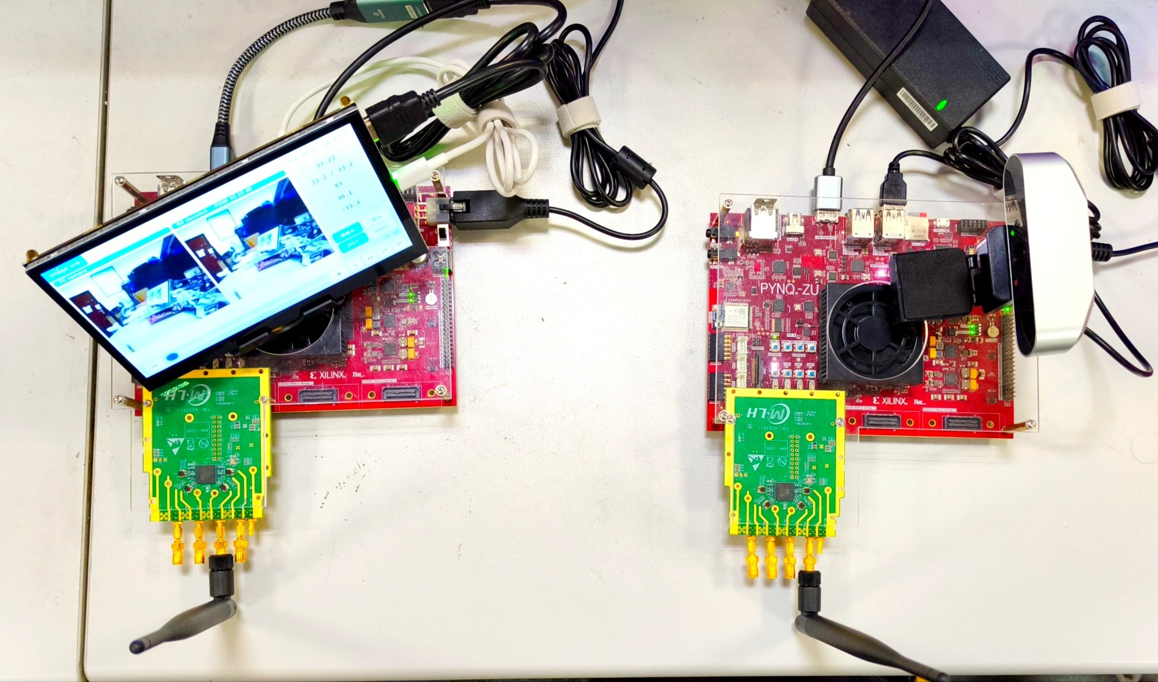
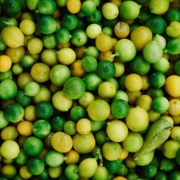



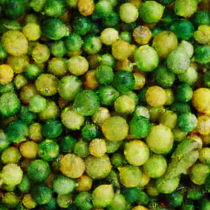

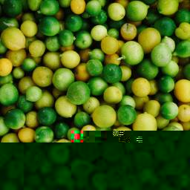

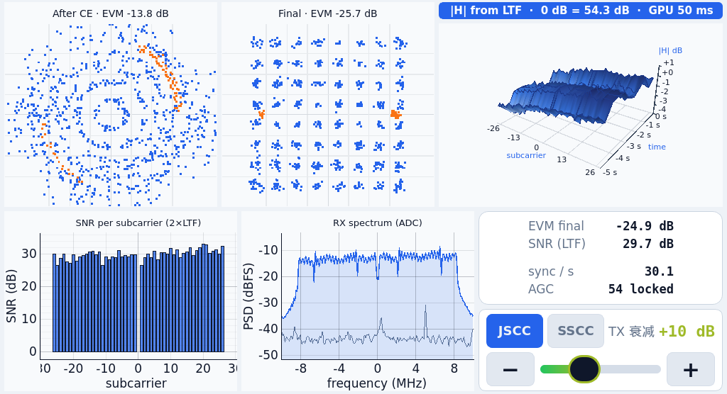
Real-Time DeepJSCC-Q on FPGA
30-fps over-the-air image transmission
A streaming CNN codec and OFDM PHY run on two Zynq boards.
Image quality degrades gradually as channel SNR falls.
30 fps
67.5 ms
+2.8 dB
256 × 256 RGB
18,020 frames over 10 min
PL frame latency
Multiple frames overlap in flight
PSNR at high SNR
DIV2K 0802, equal symbol budget
Two boards, one wireless link
Measured quality over the air
DIV2K 0802, same PHY and 32,768 symbols per image
SSCC baseline: JPEG + 802.11n LDPC (rate 2/3) + 64-QAM
Original image
RX with touch screen (left), TX with camera (right).
2 × PYNQ-ZU + 2 × AD-FMCOMMS3.
256 × 256 RGB
TX board
RX board
Camera / video
Touch-screen GUI
Reconstruction at four channel conditions
256 × 256 RGB
Image + PHY status
36.1 dB
14.2 dB
10.5 dB
2.9 dB
CNN encoder
CNN decoder
W8A12, 250 MHz
Continuous soft I/Q
DeepJSCC-Q
OFDM TX
OFDM RX
Frame buffer + IFFT
Sync + equalization
AD9361
air
AD9361
20 MSPS
Fast AGC
32.21 / 0.94
31.46 / 0.94
30.41 / 0.93
23.51 / 0.77
32,768 complex symbols per image
683 OFDM symbols per frame
SSCC
The receiver passes soft I/Q directly to the decoder. No hard constellation decisions.
Ethernet carries control and the reference preview.
No decodable
frame
30 fps for 10 minutes
18,020 frames received in 600 s
29.42 / 0.86
14.33 / 0.63
9.48 / 0.16
N/A
Matched TX attenuation; headings show the measured SNR of the DeepJSCC-Q frames.
Image labels: single-frame PSNR (dB) / SSIM. Undecodable frames are scored as mid-gray.
Streaming FPGA implementation
PL frame latency: 67.5 ms
250 MHz, W8A12, 1.15 GMAC per frame
Weight ROM
Transfer includes buffering and the RX PHY. Frames overlap in the pipeline.
Line buffer
Window
P MAC lanes
Requantize
Live PHY diagnostics
K or K+1 rows
K × K × Cin
P accumulators
Bias, act., shift
Dedicated engines form a layer pipeline. P is chosen to sustain 30 fps.
On-chip weights and buffers avoid storing full intermediate feature maps.
Full TX / RX designs after routing (xczu5eg)
Design | LUT | BRAM36 | URAM | DSP
TX | 54,241 | 104.5 | 10 | 243
RX | 63,699 | 65.5 | 7 | 133
Measured rails: TX 3.07 W / RX 3.44 W
PL + PS + DDR; excludes RF and input conversion losses.
DeepJSCC: Bourtsoulatze et al., TCCN 2019. DeepJSCC-Q: Tung et al., JSAIT 2022. Developed with Claude Code and Codex under human direction.
Notes:
Redesign of report/poster/poster_en.pptx. A0 portrait canvas and English language retained. The original file is preserved.
All photographs, reference images and reconstructions are repository assets. No image content has been synthesized or retouched.
PSNR chart: data/measurements/psnr_snr/k0802_v3_da.json, results[].snr_da_db against results[].psnr_shown, separately for mode jscc and sscc. Each point is the archived measurement window mean.
Image comparison: decoded_img/tx_reference.png and jscc/sscc_00.00db_p0.png, _20.00db_p0.png, _24.00db_p0.png, _32.00db_p0.png. These suffixes denote TX additional attenuation, not SNR. Labels 32.3,17.4,13.1,5.5 dB are mean SNR across the two schemes at matching attenuation. SSCC has no decoded image at 32 dB attenuation; the gray field is a failure placeholder, not a recovered image. PSNR/SSIM are representative single-frame values, not curve means.
Main gain claim: 31.99-28.23=3.76 dB, rounded to 3.8 dB. This is high-SNR performance on the single DIV2K 0802 image under matched PHY and 32768 complex symbols/image. It is not a dataset-wide gain or a fixed gain at every SNR.
Latency source: report/sections/30_results.md, table 3-6. Medians: encoding 38.20ms, transfer 2.87ms, decoding 30.39ms, separately measured PL total71.47ms. Transfer includes frame buffering, air transmission, synchronization and equalization. Pure airtime2.748ms. PL latency excludes application and display latency. Throughput30fps is possible because frames overlap in the layer pipeline.
Resource source: report/sections/30_results.md table3-1 and build/reports/tx_utilization.rpt, rx_utilization.rpt routed totals. Power source: data/measurements/power/tx_rails.json and rx_rails.json. Values3.06/3.71W sum selected PL,PS,auxiliary andDDR rails. RF daughterboards and12V input conversion losses excluded.
Model/architecture source: report/sections/22_hardware.md. Line buffering abstraction is per convolution engine, not a replacement for the system PHY frame buffers. Full intermediate feature maps are not stored between CNN layers.
Research references: E. Bourtsoulatze, D.B. Kurka, D. Gunduz, Deep Joint Source-Channel Coding for Wireless Image Transmission, IEEE TCCN,2019. T.-Y. Tung,D.B. Kurka,M. Jankowski,D. Gunduz, DeepJSCC-Q, IEEE JSAIT,2022.
Layout references consulted: https://mitcommlab.mit.edu/aeroastro/commkit/research-posters/ and https://mitcommlab.mit.edu/be/2023/09/27/toward-an-evenbetterposter-improving-the-betterposter-template/ . No external artwork copied.

