Slide 1

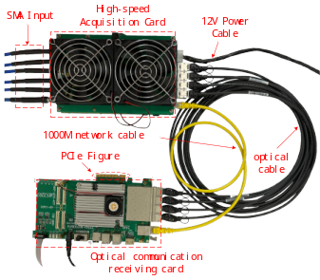

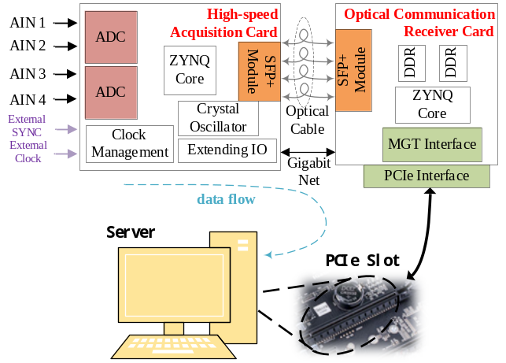

INTRODUCTION
Team Member Names Font: Times New Roman Size:12
Hao Zhang, Zian Zhan, Jiale Ji
Title ：Times New Roman Size：24
China Three Gorges University,
Hubei Province
校名
校徽
作品实物缩略图
Font: Calibri(Body) Size:11 Size:11
On board test by AMD ZYNQ7000
Radio telescopes use wireless radio reception, measurement, and analysis of celestial radio signals to explore the radio window of celestial bodies after the optical window.
A typical radio telescope system consists of an antenna system, a receiver analog front-end system, a data processing and recording system. Most of the current receiver systems have the capability of accumulate integration, FFT transformation, and correlation calculation, but cannot retain the raw data of the radio signals, Lost a lot of temporal information.
Key technical issues addressed:
1. Signal acquisition, High-performance ADC (Analog-to-Digital Converter) device.
2. Data receiving and processing, AMD-Xilinx 7 series Zynq System on a Chip (SoC) devices.
3. Data transmitting, SERDES (Serializer/Deserializer) Interface with GTX for 10G linerate.
4. Data storing, Dedicated server with disk array and RNIC support.
作品测试平台信息
C
R
R
E
E
S
A
T
U
I
L
Typical application case
系统框图，关键创新点
V
T
System Architecture
E
Optical Communication Receiver Card:
1. Communicating with the acquisition card;
2. Receiving and Handling data from SFP+ with protocol such as Ethernet, Aurora and so on;
3. Acting as an assistant to speed up the data processing workflow;
4. Collaborating with the server for data uplink and downlink;
D
SFP+ interface is driven directly by GTX, can be programmed by users to support various communication protocols. This high degree of programmability ensures maximum compatibility with both existing and future communication devices, thereby reducing the cost of device deployment and iterative updates.
Raw data storage requires a significant amount of storage bandwidth. The limitations of current storage devices necessitate the need to build disk arrays that can support high-bandwidth data storage.
E
S
I
N
背景，关键信息摘要
G
High-speed Acquisition Card:
1. Sampling and Quantization of Analog Signals;
2. Receiving and Handling data from ADC;
3. Transporting data to next work platform;
测试结果，性能，展望

