Slide 1

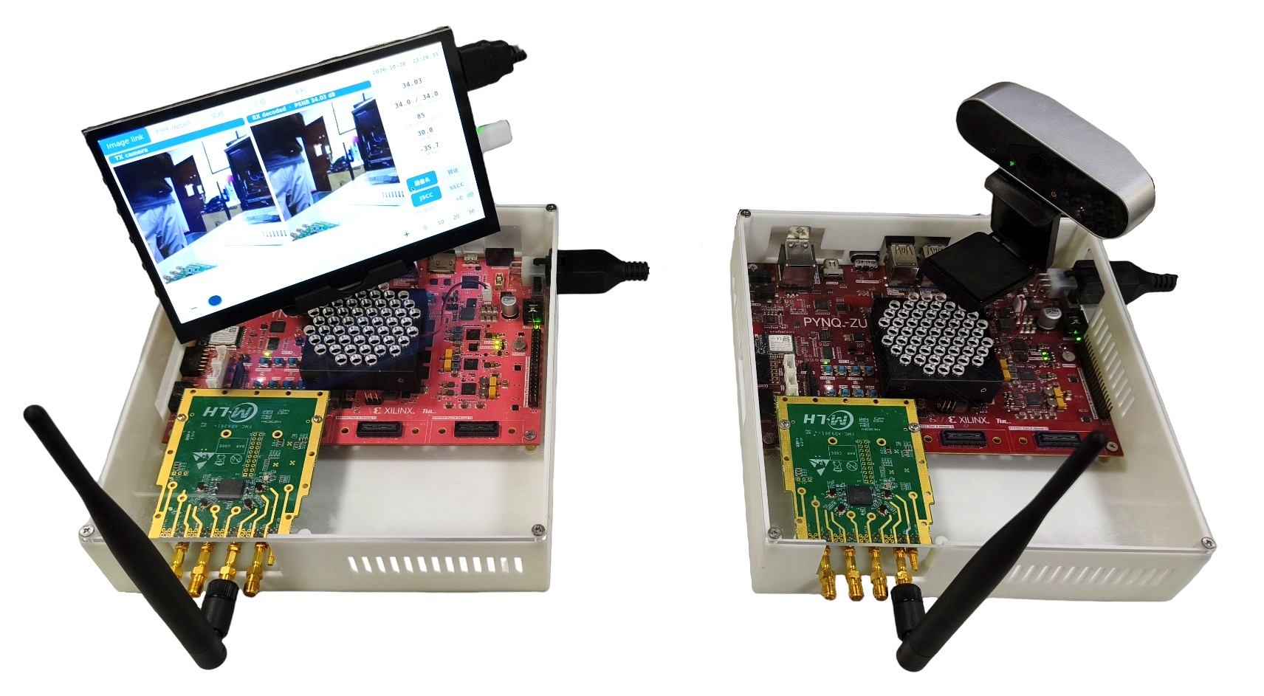

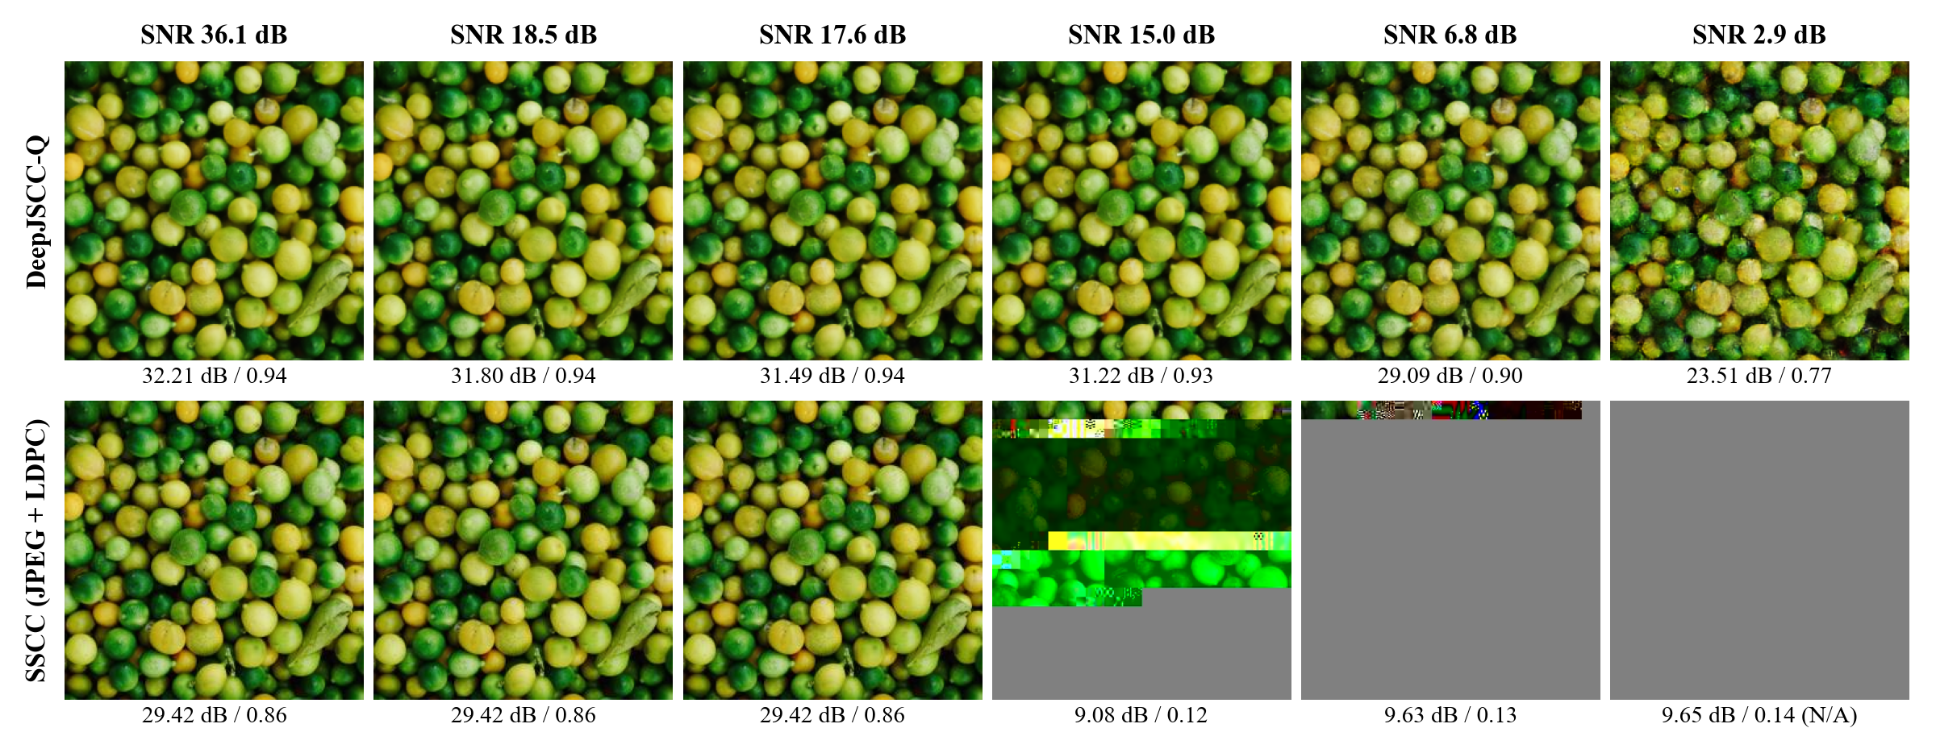
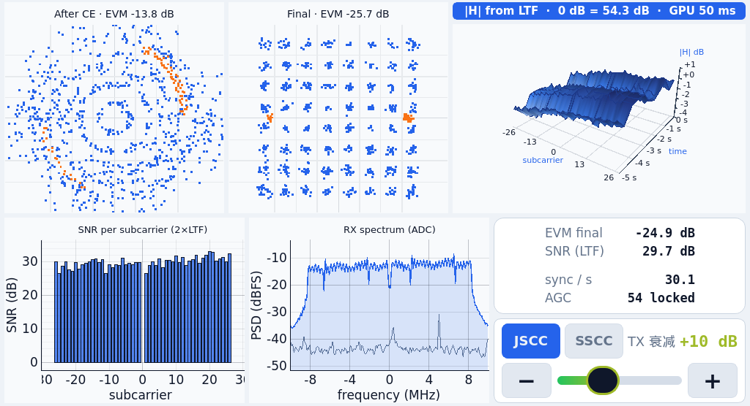


INTRODUCTION
GlideLink: Real-Time DeepJSCC-Q
Image Transmission on AMD FPGA
Cunxi Fan, Zhongyu Wang, Junxian Yang
University of Electronic Science
and Technology of China,
Sichuan Province
TX board PYNQ-ZU (xczu5eg)
System Architecture
On-board test: RX (left), TX (right)
AMD Zynq UltraScale+ MPSoC
Live video from drones, robots and remote cameras must cross radio links whose SNR changes from moment to moment. Separate source-channel coding (SSCC) compresses the image with JPEG and adds a channel code: below the code threshold, bit errors propagate through the variable-length code and the whole image is lost (the cliff effect); above it, quality no longer improves.
USB camera
USB
PS
4× Cortex-A53, Linux: camera, radio setup
AXI
PL
CNN encoder, OFDM TX, LDPC encoder
FMC
AD9361
RF card
Over-the-air PSNR (DIV2K 0802, 32,768 64QAM symbols per image)
Ethernet: TX preview, control
over the air
C
R
R
E
RX board PYNQ-ZU (xczu5eg)
E
Touch screen
DP
PS
A53 + Mali-400 GPU: GUI, web page
PL
OFDM RX, CNN decoder, LDPC decoder
AD9361
RF card
A
S
Typical application case
AXI
FMC
U
Phone
Wi-Fi
T
Camera
drone / robot
Encoder
FPGA, TX
Radio channel
noise, fading
Decoder
FPGA, RX
Display
live view
I
L
Key innovations and technical issues addressed:
V
T
1. Streaming CNN accelerator: W8A12 integer layers on 64 convolution engines in a layer pipeline at 250 MHz; all weights and activations stay on chip, no DDR traffic.
2. Asymmetric shallow decoder: trained jointly with the encoder, it needs 1/102 of the original multiply-accumulates. The codec does 5.2× the workload of a published FPGA DeepJSCC (GLOBECOM 2025) with fewer DSPs and BRAMs.
3. Soft-symbol OFDM PHY: 683-symbol frames with PN scrambling and second-order SFO/CPE tracking; equalized I/Q go to the decoder without hard decisions.
E
Deep joint source-channel coding (DeepJSCC) maps pixels directly to channel symbols with a pair of CNNs, so image quality follows the SNR smoothly. DeepJSCC-Q (Tung et al., JSAIT 2022) restricts the symbols to a QAM constellation that a standard digital PHY can carry, but it is computation-heavy and the receiver must pass undecided soft symbols to the decoder.
GlideLink builds a complete real-time link on two AMD Zynq UltraScale+ MPSoC boards (PYNQ-ZU) with AD9361 radios. The DeepJSCC-Q encoder, the decoder and an 802.11a-like OFDM PHY all run in the PL and send 256 × 256 RGB images at 30 fps over the air. The PS captures camera frames, sets up the radios and shows the live link on a touch screen.
Key technical issues: fitting a 1.15-GMAC-per-frame CNN codec into one FPGA at 30 fps with all weights on chip; synchronizing and tracking 683-symbol OFDM frames precisely enough for soft-symbol decoding; and a fair over-the-air comparison with JPEG + LDPC on the same PHY.
D
DeepJSCC-Q is 2.8 dB above JPEG + LDPC at high SNR and still gives 23.5 dB at 2.9 dB SNR, while the baseline fails abruptly at 16 to 19.5 dB.
E
S
I
G
N
4. Live system: camera to touch screen with live PSNR, constellations and a 3-D channel view on the Mali-400 GPU.
30 fps for 10 min (18,020 frames), 67.5 ms PL end-to-end latency
Design | LUT | BRAM36 | DSP | WNS (ns) | Power*
TX | 54,241 | 104.5 | 243 | +0.082 | 3.07 W
RX | 63,699 | 65.5 | 133 | +0.307 | 3.44 W
* measured, PS + PL + DDR; xczu5eg after routing

