Slide 1
Approval Workflow Improvement
DMAIC · REAL DATA · BPI CHALLENGE 2020
20.25
days
for the slowest 1 in 10 claims to be paid (P90, 7,903 paid claims, 2018)
Why 1 in 10 expense claims waits 20+ days to be paid, and three fixes that meet every target
Submit
Administration
Budget owner
Supervisor
Payment request
Payment run
Mon / Thu only
Vimlesh Sonawane · November 2026
Notes:
Self-initiated portfolio project on real data: 10,500 travel-expense claims from a university's approval process (BPI Challenge 2020). Stakeholders are role-played; improvements are proposals with what-if estimates, not implemented results.

Slide 2





Agenda
Click a phase to jump to it. Every slide has a ← Agenda link.
Define
Measure
Analyze
Improve
Control
Charter, scope, roles
Baseline KPIs and patterns
Process map, waits, rework, root causes
Fixes, to-be process, what-if scenarios
Roadmap and control plan
Slide 4 →
Slide 5 →
Slide 7 →
Slide 11 →
Slide 15 →
Summary →
Before vs after →
Lessons →
The ask →
Notes:
Interactive in slideshow mode: the phase names and links jump to each section.

Slide 3


Three fixes together meet all three targets
← Agenda
Problem
Causes
Fix
1 in 10 paid claims takes over 20.25 days. 13.14% are rejected at least once.
Payments run only Mon/Thu. Approval waits have long tails. Rejections cause rework.
Daily payment runs, a checklist with an amount > 0 rule, reminders after 3 days.
Modelled effect of all three fixes (S6, what-if on 2018 data)
P90 days
Rejected
Payment wait
20.25 → 8.74
13.14% → 7.30%
3.21 d → 1.00 d
Notes:
The one-slide answer. Every number traces to scripts in the GitHub repo.

Slide 4

Real data, run as a DMAIC project
← Agenda
Define
Measure
Analyze
Improve
Control
Charter · stakeholders · RACI
Clean data · baseline KPIs · Tableau
As-is map · bottlenecks · fishbone
Impact/effort · to-be · scenarios
Roadmap · control plan · deck
D1–D2
D3
D4–D5
D6
D7–D8
The data
BPI Challenge 2020 Domestic Declarations: 10,500 claims, 56,437 events. Verified against the publisher's checksum. 2018 = main view.
The tools
Python · Tableau · Smartsheet (schedule, RAID, roadmap) · Asana (tasks, change requests, status) · Miro (maps)
Notes:
4-week plan with milestones M0–M4 in Smartsheet; tasks and change control in Asana. Stakeholder roles are role-played.

Slide 5
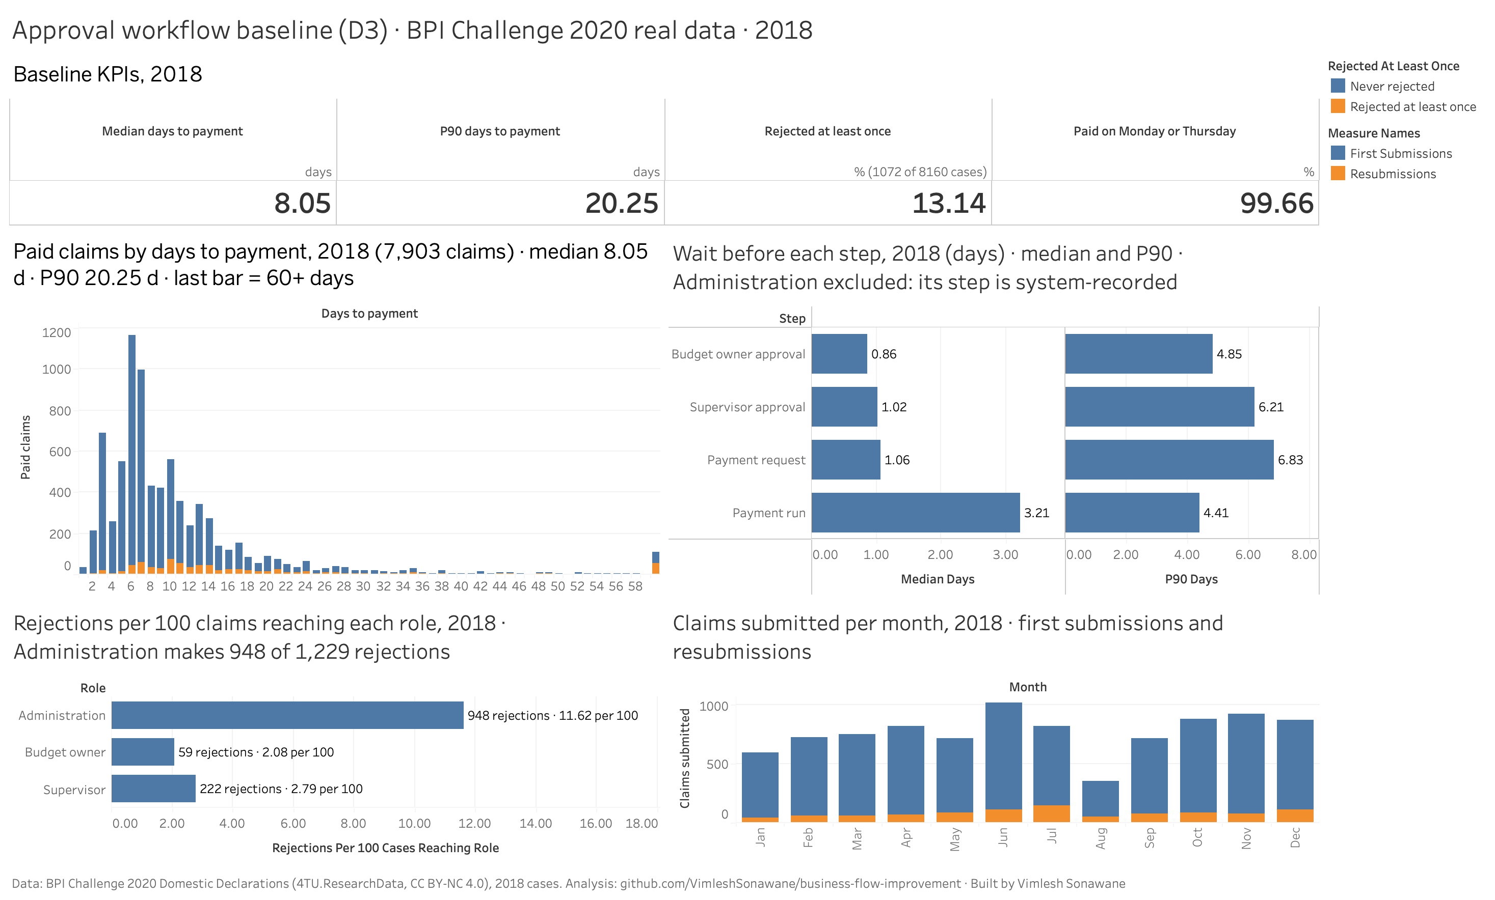
Baseline: the typical claim is fine, the tail is not
← Agenda
8.05 d
Median days to pay
20.25 d
P90 days to pay
13.14%
Rejected at least once
99.66%
Paid on Mon or Thu
Live Tableau dashboard: click the image to open it
Notes:
2018 paid claims. Rejected claims take 1.8× as long: median 13.21 vs 7.34 days. The dashboard is public on Tableau.

Slide 6
One main path; payments only twice a week
← Agenda
Notes:
Left: 55.81% of claims follow one path; 63 paths in total. Right: 99.66% of payments happen on Monday or Thursday, so a claim approved on a Friday waits until Monday.

Slide 7
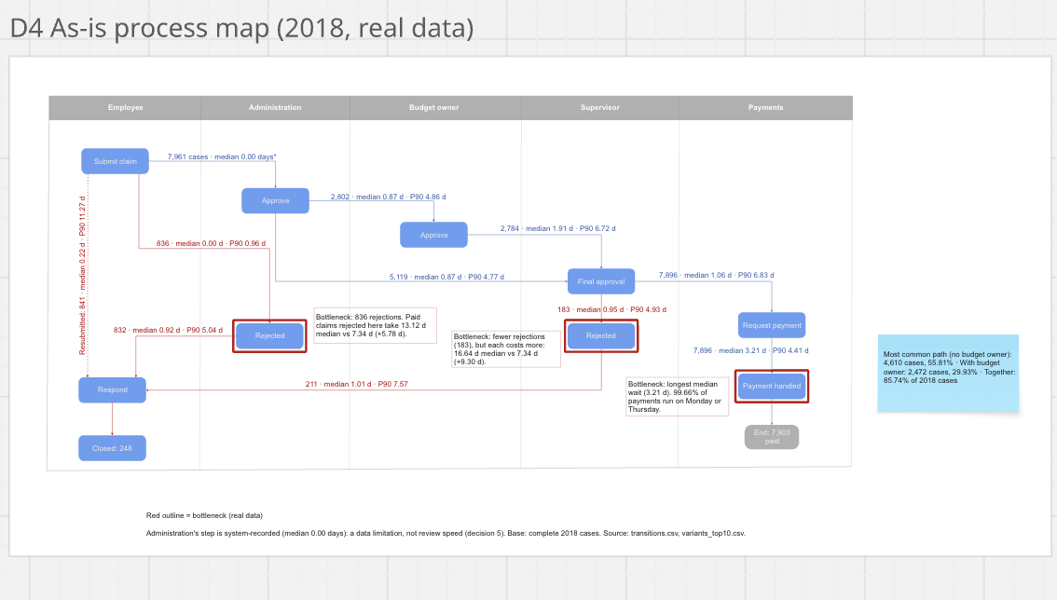
As-is map: three bottlenecks in red
← Agenda
B1
Payment run
Longest median wait, 3.21 d; Mon/Thu batches
B2
Administration rejects
836 rejections; +5.78 d when it happens
B3
Supervisor rejects
Only 183, but +9.30 d each
Notes:
Built in Miro from transitions.csv: real case counts and wait times on every arrow. Red outlines mark the bottlenecks.

Slide 8


Batching slows every claim; approvals create the tail
← Agenda
Median: payment run
3.21 d, because payments run only twice a week.
P90: approvals
Up to 6.83 d: most claims move fast, a few sit for a week.
Notes:
Source: role_wait_times.csv, 2018. Two different problems, so two different fixes: daily payment runs for the median, reminders for the tail.

Slide 9

Rework: Administration makes 3 of 4 rejections
← Agenda
1.8×
+9.30 d
Longer to pay when rejected (13.21 vs 7.34 d)
Extra median days when a supervisor rejects
253 of 1,072 rejected claims had an amount of zero
Every one was rejected and none was paid. An amount > 0 check at submission would stop all of them.
Notes:
Rejection counts from rejections_by_role.csv. The zero-amount finding is directly observed in the data, not a hypothesis.

Slide 10
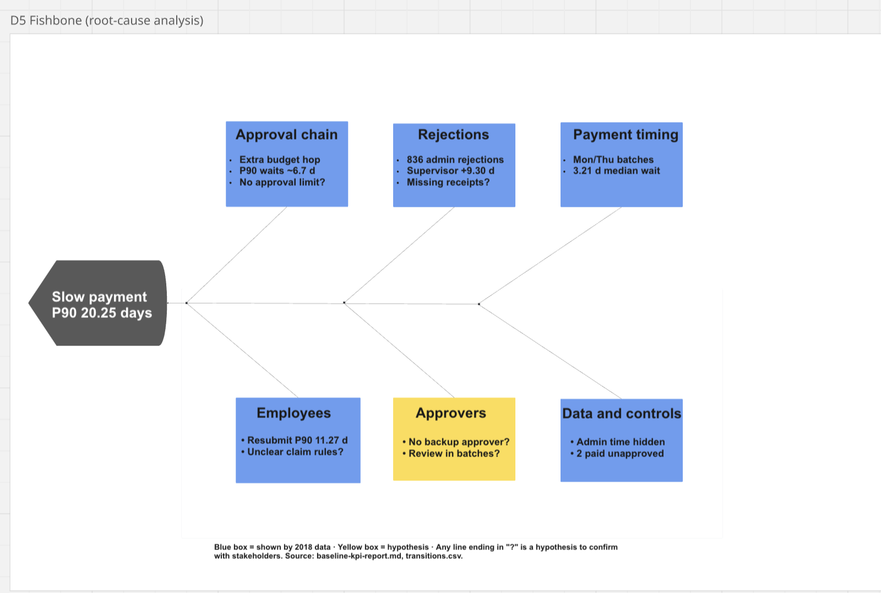
Root causes: proven by data vs still to test
← Agenda
How to read it
Blue boxes are shown by 2018 data.
The yellow box is a hypothesis to test with stakeholders.
Any line ending in "?" is still a hypothesis.
Why claims are rejected isn't in the data, so that needs interviews.
Notes:
Fishbone built in Miro (D5): 6 categories, 14 causes.

Slide 11









Eight fixes, scored for impact and effort
← Agenda
QUICK WINS
MAJOR PROJECTS
Top 3 for the business case
F2 Claim checklist
F1 Daily payment runs
F1 Daily payment runs
→ payment wait ≤ 1 d
F3 Approval reminders
F8 Payment control
F4 Backup approver
F2 Checklist + amount > 0
→ rejections ≤ 8%
FILL-INS
NOT NOW
F6 Reason codes
F5 Skip budget step
F3 Reminders after 3 days
→ P90 ≤ 14 d
F7 Log admin time
Placement is a PM judgment, to confirm with the process owner.
Impact ↑ Effort →
Notes:
From the Miro impact/effort matrix (D6). Every fix maps to a cause on the fishbone.

Slide 12
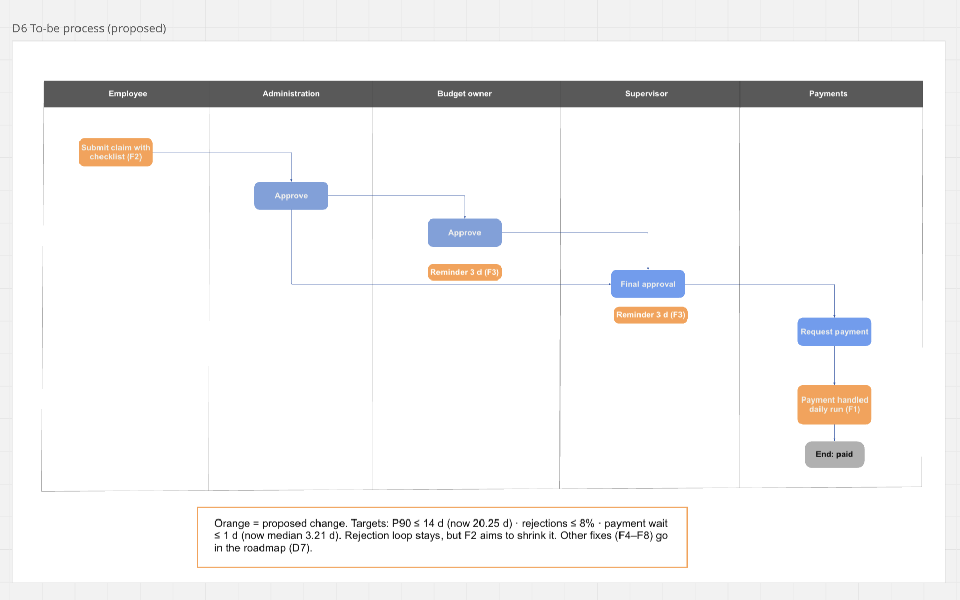
To-be: the same flow, with three proposed changes
← Agenda
F2
Checklist at submission
F3
Reminders after 3 days
F1
Daily payment run
Notes:
Orange = proposed change. The rejection loop stays, but F2 aims to shrink it.

Slide 13
Scenarios: all three fixes meet every target
← Agenda
Scenario | P90 ≤ 14 d | Rej. ≤ 8% | Pay ≤ 1 d
S1 Daily pay | – | – | ✓
S2 Reminders | ✓ | – | –
S3 S1+S2 | ✓ | – | ✓
S5 Checklist | – | ✓ | –
S6 All three | ✓ | ✓ | ✓
Estimates on 2018 data. The 40% cut in Administration rejections is assumed; the zero-amount effect is observed.
Notes:
analysis/03_scenarios.py, seed 42. The surprise: daily payments help the median most, but reminders bring the P90 under 14 days.

Slide 14

Before vs after: all three charter targets met (S6)
← Agenda
P90 days to payment
Now 20.25 d
After 8.74 d
Claims rejected
Now 13.14%
After 7.30%
Payment wait (median)
Now 3.21 d
After 1.00 d
Dashed red line = charter target. What-if estimates on 2018 data, not results.
Notes:
Grey = 2018 baseline, amber = S6 estimate, dashed line = target.

Slide 15

Roadmap: quick wins in Jan, payments by Feb
← Agenda
Wave 1
Wave 2
F2 Checklist + amount rule
F3 Approval reminders
F4 / F6 / F7 small fixes
Wave 1 KPI review
F1 Daily payment runs
F8 Payment control
Full-effect review
Jan 4
Feb 1
Mar 1
Mar 26
M5 Wave 1 live
M6 Wave 2 live
M7 Decide on F5
Notes:
Proposed rollout in Smartsheet (D7), with dependencies. F5 is decided only after the full-effect review.

Slide 16
Control plan: how the gains are kept
← Agenda
KPI | Now | Target | Alert if | Owner
P90 cycle time | 20.25 d | ≤ 14 d | > 14 d two weeks running | Process owner
Rejection rate | 13.14% | ≤ 8% | > 9% in a month | Process owner
Zero-amount submissions | 253 | 0 | Any | IT / workflow admin
Payment wait (median) | 3.21 d | ≤ 1 d | > 1.5 d in a week | Payments team
Paid without final approval | 2 | 0 | Any | Finance
Review rhythm
Weekly for 4 weeks after each wave, then monthly. Sponsor review quarterly.
Full plan: 10 KPIs in Smartsheet.
Notes:
Top 5 of the 10 KPIs in the Smartsheet control plan (D7). Owners are role-played.

Slide 17
What these numbers are, and what I learned
← Agenda
Limits
Lessons
Scenarios are what-if estimates on 2018 data, not results.
Fixes were not implemented; stakeholders were role-played.
Administration's review time is system-recorded, so it can't be measured.
2 claims paid without final approval are flagged, not judged.
The data changed the plan: I expected daily payments to fix the P90, but reminders do.
Checking a coincidence (two counts of 253) uncovered the zero-amount finding.
Labelling facts vs hypotheses kept every claim defensible.

Slide 18

The ask: approve Wave 1 for January
Checklist + amount > 0 rule
Approval reminders
Backup approvers
Reason codes + admin-time log
Low effort, starts the rejection and P90 improvements. Wave 2 (daily payment runs, payment control) follows the Wave 1 review.
GitHub: code and analysis →
Tableau: live baseline dashboard →
Vimlesh Sonawane · vimleshsonawane.com
Notes:
The decision asked of the sponsor (role-played).

