Slide 1
Quantum Phenomena
Superposition
Energy states
Quantization
Young's Double Slit & Zeeman Effect

Slide 2
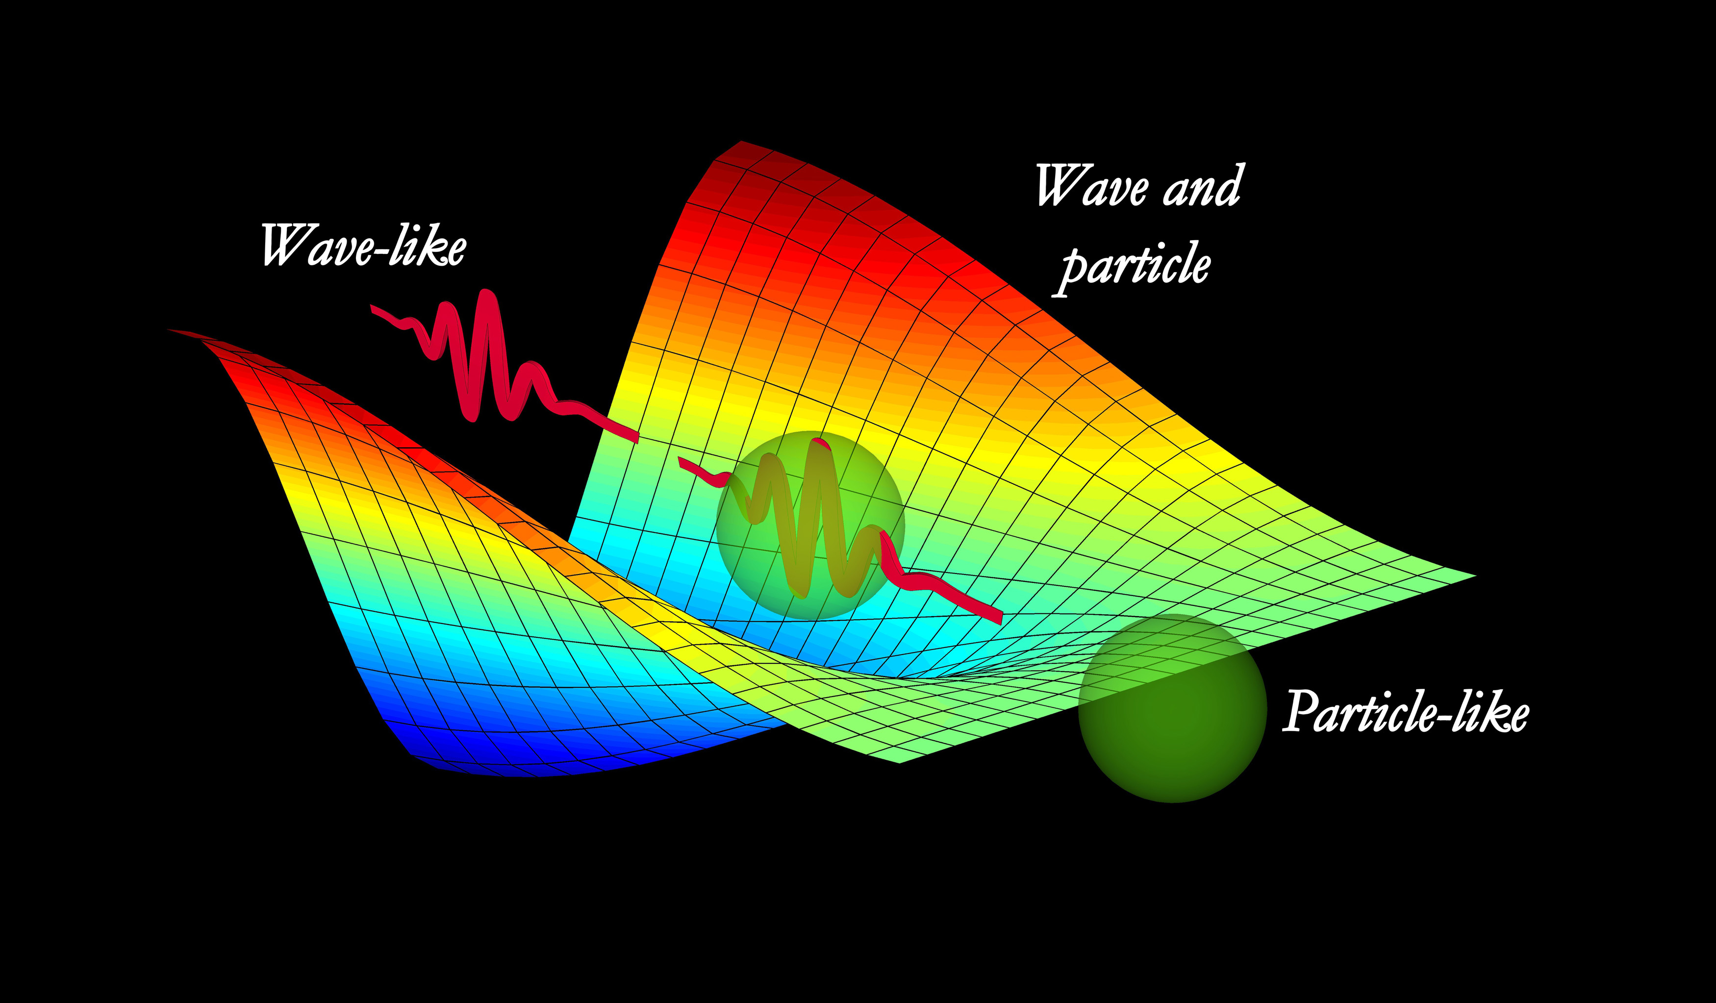
Young's Double Slit Experiment
AIM:
To determine whether light behaves as a wave or a stream of particles
by observing the pattern formed when light passes through two narrow slits.
PROCEDURE :
A single light source was directed onto a barrier with two small parallel slits.
The particles are allowed to pass through the slits without any which-path
information being collected. The cumulative pattern on the screen is recorded over time.
The experiment is repeated, but now a which-path detector is activated to determine through which slit each individual particle passes.
The resulting pattern on the screen is recorded and compared to the first result.

Slide 3
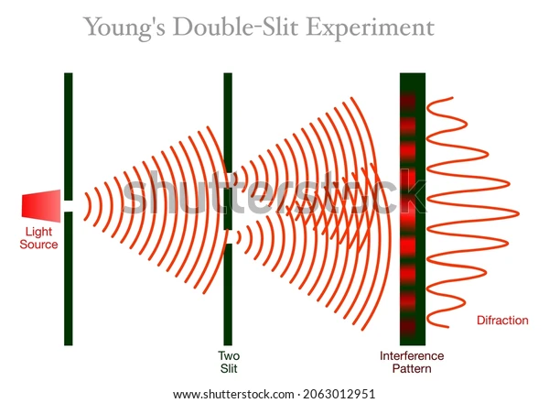
observation:
When a beam of particles or light is fired at two slits with no observation at the slits, an interference pattern of bright and dark fringes appears on the screen behind them. This is a wave phenomenon.
However, when a detector is placed to observe which slit each particle passes through, the interference pattern vanishes and is replaced by two simple clumps, corresponding to classical particle behavior.
The very act of "looking" collapses the system from a wave to a particle.

Slide 4
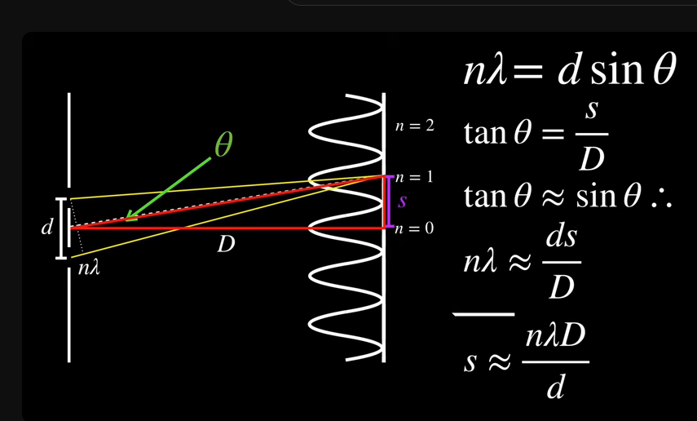
DEPENDING FACTORS:
Wavelength (λ) of the light source.
Slit separation (d)
distance between the two slits.
Screen distance (D)
distance from slits to the screen.
Source Light
MATHEMATICAL MODEL:

Slide 5
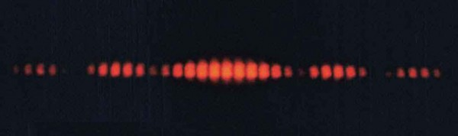
Conclusion
At the time, the result was absurd and unbelievable to many scientists because
Light was widely accepted as a stream of particles.
The idea that invisible waves could overlap and cancel each other seemed nonsensical to the early 19th-century mind.
The interference fringes defied the logic of Newtonian optics, making Young’s experiment appear almost magical or contradictory.
Yet, what seemed absurd became one of the foundations of wave optics, later forming the basis for quantum mechanics, where light exhibits both wave and particle duality.
The experiment demonstrated that light exhibits wave-like behavior, capable of interference and superposition.
This directly contradicted Newton’s then-dominant particle theory of light, revolutionizing physics by establishing the wave theory of light.

Slide 6
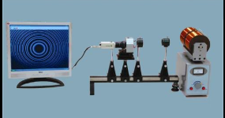
Zeeman effect
AIM:
To study how the presence of a magnetic field affects the
spectral lines emitted by atoms and to verify the Zeeman Effect
STATEMENT:
Zeeman Effect : The splitting of spectral lines due to the interaction
Between magnetic fields and atomic magnetic moments.
PROCEDURE :
The discharge lamp was placed between the poles of a strong electromagnet, with the gap adjusted so that the emitted light passed directly through the magnetic field.
The light from the lamp was directed into the spectrograph to obtain its emission spectrum.
With the magnetic field switched off, the normal spectral lines were first recorded as a reference.
The magnetic field was then gradually increased using the power supply, and changes in the spectral lines were closely observed through the spectroscope.

Slide 7
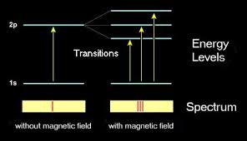
observation:
With no magnetic field, the spectrum consisted of sharp, single lines.
When the magnetic field was applied, these lines split symmetrically into multiple components.
For simple atomic transitions (like in cadmium), the line split into three distinct lines one central unshifted line and two equally spaced side lines. This is called the Normal Zeeman Effect.
For most other elements (like sodium), the splitting pattern was more complex, producing several unevenly spaced lines. This is called the Anomalous Zeeman Effect.
The distance between the split components increased linearly as the magnetic field strength was increased.

Slide 8

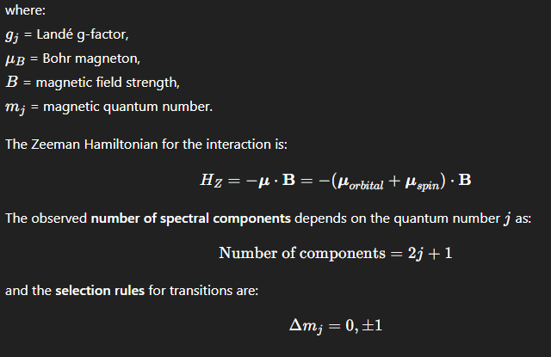
MATHEMATICAL MODEL:
DEPENDING FACTORS:
Magnetic field strength (B) – stronger fields gave larger splitting.
Element used – each element showed a different pattern depending on its electronic structure.
Quantum state of the electron transition involved.
Orientation of atomic magnetic moments with respect to the field direction.

Slide 9
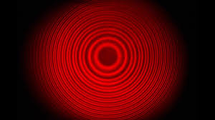
Conclusion:
Spectral lines split in the presence of a magnetic field, proving
the Zeeman Effect.
The magnitude of splitting increases proportionally with
field strength.
Simple triplet splitting corresponds to the
Normal Zeeman Effect (no spin involvement).
More complex splitting patterns are explained only by
introducing electron spin and quantum angular momentum coupling evidence of the Anomalous Zeeman Effect.
The results verify space quantization and the
validity of quantum numbers and selection rules.

Slide 10

V.Vimochini
E0125103 AIML Batch-2

